Slide 1


Streaming Architecture
Instructor：Prof. Pedram
Mentor: Arash, Amirhossein
Present by: Ryan

Slide 2


Streaming Arch
My Current Work
Next Step
CONTENTS

Slide 3

Streaming Arch
complete DNN compiler design
① Assign a specified number of DSPs to each layer
② Assign a specified size of on-chip memory to each layer
③ Assign a specified columns of each layer’s IFM to pre-store in on-chip memory
④ Assign a specified number of kernels of each layer to pre-store in on-chip memory
⑤ Generate all needed parameters definition by script

Slide 4
Streaming Arch
Previous FINN-based design
Off-chip Memory
Input feature map
duplicated weights data
weight stream buffer 2
layer1
weight stream buffer 1
layer2
reshape stream buffer
PE unit for layer 1
reshape stream buffer
PE unit for layer 2
output stream
...
After discussion, we may need to modify part of our stream HW arch

Slide 5
Streaming Arch
Our Current design
Off-chip Memory
Red circles: part of needed data.
IFM: defined column of data from our compiler
Weights: defined number of kernels from our compiler
Each layer’s two circles consist of on-chip memory occupy, which is obtained from our complier
Input feature map
weights data
Index access
buffer
layer1
Index access
buffer
layer2
Using index method to access data
PE unit for layer 1
Using index method to access data
PE unit for layer 2
output stream
...
It would be easier to access needed data, meanwhile no duplication, and increase data reuse rate.

Slide 6
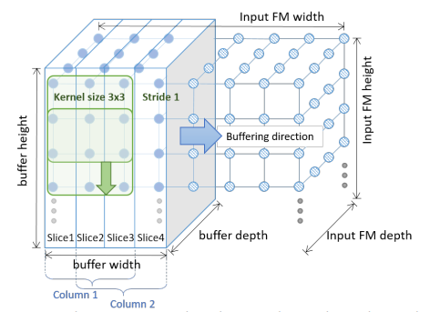
Streaming Arch
Our Current design
Off-chip Memory
Input feature map
weights data
Index access
buffer
layer1
Index access
buffer
layer2
Using index method to access data
PE unit for layer 1
Using index method to access data
PE unit for layer 2
output stream
...
For better understanding, we call Column1 as 3 cols.
Eg: We need to pre-store Column1(from compiler), then we store 3 columns in advance. If we need to pre-store Column1 and 2, then we store 4 columns in advance.

Slide 7



Compiler output

Slide 8
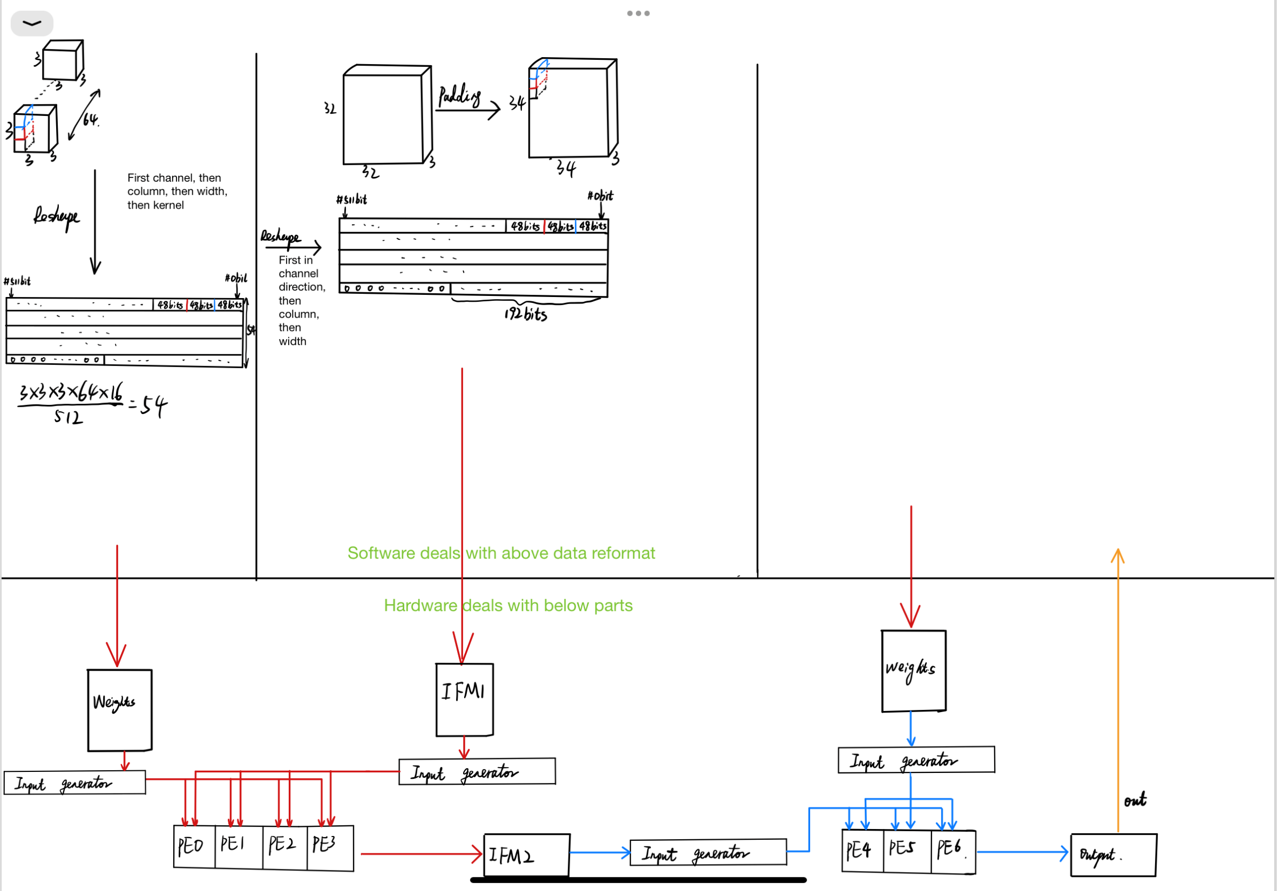
Design Detail
Red Rec part is finished.
Since we need to compare the result from software and hardware to debug, the software convolution and pooling part are also need.
Currently, I am working on HW design.

Slide 9
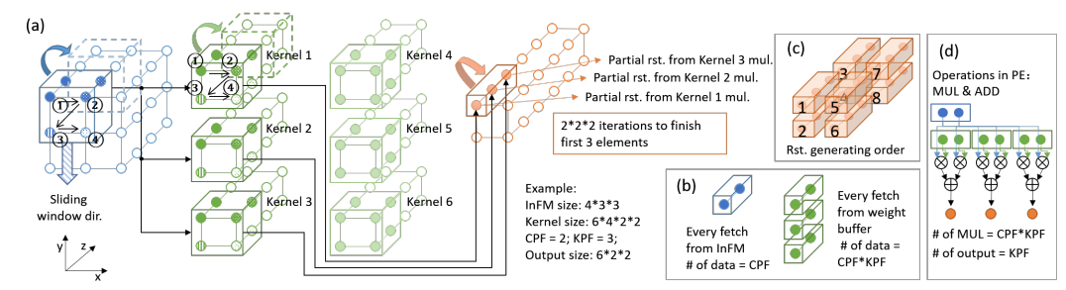
PE mapping detail
Parallel in the part of channel and the part of height dimension. This is a preliminary map method, we may need to adjust it, based on the DSP number we get, when we implement the HW.

Slide 10

Current Output from SDx
Next Step
Finish the host software part, and complete the hardware part.

Slide 11


