Slide 1
Major work
Latest Progress link fault error in table
Run the code on the server, and go through some sample codes
2. Read paper
3. Go through heterogen_Xilinx_hls file

Slide 2
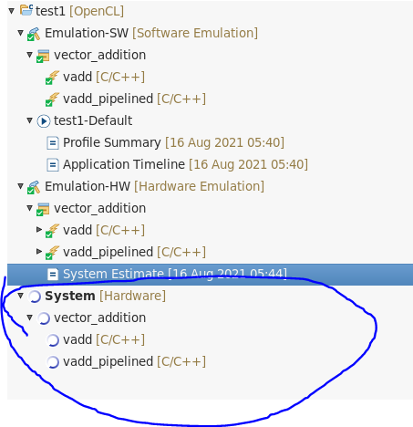

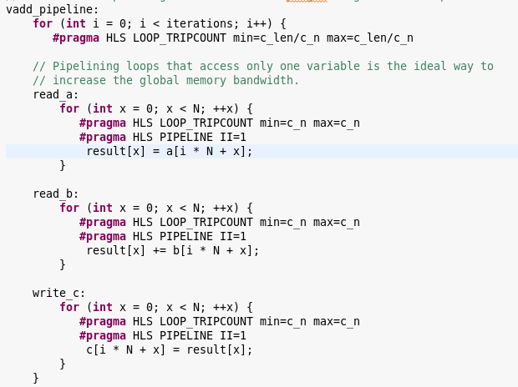
Major work
Latest Progress link fault error in table
1. sample code
loop pipelining

Slide 3
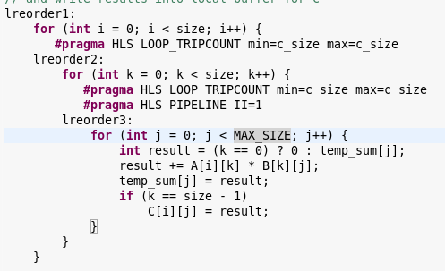
Major work
Latest Progress link fault error in table
1. sample code
reordering Loops

Slide 4
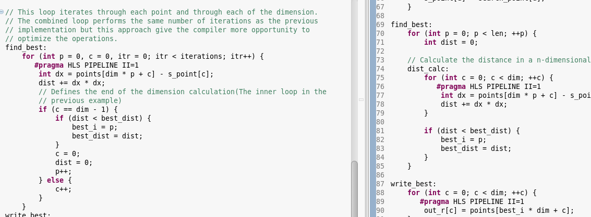
Major work
Latest Progress link fault error in table
1. sample code
Loop fusion

Slide 5
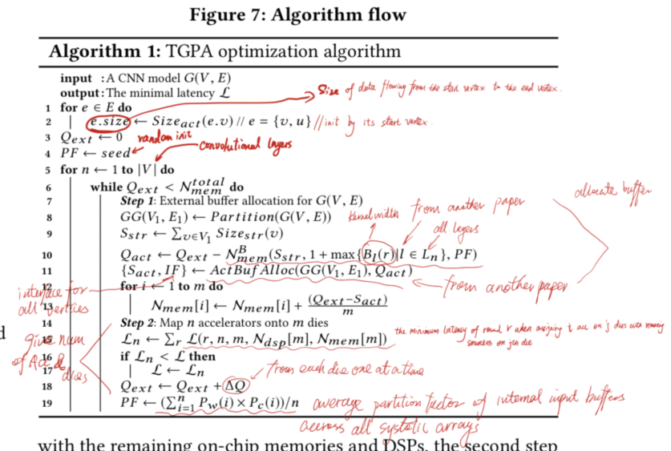
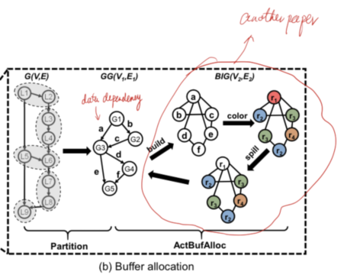
Major work
Latest Progress link fault error in table
2. Read the paper
I’ve double-checked the TPGA. There are no details about how they partition the input CNN model

Slide 6
Major work
Latest Progress link fault error in table
3. Go through heterogen_Xilinx_hls file

