Slide 1
Major work
Latest Progress link fault error in table
Sort the problems we encounter with the paper
2. Modify the code to support 16bit multiplication

Slide 2
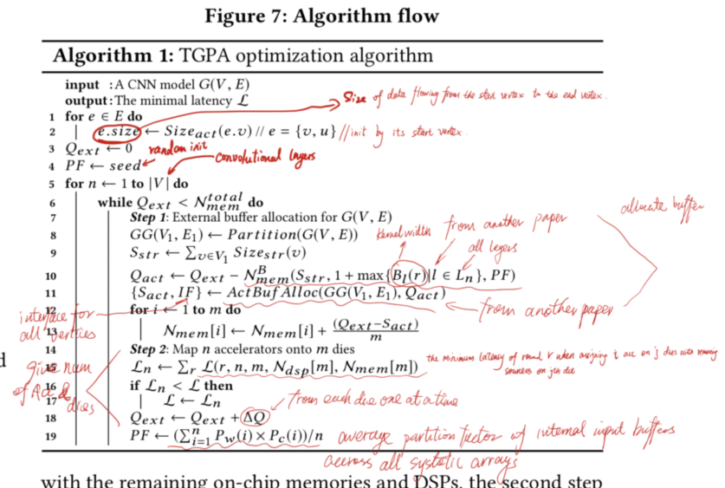
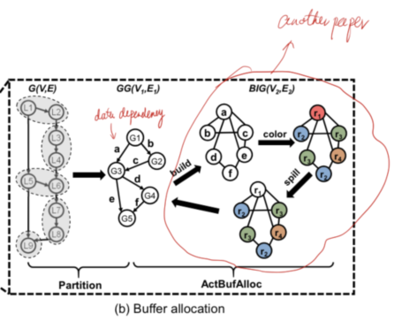
Major work
Latest Progress link fault error in table
1. How to calculate Sizeact(e,v)
2. How to partition
3. How to calculate this four elements

