Slide 1
Major work
Latest Progress link fault error in table
read two Xilinx files
2. Get familiar with the code

Slide 2
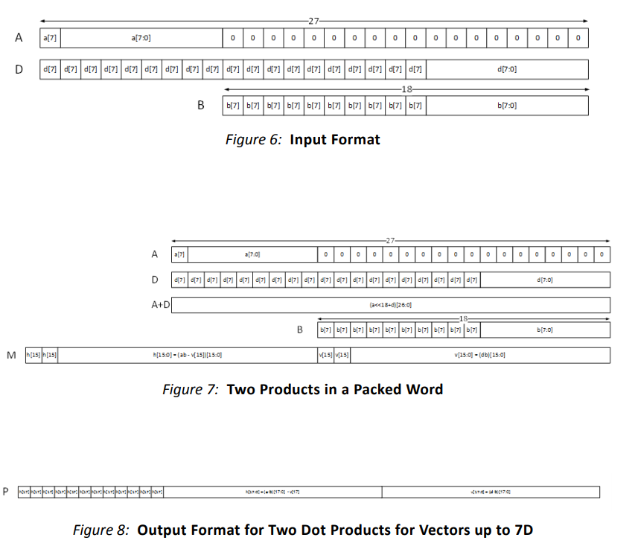
Major work
Latest Progress link fault error in table

Slide 3
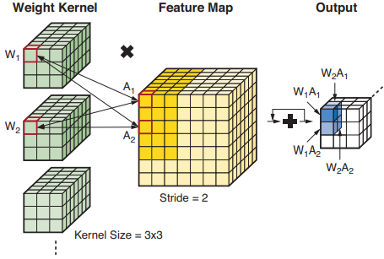
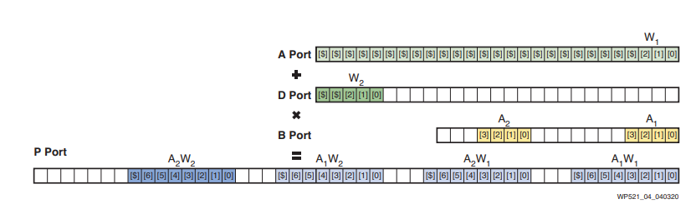
Major work
Latest Progress link fault error in table

Slide 4
Major work
Latest Progress link fault error in table

