Slide 1
Major work
Latest Progress link fault error in table
TPGA algorithm details

Slide 2
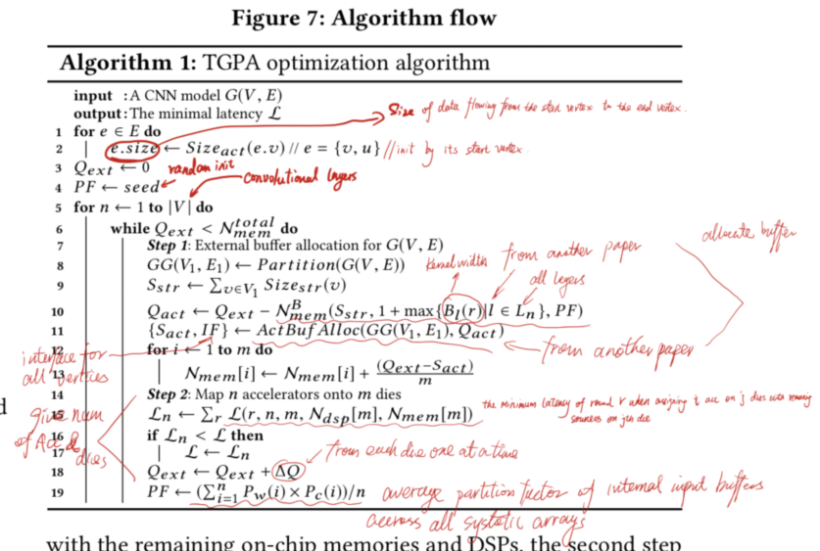
Major work
Latest Progress link fault error in table
2.the buffer size is defined by the padded output feature map size(the start vertex)
3. the external buffer size sets to zero at the begining
4. PF’s(partition factor) value is random at the begining

Slide 3
Major work
Latest Progress link fault error in table
5. If we have V layers, then for each layer its on-chip buffer size, memory interfaces need to reallocate, and accelerator's need to partition and maps to different dies
6. If external buffer size less than the total on-chip mem, then we need to continue allocate buffer size to external buffer. Unitll external buffer size larger or equal to the total on-chip mem.
8. Based on the number of accelerator, we group the layers.

Slide 4
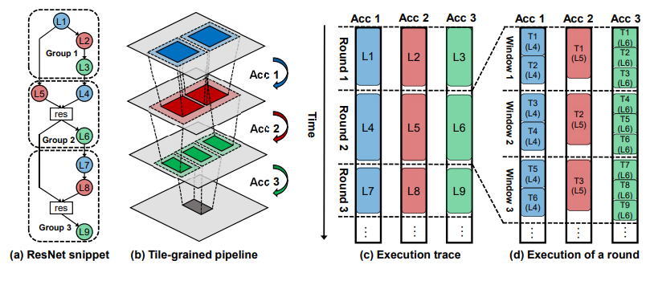
Major work
Latest Progress link fault error in table
8. Based on the number of accelerator, we group the layers.
Each group contains the same number of consecutive convolutional layers equal to the number of accelerators.
Layer from different groups execute sequentially

Slide 5

Major work
Latest Progress link fault error in table
9. Since we have partitioned the graph, GG needs occupy stream buffer, so we add them all and get the total stream buffer size.
10. It has three parameters. Number of buffer, buffer size, partition factor for each buffer
s: size of data to store
Nblk: BRAM consumption of a unit bw-width buffer

Slide 6
Major work
Latest Progress link fault error in table
11. ActBufAlloc has to input. GG(V1,E1) comes from the partition, Qact(Activation buffer size) comes from 10

Slide 7
11. ActBufAlloc has to input. GG(V1,E1) comes from the partition, Qact(Activation buffer size) comes from 10
use well-know optimizing compiler techniques to do a global data-flow analysis
Build the register interference graph
Variable propagation
Construct a 32-coloring by following seemingly trivial observation

Slide 8
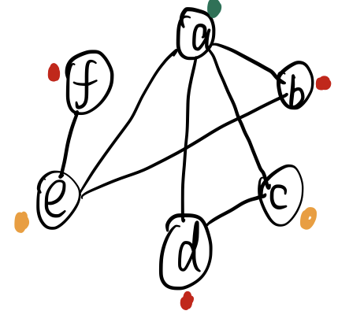
Build, Color and Spill
consider a program:
a=c+d;
e=a+b;
f=e-1;
We can allocate a,e,f to one register
r1=r2+r3;
r1=r1+r4;
r1=r1-1;
Two temporaries that are live simultaneously cannot be allocated in the same register
So construct an undirected graph

Slide 9
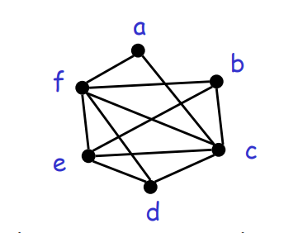
①Build
1. Each temporary is a node
2. If two nodes are living simultaneously, then there is a edge between them
Hence, two temps can be allocated to the same register if there is no edge connecting them
a=b+c;
d=-a;
e=d+f;
f=2e;
b=d+e;
e=e-1;
b=f+c;

Slide 10
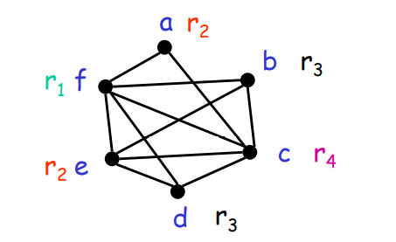
②color
Nodes connected by an edge have different colors
After coloring, the number of colors represent the registers that needs to be used
The above example can never have less than four colors
And to realize this coloring is very hard. No efficient algorithms are know

Slide 11
There is a Heuristic method.
Pick a node with fewer than k neighbors. (k is the color number we desire)
Put this node on a stack and remove it from the figure
repeat until the graph has one node

Slide 12
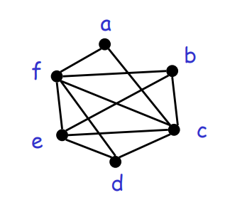
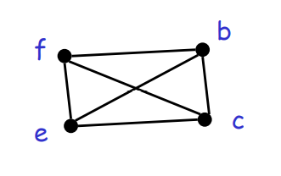
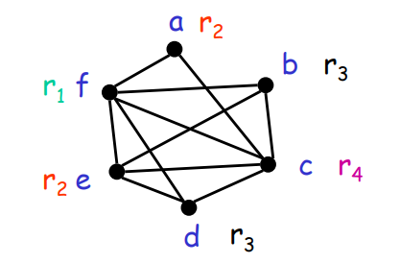
K=4
remove a then b
All nodes have fewer than 4 neighs, and can be removed

Slide 13
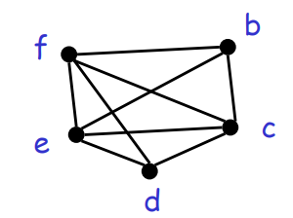
But there might exist a problem.
If we desire color number is 3 for above example
we remove a first, cause it neibs less than 3
For the next step we fail.
Then spilling is introduced

Slide 14
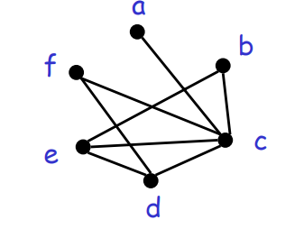
Allocate a memory location for f
Before each operation uses f, insert f=fa
After each operation that defines f, insert fa=f
a=b+c;
d=-a;
f=fa;
e=d+f;
f=2e;
fa=f;
b=d+e;
e=e-1;
f=fa;
b=f+c;

Slide 15
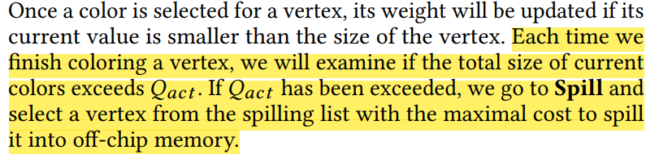
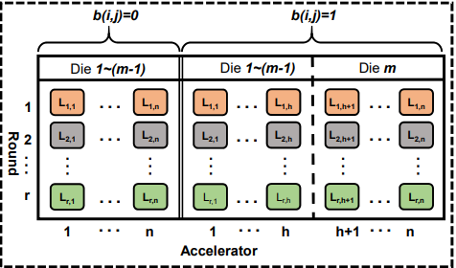
Major work
Latest Progress link fault error in table
12-13.

