Slide 1
Major work
Latest Progress link fault error in table
Setup github, configure the server
2. Read the hybrid_PU project code

Slide 2
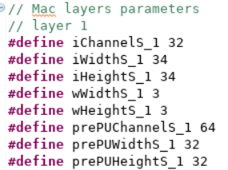
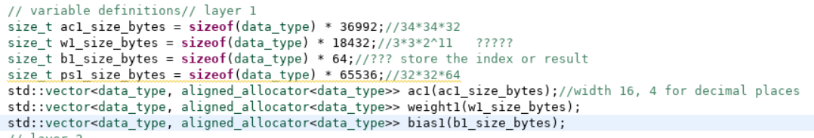
Major work
Latest Progress link fault error in table
host.cpp

Slide 3
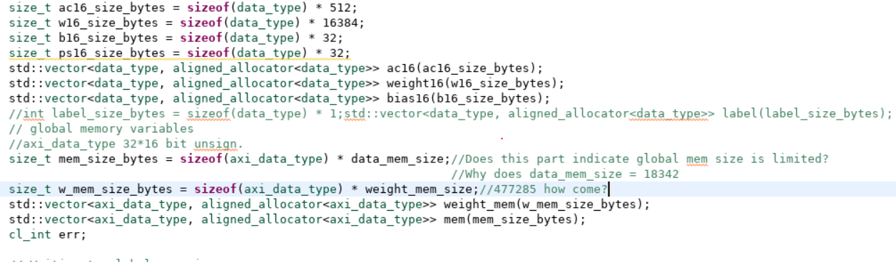
Major work
Latest Progress link fault error in table
host.cpp

