Slide 1
Major work
Latest Progress link fault error in table
Read Hybrid_PU code
2. configure compiler code on pycharm

Slide 2
Major work
Latest Progress link fault error in table
host.cpp

Slide 3
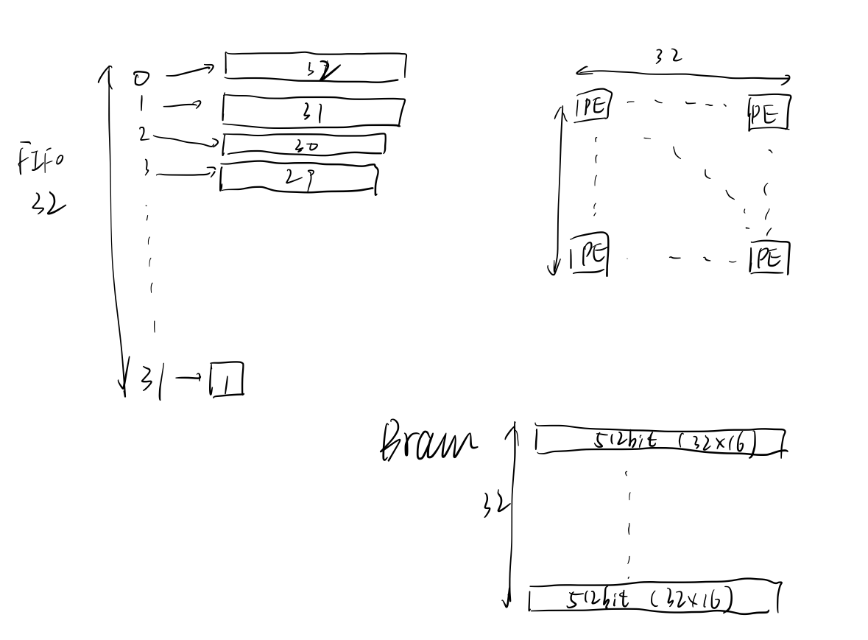
Major work
Latest Progress link fault error in table
Mac_templates.h

