Slide 1
Major work
Latest Progress link fault error in table
Sort the questions for Hybrid_PU
2. Configure gitlab on Pycharm

Slide 2
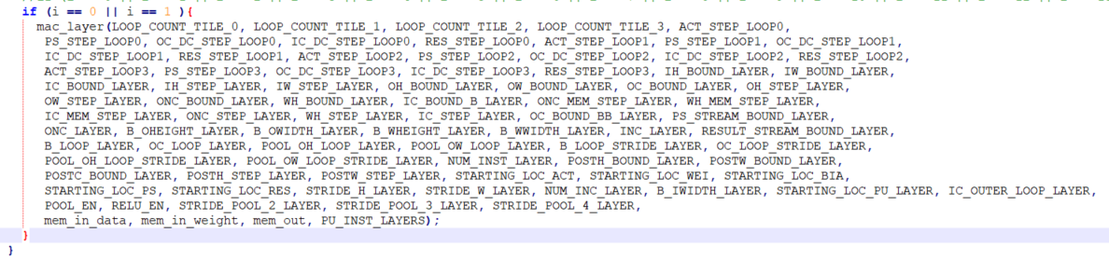

Questions
Latest Progress link fault error in table
The actual meaning of the input parameters for mac_layer
Why Mac_templates has two branches?

Slide 3
Questions

Slide 4
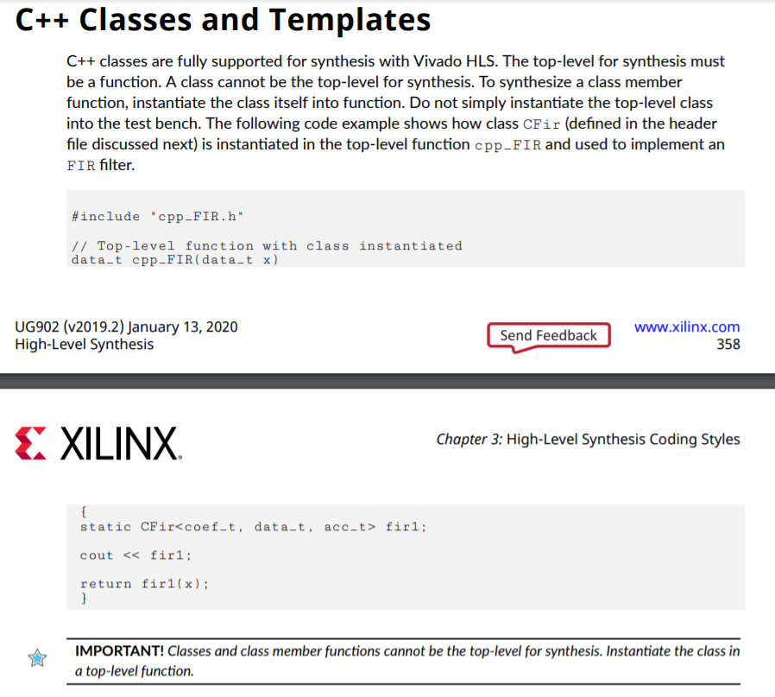
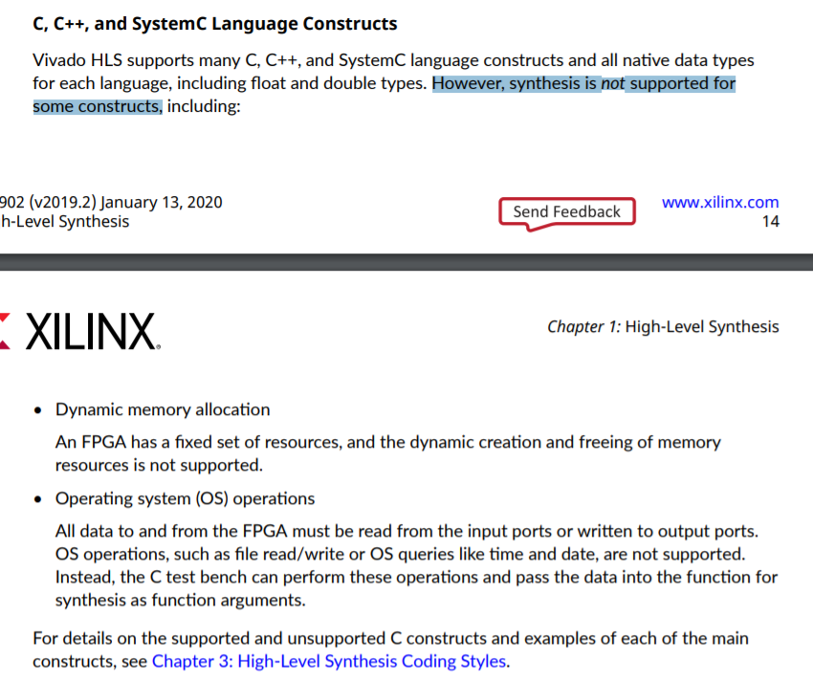
Questions
Latest Progress link fault error in table

Slide 5
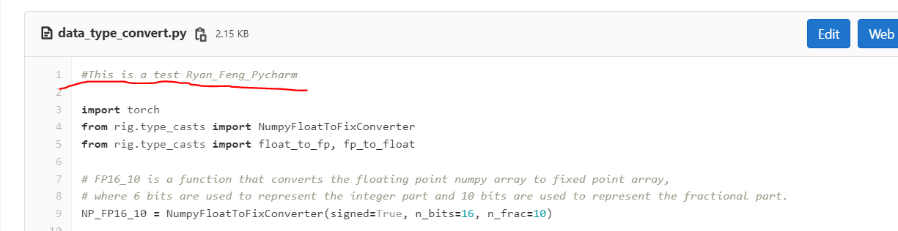
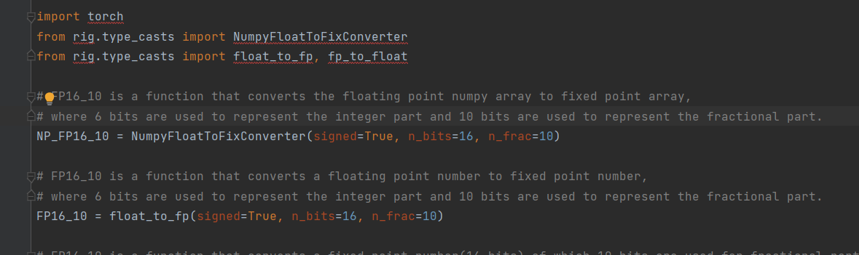
Questions

