Slide 1
Major work
Latest Progress link fault error in table
Try to use part of FINN code on Hybrid_PU
Write the host file, and configure the include files

Slide 2
Major work
Latest Progress link fault error in table
Figure out each parameters’ meaning, write part of the host file

Slide 3
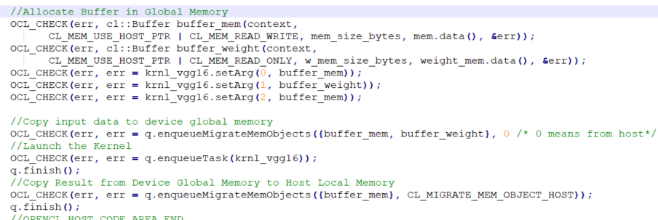
Major work
Latest Progress link fault error in table
Problem I meet
In SDx, before we run the hardware, we need to creat a space in hardware for our data
But in FINN’s code, I didn’t find this part

