Slide 1
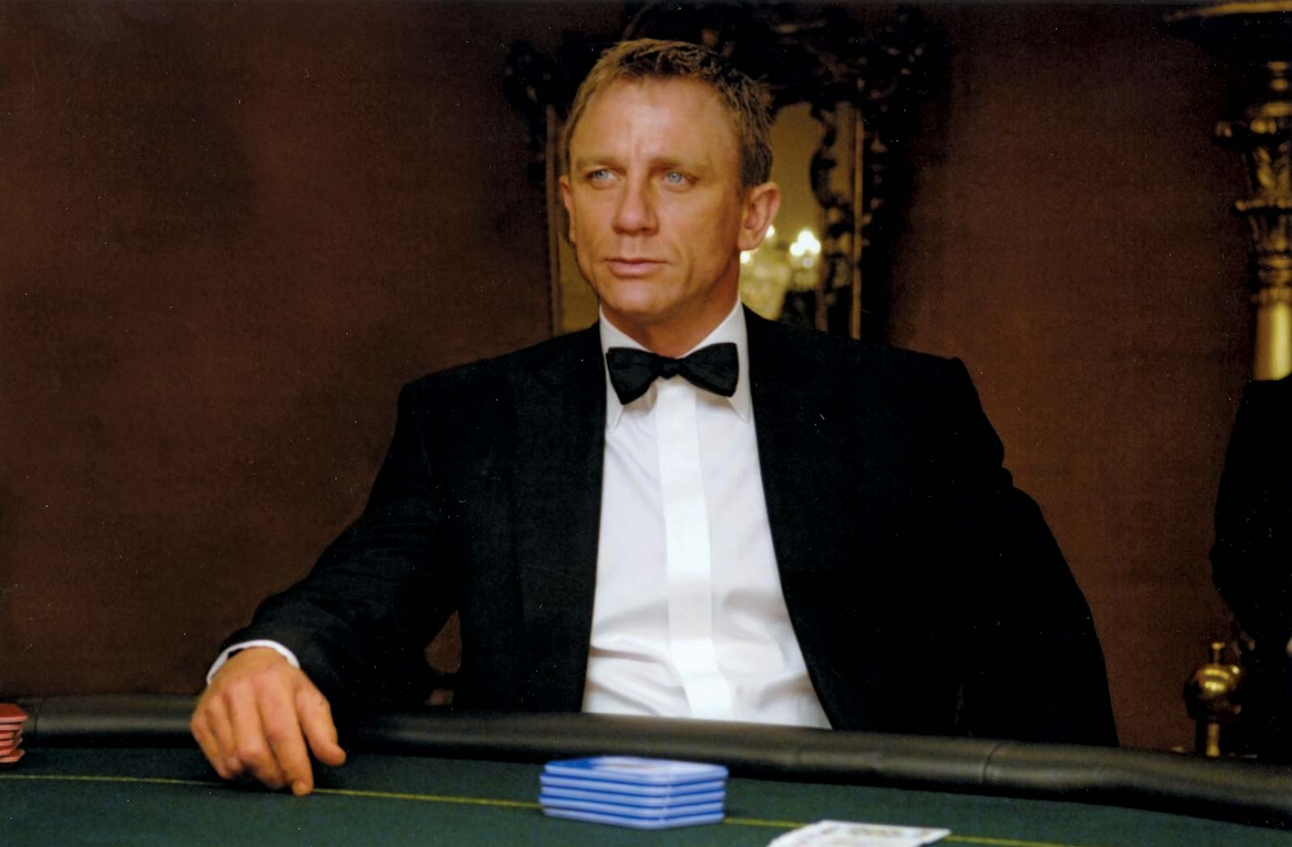
Casino Royale
Ryan Fisk, Reese Jones, Niko Revliotis (ft. James Bond)

Slide 2
Bit of Background
Poker is awesome (who doesn’t want to be James Bond)
Can we give ourselves an advantage

Slide 3
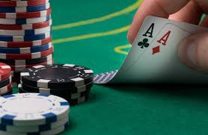
Casino Royale
Casino Royale scans poker cards and calculates the chances of winning a hand with those cards.

Slide 4
Basic Idea
The pi camera scans the first two cards each player is given, then calculates their chances of winning
When each community card is placed on the table, the odds are updated to reflect the new community cards

Slide 5
Components and Libraries
We used OpenCV and Zbar to scan the QR codes on the cards
Raspberry Pi and Pi camera
TwoPlusTwoEvaluator: open source github project for calculating poker odds

