Slide 1
WELCOME

Slide 2

My name is Ryan.
Here’s my personal email if you have any questions, no spam plz:
ryan.fleck@protonmail.com

Slide 3
Disclaimer:
-I’m not good with presentations.
-Potentially a touch of coarse language.
-All the images are fully uncredited and have essentially been pirated.

Slide 4
PYTHON3 -> JAVA

Slide 5
So, you just learned Python and now you need to learn this scary new “enterprise” language called Java.
...wyd?

Slide 6
LISTEN.

Slide 7
Java is E-Z.
I’ll teach you ITI1121 today.
The whole thing.

Slide 8
Yes, I read your syllabus.

Slide 9
What your prof said:
Identify the main objects in a software system
Contrast primitive and reference types
Create new data types
Structure an ensemble of classes as a hierarchy using inheritence
Conceive the graphical user interface of simple applications
Describe the mechanisms allowing for the construction of generic data structures without compromising the static analysis of the programs
Describe, apply and implement a stack
Throw and catch exceptions
Describe, apply and implement a queue
Create an industrial grade implementation of a list
Explain the concept of an iterator
Write recursive methods for list structures
Write and modify computer programs using binary search trees

Slide 10
What that all means:
- Learn basic Java.
- Learn some data structures.
- Slap some objects together to make the data structures and call it a day.

Slide 11
And I’m going to go fast.
Pay close attention.

Slide 12
- TOPICS COVERED -
Why??? Why do I need to learn Java?
The basics of handling .java files.
How to be a good computer programmer.
“Hello, World!” and Java boilerplate.
A bunch of easy stuff from ITI1120.
CSI2110 in a nutshell.
ITI1121, also conveniently in a nutshell.

Slide 13
So, today:
CSI2110
ITI1121
Ready? Ok.

Slide 14
Why Java?
It uses the JVM.
  Large, stable, threading support, error handling.
  Manages memory automatically. (You’ll appreciate this later.)
It’s an ‘enterprise’ language.
  Respected and widely used.
  Mature and with decent builtin libraries.
“Common” - Everyone speaks the same Java. Not true with other langs.

Slide 15
Why Java is BAD.
It uses the JVM.
  Large, stable, very very very slow.
  Uses tons of memory, manages it bureaucratically. (You’ll learn to really hate this later.)
It’s an ‘enterprise’ language.
  Boring.
Takes longer to use than Python3 for simple scripts and small tasks.

Slide 16
The basics of .java.
To install on Linux:
pkg install openjdk-8-jdk eclipse vim

Slide 17
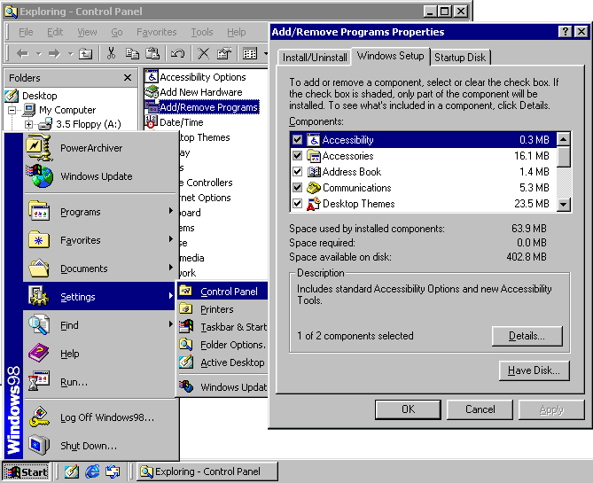
The basics of .java.
To install on Windows:
1. Download JDK.
2. Install JDK.
3. Pray to Bill Gates.
4. Add .java executables to the path at System > Advanced > ?
5. Test, and find that they aren’t working.
6. Restart your PC.
7. Download Eclipse ‘cause the CLI in Windows is a mess.
8. Install Eclipse.
9. Pray that Eclipse can compile Java.
10. Cry and install Dr. Java.

Slide 18
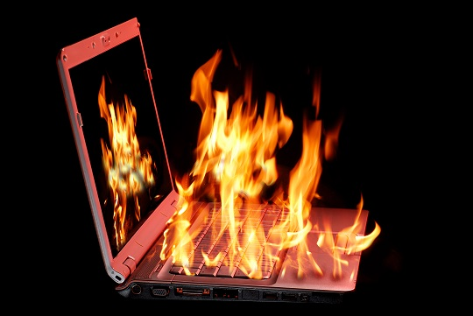
The basics of .java.
UGH.

Slide 19
We really do need a list, though:
Download a recent Java 8 JDK
Download Notepad++ (Text editor)
Download Eclipse (Integrated Dev Env)
Install all the programs, JDK first
Add the Java path to the PATH file in the Windows Environment Vars

Slide 20
To be perfectly honest, installing Java on Windows is the hardest part of this course. So, with that done:

Slide 21
(You’ve used the console before, right?)

Slide 22
Linux: touch filename.java
Windows: Right click and stuff.
To compile: javac filename.java
To run: java filename
Super easy.

Slide 23
How does this work?
Compiling the .java file converts it into a .class file, runnable bytecode compiled for use within the JVM.
Unlike Python, JVM is a sandbox that requires the code to be pre-compiled.

Slide 24
.java -> .class -> run

Slide 25
That’s all you need to know about creating and running java programs.

Slide 26
Now, before we learn to write them, we need to take a moment to think:
Programming... What is it?

Slide 27


Slide 28
Java and Python are both
“Object-Oriented”

Slide 29
The primary strength of an OOP is to create and manipulate ‘objects’ that have properties.
...to do all sorts of cool stuff.

Slide 30
Important bit:
This also means that you can think about programming problems in a unified way as long as the language observes the OOP paradigm
Tl;Dr
Java think = Python think

Slide 31
You should be able to think about how your system logically functions before you begin programming.
Everyone does this differently, but I like to write blocks and arrows.
On paper. Like a neanderthal.

Slide 32
Planning is your friend.

Slide 33
No, really.

Slide 34
As your teachers recommended:
Learn how to use java properly without an IDE, as autocomplete will ruin you.

Slide 35
What your teachers don’t know:
Learning Java is hard.
Use Eclipse if necessary.

Slide 36
My Recommendation:
Use VIM/Notepad++ (Unix/Windows) until stuck.
Use Eclipse to get over roadblocks.

Slide 37
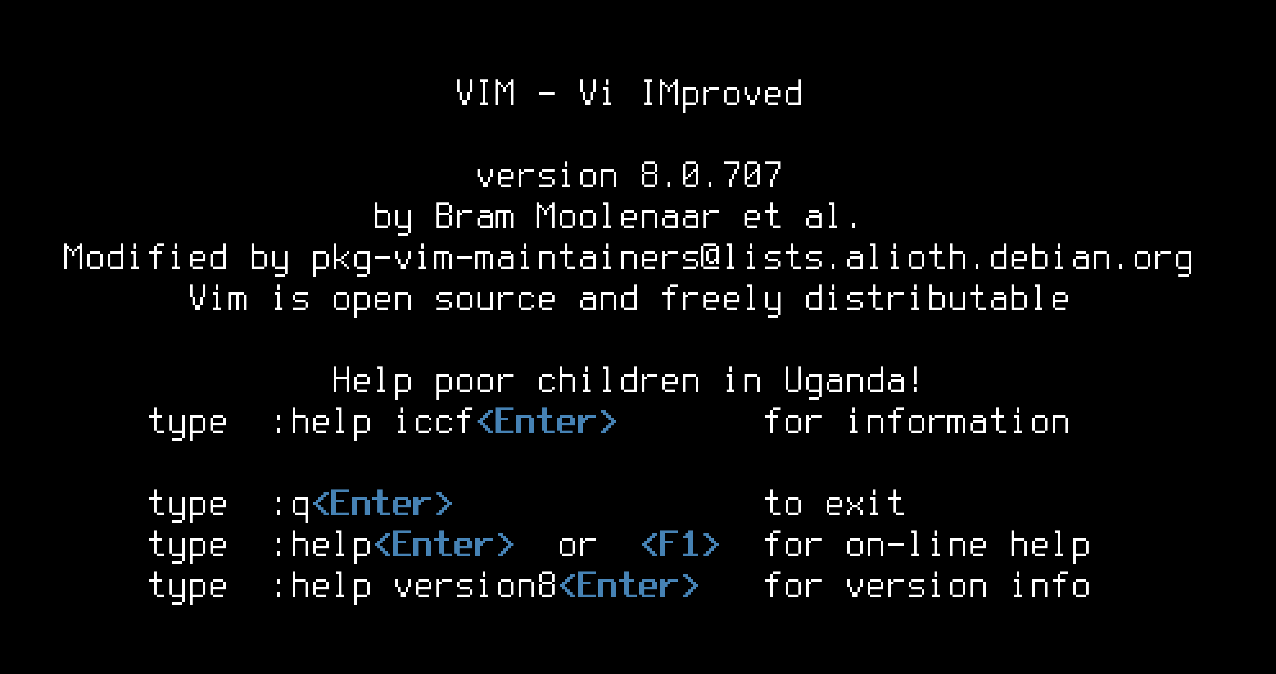

Slide 38
That was VIM.
Shameless plug:
VIM tutorial -> ryanfleck.github.io

Slide 39
Alright, enough fooling around,
let’s learn some data structures,
then we can get to programming in Java.

Slide 40
ITI1121 is essentially this:
- Learn Java and Objects.
- Learn how to stick the objects to each other.
- Stick them together into a bunch of neat shapes.

Slide 41
Shapes like:
Tree
Heap
Stack
Queue
Deque
Tables
Hash Tables
More Trees like AVL
Graphs, ETC.

Slide 42
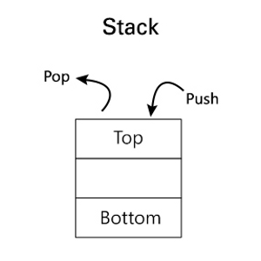
DATA STRUCT: STACK
Just like the name.
First in, last out.
HEAD points to top object.
PUSH adds one to top of stack.
POP pulls from top of stack.

Slide 43
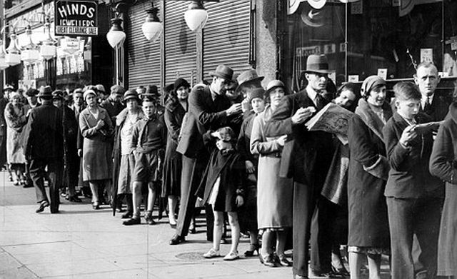
DATA STRUCT: QUEUE
Just like the name.
First in, first out.
HEAD points to ‘bottom’ object.
PUSH adds one to the top of the queue
POP pulls from the bottom of the queue.

Slide 44
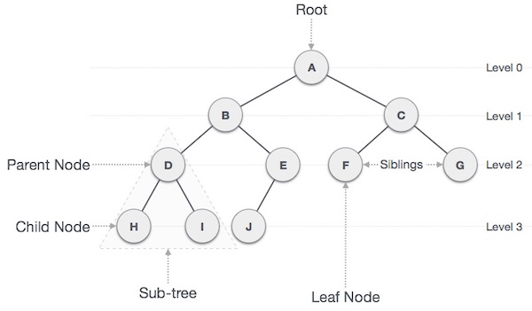
DATA STRUCT: TREE
Each node connects to two children.
Left child can be accessed by calling node.left();
Same with right.
Parent called with node.parent();
Lots of fun.

Slide 45
JAVA

Slide 46
-Review of TOPICS COVERED -
Why??? Why do I need to learn Java?
The basics of handling .java files.
How to be a good computer programmer.
“Hello, World!” and Java boilerplate.
A bunch of easy stuff from ITI1120.
CSI2110 in a nutshell.
ITI1121, here we go...

Slide 47
Finish me lol.

Slide 48
- TOPICS COVERED -
Why??? Why do I need to learn Java?
The basics of handling .java files.
How to be a good computer programmer.
“Hello, World!” and Java boilerplate.
A bunch of easy stuff from ITI1120.
CSI2110 in a nutshell.
ITI1121, also conveniently in a nutshell.

