Slide 1
WELCOME

Slide 2
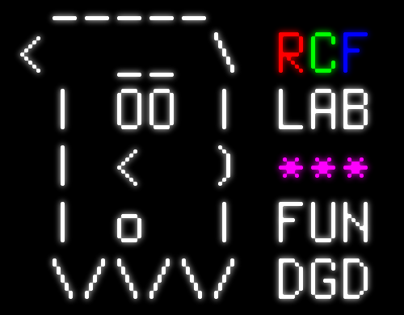
PYTHON3 => JAVA

Slide 3

TOPICS COVERED
Why do I need to use Java at all?
What to use / what not to use Java for.
How to be a good coder computer programmer:
  Best practices when programming in any language.
  How I think about programming problems.
Java is very different from Python.
Java is exactly the same as Python.
Super condensed version of Intro To Programming 2.

Slide 4
TOPICS COVERED
Why do I need to use Java at all?
What to use / what not to use Java for.
Ultra quick intro to the Java language.

