Slide 1
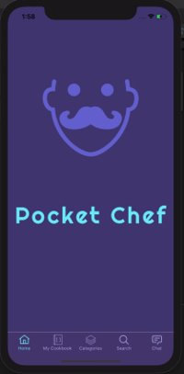
Pocket Chef

Slide 2
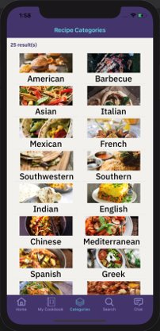
Recipes Categories​
As easy as it sounds! Just click on a category and browse through different recipes in that cuisine.

Slide 3
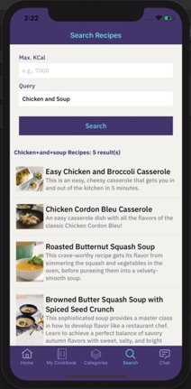
Recipes Search​
-You can specify the maximum number of calories you want
-You can specify the ingredients that you want
-Then once you click on a recipe navigate to the recipe details page

Slide 4
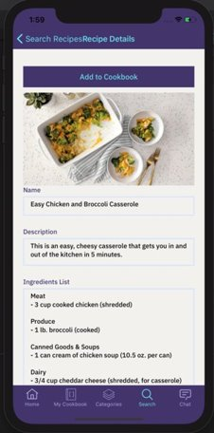
Recipes Details​
-Here you can see a list of all the ingredients
-Scroll down to see the cooking instructions
-And press the button at the top to save this recipe to your cookbook
​

Slide 5
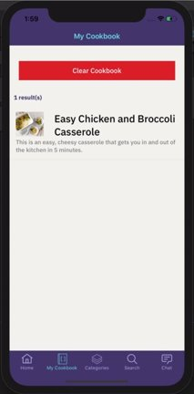
My Cookbook
-Here is where all the recipes you have added to your cookbook will appear
-If you click on a recipe you are navigated to the recipe details page
​

Slide 6
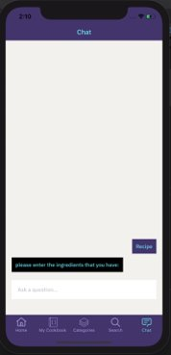
Chat
1. Type the word ”Recipe”​
2. Chatbot will respond with “please enter the ingredients you have:”​
3. Type, for example, “Carrots”​
4. The chatbot will show available recipes that contains Carrots, will show name, description, image and a link​
5. If you click the link, the app will forward you to the Recipe Details where you can view the whole recipe’s information, including in

Slide 7
How does our app help fight COVID-19​
-Encouraging users to cook at home​
-Allowing users with limited ingredients to find recipes based around what is in their fridge or pantry​
-(Future state) Allowing users to connect with each other by sharing and reviewing recipes through likes and comments​
-(Future state) promoting local restaurants by offering sponsored recipes that users can pick up or have delivered through door dash/uber eats/postmates​
-(Future state) Users will be able to send add the ingredient list of recipes they want to an instacart order​

Slide 8
Phase 2
-As mentioned in previous slide we want to give users the ability to create recipes and share them with other​
-Integrating "cart tally" functionality to add multiple recipes to a shopping cart, total all the ingredients, and place order with Instacart.
-Integrating ways for restaurants to sponsor their recipes and advertise to users​
-Integrating a way for the user to buy make at home recipe kits from restaurants through pick up or delivery​
-Ability for users to create custom diet goals and filter all recipes to support those goals
-Utilize Watson AI to suggest recipes a user might enjoy based on previously saved or reviewed recipes.​
-Create user profile where you can showcase all your recipes and other users can subscribe to you​

