Slide 1

CAPE: Context-Aware Private Embeddings for Private Language Learning
Richard Plant, Dimitra Gkatzia, Valerio Giuffrida

Slide 2


Why do we care about privacy?
We have a responsibility to limit the amount of private information our models may expose
Text data may reveal more about the author than they wish in ways they did not consider when providing samples
We may also have a legal duty to consider this aspect, e.g. GDPR data processor regulation

Slide 3
Why are we concerned with pretrained embeddings?
Embeddings give us:
Performance
Flexibility
Knowledge transfer
Information leakage¹
Preoţiuc-Pietro et al. (2015)

Slide 4
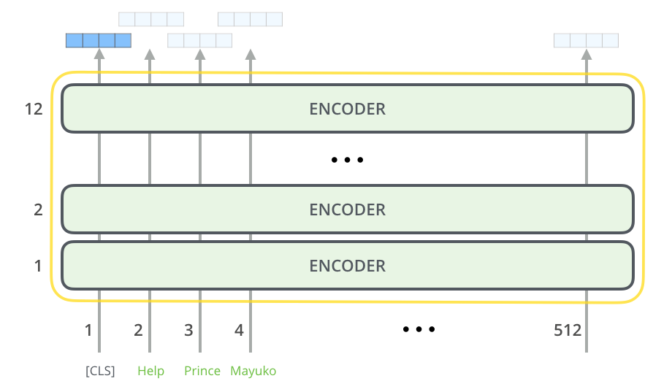
Original text
Demographic re-identification
Embedding
“ […] when I bought the TV, I never knew it would be dead within 2 weeks, total joke […]”
Male
UK
25-35

Slide 5
How can we reduce the private information captured in our embedding?
Coavoux et al. (2018) propose Multi-detasking:
Use a duplicate classifier to predict the private information
Penalise the main objective when this is effective
Lyu et al. (2020) use local differential privacy
Normalise the representation
Add noise from the Laplace distribution

Slide 6
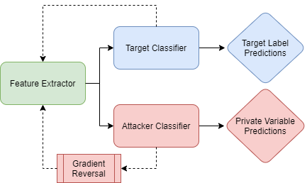
A hybrid model
Additive noise is applied across the input
An adversarial classification system is used to obfuscate specific data

Slide 7

Experiments
We use the Trustpilot dataset collected by Hovy et al. (2015)
This contains:
Review texts
Gender
Age
Location
Among others.

Slide 8
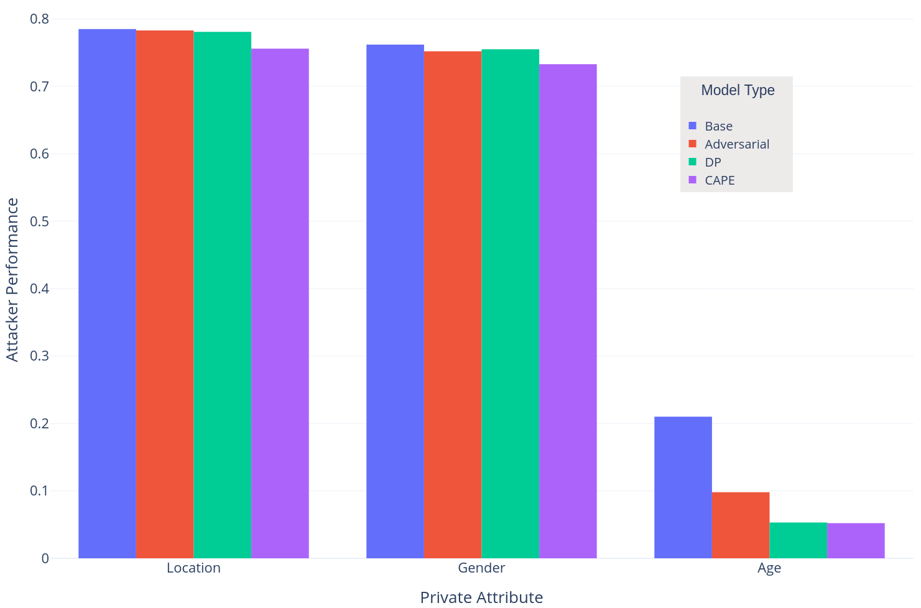
Results
How good are we at hiding our private attributes?
Attacker Task Performance

Slide 9
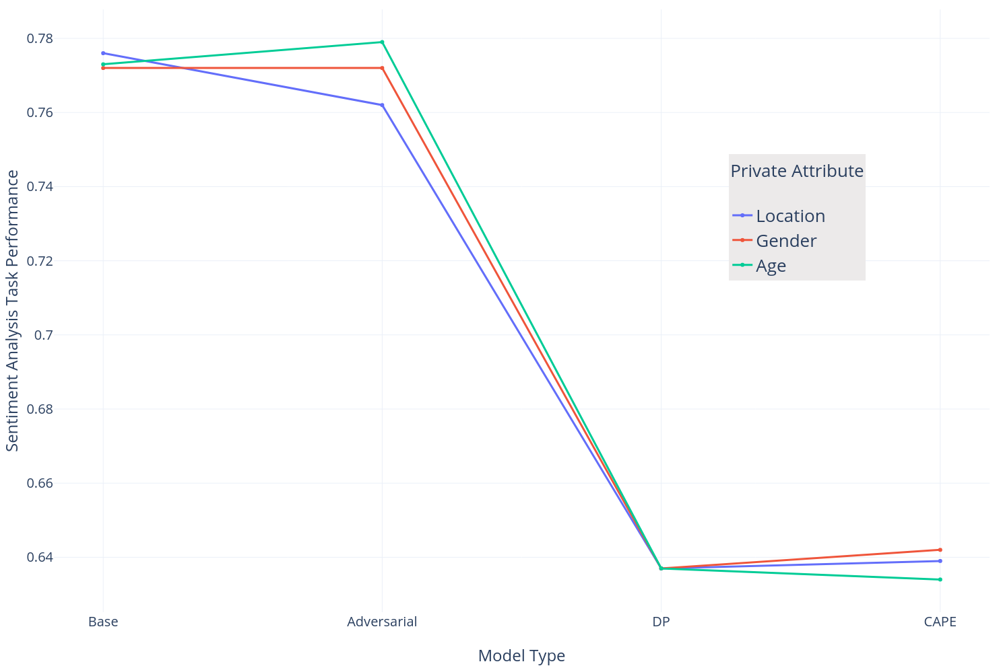
Privacy/Utility tradeoff
How much does model performance suffer?
Sentiment Analysis Task Performance

Slide 10
Multilingual datasets
Better noise calibration
Private by default
Most current research concentrates on very high resource languages, primarily English.
Intuitively, languages vary widely in demographic grammatical markers, which could make an attackers’ work much easier.
Classic differential privacy calibrates additive noise to the sensitivity of a query, a quantity that is not well defined in the case of text embeddings. We recommend here work in relaxing the definition, especially Metric Differential Privacy^{1,2}.
Our method requires the identification and annotation of sensitive attributes in the dataset used for downstream tasks.
A more straightforward approach involving fine-tuning a large language model to produce private embeddings has appeal.
Where do we go from here?
Feyisetan et al. (2020)
Fernandes (2021)

Slide 11
Thank you for your time!
r.plant@napier.ac.uk

