Slide 1
Lab 1
Kiana Greek, 40135171
Ryan Haniff, 27069421

Slide 2
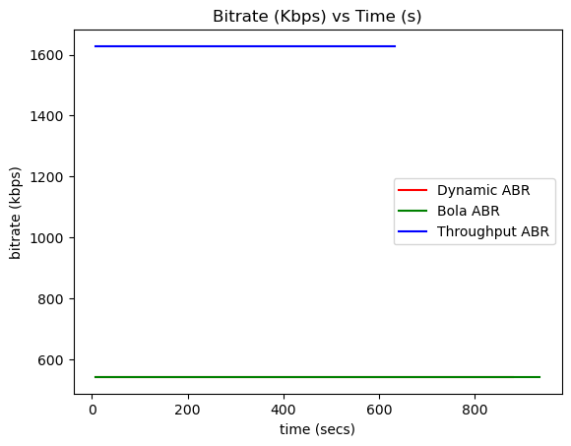
Bitrate in Kbps
Dynamic and BOLA have similar bitrates
Used dashAdapter.getBandwidthForRepresentation(
repSwitch.to,periodIdx)
var bitrate = repSwitch
? Math.round(
dashAdapter.getBandwidthForRepresentation(
repSwitch.to,
periodIdx
) / 1000
)
: NaN;

Slide 3
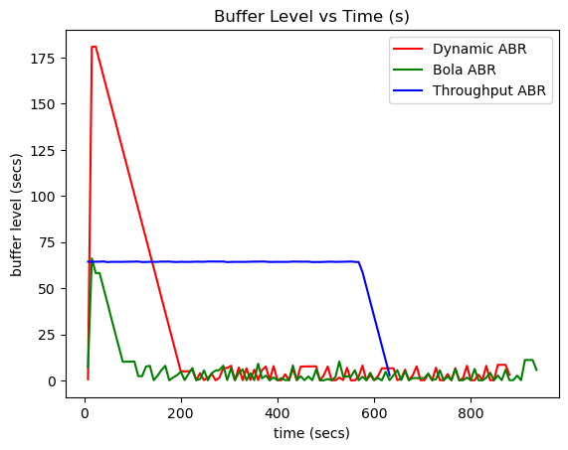
Buffer Level (secs)
Used: dashMetrics.getCurrentBufferLevel("video", true)
High peaks and large drops
After 200 seconds dynamic and Bola were similar
var bufferLevel = dashMetrics.getCurrentBufferLevel("video", true);

Slide 4
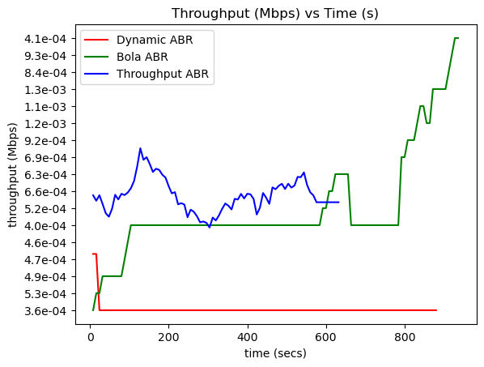
Throughput (Mbps)
Used player.getAverageThroughput("video") / 1000000
Dynamic started at a very high throughput
Leveled off within 16 seconds
Bola algo increased in throughput throughout playback
Throughput algo had large peaks and troughs
var avgThroughput = player.getAverageThroughput("video") / 1000000;

Slide 5
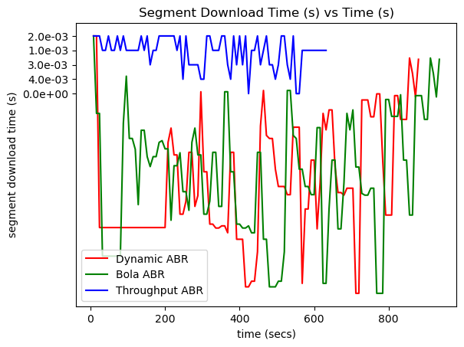
Segment Download Time (secs)
Throughput-based shortest playback
Throughput-based longest time
Most consistent of the three algos
Dynamic and Bola were erratic
if (httpRequest && httpRequest.type === "MediaSegment") {
var segmentDownloadTime =
httpRequest._tfinish.getTime() -
httpRequest.tresponse.getTime();
console.log(
"Segment download time: " + segmentDownloadTime + " ms"
);
all_the_logs += segmentDownloadTime + ", ";
}

Slide 6
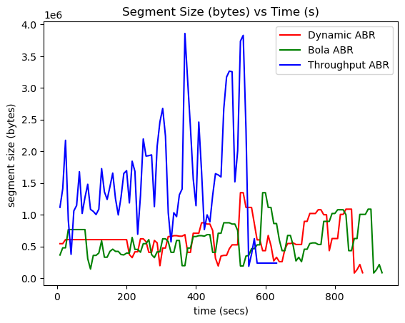
Segment Size (bytes)
Dynamic and Bola peaks were offset by 200 s
Throughput-based had the largest segment sizes
Correlation between segment size and download time
var httpRequestsSize = dashMetrics.getHttpRequests("video");
var segmentRequest = httpRequestsSize
.filter((request) => request.type === "MediaSegment")
.pop();
var segmentSize = segmentRequest
? segmentRequest.trace.reduce((acc, cur) => acc + cur.b[0], 0)
: 0;
console.log("Segment Size: " + segmentSize + " bytes");

Slide 7
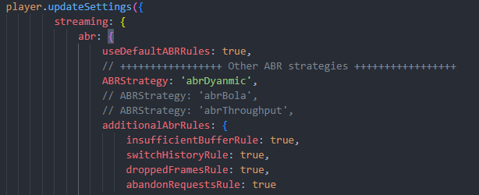
Changing ABR Settings:

Slide 8
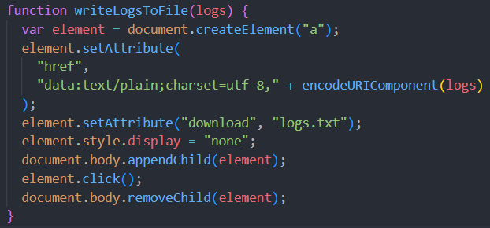
Saving console logs to txt

Slide 9
Thank you

