Slide 1
MicaSense RedEdge Spectral Response Graphs
2017 11 16
IMGS-589

Slide 2
Background Info
Images – 1280px X 960px, 2.4MB, MicaSense, 5.5mm FL
Blue Band1 – f2.8, 1ms, ISO 100, 475nm, 20nm FWHM
Green Band2 – f2.8, 0.18ms, ISO 100, 560nm, 20nm FWHM
Red Band3 – f2.8, 0.58ms, ISO 100, 668nm, 10nm FWHM
NearIR Band4 – f2.8, 1ms, ISO 100, 840nm, 40nm FWHM
RedEdge Band5 – f2.8, 0.43ms, ISO 100, 717nm, 10nm FWHM

Slide 3
Raw Digital Counts

Slide 4
Relative Sensor Spectral Response

Slide 5
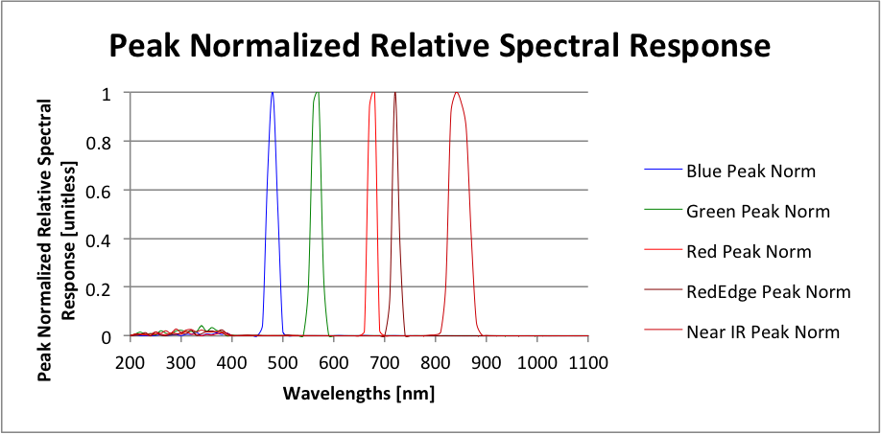
Peak Normalized Spectral Response

Slide 6
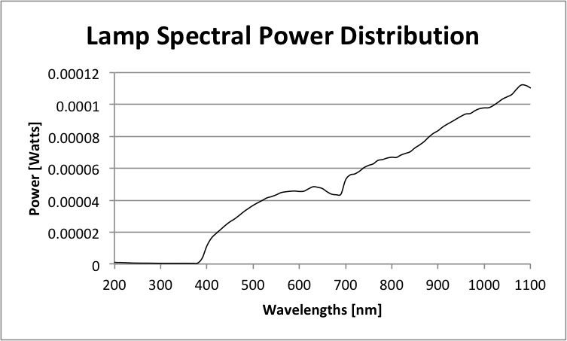
Lamp Spectral Power Distribution

