Slide 1
This is a version of a SEIR model, where an additional step between Infectious and Recovered is added, and an additional outcome (Deceased) is added. An individual who is Infectious may go straight to Recovered, go to Hospitalized Leading To Recovery, Critical Leading to Recovery, or Critical Leading to Deceased.
Susceptible
Exposed
Infectious
Mild Hospitalization
Critical Hospitalization
Critical Hospitalization
Recovered
Deceased

Slide 2
Parameter | Value
Incubation Time | 5 days
Infectious Time (before either recovery or hospitalization) | 3 days
Hospitalization Recovery Time | 23 days
Time between Hospitalization and Death | 18 days
Hospitalization Rate | 3% of all infections (including asymptomatic)
Critical hospitalization rate | 1.0% of all infections
Death rate | 0.66% of all infections
Day Zero | 5 January 2020

Slide 3
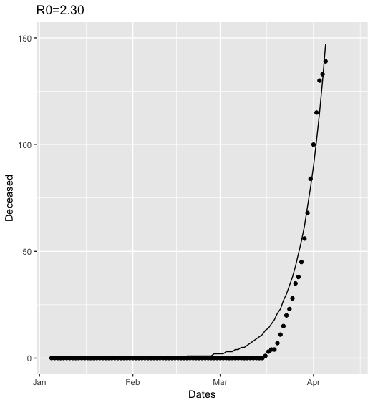
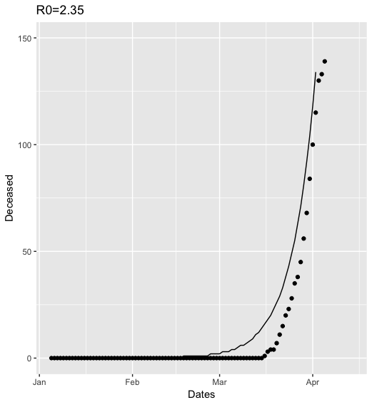
Fitting model deceased curve to observed deaths:
The curve that fit closest was for R0=2.30 (above). However, upon inspection, it was seen that the curve underpredicted observations slightly.
The reality is there are probably more deaths than are being counted that are COVID-19 deaths, so we opted for the scenario where R=2.35 (below).
Note that intervention is regarded to have occurred on day 79, 25 March 2019—the date of the stay-at-home order—and this is to soon for the intervention to affect the curve of the deceased.

Slide 4
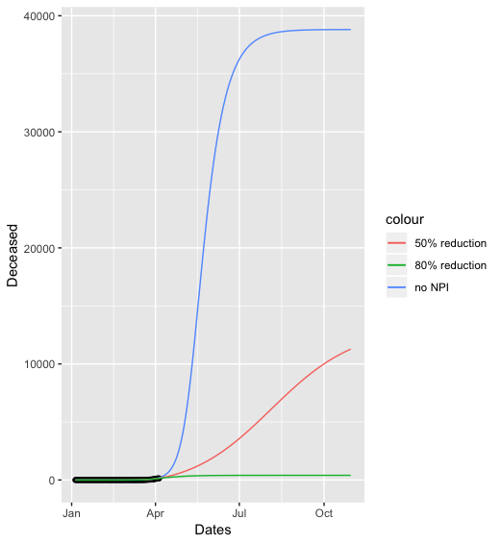
Without knowing the actual reduction in transmission rate, we can consider a few possible scenarios.
First, the blue curve, indicates no NPI whatsoever, resulting in 40K deaths by the end of October. This is very unlikely, as substantial measures have been taken to curtail transmission.
The red curve indicates a 50% reduction in transmission, with 10K deaths by the end of October.
The green curve indicates 80% reduction in transmission, with about 500 deaths by the end of October.

Slide 5
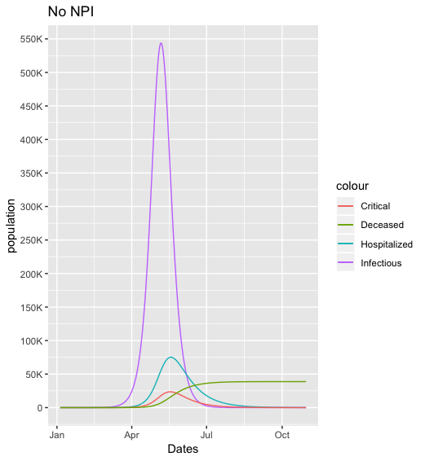
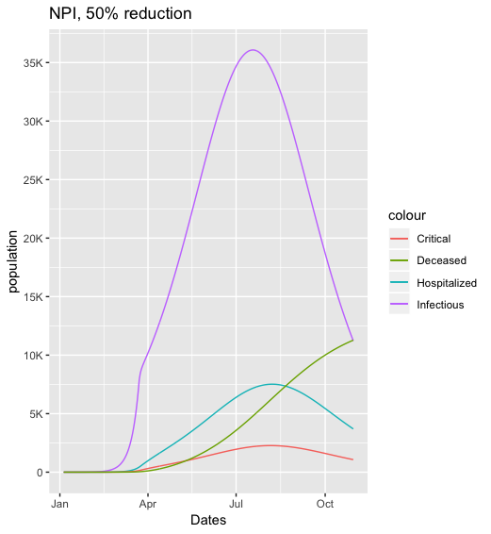
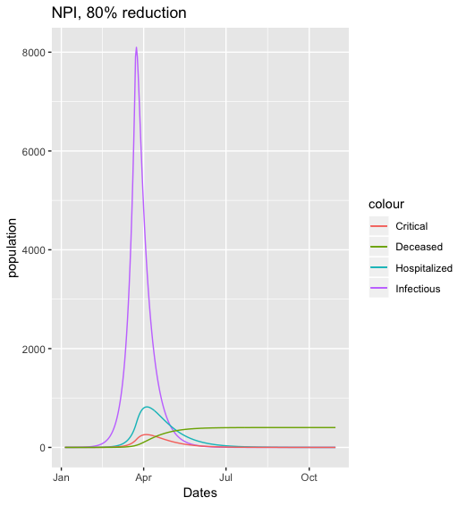
The worst case (and unlikely) scenario at this point would have us peaking in infectious at the end of April and in hospitalizations in mid-May. 50% reduction has the peak in hospitalizations occurring in late July. 80% reduction has the peak in infectious and hospitalization occurring now.
Which scenario is most accurate will not be evident for a few more weeks.

