Slide 1
ZeroMQ

Slide 2
What is it?
Open source
Cross Platform – Linux, Windows, Mac, mobile, etc…
Cross Language – (C, C++, C#, Clojure, Delphi, Erlang, F#, Felix, Go, Haskell, Haxe, Java, Lua, Node.js, Objective-C, Perl, PHP, Python, Q, Racket, Ruby, Scala, Tcl, Ada, Basic, ooc, and many more)
Lightweight
Fast!
Free

Slide 3
The Zen of Zero
Zero broker
(as close to) Zero latency (as possible)
Zero administration
Zero cost
Zero waste

Slide 4
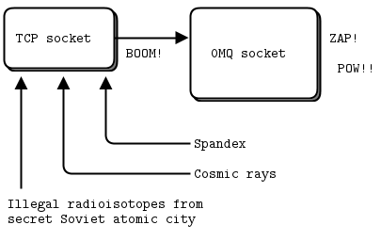
Sockets
Unicast – inproc, ipc (except on Windows), tcp
Multicast
Asynchronous
Designed for particular messaging patterns
Should only be used from a single thread

Slide 5
Valid Patterns
PUB and SUB
REQ and REP
REQ and ROUTER
DEALER and REP
DEALER and ROUTER
DEALER and DEALER
ROUTER and ROUTER
PUSH and PULL
PAIR and PAIR

Slide 6
ZeroMQ on .net
fszmq
Built for F#, but works with other .net languages
Supports ZeroMQ 4.0.4 and older
clrzmq
Last updated in November, 2012
Latest version is a Release Candidate, using ZeroMQ 3.2.2
NetMQ
Full port of ZeroMQ in C#
Relatively new, not yet production ready

Slide 7
Built-in Patterns
Request
Reply

Slide 8
Built-in Patterns
Pub
Sub
Sub
Sub

Slide 9
Built-in Patterns
Pipeline

Slide 10
Resources
http://zeromq.org
http://zguide.zeromq.org
https://github.com/zeromq

