Slide 1
ZeroMQ

Slide 2
What is it?
Open source
Cross Platform – Linux, Windows, Mac, mobile, etc…
Cross Language – (C, C++, C#, Clojure, Delphi, Erlang, F#, Felix, Go, Haskell, Haxe, Java, Lua, Node.js, Objective-C, Perl, PHP, Python, Q, Racket, Ruby, Scala, Tcl, Ada, Basic, ooc, and many more)
Lightweight
Fast!
Free

Slide 3
The Zen of Zero
Zero broker
Zero latency (as close as possible)
Zero administration
Zero cost
Zero waste

Slide 4
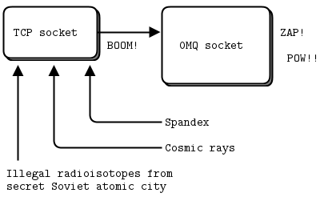
Sockets
Notes:
Sockets are created from the Context. There should be only one context created in the process, which is then used to create all of the sockets used by the application. Sockets are asynchronous internally, but are not thread-safe and should only be used from a single thread.

Slide 5
Sockets
Unicast – inproc, ipc (except on Windows), tcp
Multicast – pgm, epgm
Asynchronous
Designed for particular messaging patterns
Connect to multiple endpoints
Automatically reconnect
Queue messages when under heavy load
Should only be used from a single thread
Notes:
Sockets are created from the Context. There should be only one context created in the process, which is then used to create all of the sockets used by the application. Sockets are asynchronous internally, but are not thread-safe and should only be used from a single thread.

Slide 6
Valid Patterns
REQ and REP
REQ and ROUTER
DEALER and REP
DEALER and ROUTER
DEALER and DEALER
ROUTER and ROUTER
PUB and SUB
PUSH and PULL
PAIR and PAIR

Slide 7
ZeroMQ on .net
fszmq
Built for F#, but works with other .net languages
Supports ZeroMQ 4.0.4 and older
clrzmq
Last updated in November, 2012
Latest version is a Release Candidate, using ZeroMQ 3.2.2
NetMQ
Full port of ZeroMQ in C#
Relatively new, not yet production ready

Slide 8
Built-in Patterns
REQ
REP

Slide 9
Built-in Patterns
PUB
SUB
SUB
SUB

Slide 10
Built-in Patterns
Pipeline

Slide 11
Scaling
REQ
REQ
REQ
Proxy
Router
Dealer
REP
REP
REP

Slide 12
Resources
http://zeromq.org
http://zguide.zeromq.org
https://github.com/zeromq

