Slide 1
KnightShips
Group 3 Large Project

Slide 2
What is KnightShips?
A new take on the classic board game Battleship
GPS based mobile board game
Hide ships in real locations
Outwit your friends by hiding your ships in hard to reach locations
Search and destroy
Play as a fighter jet searching for ships
Use your current location to deploy devastating attacks around you

Slide 3
Features
Multiplayer gameplay
Play with 1 to 7 other players
Real time GPS functionality
Place ships on board locations that overlay real world
Walk around to move your fighter jet on the game board
Your board location changes based on your real GPS position
Leaderboard
Point system based on ships hit/sunk
Lose points for losing ships

Slide 4
Gameplay
Find up to 7 other people to play with
Create a lobby
Choose someone to be the host
Host creates a lobby and receives a lobby id
Players join lobby with that id
Start game
Players are given time to deploy ships on a virtual board
Search Phase
Move around to attack locations near your GPS position
30 second attack cool down
Attack as many ships as possible before yours are destroyed

Slide 5
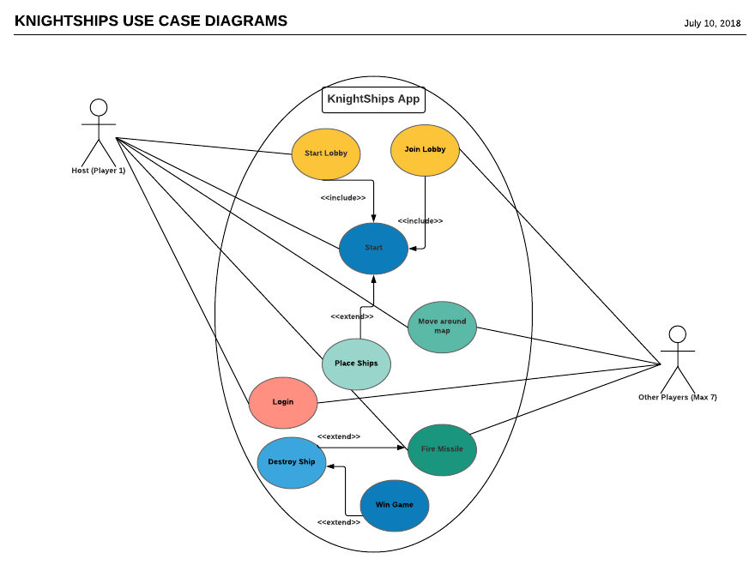
Using The Application

Slide 6
The Plan
DB/API
Login Information
Lobby selections
UI
Login
Main Menu
Board
Created based on host Location
Place ships
Board locations
Lobby
Attack board locations
Unity and C #
MySql and PHP
Unity and C #

Slide 7
Time Allocation

Slide 8
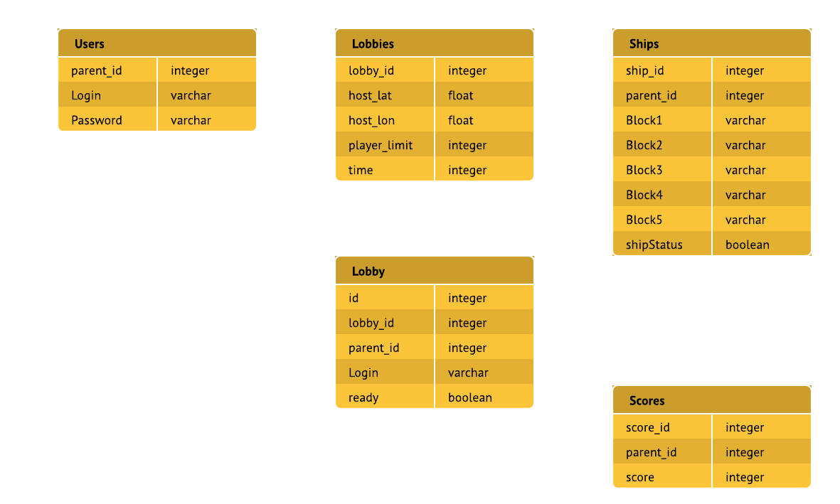
Data Management

Slide 9
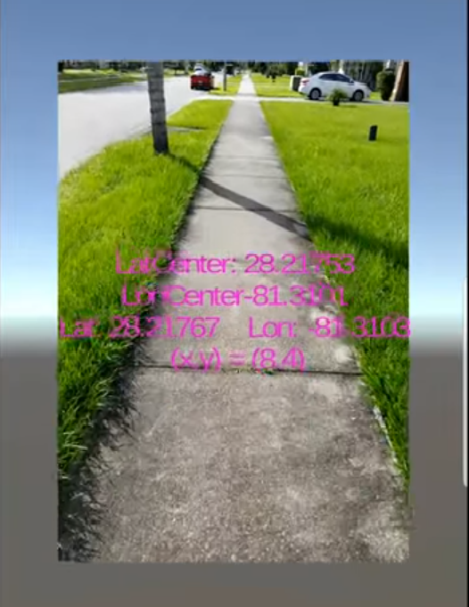
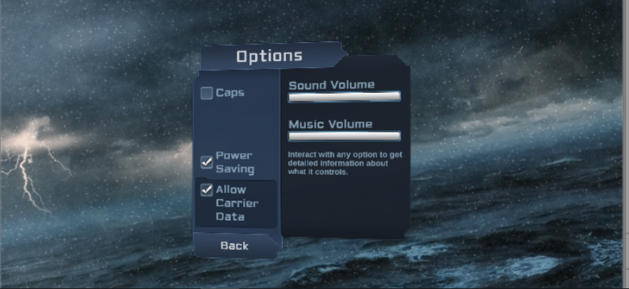
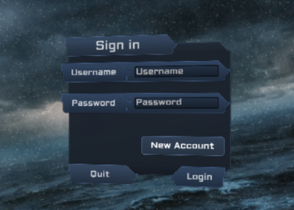
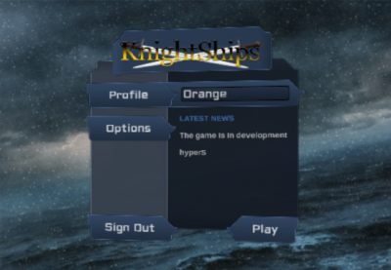
Current progress

Slide 10
Anticipated Challenges
GPS inaccuracies
Board orientation
Integration bugs
Coordinating multiplayer data with the DB

Slide 11
Why Choose us?
Utilizing a popular multiplayer gaming technology
Making a game that is competitive and accessible
Our application promotes good physical health
Have an organized approach
We are working within our skill limits

Slide 12
Questions?

