Slide 1
Dictionary Challenge
Embry-Riddle Aeronautical University
Fall 2016
CS225 Group Project
Michael Riley and Ryan Herga

Slide 2
Program Life-Cycle Evolutionary Requirements:
Version 1 – C++
Provide a console interface
Perform File IO of dictionary files
Prompt user to enter a word that corresponds to a definition
Version 2 – C++ Graphic User Interface
Design and implement a GUI to handle flow of control during game play
Version 3 – C# Graphic User Interface
Port functionality to Visual C# for advanced GUI design
Perform file input with embedded resources
Perform file output as a file-save implementation
Play sounds
Update graphics

Slide 3
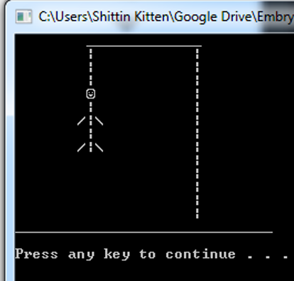
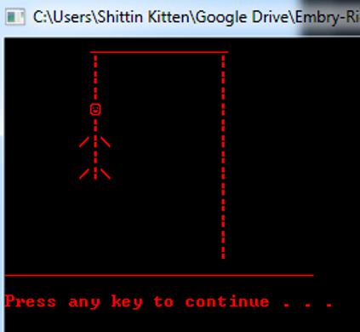
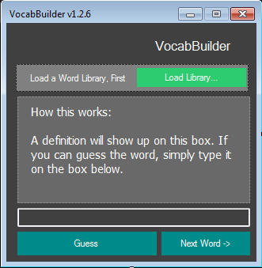
Version 2 of the program created a simple C++ GUI such as the one you see below:
The user selects a file to use a dictionary source
A definition appears
The user enters a guess or may skip this definition.
The game ends after 5 successful guesses
These two console views are from the first version of the program. This output was done by using cout with modifiers such as setw, left, and right.
BTW changing color on PRCLAB, as it turns out, is
rather trivial for example:
std::cout << "\033[1;31mbold red text\033[0m\n";
Will turn the text red

Slide 4
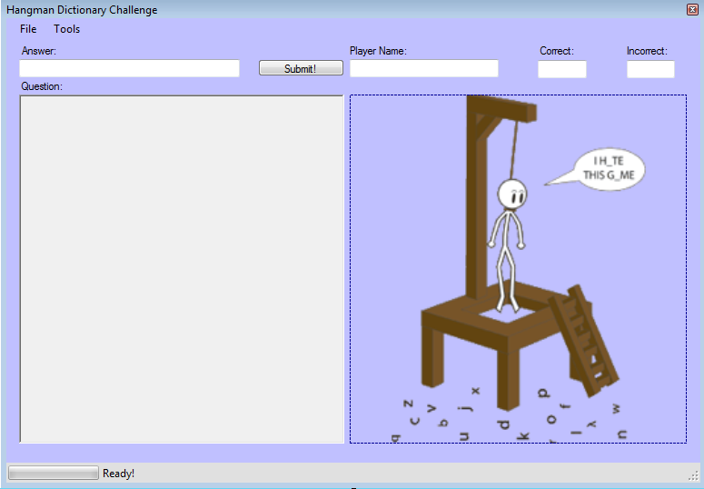
Version 3 Brief Detail
Implemented a more advanced user interface which
plays sounds
updates graphics
allows the user to save
Exit
displays an about the program pop up when commanded.
This program runs via a windows executable and does not require any additional files to be present within the directory.
The save process invokes the standard windows forms save dialogue box.

Slide 5
Style Guide
Opening brackets go below function label unless inline definition and implementation is possible within the 100 column limit
Variables shall be named with standard camel case unless there is a specific requirement
Variable, function names, and classes must be named appropriately for what the will be used for

Slide 6
Class Project Requirements:
if, while, do-while, and/or for loops
In this project only the do-while was not utilized. For Each was utilized instead
Functions – The following are examples of user defined functions created for this project
private void buildDictionary(), public string lineTrimmer(string lineIn, int trimTo)
, private void DisplayQuestion()
class definitions
public class Player
public abstract class Dict : Word
This is an abstract data class in C# form
public class Word
{
// Composition
private Def defObj = new Def();
}
public class Def
This is a half ass attempt to show composition
operator overloading
public static Player operator++ (Player p) { p.right++; return p; }
public static Player operator-- (Player p) { p.bodyParts--; return p; }
These two operator overloads are used to directly change the private members

Slide 7
Class Project Requirements:
Exceptions
try { backgroundWorker1.RunWorkerAsync(); }
catch(Exception e)
{
MessageBox.Show(e.ToString());
}
if (e.ProgressPercentage > 100) { throw new IndexOutOfRangeException(); }
file I/O
Version 2: File IO was performed by selecting a file from a specific directory
Version3: Files necessary for program execution on any windows based platform were included as resource files and compiled as part of the executable (a.out for instance). These files were read during the form load, and data from them were used to instantiate class objects. File output was achieved by writing player and program statistics to a text file at a location chosen by the user.

Slide 8
Class Relationships
A Dictionary IS A
Collection of Words
A Word HAS A
Part of speech
Definition
The dictionary class is abstract and cannot be instantiated so instead each Word is an object that contains a private data member for the actual word, and an object of class Def which contains the definition and part of speech.
The program makes use of the ‘List’ data type or ‘Container’ which is a more improved version of the C++ vector class. Each Element in the list is an object of Class Word.

