Slide 1
DataScience.career.max()
How best to maximize your value & opportunities as a
New Data Scientist

Slide 2
What Do We Wish To Know?
How best can you maximize your value as a Data Scientist?
What are the hottest areas for Data Science?
What are the most common and highest paying skills?
How much more in yearly salary will you average by searching among ideal features?
Bonus: How to maximize your value when seeking a non-commercial organization?

Slide 3
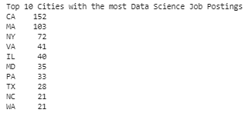
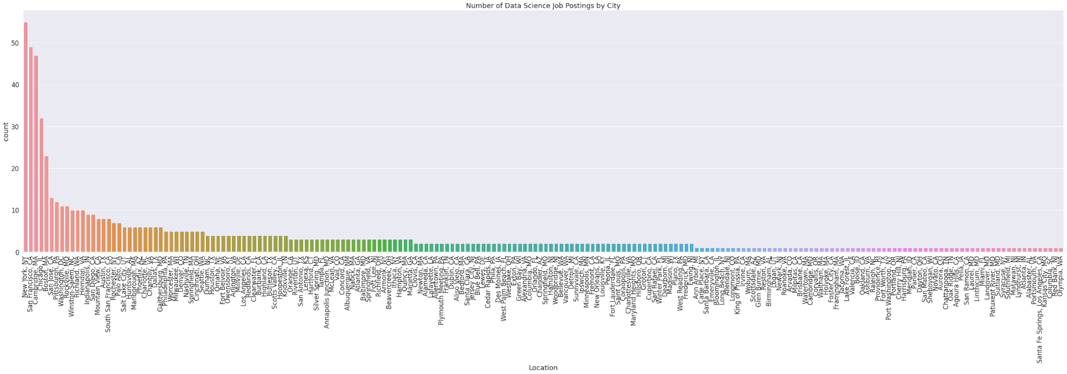
Postings By City

Slide 4
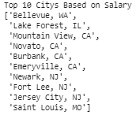
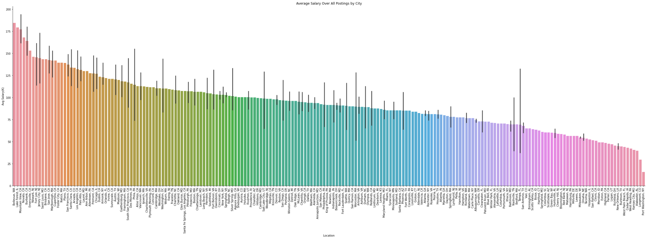
Salary By City

Slide 5
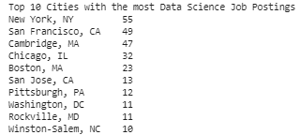
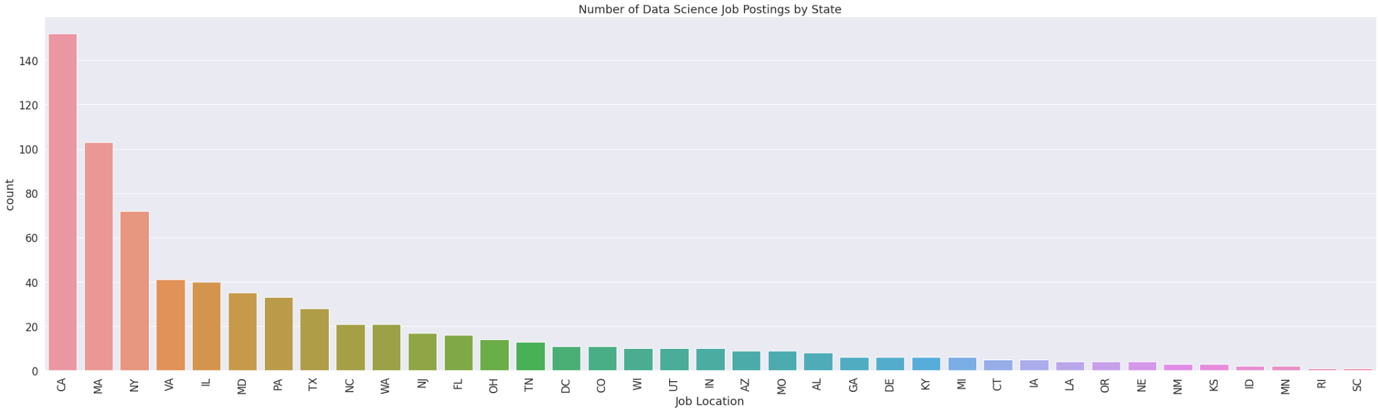
Postings By State

Slide 6
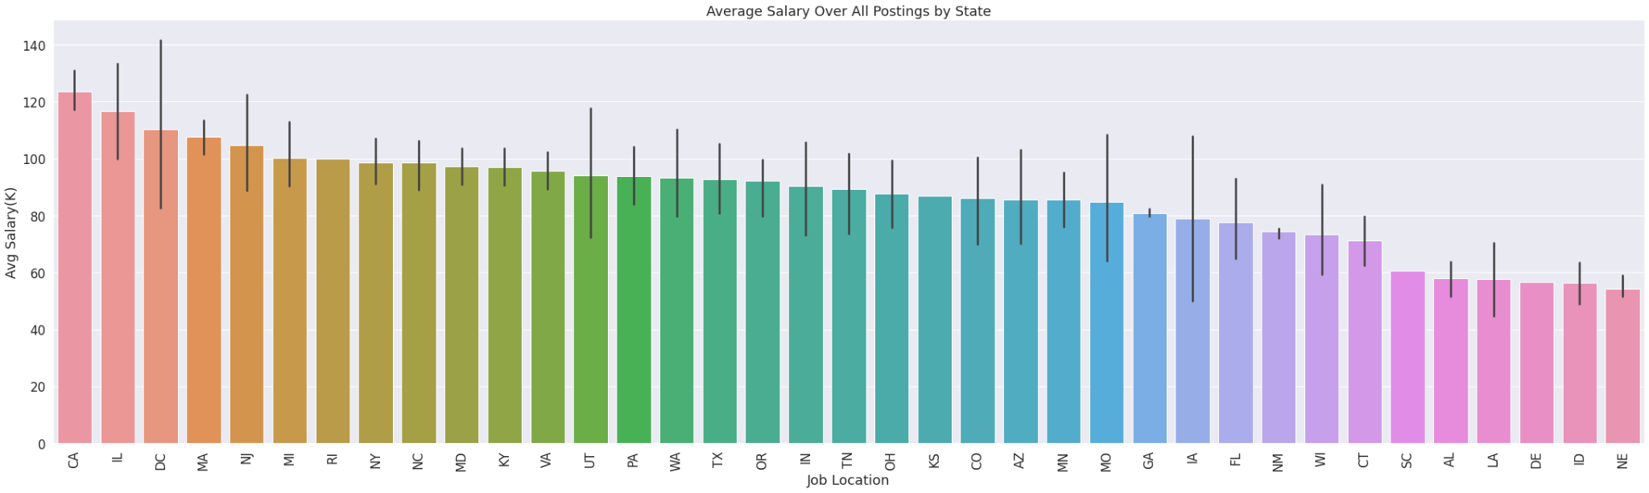
Salary By State

Slide 7
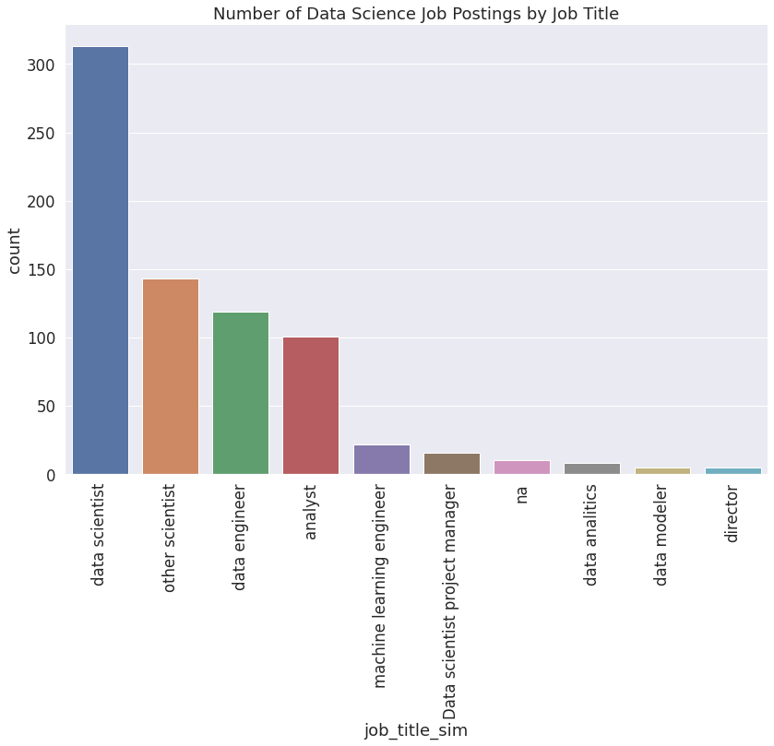
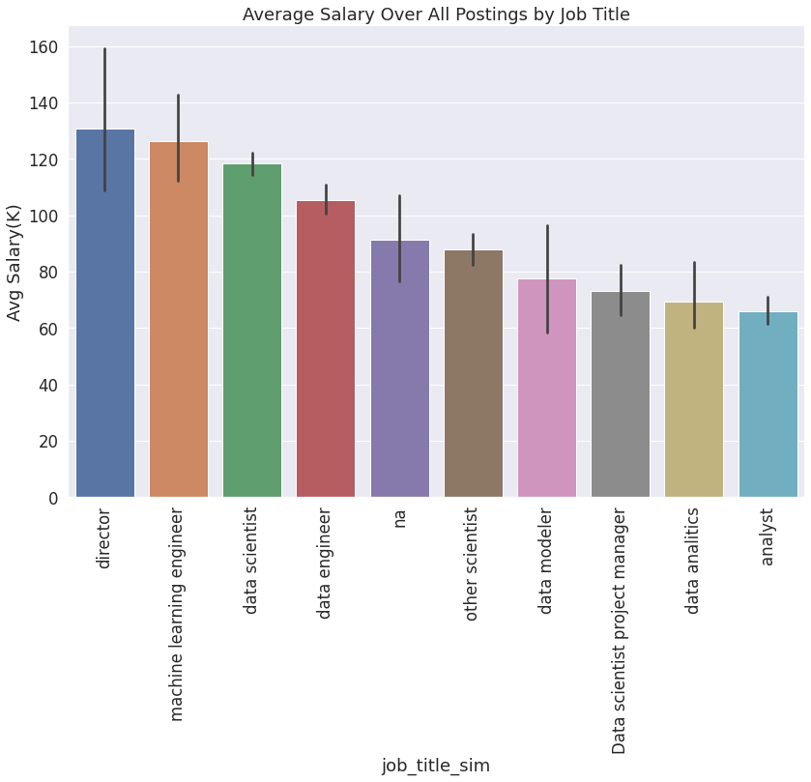
Job Titles

Slide 8
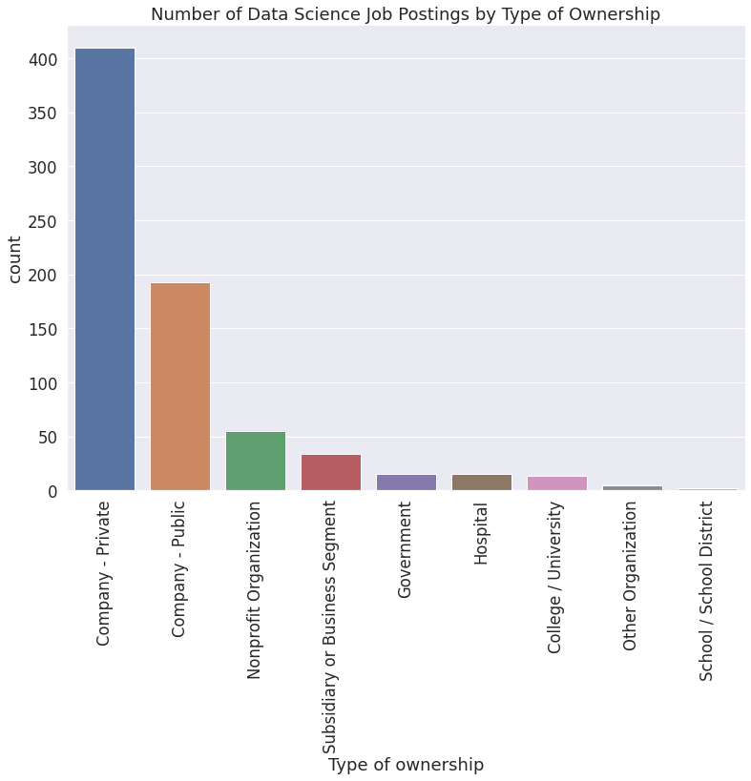
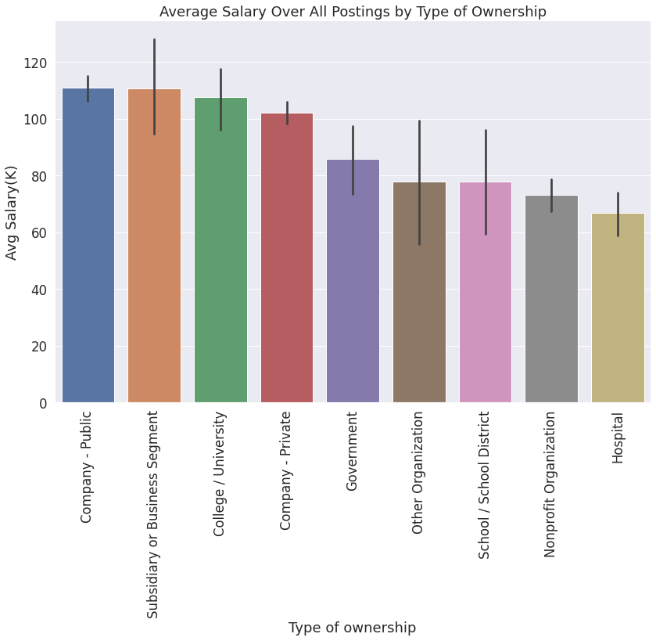
Business Type of Ownership

Slide 9
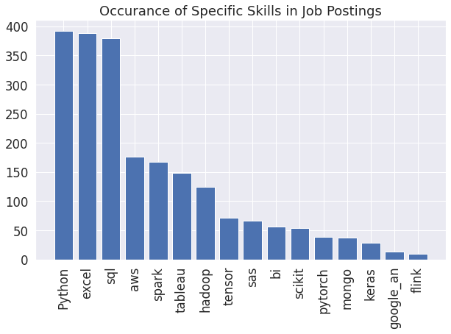
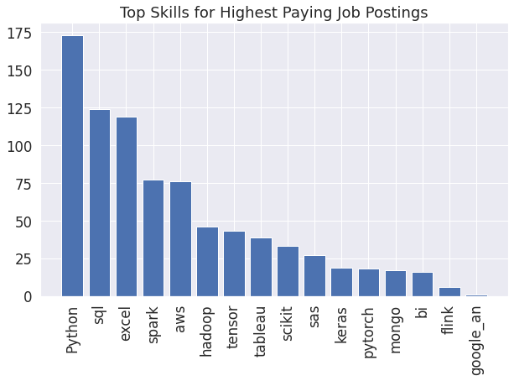
Skills

Slide 10
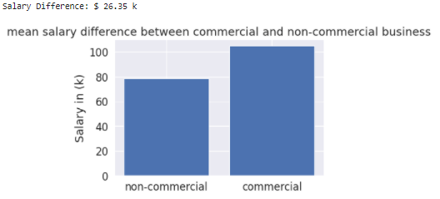
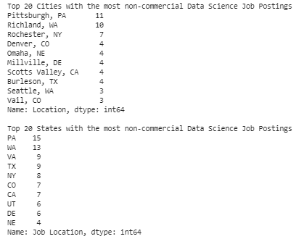
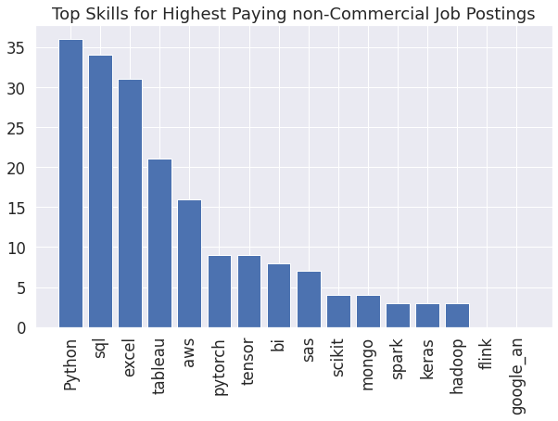
Is Altruism Expensive?

Slide 11
Summary
Job Title : Data Science or Data Engineer
States: Massachusetts, California or Illinois
Business Ownership: Public or Private
Skills: Python, Excel, SQL, spark and aws with hadoop, tensor & tableau
Using these ideal features you can net an additional $33.5k on average

