Slide 1
Skin Disease Image Classification Using Convolutional Neural Networks
By Ryan Johnson

Slide 2

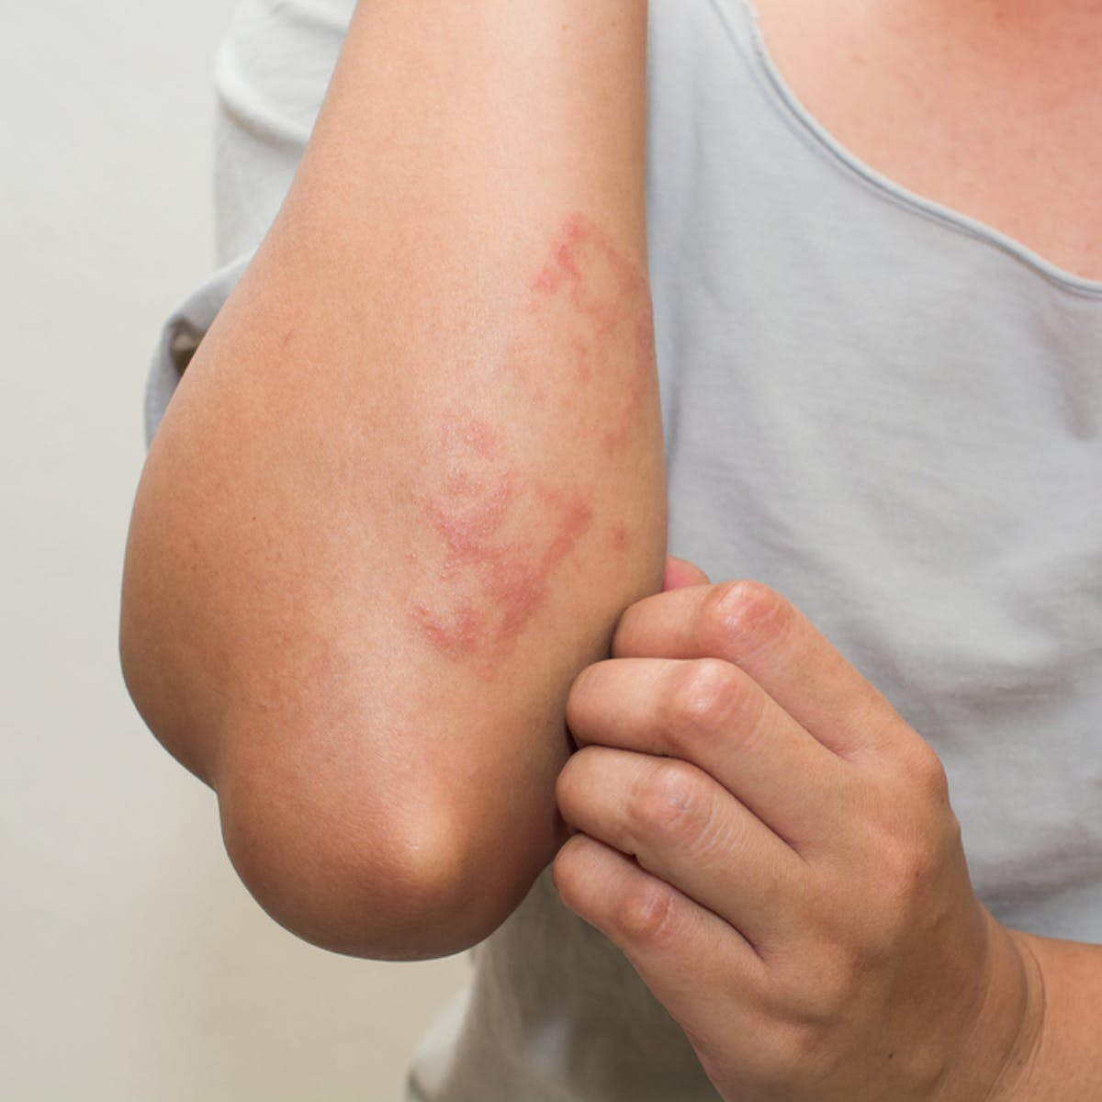
Problem
Few Doctors Performing In Person Visits
Medical Staff Overworked and in Short Supply
Not Everyone Has Access to a Webcam, Cell Phone or Internet
Diagnosing a Skin Condition is Difficult if not Familiar

Slide 3
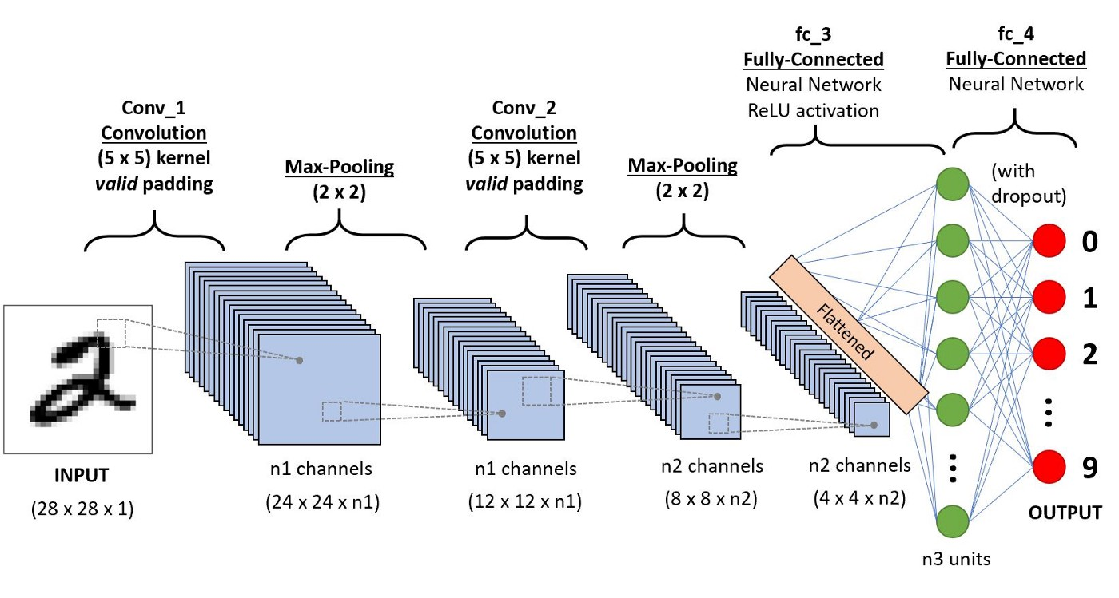
Problem Cont.
Image Classification
Convolutional Neural Networks
Goal of 50% Accuracy

Slide 4


Data
Scraped from Dermnet by Shubham Ggoel, posted on Kaggle
15,557 Training Images, 3,946 Testing Images
23 Very Broad Categories

Slide 5
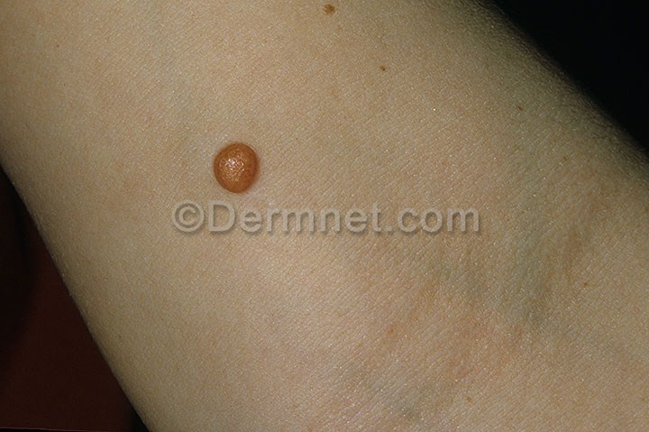
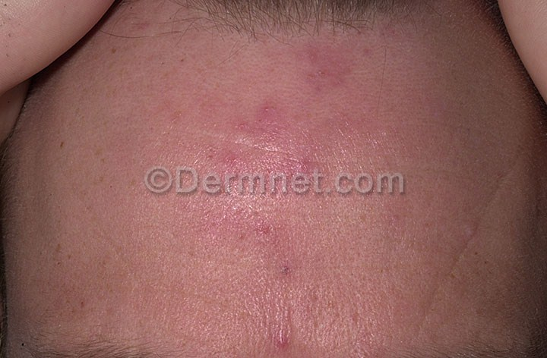
Data Cont.
Watermarks
Categories Very Broad With Varying Amounts of Samples
Varying Body Parts
Performed NLP to Attempt Sub-division of Categories

Slide 6
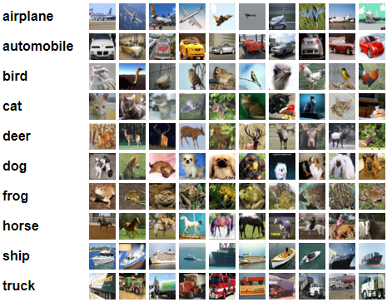
Method
4 CNN Layers of Increasing Filter Size, 2 FC Layers
Activation - elu, Kernel - he_normal
Image Augmentation - Shear, Zoom, Rotate, Flip
Maintained RGB Colorspace
Compared My Model With Transfer Learned Resnet50 Model
Verified Both Models on CiFar10 Image Set

Slide 7
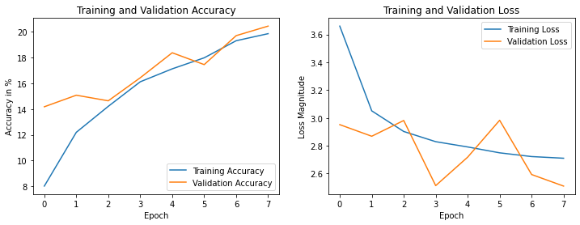
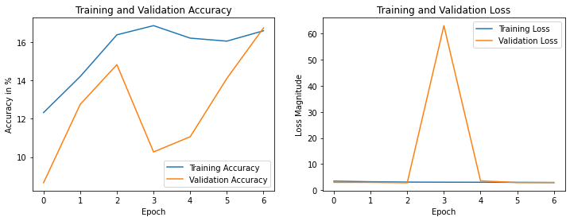
Modeling - Skin Image Set
My Model - 20% Validation Accuracy
Resnet 50 Model - 16% Validation Accuracy

Slide 8
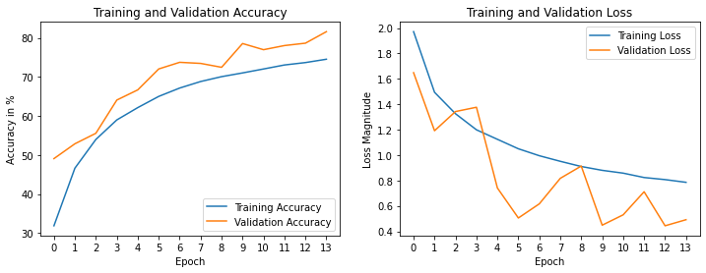
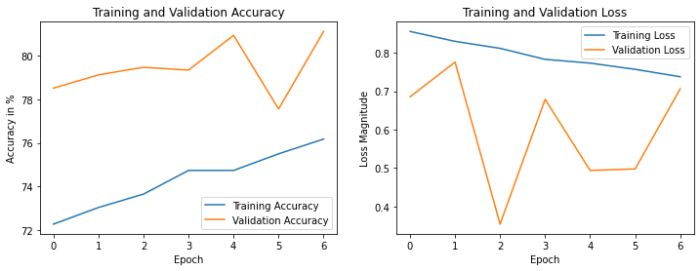
Modeling - CiFar10 Image Set
My Model > 80% Validation Accuracy
Resnet 50 Model > 80% Validation Accuracy

Slide 9
Further Research
Remove Watermarks or Obtain Images Without
Sub-Divide the Image Set Into More Categories and Separate Body Parts
Run Images Through a Body Part Classifier Before Condition Classifier
Obtain Larger Dataset Per Sub Category
Tune Dangerous Conditions to Have a Low False Negative Rate
Return Top 5 Most Likely Conditions Instead of Just the Most Likely Condition

Slide 10
Recommendations
Implement the model as an API and or a mobile device app.
Allow users to submit their own pictures to improve accuracy even more and have them classified by body part. Design app so when inputting images there are only fixed options to select.
Work with Physicians and Medical Students to check accuracy of submitted pictures and provide free/low cost human classification, similar to CAPTCHAs.
Encourage Nurses and Physician Assistants to use for initial diagnosis.

