Slide 1

Sprocket Central Pty Ltd
Data analytics approach
Ryan J Talbot, Data Scientist

Slide 2
Agenda
Data Exploration
Model Development
Interpretation

Slide 3
Introduction
Data analysis for new customers
Age Distribution (decade and Age)
Job Industry
Postal Code
Property Value

Slide 4
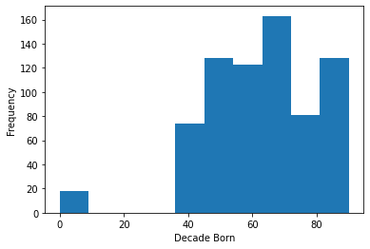
Data Exploration: Age
Top age groups are: 40s, 50s, followed by 60s
Females are slightly more likely than males to buy a bike
Target audience should be middle-aged individuals, slightly skewed towards women.

Slide 5
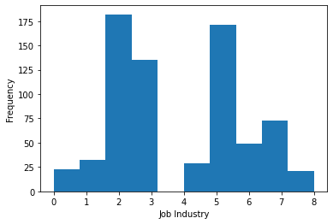
Data Exploration: Job Industry
Top three profit-generating job-industries are Financial Services, Manufacturing, and Health (in the chart its numbers 2, 3, and 5)

Slide 6
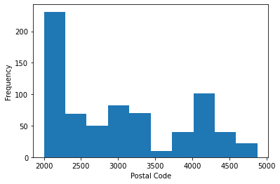
Data Exploration: Postal Code
The majority of bikes were sold to postal codes in the low 2000s.

Slide 7
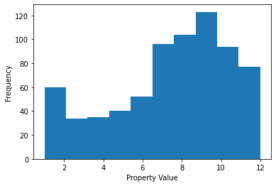
Data Exploration: Property Value
1. Individuals with a higher property value made the most purchases.

Slide 8
Model Development
Classify Customers
Middle-aged Individuals
Individuals working in financial services, manufacturing and health.
Individuals whos' postal code is in the low 2000s
Individuals who have a higher property value.

Slide 9
Interpretation
Place headline insight or information here. This should be the most important point for this slide.
INTEPRETATION AND REPORTING
Visualization and presentation of findings. This may involve interpreting the
significant variables and co-efficient from a business perspective. These slides
should tell a compelling storing around the business issue and support your
case with quantitative and qualitative observations. Please refer to module
below for further details
Place any supporting images, graphs, data or extra text here.

Slide 10
Questions

