Slide 1
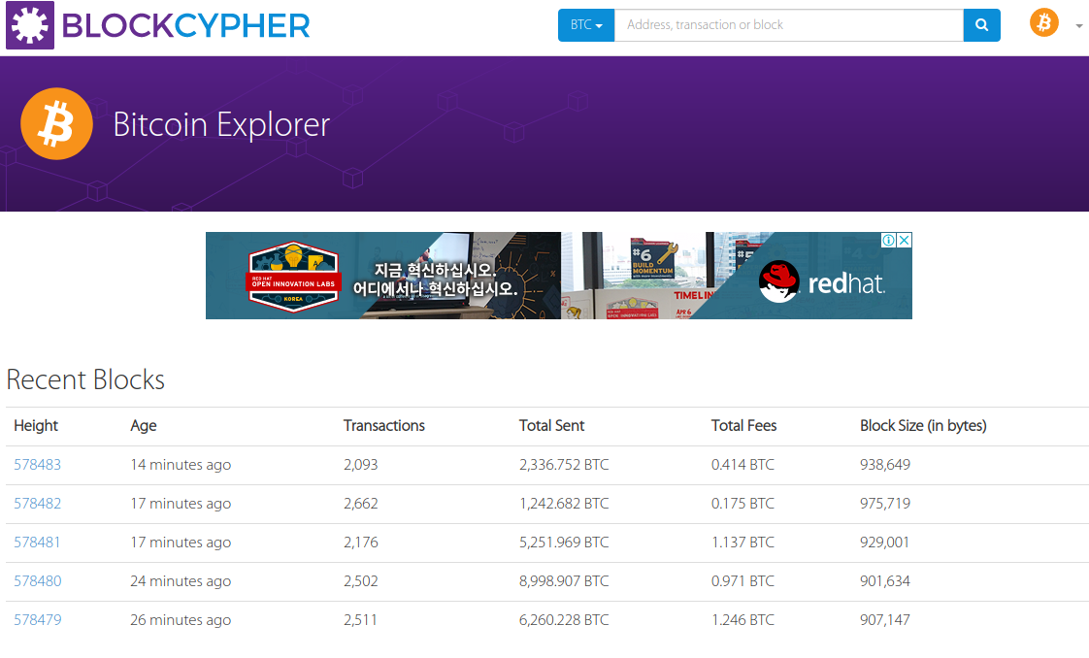
메인화면

Slide 2
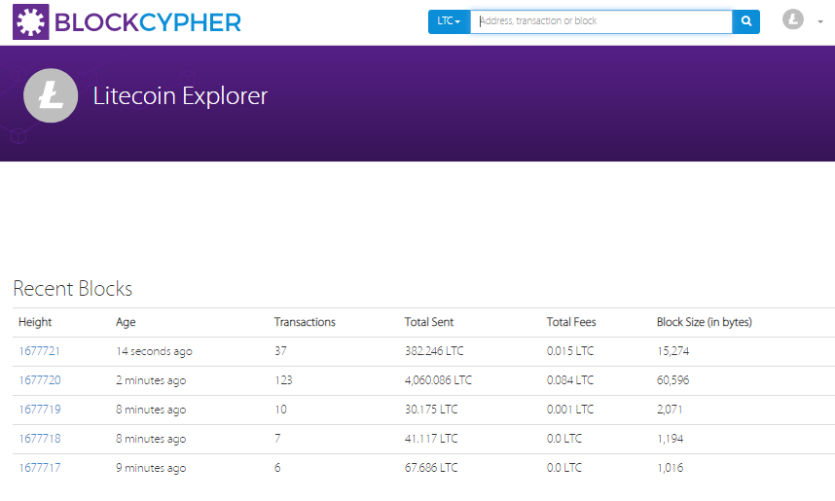
메인화면

Slide 3


검색

Slide 4
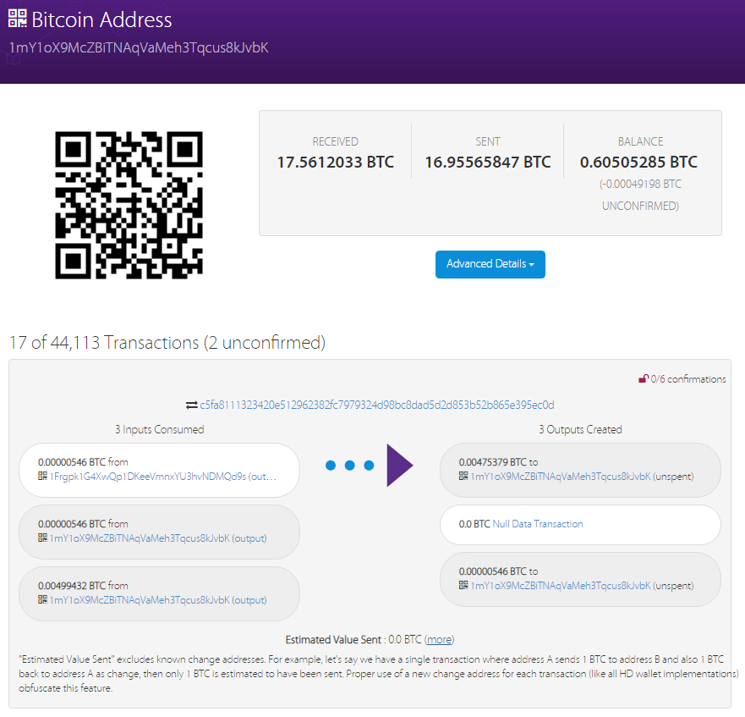
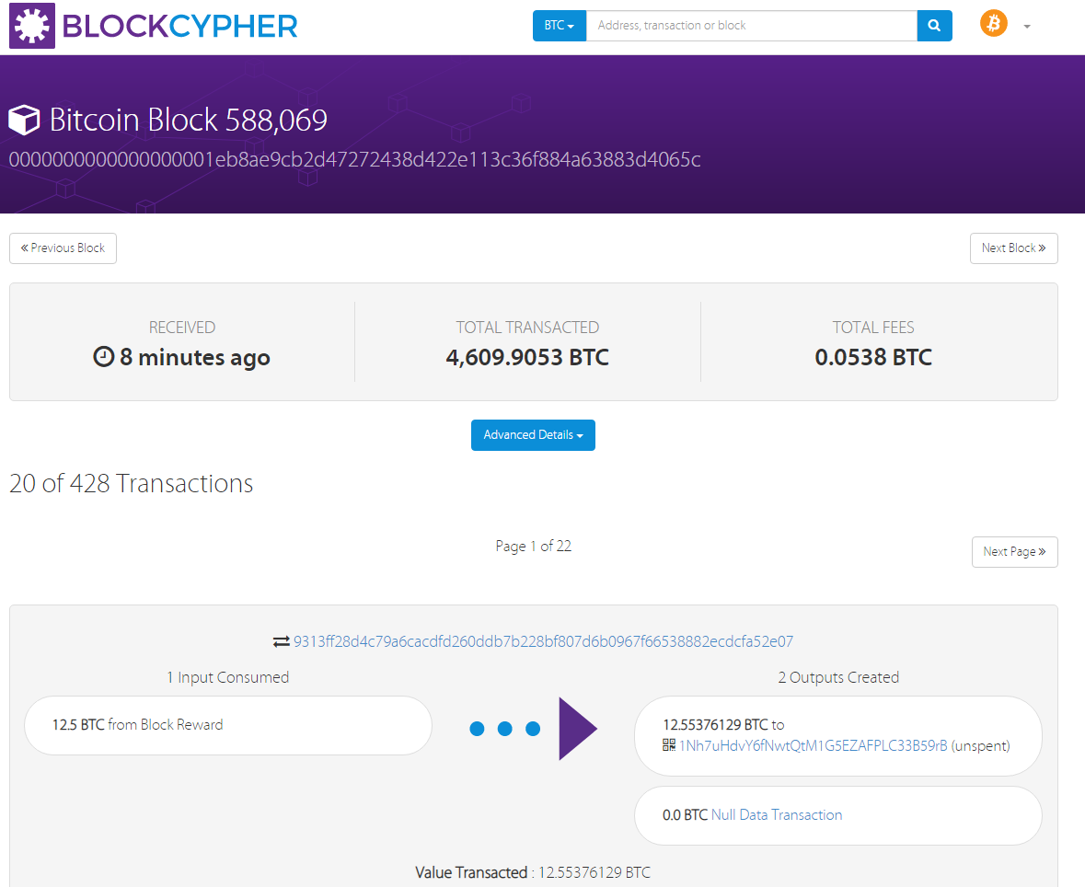
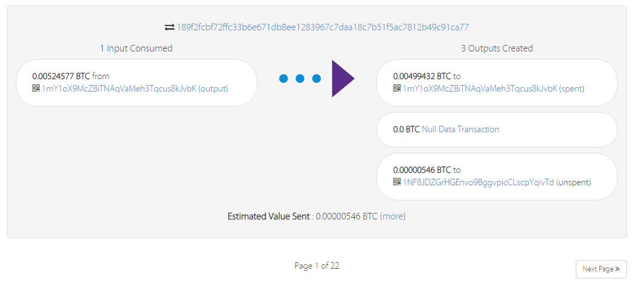
거래내역
...
https://live.blockcypher.com/btc/block/0000000000000000001eb8ae9cb2d47272438d422e113c36f884a63883d4065c/

