Slide 1
Bitcoin Wallet 분석
Ryan M. Jeong
July 18 2019
ryan.m.jeong@hotmail.com

Slide 2
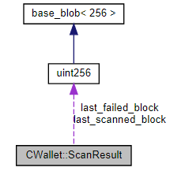
Structures(2/10)
CWallet::Balance
CWallet::ScanResult
Inheritance diagram

Slide 3
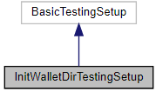
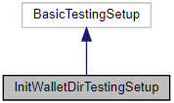
Structures(3/10)
InitWalletDirTestingSetup
Inheritance diagram
Collaboration diagram

Slide 4
Structures(6/10)
interfaces::WalletAddress
Information about one wallet address.
interfaces::WalletBalances
Collection of wallet balances.
interfaces::WalletTx

Slide 5
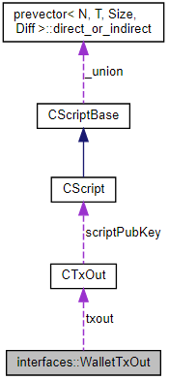
Structures(7/10)
interfaces::WalletTxOut
Wallet transaction output.
Collaboration diagram

Slide 6
Structures(10/10)
interfaces::WalletTxStatus
Updated transaction status.
WalletDatabaseFileId
WalletModel::SendCoinsReturn

Slide 7
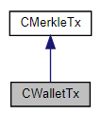
Classes(1/21)
CWalletTx(Cont’d)
A transaction with a bunch of additional info that only the owner cares about. It includes any unrecorded transactions needed to link it back to the block chain.
Inheritance diagram

Slide 8
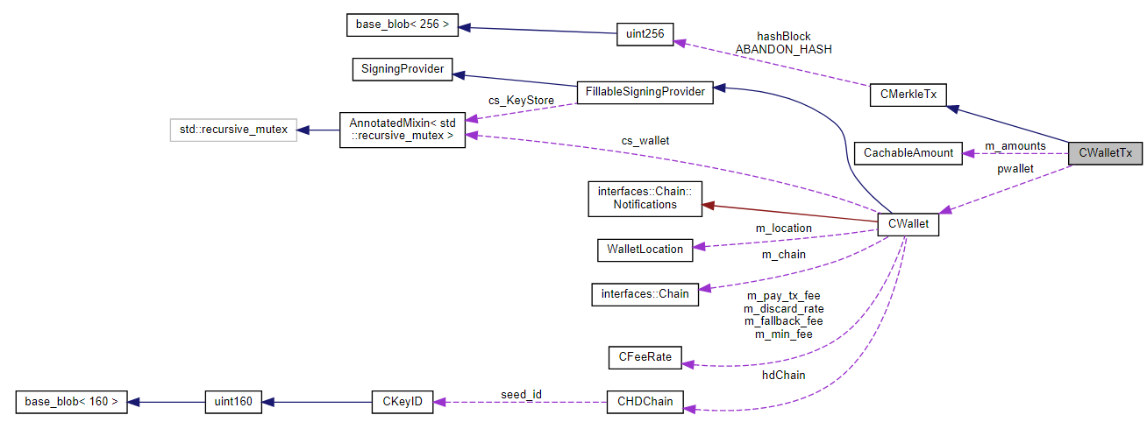
Classes(1/21)
CWalletTx
Collaboration diagram

Slide 9
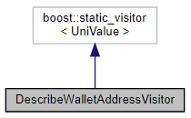
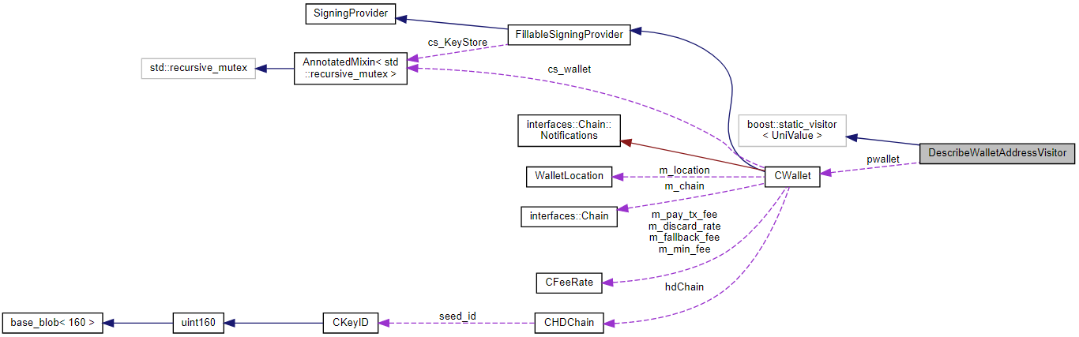
Classes(2/21)
DescribeWalletAddressVisitor
Inheritance diagram
Collaboration diagram

Slide 10
Classes(5/21)
CWalletKey
Private key that includes an expiration date in case it never gets used.
CWalletScanState
interfaces::PendingWalletTx
Tracking object returned by CreateTransaction and passed to CommitTransaction.

Slide 11
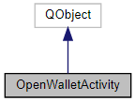
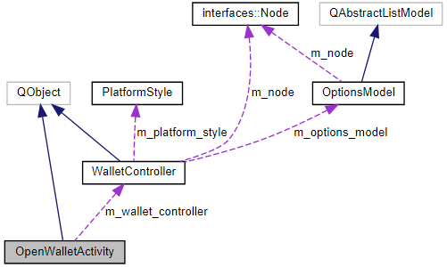
Classes(7/21)
interfaces::Wallet
Interface for accessing a wallet.
OpenWalletActivity
Inheritance diagram
Collaboration diagram

Slide 12
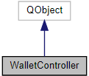
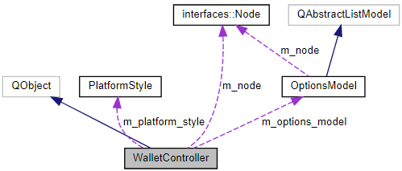
Classes(8/21)
WalletController
Controller between interfaces::Node, WalletModel instances and the GUI.
Inheritance diagram
Collaboration diagram

Slide 13
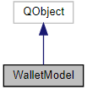
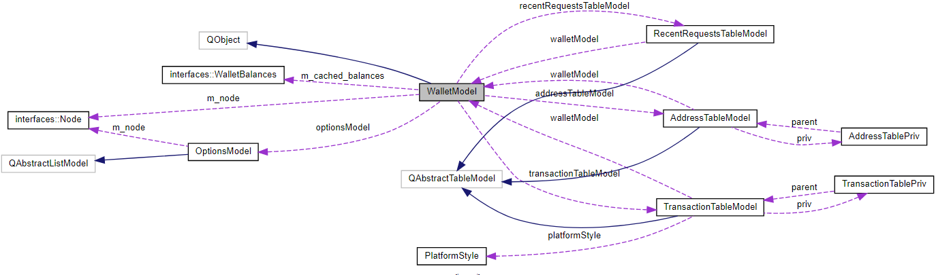
Classes(9/21)
WalletModel
Interface to Bitcoin wallet from Qt view code.
Inheritance diagram
Collaboration diagram

Slide 14
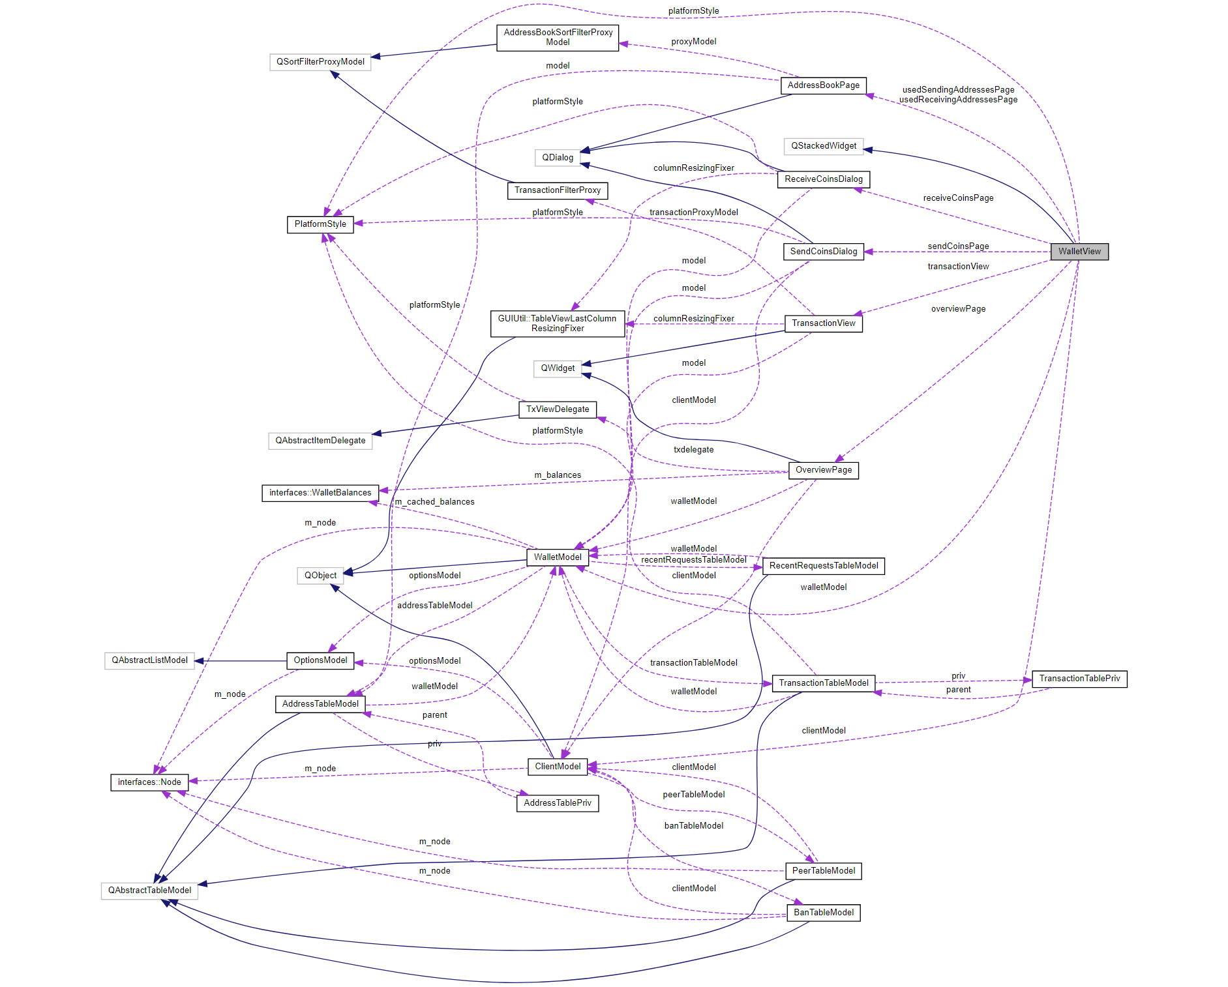
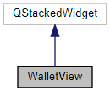
Classes(10/21)
WalletView
Inheritance diagram
Collaboration diagram

Slide 15
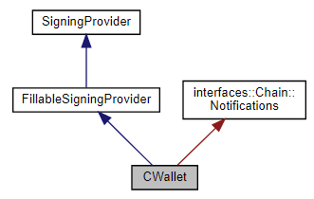
Classes(11/21)
CWallet(Cont’d)
A CWallet is an extension of a keystore, which also maintains a set of transactions and balances, and provides the ability to create new transactions.
Inheritance diagram

Slide 16
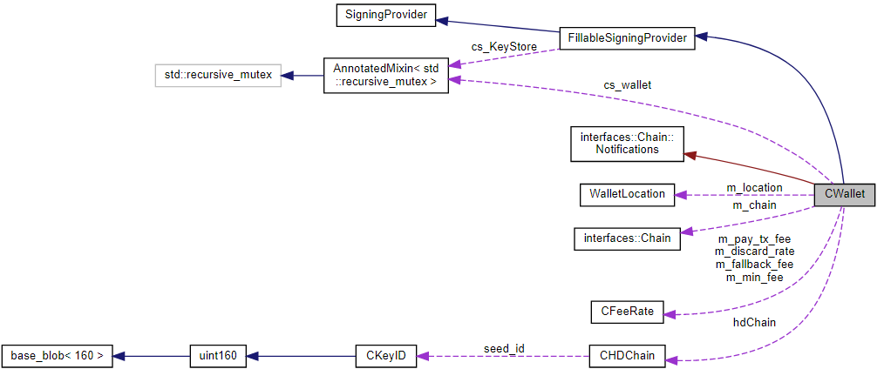
Classes(11/21)
CWallet
Collaboration diagram

Slide 17
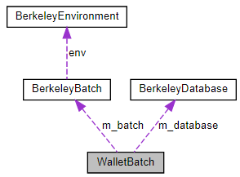
Classes(12/21)
WalletBatch
Access to the wallet database.
Collaboration diagram

Slide 18
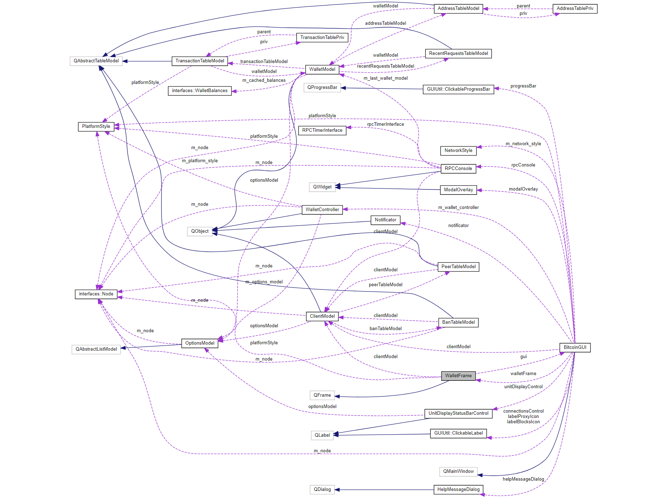
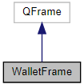
Classes(13/21)
WalletFrame
A container for embedding all wallet-related controls into BitcoinGUI
Inheritance diagram
Collaboration diagram

Slide 19
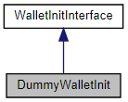
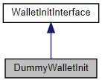
Classes(14/21)
DummyWalletInit
Inheritance diagram
Collaboration diagram

Slide 20
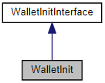
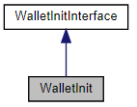
Classes(15/21)
WalletInit
Inheritance diagram
Collaboration diagram

Slide 21
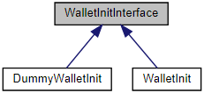
Classes(17/21)
WalletInitInterface
Inheritance diagram
WalletLocation
The WalletLocation class provides wallet information.

Slide 22
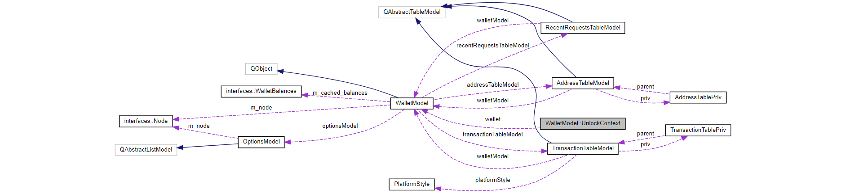
Classes(18/21)
WalletModel::UnlockContext
Collaboration diagram

Slide 23
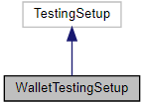
Classes(20/21)
WalletModelTransaction
Data model for a walletmodel transaction.
WalletTestingSetup(Cont’d)
Testing setup and teardown for wallet.
Inheritance diagram

Slide 24
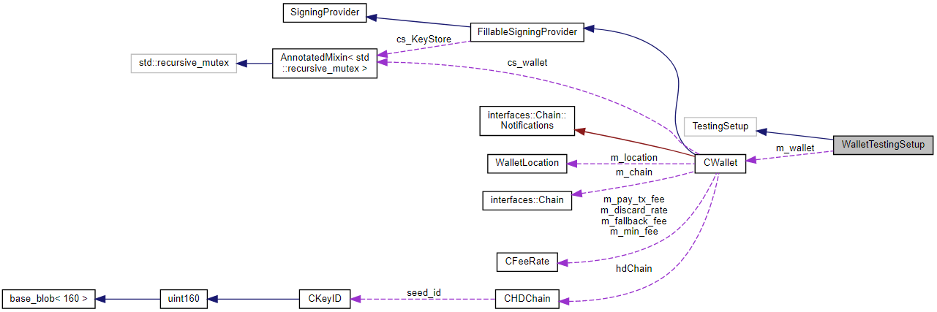
Classes(20/21)
WalletTestingSetup
Collaboration diagram

Slide 25
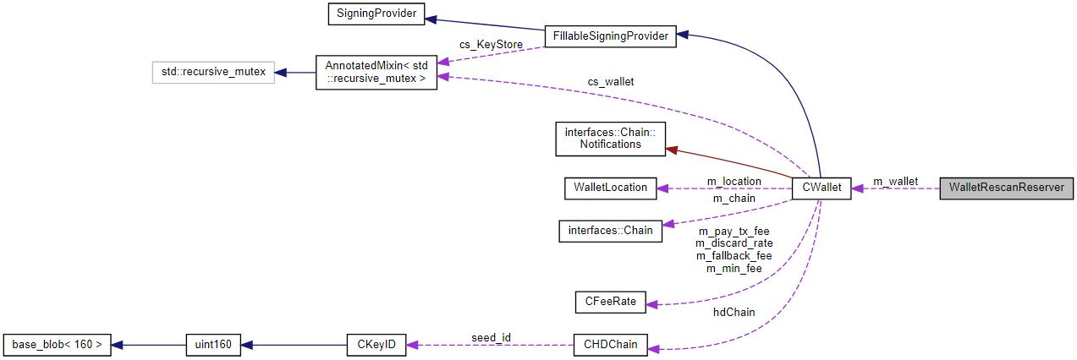
Classes(21/21)
WalletRescanReserver
RAII object to check and reserve a wallet rescan.
Collaboration diagram

