Slide 1
Node.js and Express.js Notes

Slide 2
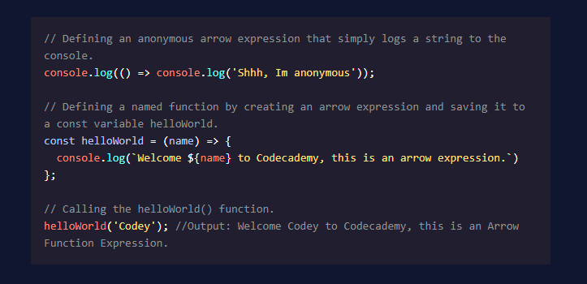
Arrow Expressions (Codecademy.com)

Slide 3
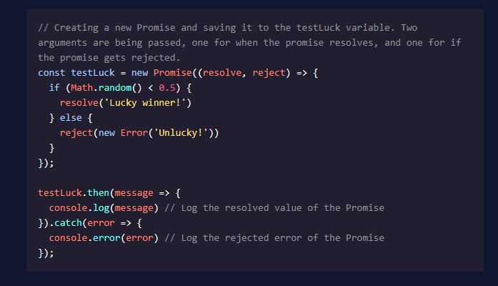
Synchronous Code vs. Asynchronous Code
Synchronous (blocking I/O) code must wait for other non-JS processes to finish before continuing execution, as it requires external data, etc.
Asynchronous (non-blocking I/O) code can continue execution independent of other processes.
Promise: JS object showing possible outcomes of asynchronous operation:
Pending – Undefined result, waiting on a result.
Fulfilled – Operation completed successfully; value returned.
Rejected – Operation was unsuccessful, returns error object.

Slide 4
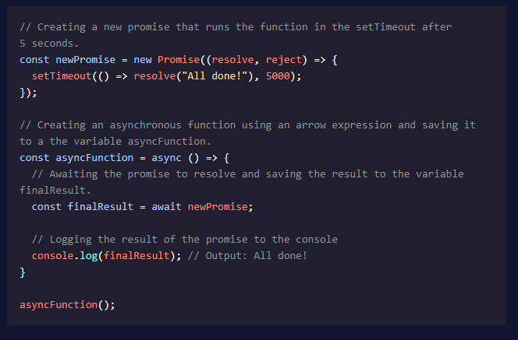
Async / Await
async keyword used in combination with a function declaration creates an async function that returns a Promise.
Use the await keyword to block event loop until Promise resolves or rejects.
await allows assignment of a resolved Promise value to a variable.

Slide 5
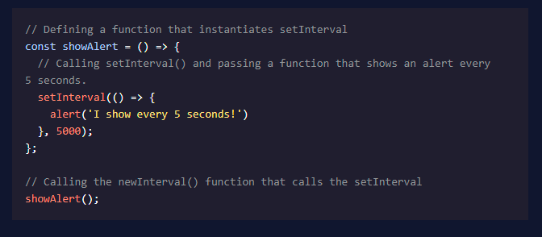
setInterval()
setInterval() executes code blocks at specific intervals, measured in milliseconds.
Two arguments required: name of function, number of milliseconds.
Option: Pass additional arguments to the called function.
setInterval() will continue to run until:
clearInterval() is called.
Node process exits.

Slide 6
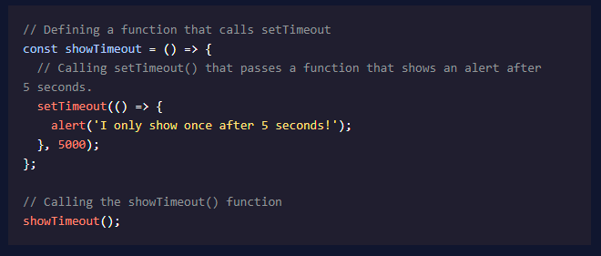
setTimeout()
Executes a block of code once after a specific time interval in milliseconds.
Accepts same arguments as setInterval()
clearTimeout() will prevent specified function from executing.

Slide 7
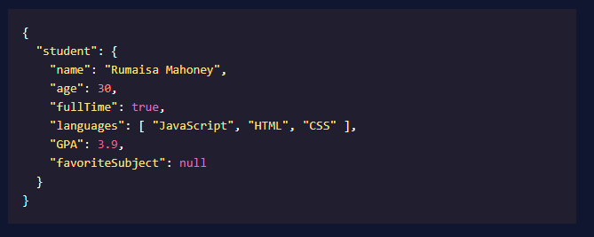
Who the f&*k is JSON?
JavaScript Object Notation
Language-independent format for storing and exchanging data.
JSON Syntax
{..} hold objects.
[..] hold arrays.
Data is stored in name-value pairs separated by a :
Name-value pairs and array elements are separated by ,
“Suddenly Mr. Han, I want to use a trailing comma.” “No, it is forbidden!”
JSON property names must be in “ ”
JSON data types permitted are:
string inside “ ”
int or float
object (name-value pair)
array (comma-delimited)
boolean (true or false)
null
Data types not permitted in JSON can be stored as strings, all modern programming languages have built-in tools to convert these strings into more usable formats.

Slide 8
Node REPL
Read – Eval – Print Loop
Testing environment, allows users to experiment and test code.
Essentially a command line for running Node.js

Slide 9
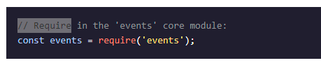
Modules
Modules are files containing blocks of code specific to certain events, functions, or roles.
Use the require() function to include a module.
Modules can be stored to a variable.

