Slide 1
React Native Notes

Slide 2
Components
Small, reusable pieces of the app. Usually have a single responsibility.
Single component that ‘starts’ the app is the entry point.
Core Components – Fundamental components that ship with React Native.
Native Components – Associated with core components, allows for React to render on each platform.
Appearance may vary depending on OS patform.

Slide 3
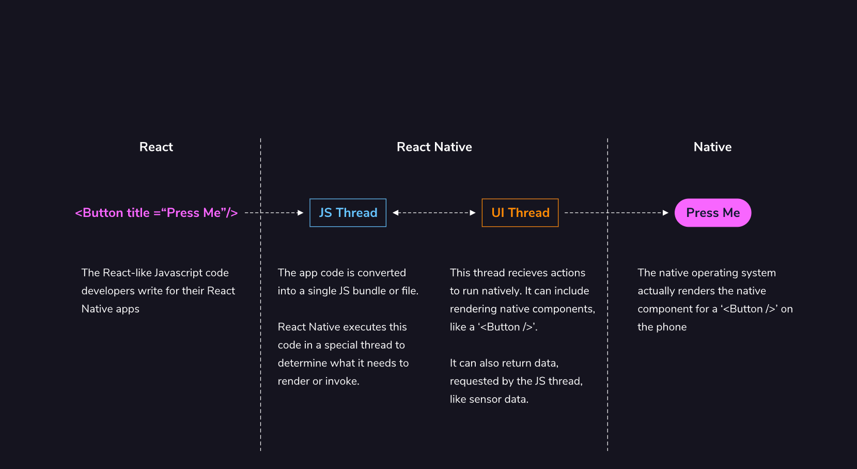
Native Rendering Example from Codecademy.com

Slide 4
Running React Apps
Expo and React Native runs using two threads to provide smooth performance:
One for the actual React JS
One for the UI

