Slide 1
Node.js and Express.js Notes

Slide 2
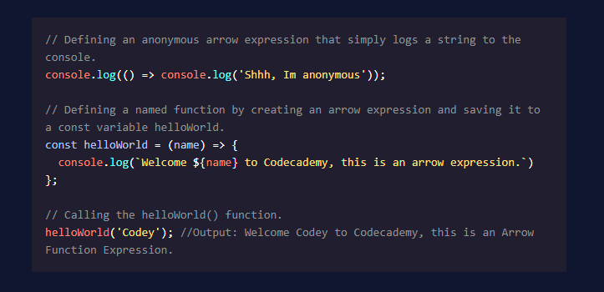
Arrow Expressions (Codecademy.com)

Slide 3
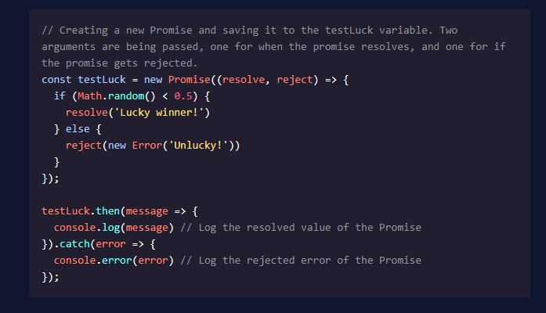
Synchronous Code vs. Asynchronous Code
Synchronous (blocking I/O) code must wait for other non-JS processes to finish before continuing execution, as it requires external data, etc.
Asynchronous (non-blocking I/O) code can continue execution independent of other processes.
Promise: JS object showing possible outcomes of asynchronous operation:
Pending – Undefined result, waiting on a result.
Fulfilled – Operation completed successfully; value returned.
Rejected – Operation was unsuccessful, returns error object.

Slide 4
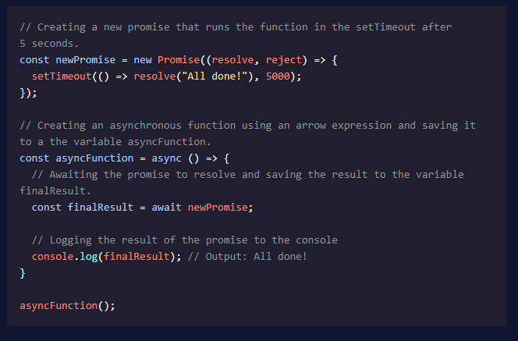
Async / Await
async keyword used in combination with a function declaration creates an async function that returns a Promise.
Use the await keyword to block event loop until Promise resolves or rejects.
await allows assignment of a resolved Promise value to a variable.

Slide 5
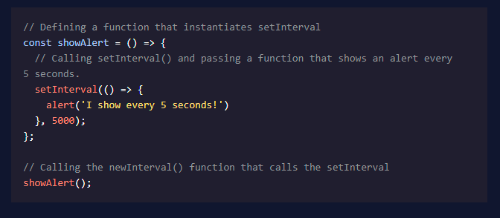
setInterval()
setInterval() executes code blocks at specific intervals, measured in milliseconds.
Two arguments required: name of function, number of milliseconds.
Option: Pass additional arguments to the called function.
setInterval() will continue to run until:
clearInterval() is called.
Node process exits.

Slide 6
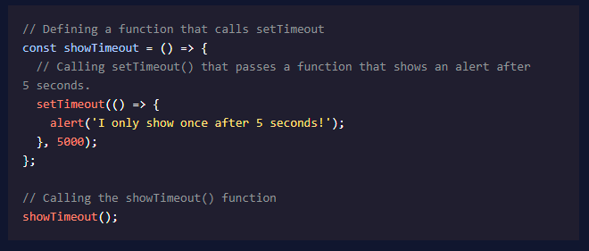
setTimeout()
Executes a block of code once after a specific time interval in milliseconds.
Accepts same arguments as setInterval()
clearTimeout() will prevent specified function from executing.

Slide 7
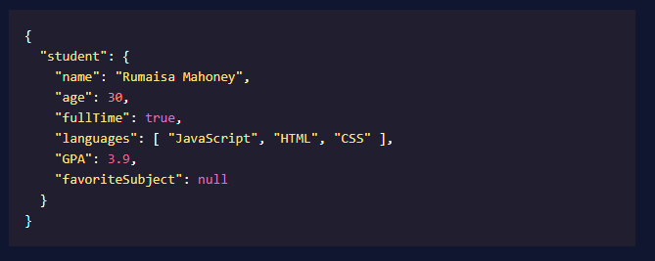
Who the f&*k is JSON?
JavaScript Object Notation
Language-independent format for storing and exchanging data.
JSON Syntax
{..} hold objects.
[..] hold arrays.
Data is stored in name-value pairs separated by a :
Name-value pairs and array elements are separated by ,
“Suddenly Mr. Han, I want to use a trailing comma.” “No, it is forbidden!”
JSON property names must be in “ ”
JSON data types permitted are:
string inside “ ”
int or float
object (name-value pair)
array (comma-delimited)
boolean (true or false)
null
Data types not permitted in JSON can be stored as strings, all modern programming languages have built-in tools to convert these strings into more usable formats.

Slide 8
Node REPL
Read – Eval – Print Loop
Testing environment, allows users to experiment and test code.
Essentially a command line for running Node.js

Slide 9

Modules
Modules are files containing blocks of code specific to certain events, functions, or roles.
Use the require() function to include a module.
Modules can be stored to a variable.

Slide 10
Process Module
Global process object with methods and info re: current process
process.env is a property which stores and controls info. re: environment process is currently running.
Example: can use if/else statements to change behavior between PRODUCTION and DEVELOPMENT environment.
Usually added as a process.env key NODE_ENV of ‘production’ or ‘development’.
process.argv property stores command line values in an array when process is initiated.
First element will be the absolute path to node.
Second element is file path that is running in Node.
Remaining elements will be command line arguments passed to Note.

Slide 11
OS Module [Core Module]
OS Module is not global, must be included.
const os = require(‘os’);
os.type() – Return machine OS
os.arch() – Return CPU architecture
os.NetworkInterfaces() – Return info such as IP and MAC address.
os.homedir() – Return current user’s home directory.
os.hostname() – Return hostname of OS.
os.uptime() – Return system uptime, in seconds.

Slide 12
Util Module [Core Module]
Can be used to create functions useful for debugging and maintenance purposes.
Not a global module, must be included in file
types object provides runtime type checking.
.promisify() can turn callback functions into Promises.
[I need to review this usage.]

Slide 13
Review Notes
Blocking code runs synchronously and non-blocking code, such as timer functions, runs asynchronously.
Core modules are provided to developers to perform common tasks efficiently. Core modules are used by passing a string with the module’s name into the require() statement.
We can make our own instances of the EventEmitter class, and we can subscribe to listen for named events with the .on() method and emit events with the .emit() method.
Node allows for both output, data/feedback to a user-provided by a computer, and input data/feedback to the computer provided by the user. To handle errors during asynchronous operations, provided callback functions are expected to have an error as their first parameter.
The buffer module provides global Buffer objects used to represent a fixed amount of memory that can’t be resized.
The timer module provides functions that allow developers to execute callbacks at a specified point of time in the future.
The Node fs core module is an API for interacting with the file system.
Streams allow us to read or write data piece by piece instead of all at once.

Slide 14
Get some REST [API]
Representational State Transfer
REST Compliant (RESTful) Systems are STATELESS
Client and Server concerns are separate and do not impact one another.
Resources are the objects of the web: objects, documents, etc.
Requests are sent to the server, generally consist of:
HTTP verb, defines type of operation.
GET – retrieve a specific resource (by id) or collection of resources.
POST – create a new resource.
PUT – update a specific resource (by id)
DELETE – Remove a specific resource.
Header, allows client to pass information to server.
Accept field defines what data client will accept from server, in MIME Type format.
MIME type format is type/subtype such as text/html or audio/mpeg
Path to resource.
Usually, first part of path is plural form of the resource, i.e. customers/, images/, videos/
Should contain information to be as specific, as necessary.
Optional message body containing data.
Responses are sent to the client.
Must include a content-type in response header.
Response Code alerts client to status of request.
GET – return 200 (OK)
POST – return 201 (CREATED)
PUT – return 200 (OK)
DELETE – return 204 (NO CONTENT)

Slide 15
What’s this CRUD on my shoe?
Create
Read
Update
Delete

