Slide 1
Intro to Web Design
Ryan Kadri

Slide 2
What is this course?
For Beginners
Not an overview
Bi Weekly
Interactive
Flexible
Project-Driven?

Slide 3
What is a Web Site?
News / Blogs / Recipes
Search
Apps (Email, Drive, iCloud)
Social Network
Video / Media Player
Games
Visualization

Slide 4
What is a Browser?
Tabs
Bookmarks
Password Manager
Search
History
Settings
Suggestions
Much more...

Slide 5
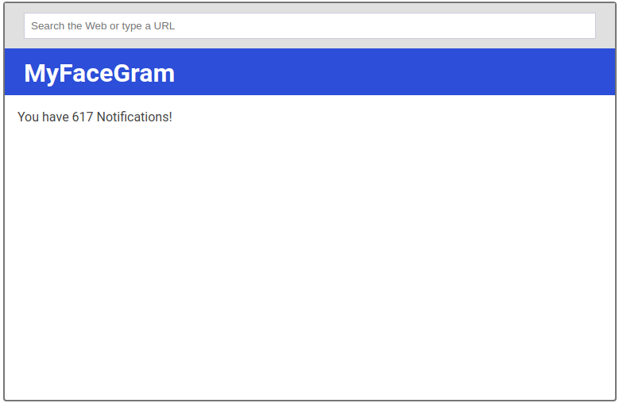
Notes:
Glossary of terms
Client
Server
Pixel

Slide 6
What is a Browser?
Rendering Engine
Network-aware
Based on shared standards
Secure
Remote Client

Slide 7
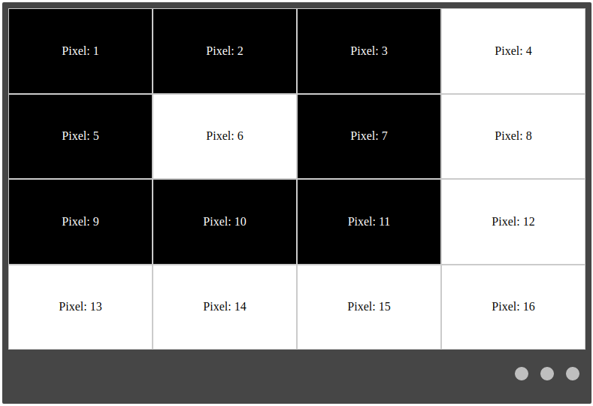

Slide 8
HTML
“Structure” of a web site / application
Hierarchical
Uses publishing terminology
Based on XML
Not a programming language

Slide 9
XML
<Book isbn=”9788580410631”>
<Title>The Name of the Wind</Title>
<Author>
<FirstName>Patrick</FirstName>
<LastName>Rothfuss</LastName>
</Author>
</Book>

Slide 10
HTML
<article>
<section>
<header>...</header>
<p>...</p>
<p>...</p>
</section>
<section>
<header>...</header>
...
</section>
</article>
Article
Section
- Header
- Paragraph
- Paragraph
Section
- Header
- ...

Slide 11
Let’s Code!

Slide 12
CSS
Adds styles to a web app / site
Identifies elements using selectors
More specific rules override less specific rules
Not a programming language

Slide 13
CSS
article p.special {
color: blue;
font-size: 24px;
}
<article>
<p>This is not special</p>
<p class=”special”>This is special!</p>
</article>
<p class=”special”>This is not special either :(</p>

Slide 14
JavaScript
Is a programming language!
Lets the page react
Can do things “instantly”
Runs in the browser

Slide 15
DOM
Document Object Model
Like a browser’s memory
JavaScript may modify this

Slide 16
Moving Forward
Developer Tools
OpenCourseWare

Slide 17
Questions?

Slide 18
Resources
https://developer.mozilla.org/en-US/docs/Web/HTML/Element
https://developer.mozilla.org/en-US/docs/Learn/Getting_started_with_the_web/CSS_basics
https://developer.mozilla.org/en-US/docs/Web/CSS/Reference

