Slide 1
Intro to Web Design
Ryan Kadri

Slide 2
What is a Browser?
Password Manager
Bookmarks
Search
History
Settings
Suggestions
Homepage

Slide 3
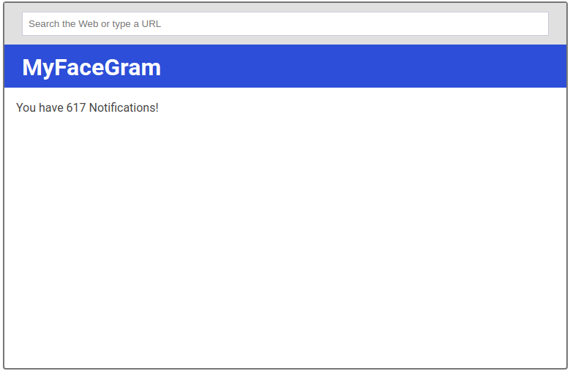

Slide 4
What is a Browser?
Rendering Engine
Based on agreed standards
Secure
Remote Client

Slide 5
HTML
“Structure” of a web site / application
Based on XML
Made up of “tags” and “attributes”
Uses publishing terminology
Not a programming language

Slide 6
DOM
Document Object Model

Slide 7
CSS
Adds styles to a web app / site
Identifies elements using selectors
More specific rules override less specific rules
Not a programming language

Slide 8
JavaScript
Defines behaviors on the page
Interacts with the DOM

