Slide 1
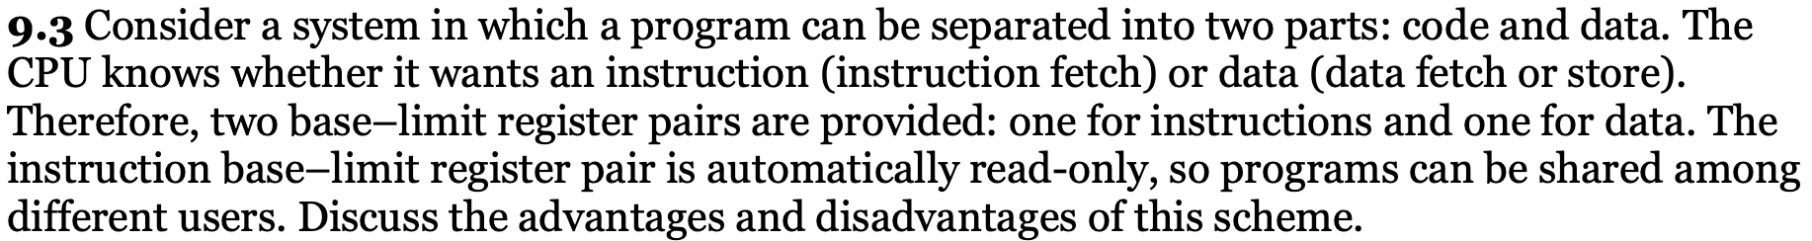
운영체제 4차 문제 풀이 – Memory 문제 풀이
2013130890
영어영문학과
김승태
Answer:
A logical address does not refer to an actual existing address; rather, it refers to an abstract address in an abstract address space. Contrast this with a physical address that refers to an actual physical address in memory. A logical address is generated by the CPU and is translated into a physical address by the memory management unit(MMU). Therefore, physical addresses are generated by the MMU.
Answer:
Recall that paging is implemented by breaking up an address into a page and offset number. It is most efficient to break the address into X page bits and Y offset bits, rather than perform arithmetic on the address to calculate the page number and offset. Because each bit position represents a power of 2, splitting an address between bits results in a page size that is a power of 2.
Answer:
The major advantage of this scheme is that it is an effective mechanism for code and data sharing. For example, only one copy of an editor or a compiler needs to be kept in memory, and this code can be shared by all processes needing access to the editor or compiler code. Another advantage is protection of code against erroneous modification. The only disadvantage is that the code and data must be separated, which is usually adhered to in a compiler-generated code.

Slide 2
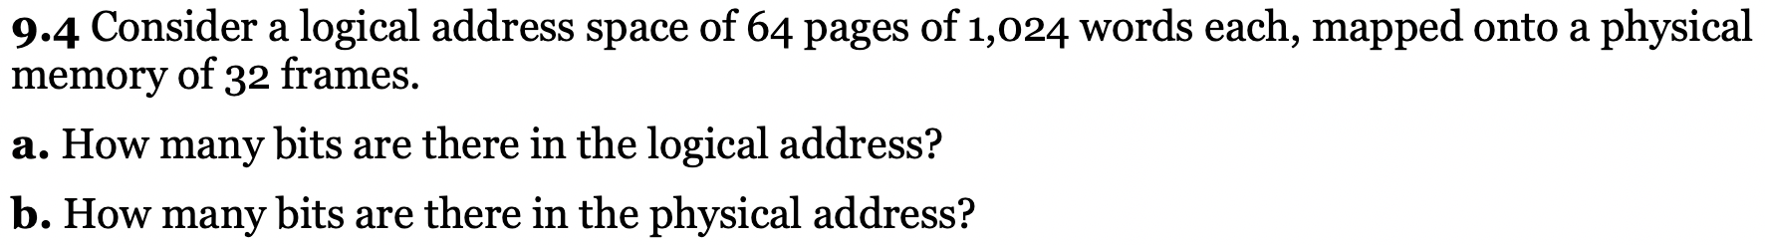
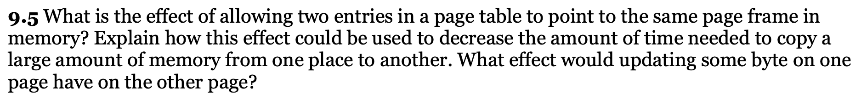
Answer:
Logical address: 16 bits
Physical address: 15 bits
Answer:
By allowing two entries in a page table to point to the same page frame in memory, users can share code and data. If the code is reentrant, much memory space can be saved through the shared use of large programs such as text editors, compilers, and database systems. “Copying” large amounts of memory could be effected by having different page tables point to the same memory location.
However, sharing of nonreentrant code or data means that any user having access to the code can modify it and these modifications would be reflected in the other user’s “copy.”
Answer:
a. First fit:
b. 115 KB is put in 300-KB partition, leaving 185 KB, 600 KB, 350 KB, 200 KB, 750 KB, 125 KB
c. 500 KB is put in 600-KB partition, leaving 185 KB, 100 KB, 350 KB, 200 KB, 750 KB, 125 KB
d. 358 KB is put in 750-KB partition, leaving 185 KB, 100 KB, 350 KB, 200 KB, 392 KB, 125 KB
e. 200 KB is put in 350-KB partition, leaving 185 KB, 100 KB, 150 KB, 200 KB, 392 KB, 125 KB
f. 375 KB is put in 392-KB partition, leaving 185 KB, 100 KB, 150 KB, 200 KB, 17 KB, 125 KB
g. Best fit
h. 115 KB is put in 125-KB partition, leaving 300 KB, 600 KB, 350 KB, 200 KB, 750 KB, 10 KB
i. 500 KB is put in 600-KB partition, leaving 300 KB, 100 KB, 350 KB, 200 KB, 750 KB, 10 KB
j. 358 KB is put in 750-KB partition, leaving 300 KB, 100 KB, 350 KB, 200 KB, 392 KB, 10 KB
k. 200 KB is put in 200-KB partition, leaving 300 KB, 100 KB, 350 KB, 0 KB, 392 KB, 10 KB
l. 375 KB is put in 392-KB partition, leaving 300 KB, 100 KB, 350 KB, 0 KB, 17 KB, 10 KB
m. Worst t:
n. 115 KB is put in 750-KB partition, leaving 300 KB, 600 KB, 350 KB, 200 KB, 635 KB, 125 KB
o. 500 KB is put in 635-KB partition, leaving 300 KB, 600 KB, 350 KB, 200 KB, 135 KB, 125 KB
p. 358 KB is put in 600-KB partition, leaving 300 KB, 242 KB, 350 KB, 200 KB, 135 KB, 125 KB
q. 200 KB is put in 350-KB partition, leaving 300 KB, 242 KB, 150 KB, 200 KB, 135 KB, 125 KB
r. 375 KB must wait

Slide 3
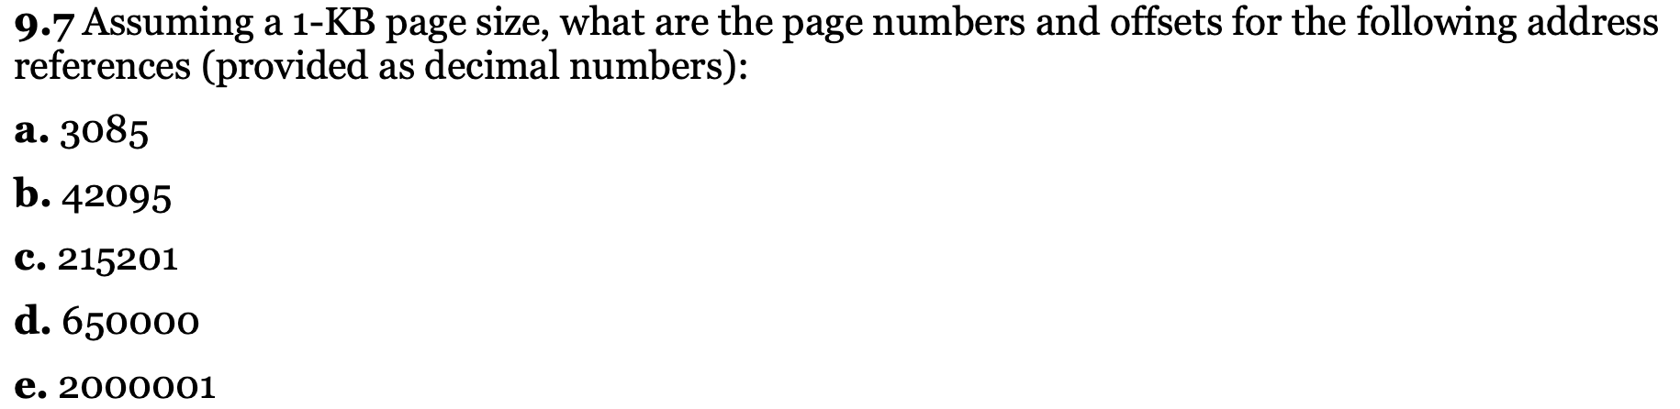
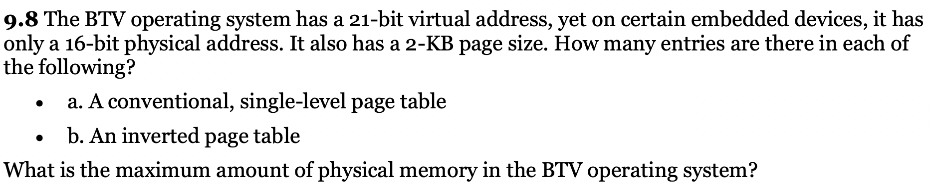
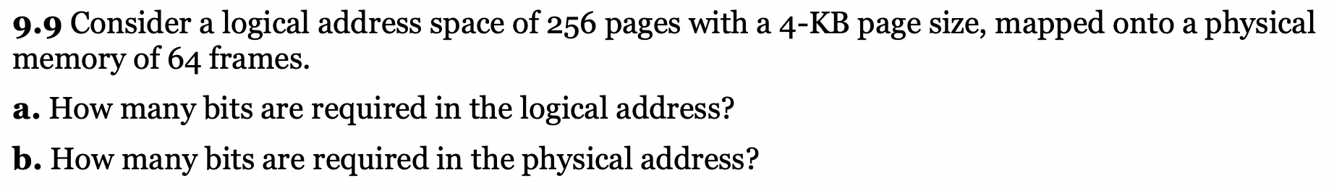
page = 3; offset = 13
page = 41; offset = 111
page = 210; offset = 161
page = 634; offset = 784
page = 1953; offset = 12
Answer:
Conventional, single-level page table will have 210 = 1024 entries.
Inverted page table will have 25 = 32 entries. The maximum amount of physical memory is 216 = 65536 (or 64 KB.)
Answer:
a. 12 + 8 = 20 bits.
b. 12 + 6 = 18 bits.

Slide 4
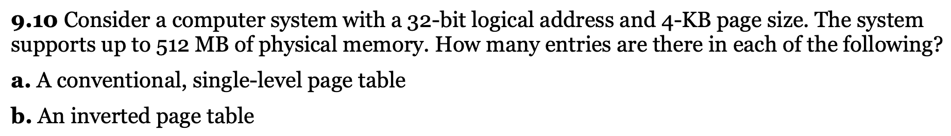
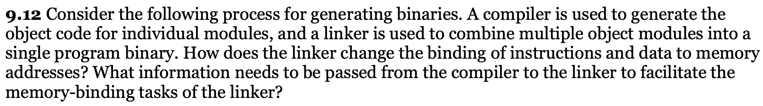
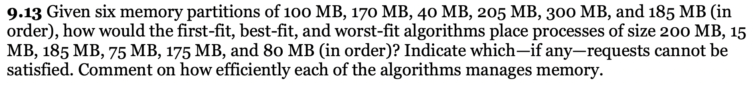
Internal Fragmentation occurs when a fixed size memory allocation technique is used. External fragmentation occurs when a dynamic memory allocation technique is used.
• Internal fragmentation occurs when a fixed size partition is assigned to a program/file with less size than the partition making the rest of the space in that partition unusable. External fragmentation is due to the lack of enough adjacent space after loading and unloading of programs or files for some time because then all free space is distributed here and there.
• External fragmentation can be mined by compaction where the assigned blocks are moved to one side, so that contiguous space is gained. However, this operation takes time and also certain critical assigned areas for example system services cannot be moved safely. We can observe this compaction step done on hard disks when running the disk defragmenter in Windows.
• External fragmentation can be prevented by mechanisms such as segmentation and paging. Here a logical contiguous virtual memory space is given while in reality the files/programs are splitted into parts and placed here and there.
• Internal fragmentation can be maimed by having partitions of several sizes and assigning a program based on the best fit. However, still internal fragmentation is not fully eliminated.
Answer:
a. 220 entries.
b. 512 K K/4K = 128K entries.

Slide 5
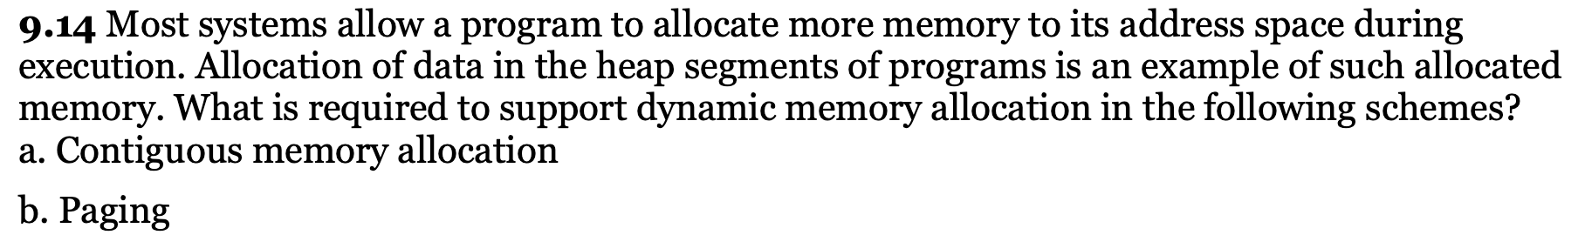
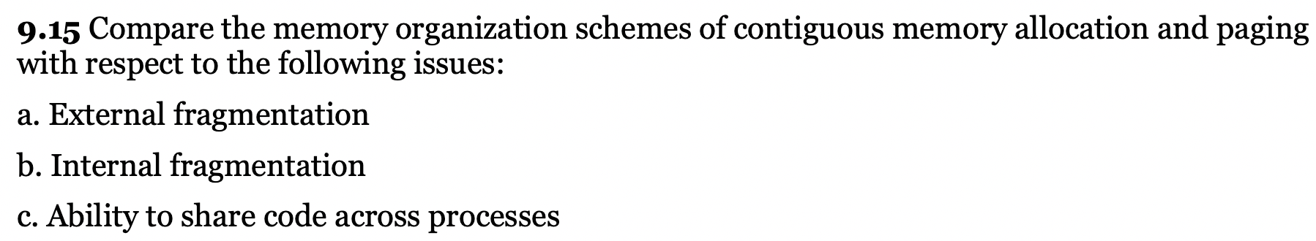
an ddress on a paging system is a logical page number and an offset. The physical page is found by searching a table based on the logical page number to produce a physical page number.
Because the operating system controls the contents of this table, it can limit a process to accessing only those physical pages allocated to the process.
There is no way for a process to refer to a page it does not own because the page will not be in the page table.
To allow such access, an operating system simply needs to allow entries for non-process memory to be added to the process' page table. This is useful when two or more processes need to exchange data they just read and write to the same physi-cal addresses (which may be at varying logical addresses).
This makes for very efficient interprocess communication.

Slide 6
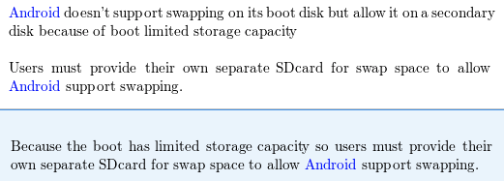
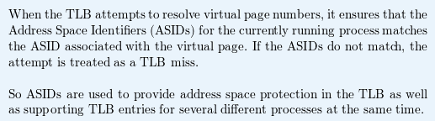
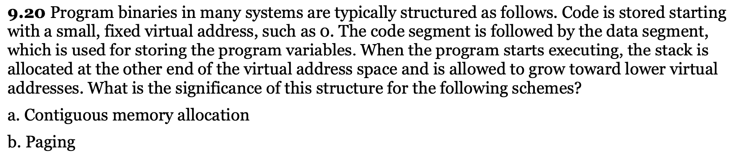
mobile operating systems such as iOS and Android does not support swappining the main reason is that mobiles uses flash memory and flash memeory has reduced reliability with higher inputs of actions and data.also there is space issues with flash memory, swapping is avoided to avoid having crashes and failures of the drive. They use this because they need to be quick, small and portable, but even they have their limit.
Also there is typically poor throughput between main memory and flash memory.
these can be resons why dont mobile operating systems such as iOS and Android support swapping.

Slide 7
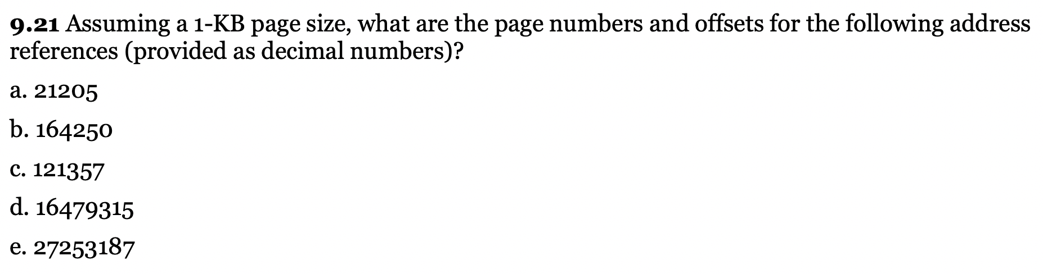
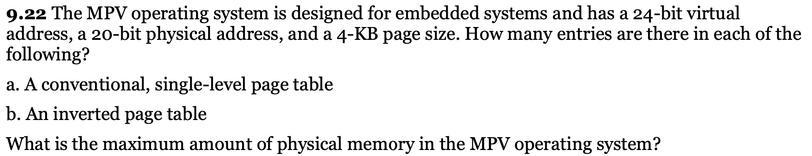
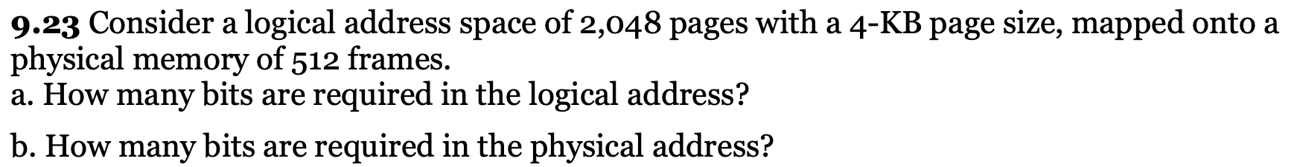
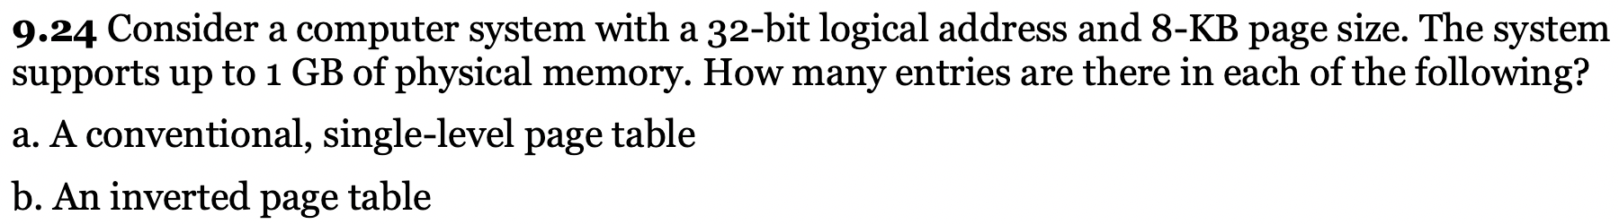

Slide 8
