Slide 1
Assembly Language for x86 Processors 6th Edition
Kip Irvine
Chapter 1: Introduction to ASM
Slides prepared by the author
Revision date: 2/15/2010
(c) Pearson Education, 2010. All rights reserved. You may modify and copy this slide show for your personal use, or for use in the classroom, as long as this copyright statement, the author's name, and the title are not changed.

Slide 2
The Bottom-Up Approach
We can study computer architectures by starting with the basic building blocks
Transistors and logic gates
To build more complex circuits
Flip-flops, registers, multiplexors, decoders, adders, ...
From which we can build computer components
Memory, processor, I/O controllers…
Which are used to build a computer system
This was the approach taken in your first course 03-60-265: Computer Architecture I: Digital Design

Slide 3
The Top-Down Approach
In this course we will study computer architectures from the programmer’s view
We study the actions that the processor needs to do to execute tasks written in high level languages (HLL) like C/C++, Pascal, …
But to accomplish this we need to:
Learn the set of basic actions that the processor can perform: its instruction set
Learn how a HLL compiler decomposes HLL command into processor instructions

Slide 4
The Top-Down Approach (Ctn.)
We can learn the basic instruction set of a processor either
At the machine language level
But reading individual bits is tedious for humans
At the assembly language level
This is the symbolic equivalent of machine language (understandable by humans)
Hence we will learn how to program a processor in assembly language to perform tasks that are normally written in a HLL
We will learn what is going on beneath the HLL interface

Slide 5
Welcome to Assembly Language
How does assembly language (AL) relate to machine language?
How do C++ and Java relate to AL?
Is AL portable?
Why learn AL?

Slide 6
Levels and Languages
High-level
language
program
Assembly
language
program
Machine
language
program
Compiler
Assembler
The compiler translates each HLL statement into one or more assembly language instructions
The assembler translate each assembly language instruction into one machine language instruction
Each processor instruction can be written either in machine language form or assembly language form
Example, for the Intel Pentium:
MOV AL, 5 ;Assembly language
10110000 00000101 ;Machine language
Hence we will use assembly language

Slide 7
Translating Languages
English: Display the sum of A times B plus C.
C++: cout << (A * B + C);
Assembly Language:
Mov eax,A
Mul B
Add eax,C
Call WriteInt
Intel Machine Language:
A1 00000000
F7 25 00000004
03 05 00000008
E8 00500000

Slide 8
Assembly Language Today
A program written directly in assembly language has the potential to have a smaller executable and to run faster than a HLL program
But it takes too long to write a large program in assembly language
Only time-critical procedures are written in assembly language (optimization for speed)
Assembly language are often used in embedded system programs stored in PROM chips
Computer cartridge games, micro controllers, …
Remember: you will learn assembly language to learn how high-level language code gets translated into machine language
i.e. to learn the details hidden in HLL code

Slide 9
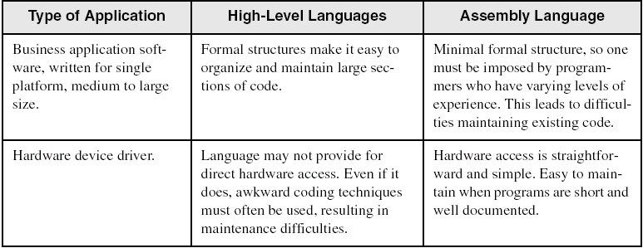
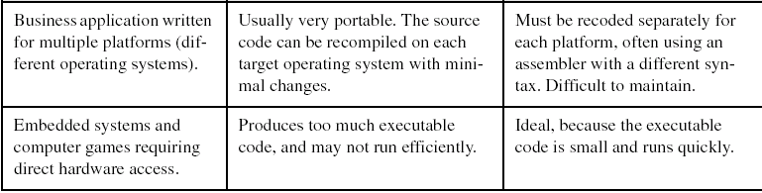
Comparing ASM to High-Level Languages

Slide 10
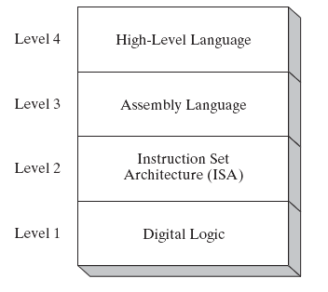
Specific Machine Levels
(descriptions of individual levels follow . . . )

Slide 11
High-Level Language
Level 4
Application-oriented languages
C++, Java, Pascal, Visual Basic . . .
Programs compile into assembly language (Level 3)

Slide 12
Assembly Language
Level 3
Instruction mnemonics that have a one-to-one correspondence to machine language
Programs are translated into Instruction Set Architecture Level - machine language (Level 2)
To be learned in 03-60-266

Slide 13
Instruction Set Architecture (ISA)
Level 2
Also known as conventional machine language
Executed by Level 1 (Digital Logic)
The hardware (taught in 03-60-265)

Slide 14
Digital Logic
Level 1: the digital system seen in 03-60-265
CPU, constructed from digital logic gates
System bus
Memory
Implemented using bipolar transistors

Slide 15
Basic Microcomputer Design
Central Processor Unit:
clock synchronizes CPU operations
control unit (CU) coordinates sequence of execution steps
ALU performs arithmetic and logic operations
Bus: transfer data between different parts of the computer
Data bus, Control bus, and Address bus

Slide 16
Review: Data Representation
Binary Numbers
Translating between binary and decimal
Binary Addition
Integer Storage Sizes
Hexadecimal Integers
Translating between decimal and hexadecimal
Hexadecimal subtraction
Signed Integers
Binary subtraction
Character Storage

Slide 17
Memory Units for the Intel x86
The smallest addressable unit is the BYTE
1 byte = 8 bits
For the x86, the following units are used
1 word = 2 bytes
1 double word = 2 words (= 32 bits)
1 quad word = 2 double words

Slide 18
Data Representation
To obtain the value contained in a block of memory we need to choose an interpretation
Ex: memory content 0100 0001 can either represent:
The number
Or the ASCII code of character “A”
Only the programmer can provide the interpretation

Slide 19
Number Systems
A written number is meaningful only with respect to a base
To tell the assembler which base we use:
Hexadecimal 25 is written as 25h
Octal 25 is written as 25o or 25q
Binary 1010 is written as 1010b
Decimal 1010 is written as 1010 or 1010d
You already know how to convert from one base to another (if not, review your 03-60-265 class notes)

Slide 20
Binary Numbers
Digits are 1 and 0
1 = true
0 = false
MSB – most significant bit
LSB – least significant bit
Bit numbering:

Slide 21
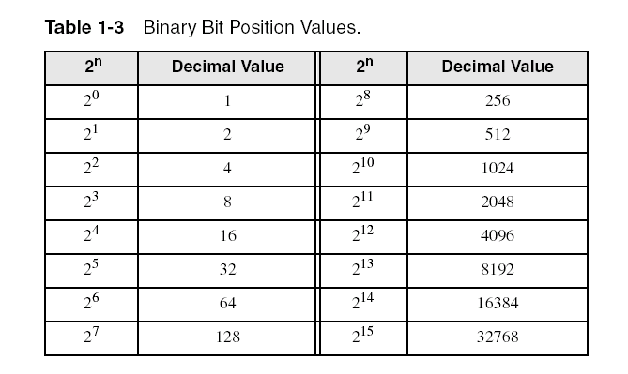
Binary Numbers
Each digit (bit) is either 1 or 0
Each bit represents a power of 2:
Every binary number is a sum of powers of 2

Slide 22
Translating Binary to Decimal
Weighted positional notation shows how to calculate the decimal value of each binary bit:
dec = (D_{n-1} × 2^{n-1}) + (D_{n-2} × 2^{n-2}) + ... + (D₁ × 2¹) + (D₀ × 2⁰)
D = binary digit
binary 00001001 = decimal 9:
(1 × 2³) + (1 × 2⁰) = 9

Slide 23
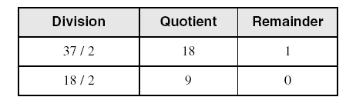
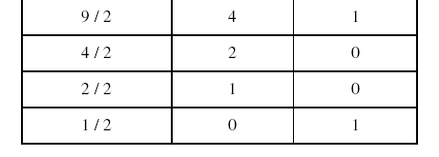
Translating Unsigned Decimal to Binary
Repeatedly divide the decimal integer by 2. Each remainder is a binary digit in the translated value:
37 = 100101

Slide 24
Binary Addition
Starting with the LSB, add each pair of digits, include the carry if present.

Slide 25
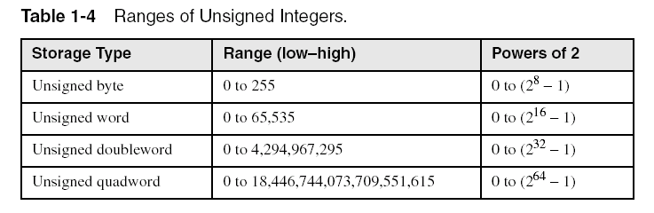
Integer Storage Sizes
Standard sizes:
What is the largest unsigned integer that may be stored in 20 bits?

Slide 26
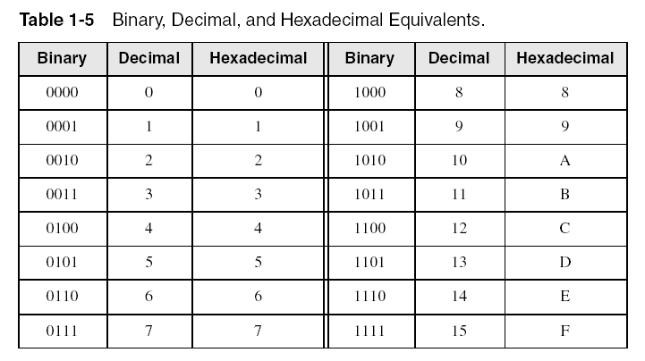
Hexadecimal Integers
Binary values are represented in hexadecimal.

Slide 27

Translating Binary to Hexadecimal
Each hexadecimal digit corresponds to 4 binary bits.
Example: Translate the binary integer 000101101010011110010100 to hexadecimal:

Slide 28
Converting Hexadecimal to Decimal
Multiply each digit by its corresponding power of 16:
dec = (D₃ × 16³) + (D₂ × 16²) + (D₁ × 16¹) + (D₀ × 16⁰)
Hex 1234 equals (1 × 16³) + (2 × 16²) + (3 × 16¹) + (4 × 16⁰), or decimal 4,660.
Hex 3BA4 equals (3 × 16³) + (11 * 16²) + (10 × 16¹) + (4 × 16⁰), or decimal 15,268.

Slide 29
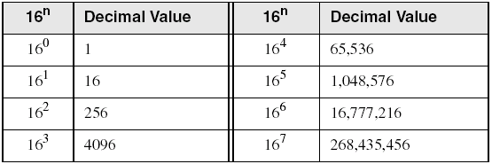
Powers of 16
Used when calculating hexadecimal values up to 8 digits long:

Slide 30
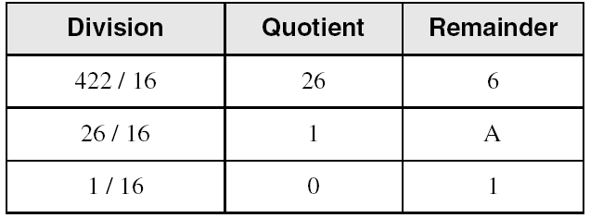
Converting Decimal to Hexadecimal
decimal 422 = 1A6 hexadecimal

Slide 31
Hexadecimal Addition
Divide the sum of two digits by the number base (16). The quotient becomes the carry value, and the remainder is the sum digit.
1
1
36 28 28 6A
42 45 58 4B
78 6D 80 B5
21 / 16 = 1, rem 5
Important skill: Programmers frequently add and subtract the addresses of variables and instructions.

Slide 32
Hexadecimal Subtraction
When a borrow is required from the digit to the left, add 16 (decimal) to the current digit's value:
16 + 5 = 21
−1
C6 75
A2 47
24 2E
Practice: The address of var1 is 00400020. The address of the next variable after var1 is 0040006A. How many bytes are used by var1?

Slide 33
Integer Representations
Two different representations exists for integers
The signed representation: in that case the most significant bit (MSB) represents the sign
Positive number (or zero) if MSB = 0
Negative number if MSB = 1
The unsigned representation: in that case all the bits are used to represent a magnitude
It is thus always a positive number or zero

Slide 34
Signed Integers
The highest bit indicates the sign. 1 = negative, 0 = positive
If the highest digit of a hexadecimal integer is > 7, the value is negative. Examples: 8A, C5, A2, 9D

Slide 35
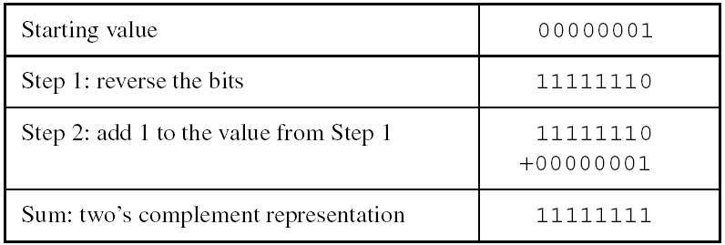
Forming the Two's Complement
Negative numbers are stored in two's complement notation
Represents the additive Inverse
Note that 00000001 + 11111111 = 00000000

Slide 36
Binary Subtraction
When subtracting A – B, convert B to its two's complement
Add A to (–B)
0 0 0 0 1 1 0 0 0 0 0 0 1 1 0 0
– 0 0 0 0 0 0 1 1 1 1 1 1 1 1 0 1
0 0 0 0 1 0 0 1
Practice: Subtract 0101 from 1001.

Slide 37
Learn How To Do the Following:
Form the two's complement of a hexadecimal integer
Convert signed binary to decimal
Convert signed decimal to binary
Convert signed decimal to hexadecimal
Convert signed hexadecimal to decimal

Slide 38
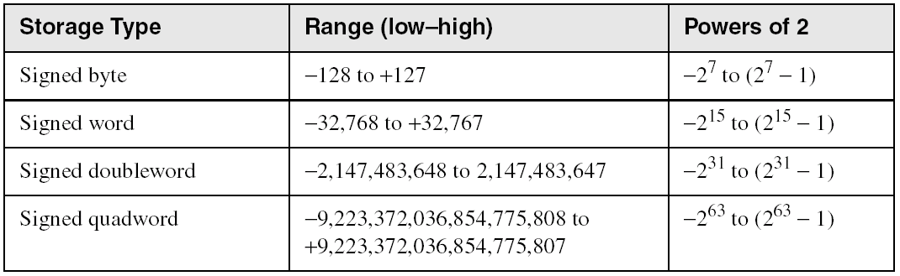
Ranges of Signed Integers
The highest bit is reserved for the sign. This limits the range:
Practice: What is the largest positive value that may be stored in 20 bits?

Slide 39
Signed and Unsigned Interpretation
To obtain the value of a integer in memory we need to chose an interpretation
Ex: a byte of memory containing 1111 1111 can represent either one of these numbers:
-1 if a signed interpretation is used
255 if an unsigned interpretation is used
Only the programmer can provide an interpretation of the content of memory

Slide 40
Maximum and Minimum Values
The MSB of a signed integer is used for its sign
fewer bits are left for its magnitude
Ex: for a signed byte
smallest positive = 0000 0000b
largest positive = 0111 1111b = 127
largest negative = -1 = 1111 1111b
smallest negative = 1000 0000b = -128
Exercise 2: give the smallest and largest positive and negative values for
A) a signed word
B) a signed double word

Slide 41
Character Representation
Each character is represented by a 7-bit code called the ASCII code
ASCII codes run from 00h to 7Fh (h = hexadecimal)
Only codes from 20h to 7Eh represent printable characters. The rest are control codes (used for printing, transmission…).
An extended character set is obtained by setting the most significant bit (MSB) to 1 (codes 80h to FFh) so that each character is stored in 1 byte
This part of the code depends on the OS used
For Windows: we find accentuated characters, Greek symbols and some graphic characters

Slide 42
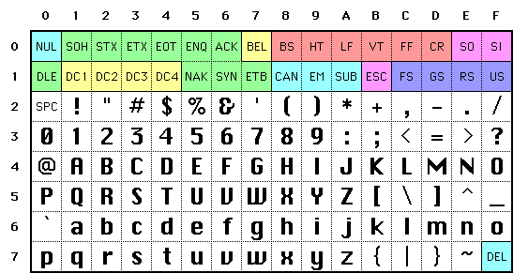
The ASCII Character Set
CR = “carriage return” (Windows: move to beginning of line)
LF = “line feed” (Windows: move directly one line below)
SPC = “blank space”

Slide 43
Text Files
These are files containing only printable ASCII characters (for the text) and non-printable ASCII characters to mark each end of line.
But different conventions are used for indicating an “end-of line”
Windows: <CR>+<LF>
UNIX: <LF>
MAC: <CR>
This is at the origin of many problems encountered during transfers of text files from one system to another

Slide 44
Character Storage
Character sets
Standard ASCII (0 – 127)
Extended ASCII (0 – 255)
ANSI (0 – 255)
Unicode (0 – 65,535)
Null-terminated String
Array of characters followed by a null byte
Using the ASCII table
back inside cover of book

Slide 45
Numeric Data Representation
pure binary
can be calculated directly
ASCII binary
string of digits: "01010101"
ASCII decimal
string of digits: "65"
ASCII hexadecimal
string of digits: "9C"
next: Boolean Operations

Slide 46
Boolean Operations
NOT
AND
OR
Operator Precedence
Truth Tables

Slide 47
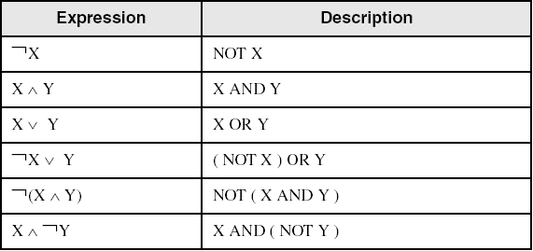
Boolean Algebra
Based on symbolic logic, designed by George Boole
Boolean expressions created from:
NOT, AND, OR

Slide 48
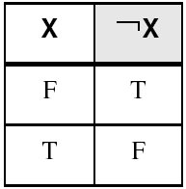
NOT
Inverts (reverses) a boolean value
Truth table for Boolean NOT operator:
Digital gate diagram for NOT:

Slide 49
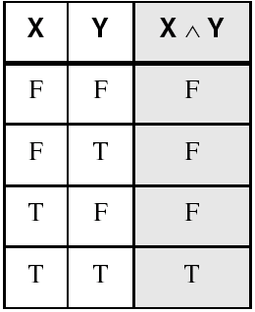
AND
Truth table for Boolean AND operator:
Digital gate diagram for AND:

Slide 50
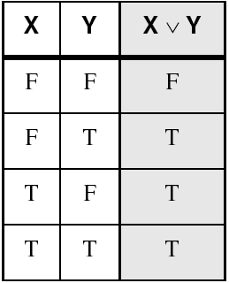
OR
Truth table for Boolean OR operator:
Digital gate diagram for OR:

Slide 51
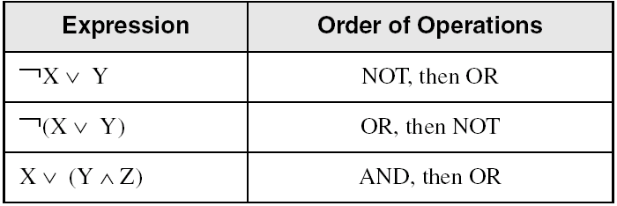
Operator Precedence
Examples showing the order of operations:

Slide 52
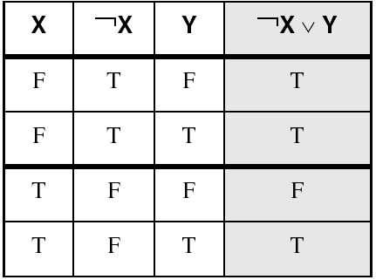
Truth Tables (1 of 3)
A Boolean function has one or more Boolean inputs, and returns a single Boolean output.
A truth table shows all the inputs and outputs of a Boolean function
Example: ¬X ∨ Y

Slide 53
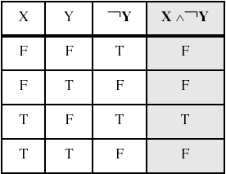
Truth Tables (2 of 3)
Example: X ∧ ¬Y

Slide 54
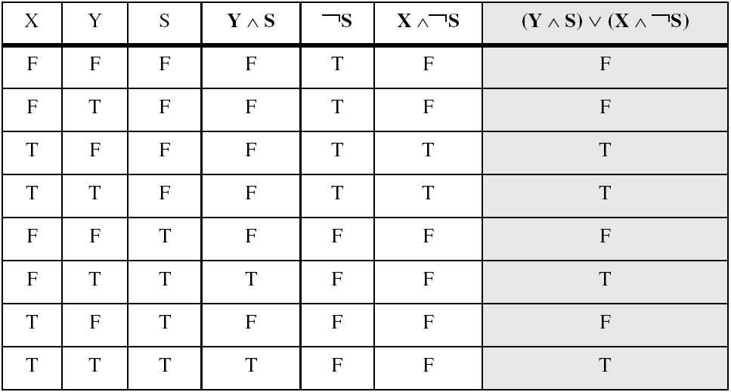
Truth Tables (3 of 3)
Example: (Y ∧ S) ∨ (X ∧ ¬S)
Two-input multiplexer

Slide 55
Summary
Assembly language helps you learn how software is constructed at the lowest levels
Assembly language has a one-to-one relationship with machine language
Each layer in a computer's architecture is an abstraction of a machine
layers can be hardware or software
Boolean expressions are essential to the design of computer hardware and software

Slide 56
54 68 65 20 45 6E 64
What do these numbers represent?

