Slide 1
Assembly Language for x86 Processors 6th Edition
Kip Irvine
Chapter 2: x86 Processor Architecture
Slides prepared by the author
Revision date: 2/15/2010
(c) Pearson Education, 2010. All rights reserved. You may modify and copy this slide show for your personal use, or for use in the classroom, as long as this copyright statement, the author's name, and the title are not changed.

Slide 2
Basic Microcomputer Design
Central Processor Unit:
clock synchronizes CPU operations
control unit (CU) coordinates sequence of execution steps
ALU performs arithmetic and logic operations
Bus: transfer data between different parts of the computer
Data bus, Control bus, and Address bus

Slide 3
Clock
synchronizes all CPU and BUS operations
clock cycle measures time of a single operation
clock is used to trigger events
Clock cycle duration = 1/(clock speed in Hz)
Ex: if speed is 1GHz then duration = 1 nanosecond
Instruction execution: between 1 to 50+ clock cycles.

Slide 4
Instruction Execution Cycle [Fetch-and-Execute Cycle]
Loop:
Fetch next instruction then increment IP (the Instruction Pointer)
Decode the instruction
If memory operand needed then
Fetch operand’s value from memory
Execute the instruction
If result is memory operand then
Store output to memory
Continue loop

Slide 5
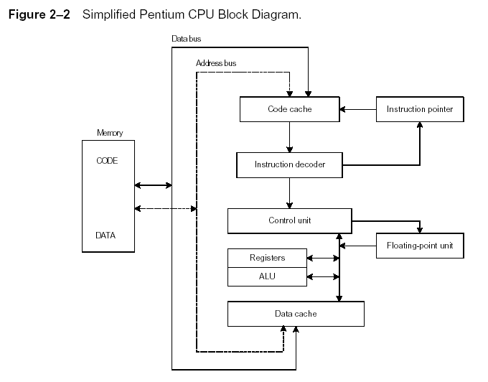
Instruction Execution Cycle
Instruction Execution Cycle
Fetch
Decode
Fetch operands
Execute
Store output
(See Page 27)

Slide 6
The Platform We Will Use
Assembly language and machine language are processor specific
We will write code for Intel’s 80x86 (x>=3)
IA-32 family: Intel 80386, 486, … Pentium, …
The assembler places its machine code into an object file which is OS specific
Our code will run (only) on Windows
And it will crash on DOS
Our programs will be Win32 console applications
These are programs for which all I/O operations are character-based
They run into an MS-DOS box but they are not DOS programs (they do not use DOS calls)

Slide 7
The Intel X86 Family
Pentium
. . . etc
80486
80386
80286
8086
The instruction set of the x86 is backward compatible with any one of its predecessors
New additional instructions are introduced with each new processor

Slide 8
Basic Program Execution Registers
Registers: high-speed memories located in the CPU
Registers for 8086 and 80286 are 16 bits wide
Registers for IA-32 family are 32 bits wide

Slide 9
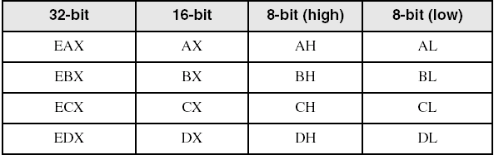
General-Purpose Registers
8 registers used for arithmetic and data movement
Use 8-bit name, 16-bit name, or 32-bit name
Applies to EAX, EBX, ECX, and EDX only

Slide 10
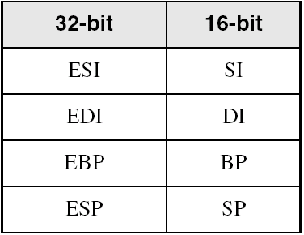
Index and Base Registers
Some registers have only a 16-bit name for their lower half:
EBP/ESP registers are used as pointers to stack
ESI/EDI registers used for fast memory indexing.
Or as pointers to arrays

Slide 11
Segment Registers
Each program is subdivided into logical parts called SEGMENTS
Code segment (CS)
Stack segment (SS)
Data segments (DS, ES, FS, and GS)
Real-address mode: segment registers hold the “base address” of these program segments
Protected mode: segment registers hold pointers to segment descriptor table
Segment registers are 16-bit wide
CS
SS
DS
ES
FS
GS

Slide 12
Some Specialized Register Uses (1 of 2)
General-Purpose
EAX – accumulator
ECX – loop counter
ESP – stack pointer
ESI, EDI – index registers
EBP – extended frame pointer (stack)
Segment:
stores the address of a memory segment
CS – code segment
DS – data segment
SS – stack segment
ES, FS, GS - additional segments

Slide 13
Some Specialized Register Uses (2 of 2)
EIP – instruction pointer
Stores the address of the next instruction to be executed
IP for 8086
EFLAGS
control flags:
Controling the operation of the CPU
status flags:
Reflecting outcome of CPU operations
each flag is a single binary bit
Set flag = 1 and Clear flag = 0

Slide 14
EFLAGS’s Status Flags
Carry
CF: unsigned arithmetic out of range
Overflow
OF: signed arithmetic out of range
Sign
SF: result is negative
Zero
ZF: result is zero
Auxiliary Carry
AF: carry from bit 3 to bit 4
Parity
PF: sum of 1 bits is an even number
Direction DF: (CPU control flag)
Process arrays up or down ?

Slide 15
Floating-Point UNIT, MMX, XMM Registers
Eight 80-bit floating-point data registers
ST(0), ST(1), . . . , ST(7)
arranged in a stack
used for all floating-point arithmetic
Eight 64-bit MMX registers
Eight 128-bit XMM registers for single-instruction multiple-data (SIMD) operations
Skip to Page 23

Slide 16
Early Intel Microprocessors
Intel 8080
64K addressable RAM
8-bit registers
CP/M operating system
S-100 BUS architecture
8-inch floppy disks!
Intel 8086/8088
IBM-PC Used 8088
1 MB addressable RAM
16-bit registers
16-bit data bus (8-bit for 8088)
separate floating-point unit (8087)

Slide 17
The IBM-AT
Intel 80286
16 MB addressable RAM
Protected memory
several times faster than 8086
introduced IDE bus architecture
80287 floating point unit

Slide 18
Intel IA-32 Family
Intel386
4 GB addressable RAM, 32-bit registers, paging (virtual memory)
Intel486
instruction pipelining
Pentium
superscalar, 32-bit address bus, 64-bit internal data path

Slide 19
64-bit Processors
Intel64
64-bit linear address space
Intel: Pentium Extreme, Xeon, Celeron D, Pendium D, Core 2, and Core i7
IA-32e Mode
Compatibility mode for legacy 16- and 32-bit applications
64-bit Mode uses 64-bit addresses and operands

Slide 20
Intel Technologies
HyperThreading technology
two tasks execute on a single processor at the same time
Dual Core processing
multiple processor cores in the same IC package
each processor has its own resources and communication path with the bus

Slide 21
Intel Processor Families
Currently Used:
Pentium & Celeron – dual core
Core 2 Duo - 2 processor cores
Core 2 Quad - 4 processor cores
Core i7 – 4 processor cores

Slide 22
CISC and RISC
CISC – complex instruction set
large instruction set
high-level operations
requires microcode interpreter
examples: Intel 80x86 family
RISC – reduced instruction set
simple, atomic instructions
small instruction set
directly executed by hardware
examples:
ARM (Advanced RISC Machines)
DEC Alpha (now Compaq)

Slide 23
Logical and Physical Addresses
Addresses specify the location of instructions and data
Addresses that specify an absolute location in main memory are physical addresses (called linear addresses)
They appear on the address bus
Addresses that specify a location relative to a point in the program are logical (or virtual) addresses
They are addresses used in the code and are independent of the structure of main memory
Each logical address for the x86 consist of 2 parts:
A segment number used to specify a (logical) part of the program [The physical address of the segment]
A offset number used to specify a location relative to the beginning of the segment

Slide 24
Segmented Memory
Segmented memory addressing: absolute (linear) address is a combination of a 16-bit segment value added to a 16-bit offset
one segment
linear addresses

Slide 25
Addressable Memory
Protected mode
4 GB
32-bit address
Real-address and Virtual-8086 modes
1 MB space
20-bit address

Slide 26
IA-32 Memory Management (Real-Address mode)
1 MB RAM maximum addressable
Application programs can access any area of memory
Single tasking
Supported by MS-DOS operating system

Slide 27
Address Translation and Running Modes
The translation from logical to physical addresses is done at run time
The way in which this address translation is done depends on the running mode of the x86
Two different running modes exist for the x86:
Real mode (supported by every x86)
Protected mode (all x86 except the 8086)
You will use this mode

Slide 28
IA-32 Processor Architecture (Modes of Operation)
Protected mode: programs in separate segments
native mode (Windows, Linux)
Supported by all x86 except 8086
Real-address mode: 8086
native MS-DOS
Supported by all x86
System management mode: customized processor
power management, system security, diagnostics
Virtual-8086 mode
Protected, but can execute real-address mode software
each program has its own 8086 computer

Slide 29
Address Translation in Real Mode
The 16-bit segment number (contained in a segment register) is first multiplied by 16 to give the 20-bit physical address of the first byte of the referenced segment: Seg_adr + Off_adr
Then we add the 16-bit offset address to obtain the 20-bit physical address of the referenced data (or instruction)
Ex: if CS contains 15A6h (in hexadecimal), and IP contains 0012h, then
The physical address of the instruction to be executed next is just 15A60h + 0012h = 15A72h

Slide 30
Calculating Linear Addresses
Given a segment address, multiply it by 16 (add a hexadecimal zero), and add it to the offset
Example: convert 08F1:0100 to a linear address
Adjusted Segment value: 0 8 F 1 0
Add the offset: 0 1 0 0
Linear address: 0 9 0 1 0

Slide 31
Your turn . . .
What linear address corresponds to the segment/offset address 028F:0030?
028F0 + 0030 = 02920
Always use hexadecimal notation for addresses.

Slide 32
Your turn . . .
What segment addresses correspond to the linear address 28F30h?
Many different segment-offset addresses can produce the linear address 28F30h. For example:
28F0:0030, 28F3:0000, 28B0:0430, . . .

Slide 33
Characteristics of (Archaic) Real Mode
Can address only up to 1MB of physical memory
Uses 20-bit address for referenced segment
Does not support multitasking
Only 1 process at a time is active
No protection is provided: a program can write anywhere (and corrupt the operating system)
The 8086 runs only in this mode
DOS is a real-mode operating system
Our programs will not run in this archaic mode
They will run in protected mode which does not suffer from any of these limitations

Slide 34
IA-32 Memory Management (Protected Mode)
4 GB addressable RAM
(00000000 to FFFFFFFFh)
Each program assigned a memory partition which is protected from other programs
Designed for multitasking
Supported by Linux & MS-Windows

Slide 35
Protected mode
Segment descriptor tables
Program structure
code, data, and stack areas
CS, DS, SS segment descriptors
global descriptor table (GDT)
MASM Programs use the Microsoft flat memory model

Slide 36
Address Translation in Protected Mode
The logical/virtual address of a referenced word is given by a pair of numbers (segment, offset)
The segment number is contained in a segment register and is used to select (or index) an entry in a segment table (called a descriptor table)
Hence, a segment register is also called a selector
The selected entry (the descriptor) contains the base address and length of the referenced segment
The 32-bit base address is added to the 32-bit offset to form a 32-bit linear address (P1,P2,D)
P1 indexes a directory page table (in memory) to obtain the base address of a second page table which is indexed by P2 to give the physical address of the referenced word

Slide 37
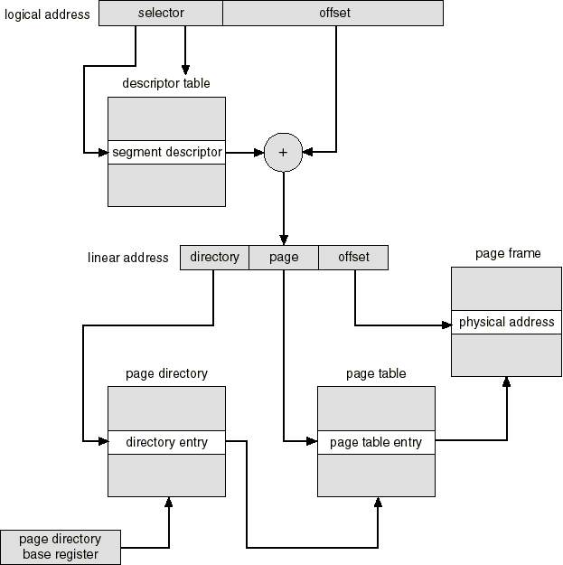
Intel 386 Address Translation
P1
P2
D

Slide 38
The FLAT Memory Model
The segmentation part is hidden to the programmer when the base address of each segment descriptor is the same
Each selector then points to the same segment so that code, data, and stack share the same segment
Protection bits (read-only, read-write) in each descriptor can still be used
Done by Windows, Linux, FreeBSD…
The offset part of the logical address is then equivalent to the linear address (P1,P2,D).
Only the offset part of the logical address is used to specify the location of a referenced word
The address space is then said to be FLAT
All our programs will use the FLAT memory model

Slide 39
Flat Segment Model
Single global descriptor table (GDT).
All segments mapped to entire 32-bit address space
Skip the remaining pages

Slide 40
Multi-Segment Model
Each program has a local descriptor table (LDT)
holds descriptor for each segment used by the program

Slide 41
Paging
Supported directly by the CPU
Divides each segment into 4096-byte blocks called pages
Sum of all programs can be larger than physical memory
Part of running program is in memory, part is on disk
Virtual memory manager (VMM) – OS utility that manages the loading and unloading of pages
Page fault – issued by CPU when a page must be loaded from disk

Slide 42
54 68 65 20 45 6E 64
What do these numbers represent?

Slide 43
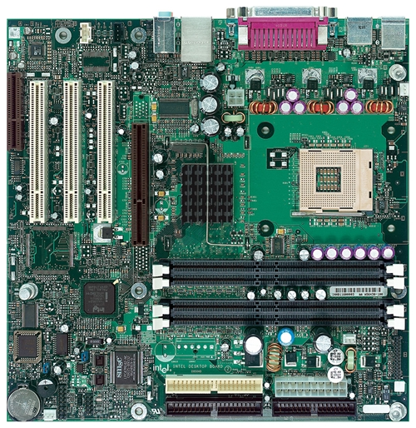
Intel D850MD Motherboard
mouse, keyboard, parallel, serial, and USB connectors
Video
Audio chip
PCI slots
memory controller hub
Pentium 4 socket
AGP slot
dynamic RAM
Firmware hub
I/O Controller
Speaker
Power connector
Battery
Diskette connector
Source: Intel® Desktop Board D850MD/D850MV Technical Product Specification
IDE drive connectors

Slide 44
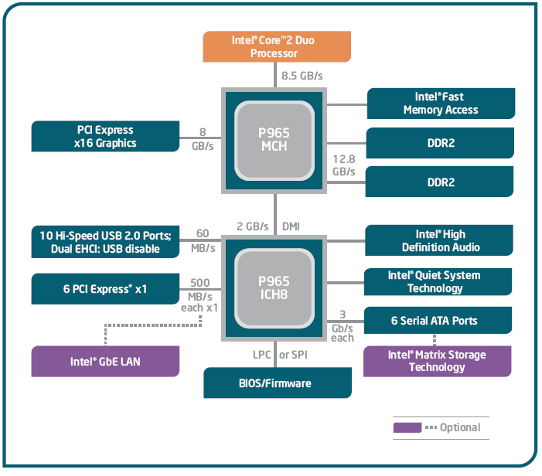
Intel 965 Express Chipset

Slide 45
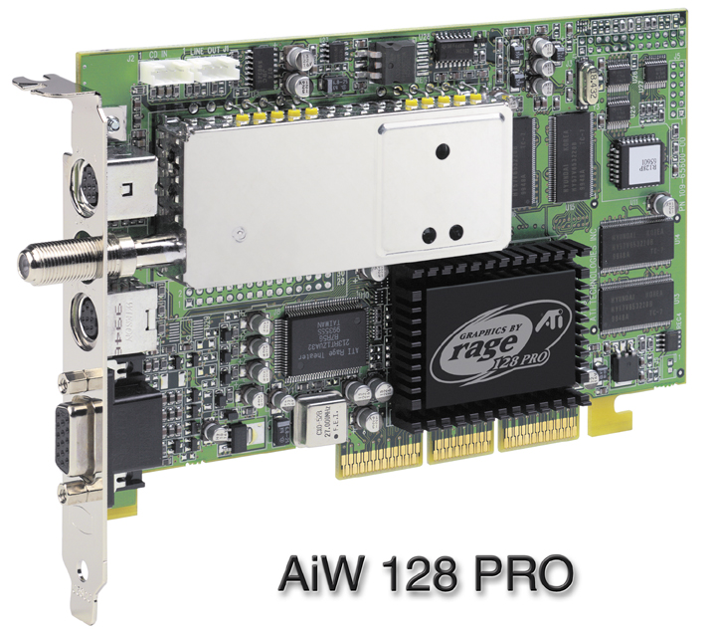
Sample Video Controller (ATI Corp.)
128-bit 3D graphics performance powered by RAGE™ 128 PRO
3D graphics performance
Intelligent TV-Tuner with Digital VCR
TV-ON-DEMAND™
Interactive Program Guide
Still image and MPEG-2 motion video capture
Video editing
Hardware DVD video playback
Video output to TV or VCR

Slide 46
Displaying a String of Characters
When a HLL program displays a string of characters, the following steps take place:

Slide 47
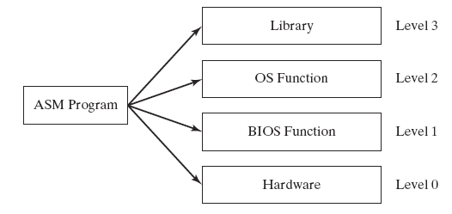
Programming levels
Assembly language programs can perform input-output at each of the following levels:

Slide 48
42 69 6E 61 72 79
What does this say?

