Slide 1
03-60-440: Principles of Programming Languages Classification of programming languages
“There are only two kinds of programming languages: those people always bitch about and those nobody uses.”
--Bjarne Stroustrup

Slide 2
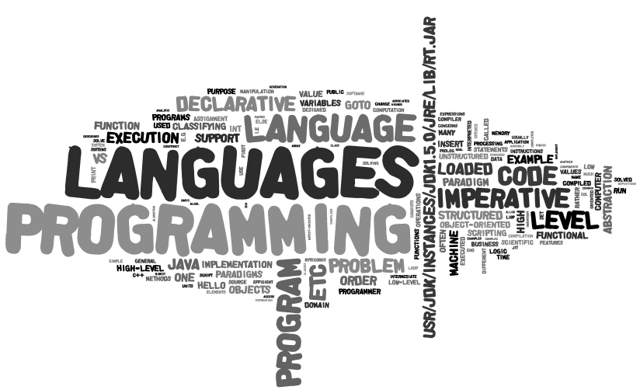
Generated using wordle.net from the text of this ppt file

Slide 3
Categories of programming languages, wikipedia, 2010
1 Array languages
2 Aspect-oriented languages
3 Assembly languages
4 Authoring languages
5 Command line interface languages
6 Compiled languages
7 Concurrent languages
8 Dataflow languages
9 Data-oriented languages
10 Data-structured languages
11 Declarative languages
12 Esoteric languages
13 Extension languages
14 Fourth-generation languages
15 Functional languages
16 Interactive mode languages
17 Interpreted languages
18 Iterative languages
19 List-based languages – LISPs
20 Little languages
21 Logic-based languages
22 Machine languages
23 Macro languages
24 Metaprogramming languages
25 Multiparadigm languages
26 Numerical analysis
27 Non-English-based languages
28 Object-oriented class-based languages
29 Object-oriented prototype-based languages
30 Off-side rule languages
31 Procedural languages
32 Reflective languages
33 Rule-based languages
34 Scripting languages
35 Stack-based languages
36 Synchronous languages
37 Syntax handling languages
38 Visual languages
39 Wirth languages
40 XML-based languages

Slide 4
From Wikipedia 2017
1 Array languages
2 Assembly languages
3 Authoring languages
4 Constraint programming languages
5 Begin...End languages
6 Command line interface languages
7 Compiled languages
8 Concurrent languages
9 Curly-bracket languages
10 Dataflow languages
11 Data-oriented languages
12 Data-structured languages
13 Decision table languages
14 Declarative languages
15 Embeddable languages
15.1 In source code
15.1.1 Server side
15.1.2 Client side
15.2 In object code
16 Educational languages
17 Esoteric languages
18 Extension languages
19 Fourth-generation languages
20 Functional languages
20.1 Pure
20.2 Impure
21 Hardware description languages
21.1 HDLs for analog circuit design
21.2 HDLs for digital circuit design
22 Imperative languages
23 Interactive mode languages
24 Interpreted languages
25 Iterative languages
26 Languages by memory management type
26.1 Garbage collected languages
26.2 Languages with manual memory management
27 List-based languages – LISPs
28 Little languages
29 Logic-based languages
30 Machine languages
31 Macro languages
31.1 Textual substitution macro languages
31.2 Application macro languages
32 Metaprogramming languages
33
Multiparadigm languages
34 Numerical analysis
35 Non-English-based languages
36 Object-oriented class-based languages
36.1 Multiple dispatch
36.2 Single dispatch
37 Object-oriented prototype-based languages
38 Off-side rule languages
39 Procedural languages
40 Reflective languages
41 Rule-based languages
42 Scripting languages
43 Stack-based languages
44 Synchronous languages
45 Syntax handling languages
46 Transformation languages
47 Visual languages
48 Wirth languages
XML-based languages

Slide 5
Classification of Programming Languages
There are different ways of grouping programming languages together
By abstraction level
Low level, high level, very high level
By domain
business languages, scientific languages, AI languages, systems languages, scripting languages, XML-based languages
By generality
general purpose vs. special purpose
By implementation methods
Interpreted vs. compiled
By paradigm
a paradigm is a way of viewing programming, based on underlying theories of problem solving styles
programming languages grouped in the same paradigm are similar in their approach to problem solving
imperative, object-oriented, logic-based, functional, etc.

Slide 6
By abstract level from the machine
Low-level languages
Machine languages, assembly languages
High-level languages
Algol, Pascal, C++, Java, C#, etc.
Very high-level languages
Usually limited to a very specific application.
Due to this limitation in scope, they might use syntax that is never used in other programming languages.
E.g., Prolog, SQL
Note that the terms "high-level" and "low-level" are inherently relative.
Originally C was considered high level but nowadays many programmers might refer C as low level, as it stills allows memory to be accessed by address, and provides direct access to the assembly level.
Classification by level

Slide 7
High –level vs. low level languages
“High-level” refers to the higher level of abstraction from machine language.
it does not imply that the language is superior to low-level programming languages.
Characteristics:
High-level languages deal with variables, arrays and complex arithmetic or boolean expressions;
“low-level” languages deal with registers, memory addresses etc.
Pros and cons
High-level languages make programming simpler;
while low-level languages produce more efficient code;
code which needs to run efficiently may be written in a lower-level language.
Classification by level
Very high level Language
High Level Language
Assembly Language
Machine Language
thought
machine
Languages
Closer to humans

Slide 8
Low vs. high level languages
; Author: Paul Hsieh gcd: neg eax
je L3 L1: neg eax xchg eax,edx L2: sub eax,edx jg L2 jne L1 L3: add eax,edx jne L4 inc eax L4: ret
; WATCOM C/C++ v10.0a output gcd: mov ebx,eax mov eax,edx test ebx,ebx jne L1 test edx,edx jne L1 mov eax,1 ret L1: test eax,eax jne L2 mov eax,ebx ret L2: test ebx,ebx je L5 L3; cmp ebx,eax je L5 jae L4 sub eax,ebx jmp L3 L4: sub ebx,eax jmp L3 L5: ret
Classification by level
unsigned int gcd (unsigned int a, unsigned int b){ if (a == 0 &&b == 0) b = 1; else if (b == 0) b = a; else if (a != 0) while (a != b) if (a <b) b -= a; else a -= b; return b; }

Slide 9
Java and bytecode
public class Hello {
public static void main(String [ ] a){
System.out.println("Hello");
}
}
Btw, How to view the byte code?
javap –c Hello
public class Hello extends java.lang.Object{
public Hello();
Code:
0: aload_0
1: invokespecial #1; //Method java/lang/Object."<init>":()V
4: return
public static void main(java.lang.String[]);
Code:
0: getstatic #2; //Field java/lang/System.out:Ljava/io/PrintStream;
3: ldc #3; //String Hello
5: invokevirtual #4; //Method java/io/PrintStream.println:(Ljava/lang/String;)V
8: return
}
Classification by level

Slide 10
Classifying Languages by Domain: Scientific
Historically, languages were classified most often by domains.
Scientific, Business (Data Processing), AI, System, Scripting.
The first digital computer was used and invented for scientific application.
The first high level programming language is for scientific (engineering) application
Simple data structures but large number of floating-point arithmetic computations.
This is in contrast to business application that requires strong language support for file manipulation, table lookup, report generation, etc.
Often efficient
Example languages: Fortran, Algol.
Classification by domain

Slide 11
Classifying Languages by Domain: Business
Business (sometimes a.k.a. data processing)
Language features emphasize file handling, table lookup, report generation, etc.
Weak language support for math functions, graphics, recursion, etc.
Example language: COBOL(COmmon Business Oriented Language), initial version in 1960.
Now mostly handled by database systems, spreadsheets, etc.
Classification by domain

Slide 12
Classifying Languages by Domain: Artificial Intelligence
High level of abstraction for symbol manipulation, rather than numeric computation
Symbolic manipulation: symbols, consisting of names rather than numbers, are computed
Linked lists (often built-in) rather than array, declarative, recursion rather than loop, self-modification, etc.
Often (very) high-level, inefficient
Example languages:
Lisp (LISt Processing), Scheme, ML, Miranda, etc.
Prolog (French for “logic programming”), etc.
Classification by domain

Slide 13
Classifying Languages by Domain: Systems
Languages for system software
System software includes operating systems and programming support tools.
Language support for hardware interface, operating system calls, direct memory/device access, etc.
Little or no direct support for programmer defined abstraction, complex types, symbol manipulation
Low-level, very efficient
Very few restrictions on programmer (access to everything)
Example languages: C, Go
Low level, efficient, few safety restrictions.
Classification by domain

Slide 14
Classifying Languages by Domain: Scripting
Scripting: connecting diverse pre-existing components to accomplish a new related task.
Initially designed for "scripting" the operations of a computer.
Early script languages were often called batch languages or job control languages (Shell Script), such as .bat, csh.
rm A3Scanner.* A3Parser.* A3User.class A3Symbol.* A3.output
java JLex.Main A3.lex
java java_cup.Main -parser A3Parser -symbols A3Symbol < A3.cup
javac A3.lex.java A3Parser.java A3Symbol.java A3User.java
java A3User
more A3.output
A script is more usually interpreted than compiled, but not always.
Classification by domain

Slide 15
Scripting language (2)
Now scripting languages can be quite sophisticated, beyond automating computer tasks;
JavaScript, PHP: Web programming;
Perl: text processing, but later developed into a general purpose languages;
Characteristics:
Favor rapid development over efficiency of execution;
Often implemented with interpreters rather than compilers;
Strong at communication with program components written in other languages.
Classification by domain

Slide 16
XML-based languages
Languages that
Operate on XML documents
Usually the syntax of the language is XML
Examples
XPath
XQuery
XSLT
Classification by domain

Slide 17
Classifying Languages by Generality
General Purpose
Languages with features that allow implementation of virtually any algorithm
Roughly uniform level of abstraction over language features
C, C++, Java, Delphi, etc., etc., etc.
Special Purpose
Languages with a very restricted set of features
High level of abstraction among features
SQL, MATLAB, R, lex/yacc (JLex/JavaCup), etc. etc.
Classification by generality

Slide 18
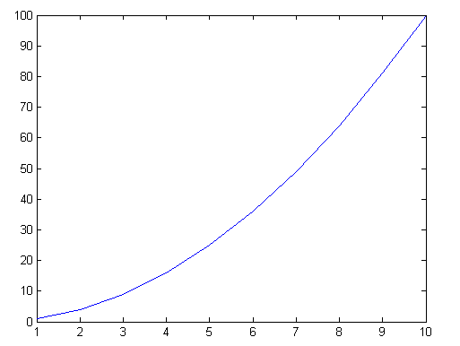
MATLAB
Matrix manipulation
Plotting
Widely used by engineers and applied statisticians
Example
x=1:10;
y=x.^2
plot(y)
Notice there is no explicit loop!
Classification by generality

Slide 19
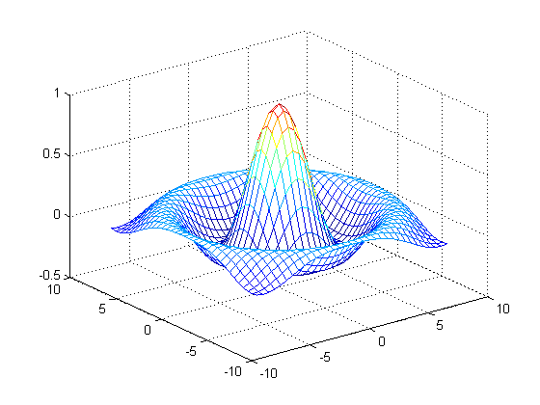
figure
[X,Y] = meshgrid(-8:.5:8);
R = sqrt(X.^2 + Y.^2) + eps;
Z = sin(R)./R; mesh(X,Y,Z)

Slide 20
Classifying languages by implementation methods
Compilation: translating high-level program (source language) into machine code (machine language)
Slow translation, fast execution
Pure Interpretation: Programs are interpreted by another program known as an interpreter
It takes longer to run a program under an interpreter than to run the compiled code.
Hybrid Implementation Systems
A compromise between compilers and pure interpreters
Classification by implementation methods

Slide 21
Compilation and execution
Source program
compiler
Lexical Analysis (scanning)
Token Sequence
Syntactic Analysis (parsing)
Symbol Table
Parse Tree
Code Optimization
Abstract Program (Intermediate code)
Semantic Analysis
Abstract Program (Optimized)
Classification by implementation methods
Code Generation
Object Program (Native Code)
Loader / Linker
Target Program
Input Data
Computer
Output Data

Slide 22
Implementation methods: Compilation
Compilation process has several phases:
Lexical analysis: converts characters in the source program into lexical units
Syntax analysis: transforms lexical units into parse trees which represent the syntactic structure of program
Semantics analysis: check types etc; generate intermediate code
Code generation: machine code is generated
Additional Compilation Terminologies
Linking and loading: When loading compiled programs into computer memory, they are linked to the relevant program resources, and then the fully resolved codes are into computer memory, for execution.
Classification by implementation methods

Slide 23
Run java -verbose
public class Hello {
public static void main(String [] a){
System.out.println("Hello");
}
}
sol:~/440>java -verbose Hello
[Opened /usr/jdk/instances/jdk1.5.0/jre/lib/rt.jar]
[Opened /usr/jdk/instances/jdk1.5.0/jre/lib/jsse.jar]
[Opened /usr/jdk/instances/jdk1.5.0/jre/lib/jce.jar]
[Opened /usr/jdk/instances/jdk1.5.0/jre/lib/charsets.jar]
[Loaded java.lang.Object from /usr/jdk/instances/jdk1.5.0/jre/lib/rt.jar]
[Loaded java.io.Serializable from /usr/jdk/instances/jdk1.5.0/jre/lib/rt.jar]
[Loaded java.lang.Comparable from /usr/jdk/instances/jdk1.5.0/jre/lib/rt.jar]
[Loaded java.lang.CharSequence from /usr/jdk/instances/jdk1.5.0/jre/lib/rt.jar]
[Loaded java.lang.String from /usr/jdk/instances/jdk1.5.0/jre/lib/rt.jar]
[Loaded java.lang.reflect.GenericDeclaration from /usr/jdk/instances/jdk1.5.0/jre/lib/rt.jar]
[Loaded java.lang.reflect.Type from /usr/jdk/instances/jdk1.5.0/jre/lib/rt.jar]
[Loaded java.lang.reflect.AnnotatedElement from /usr/jdk/instances/jdk1.5.0/jre/lib/rt.jar]
[Loaded java.lang.Class from /usr/jdk/instances/jdk1.5.0/jre/lib/rt.jar]
[Loaded java.lang.Cloneable from /usr/jdk/instances/jdk1.5.0/jre/lib/rt.jar]
[Loaded java.lang.ClassLoader from /usr/jdk/instances/jdk1.5.0/jre/lib/rt.jar]
[Loaded java.lang.System from /usr/jdk/instances/jdk1.5.0/jre/lib/rt.jar]
… (hundreds of related classes)
[Loaded Hello from file:/global/fac2/jlu/440/]
Hello
[Loaded java.lang.Shutdown from /usr/jdk/instances/jdk1.5.0/jre/lib/rt.jar]
[Loaded java.lang.Shutdown$Lock from /usr/jdk/instances/jdk1.5.0/jre/lib/rt.jar]
Classification by implementation methods

Slide 24
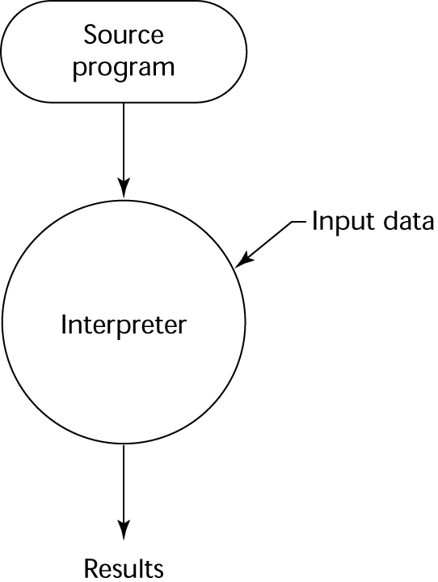
Interpreted language
Programs are executed from source form, by an interpreter.
many languages have both compilers and interpreters, including Lisp, Scheme, BASIC, and Python.
Disadvantages:
Much slower
Real time translation;
Initially, interpreted languages were compiled line-by-line; each line was compiled as it was about to be executed, and if a loop or subroutine caused certain lines to be executed multiple times, they would be recompiled every time.
Require more space.
Source code, symbol table, …
Advantage of interpreted languages
Easy implementation of source-level debugging operations, because run-time errors can refer to source-level units
E.g., if an array index is out of range, the error message can easily indicate the source line and the name of the array.
It can take less time to interpret it than the total time required to compile and run it. This is especially important when prototyping and testing code when an edit-interpret-debug cycle can often be much shorter than an edit-compile-run-debug cycle. (e.g., csh)
Classification by implementation methods

Slide 25
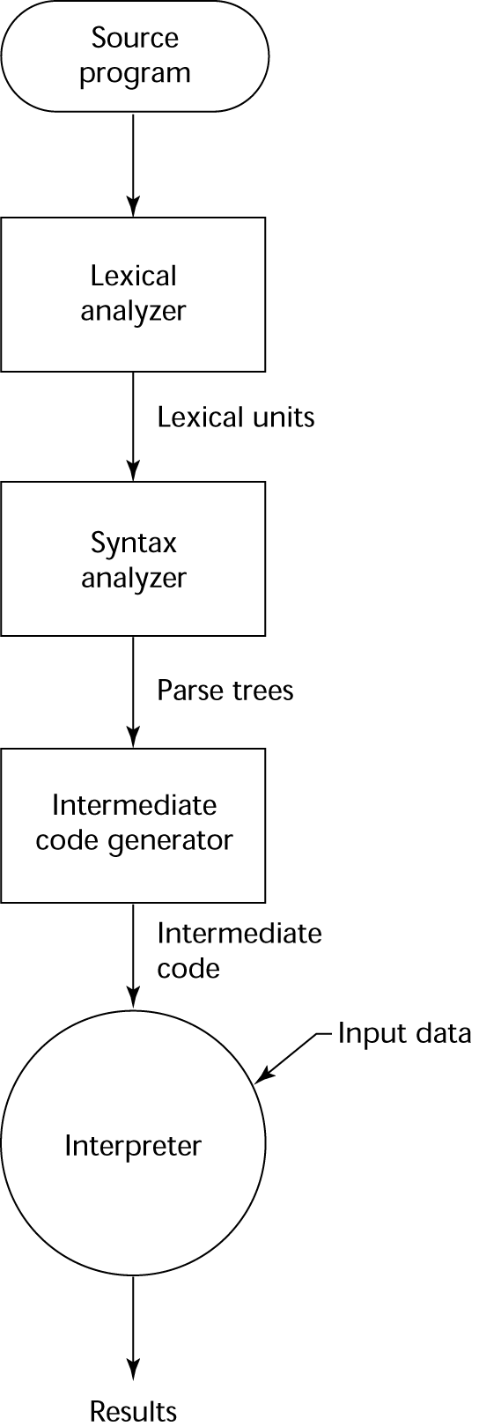
Hybrid implementation
A compromise between compilers and pure interpreters
Translate high-level language program into intermediate language designed to allow easy interpretation;
Faster than pure interpretation since the source is translated only once.
Example: Java.
Provides portability to any machine that support the intermediate language
Other language that uses hybrid implementation?
Can we make it faster?
JIT (Just-In-Time) compiler
Classification by implementation methods
Notes:
C# also uses hybrid implementation.

Slide 26
JIT compiler
A just-in-time compiler (JIT) improves performance of bytecodes by compiling them into native machine code before executing them.
Translates bytecodes (or other intermediate code) into machine instructions as they are read in;
Performs a degree of optimization;
The resulting program is then run;
Parts of the program that don't execute aren't compiled, so a JIT doesn't waste time optimizing code that never runs.
The machine instructions aren't saved anywhere except in memory. The next time the program is run, the bytecodes are translated into machine code once again.
The result is that the bytecodes are still portable,
and they typically run much faster than they would in a normal interpreter.
Introduced in Sun JRE 1.2
Classification by implementation methods

Slide 27
Review
Classifying languages by
Abstraction level (low level, high level, very high level)
Domain (scientific, data processing, scripting…)
General purpose vs. special purpose
Implementation methods (interpreter, compiler, hybrid)
compilation process
… …
Paradigms
“language shapes the way we think, and determines what we can think about. “ –B.L. Whorf

Slide 28
Programming Paradigms
A style of programming
A programming paradigm provides the view that the programmer has of the execution of the program.
Object-oriented programming: programmers think of a program as a collection of interacting objects;
Functional programming: a program can be thought of as a sequence of stateless function evaluations.
Many programming paradigms are as well-known for what techniques they forbid as for what they enable.
Pure functional programming disallows the use of side-effects;
Structured programming disallows the use of goto.
Classification by paradigms

Slide 29
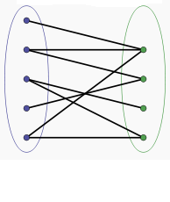
Paradigms and languages
Some languages are designed to support one particular paradigm
Smalltalk supports object-oriented programming
Scheme supports functional programming.
A programming language can support multiple paradigms.
E.g., Java is designed to support imperative programming, object-oriented programming, and generic programming.
A programming language advocates (not enforce) a paradigm (s).
Programmers decide how to build a program using those paradigm elements.
E.g., one can write a purely imperative program in Java (not encouraged)
The followings are unstructured and structured program written in the same language
paradigms
languages
10 dim i
20 i = 0
30 i = i + 1
40 if i <> 10 then goto 90
50 if i = 10 then goto 70
60 goto 30
70 print "Program Completed."
80 end
90 print i & " squared = " & i * i
100 goto 30
dim i
for i = 1 to 10
print i & " squared = " & square(i)
next
print "Program Completed."
function square(i)
square = i * i
end function
Classification by paradigms

Slide 30
Example paradigms
Structured programming vs. Unstructured programming
Imperative programming vs. Declarative programming
Object-oriented programming
Aspect Oriented Programming
Functional programming
Logic programming
Service oriented programming
Classification by paradigms

Slide 31
Some programming paradigms
Imperative:
how do we solve a problem (what steps does a solution have)?
Logic-based:
what is the problem to be solved? (The language implementation decides how to do it.)
Functional:
what simple operations (functions) can be applied to solve a problem, how are they mutually related, and how can they be combined?
Object-oriented:
What objects play roles in a problem, what can they do, and how do they interact to solve the problem?
Aspect-oriented:
What are the concerns and crosscutting concerns? How to allow the concerns interact with each other?
Classification by programming paradigms

Slide 32
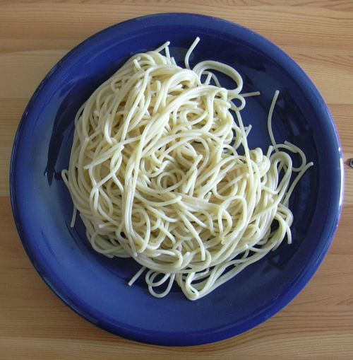
Structured vs. unstructured programming
Unstructured programming: All code is contained in a single continuous block.
Have to rely on execution flow statements such as Goto, used in many languages to jump to a specified section of code.
Complex and tangled, difficult to read and debug;
Unstructured programming results in spaghetti code
Discouraged in programming languages that support any kind of structure.
an example Spaghetti code in BASIC:
10 dim i
20 i = 0
30 i = i + 1
40 if i <> 10 then goto 90
50 if i = 10 then goto 70
60 goto 30
70 print "Program Completed."
80 end
90 print i & " squared = " & i * i
100 goto 30
Classification by programming paradigms

Slide 33
Structured vs. unstructured
Structured programming:
Programmatic tasks are split into smaller sections (known as functions or subroutines) that can be called whenever they are required.
Remove GOTO statements;
Single entry (and single exit) for each program section.
Consider:
Is Java a structured programming language?
Compared with C++, which one is more structured?
Here is an example Spaghetti code and structured code in BASIC:
10 dim i
20 i = 0
30 i = i + 1
40 if i <> 10 then goto 90
50 if i = 10 then goto 70
60 goto 30
70 print "Program Completed."
80 end
90 print i & " squared = " & i * i
100 goto 30
Can we turn all unstructured code to structured one?
Classification by programming paradigms
dim i
for i = 1 to 10
print i & " squared = " & square(i)
next
print "Program Completed."
function square(i)
square = i * i
end function

Slide 34
Structured programming
Structured program theorem
Any program can be goto-free (1966, Böhm and Jacopini, CACM)
any program with gotos could be transformed into a goto-free form involving only
Sequential composition
choice (IF THEN ELSE) and
loops (WHILE condition DO xxx),
possibly with duplicated code and/or the addition of Boolean variables (true/false flags).
Classification by programming paradigms
Y
C
N
Y
C
N
S1
S2
S₁
S₂
S

Slide 35
Imperative vs. declarative
Imperative: a programming paradigm that describes computation in terms of a program state and statements that change the program state.
In much the same way as the imperative mood in natural languages expresses commands to take action, imperative programs are a sequence of commands for the computer to perform.
Derived from Von Neumann machine
A computer functions by executing simple instructions one after another
Imperative languages mirror this behaviour at a slightly higher level of abstraction from machine:
the programmer specifies operations to be executed and specifies the order of execution to solve a problem
the imperative language operations are themselves just abstractions of some sequence of lower-level machine instructions
Programmer must still describe in detail how a problem is to be solved (i.e., all of the steps involved in solving the problem)
Most of the languages we use support imperative paradigm, which include assembly, Fortran, Algol, Ada, Pascal, C, C++, etc., etc.
Classification by programming paradigms

Slide 36
Imperative vs. declarative
A program is "declarative" if it describes what something is, rather than how to create it.
Imperative programs make the algorithm explicit and leave the goal implicit;
Declarative programs make the goal explicit and leave the algorithm implicit.
Examples of declarative languages:
Functional programming languages, Logic programming languages, SQL.
Two major differences between imperative and declarative programming:
Assignment statement;
Order of execution.
Classification by programming paradigms

Slide 37
Declarative vs. Imperative: Assignment
Imperative language:
based on the concept of variables names which can be associated with changeable values through expressions.
different values are continually associated with a particular variable name is referred to as destructive assignment - each fresh assignment obliterates the existing value.
Declarative language:
variables can only ever have one value "assigned" to them and this value can not be altered during a program's execution.
We refer to this as non-destructive assignment.
Code not allowed in declarative programming:
Int X=10;
…
X=11;
Classification by programming paradigms

Slide 38
Declarative vs. imperative: order of execution
Imperative language:
Value of a variable can be changed;
order of execution is crucial.
A variable's value may be changed before that variable is used in the next expression, i.e. imperative expressions have side effects.
commands can only be understood in the context of the previous computation.
Declarative language
The values associated with variable names cannot be changed.
the order in which definitions are called does not matter, i.e. they are order independent.
declarative definitions do not permit side effects, i.e. the computation of one value will not effect some other value.
declarative programs must be executed in some order, but the order should not affect the final result.
program statements are independent of the computational context.
Example
x=f(y)+f(y)*f(y);
➔ z=f(y); x=z+z*z;
Classification by programming paradigms

Slide 39
Example of imperative and declarative programming
Declarative programming:
Declare what to do, but not how to do it;
Don’t change values of variables;
No loop constructs;
Execution sequence is not specified.
fun insertsort [] = []
| insertsort (x::xs) =
let fun insert (x:real, []) = [x]
| insert (x:real, y::ys) =
if x<=y then x::y::ys
else y::insert(x, ys)
in insert(x, insertsort xs)
end;
void insertionSort (int[ ] A) {
int j;
for (int i = 1; i < A.length; i++) {
int a = A[i];
for (j = i-1; j >=0 && A[j] > a; j- -)
A[j + 1] = A[j];
A[j + 1] = a;
}
}
Classification by paradigms

Slide 40
Functional programming
A problem is solved as the evaluation of a function
A program consists of a set of function definitions, where a function is simply a mapping from elements of one set to elements of another set
Program execution consists of evaluating a top-level function (i.e., applying a function to specified elements of a set)
The language itself is the function evaluator; the evaluation mechanism is not visible to the programmer (major procedural abstraction!)
No variables, no assignment
“everything is a function”
can apply functions to functions too !
Lisp, Scheme, Common Lisp, ML, CAML, Haskell
Classification by programming paradigms

Slide 41
Functional programming
Truly different from imperative languages:
Cannot assign values to variables or change a variable’s value;
No loop construct;
Order of execution of statements supposed to be irrelevant (and unknown)
fun insertsort [ ] = [ ]
| insertsort (x::xs) =
let fun insert (x:real, [ ]) = [x]
| insert (x:real, y::ys) = if x<=y then x::y::ys
else y::insert(x, ys)
in insert(x, insertsort xs)
end;
Classification by paradigms

Slide 42
Declarative programming example: SQL
Consider the following query:
customers(id, name, phone)
Orders(o-id, c-id, product, price, date)
SELECT product, price, date
FROM customers, orders
WHERE customers.id = orders.c-id AND customers.name=“john”
It declares what we want. Does not specify how to implement it.
e.g. which condition to run first?
There are many different ways to implement.
A naïve one would be very expensive (construct the Cartesian product of the two tables, join two ids first) would be very expensive;
Query engine (compiler) will take care of these implementation issue.
Conclusions:
Declarative programming focus on higher level of abstraction;
It is more difficult to implement.
id | name | phone
123 | Mike | 2533000
124 | john | 2345678
125 | Vivian | 123 4567
O-id | C-id | product | price | Date
01 | 123 | Coke | 1.00 | 06-01-11
02 | 124 | water | 6 | 06-01-02
03 | 123 | juice | 4 | 06-01-03
04 | 125 | milk | 3.8 | 06-01-01
Classification by programming paradigms
id | name | Phone | O-id | C-id | Product | price | date
123 | Mike | 2533000 | 01 | 123 | Coke | 1.00 | ..
123 | Mike | 2533000 | 03 | 123 | Juice | 4 | ..
124 | john | 2345678 | 02 | 124 | Water | 6 | ..
125 | Vivian | 123 4567 | 04 | 125 | Wilk | 3.8 | ..

Slide 43
Logic programming
A problem is solved by stating the problem in terms of logic (usually first-order logic, a.k.a. predicate calculus)
a program consists of known facts of the problem state as well as rules for combining facts (and possibly other rules)
program execution consists of constructing a resolution proof of a stated proposition (called the goal)
A theorem prover is built-in to the language and is not visible to the programmer (major procedural abstraction!)
Prolog, Datalog
Classification by programming paradigms

Slide 44
Prolog
Truly different from imperative languages
Cannot assign values to variables or change a variable’s value;
No loop construct;
Order of execution of statements supposed to be irrelevant (and unknown), theoretically.
isort([ ],[ ]).
isort([X|UnSorted], AllSorted) :-
isort(UnSorted, Sorted),
insert(X, Sorted, AllSorted).
insert(X, [ ], [X]).
insert(X, [Y|L], [X, Y|L]) :- X =< Y.
insert(X, [Y|L], [Y|IL]) :- X > Y, insert(X, L, IL).
Classification by paradigms

Slide 45
Classifying Languages by Paradigm
more procedural abstraction
functional;
logic-based
object-oriented
imperative
Classification by programming paradigms
more data abstraction
All is about ABSTRACTION
A program consists of data and procedure.
There are procedural abstraction and data abstraction
Control in functional/logic paradigms is abstracted to the point of nonexistence
In OO you still have loops, functions (methods), blocks of sequential code in which order of execution matters, etc.

Slide 46
Object-Oriented programming
Program is composed of a collection of individual units, or objects, that act on each other,
Traditional (imperative) view: a program is a list of instructions to the computer.
Objects as a programming entities were first introduced in Simula 67, a programming language designed for making simulations.
The Smalltalk language, which was developed at Xerox PARC, introduced the term Object-oriented programming to represent the pervasive use of objects and messages as the basis for the computation.
A problem is solved by specifying objects involved in the problem
Objects in OO correspond roughly to real-world objects in the problem
Objects are instances of classes (abstract data types)
Classes are arranged in hierarchies, with subclasses inheriting properties of superclasses
Operations (called methods) are defined specific to each class
Problem solving is accomplished through message passing between objects (a message is a call to a method of a specific object)
OO languages: Simula, Smalltalk, C++, Java, C# etc.
Classification by programming paradigms

Slide 47
Paradigms: Aspect-Oriented Programming
A less general solution
Aspect Oriented programming language should be used together with other languages;
Base language defines functionality
AOP describes crosscutting concerns.
Simple and powerful
Became popular and wide-spread
Many approaches, many implementations
Also called AOSD, Aspect-Oriented Software Development
Most famous: AspectJ
Classification by programming paradigms

Slide 48
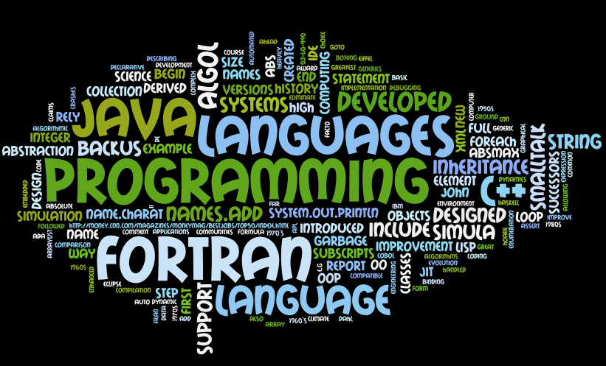
Programming language history
Created by wordle.net, from the text in this slide

Slide 49
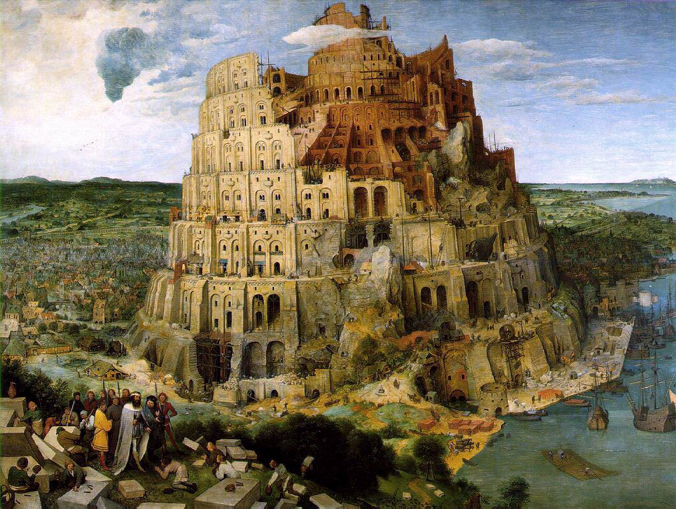

Slide 50
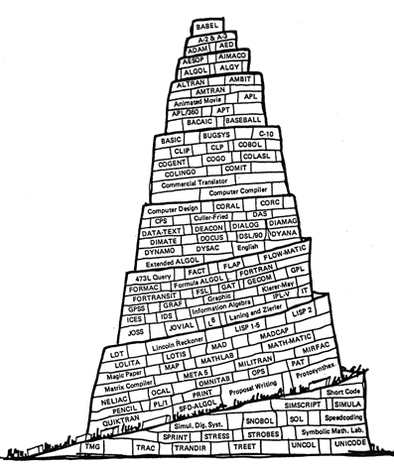
03-60-440: Programming language history
Tower of Babel, CACM cover, Jan. 1961
Babel:
a city in Shinar where the building of a tower is held in Genesis to have been halted by the confusion of tongues
a confusion of sounds or voices
a scene of noise or confusion
--Webster

Slide 51
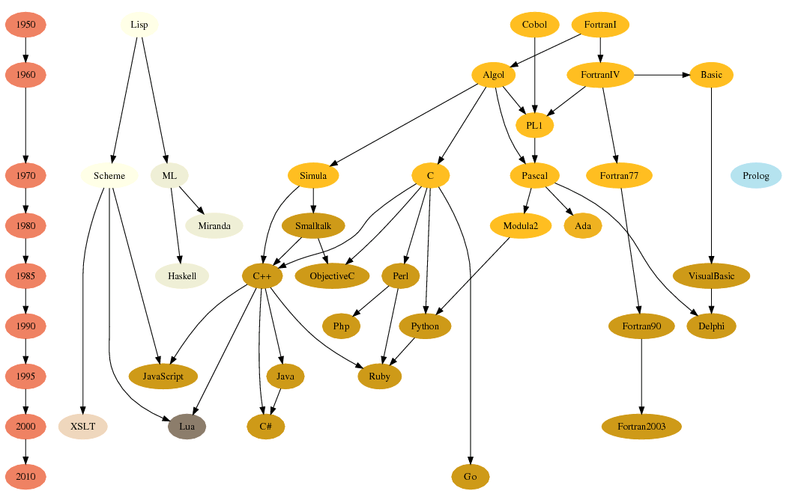
Evolution of programming languages
Functional
Imperative

Slide 52
Relations between languages derived from GitHub user interactions. Generated by Zhongpei Zhang and Jianguo Lu

Slide 53
FORTRAN (Formula Translator)
It is the first high level programming language
The Preliminary Report, 1954, claims that FORTRAN will virtually eliminate coding and debugging.
Developed by John Backus, at IBM.
Major versions: Fortran II in 1958, Fortran IV in 1961, Fortran 77, Fortran 95, Fortran 2003 (OO support).
Initial versions rely heavily on GOTO statement;
It remains the language of choice for high performance numerical computing in science and engineering communities
Example applications:
Weather and climate modeling, solar system dynamics, simulation of auto crashes.

Slide 54
ALGOL (ALGOrithmic Language)
de facto standard way to report algorithms in print
Designed to improve Fortran
John Backus developed the Backus Naur Form method of describing programming languages.
ALGOL 60 inspired many languages that followed it
"ALGOL 60 was a great improvement on its successors.“
The full quote is "Here is a language so far ahead of its time, that it was not only an improvement on its predecessors, but also on nearly all its successors" --C. A. R Hoare
procedure Absmax(a) Size:(n, m) Result:(y) Subscripts:(i, k);
value n, m; array a; integer n, m, i, k; real y;
comment The absolute greatest element of the matrix a, of size n by m is transferred to y, and the subscripts of this element to i and k;
begin integer p, q;
y := 0; i := k := 1;
for p:=1 step 1 until n do
for q:=1 step 1 until m do
if abs(a[p, q]) > y then
begin y := abs(a[p, q]);
i := p; k := q
end
end Absmax

Slide 55
The origin of OOP: Simula and Smalltalk
Simula 67:
Developed in 1960’s, by Ole-Johan Dahl
Simulation of complex systems
Introduced objects, classes, and inheritance.
Smalltalk:
Developed at Xerox PARC, initially by Alan Kay, in 1970’s.
First full implementation of an object-oriented language (data abstraction, inheritance, and dynamic type binding)
Pioneered the graphical user interface design
Promoted OOP

Slide 56
Java (and comparison with C++)
Derived from C++. Smaller, simpler, and more reliable
e.g., no pointers, no multiple inheritance, automated garbage collection.
Design philosophy
Java was created to support networking computing, embedded systems.
C++ was created to add OO to C. Support systems programming.
Version history
1.0: 1996
1.2: 1998, Introduced Swing, JIT
1.4: 2002, assert, regular expression, XML parsing
1.5 (5): 2004, generics, enumeration
6: Dec 2006 web service support(JAX WS)
7: July 2011
8: 2014, lambda expression, higher order functions

Slide 57
Java and C#
The syntax of both languages is similar to C++, which was in turn derived from C.
Both languages were designed to be object oriented from the ground up; unlike C++, they were not designed to be compatible with C.
Both provide parametric polymorphism by generic classes.
Both languages rely on a virtual machine.
Both the Java VM and the .NET platform optimize code at runtime through just-in-time compilation (JIT).
Both include garbage collection.
Both include boxing and unboxing of primitive types, allowing numbers to be handled as objects.
Both include foreach, an enhanced iterator-based for loop.

Slide 58
Foreach statement: an example of abstraction
Java iteration: traditional way (before 2004)
List names = new ArrayList();
names.add("a");
names.add("b");
names.add("c");
for (Iterator it = names.iterator(); it.hasNext(); ) {
String name = (String)it.next();
System.out.println(name.charAt(0));
}
Java 1.5:
for (String name: names) System.out.println(name.charAt(0));
New loop structure is more declarative.

Slide 59
XML programming
XPath
XQuery
XSLT
JSP
Web service programming

Slide 60
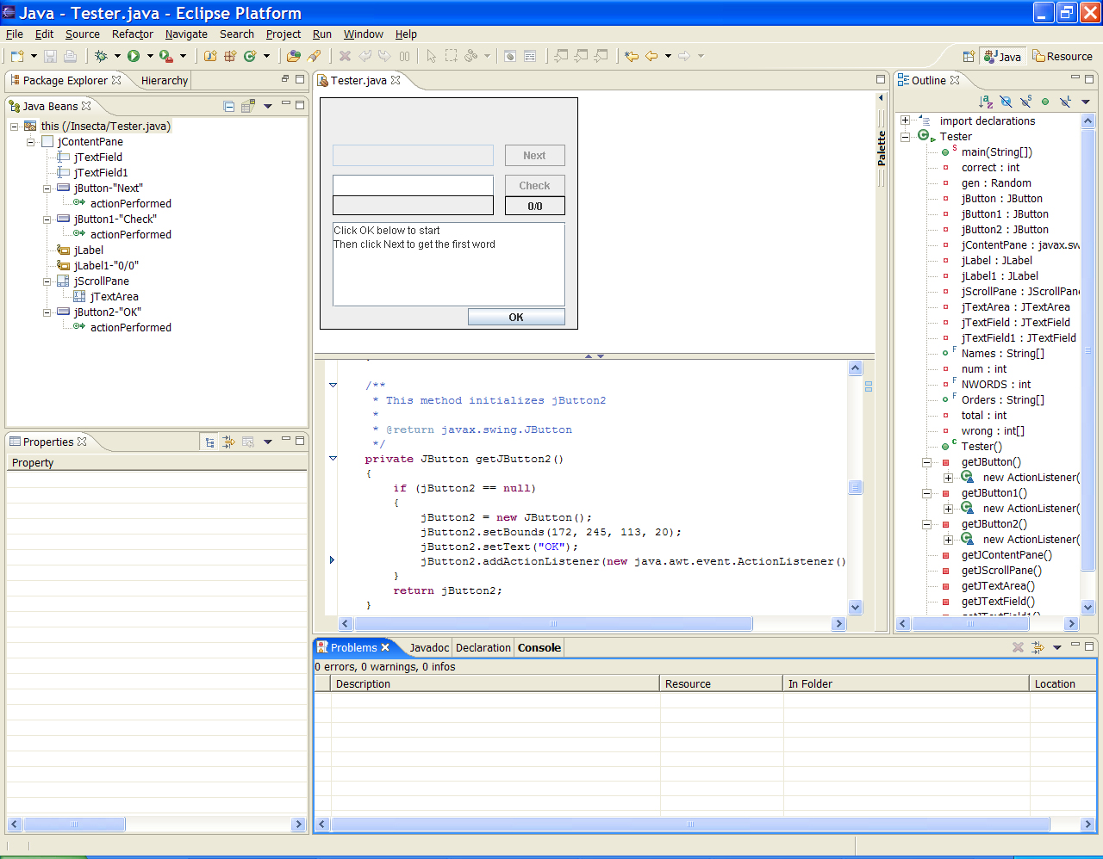
IDE (Integrated Development Environment)
IDE for Java: Eclipse

Slide 61
Turing award (Nobel prize in computer science) recipients relevant to this course
Year | Recipient | Contribution to programming languages
1966 | Alan Jay Perlis | Compiler and Algol
1971 | John McCarthy | Lisp
1972 | Edsger Dijkstra | Algol, Structured programming
1977 | John Backus | Fortran, BNF
1980 | C.A.R. Hoare | Axiomatic semantics
1983 | Ken Thompson and Dennis M. Ritchie | c and unix
1984 | Niklaus Wirth | Modula, PASCAL
2001 | Ole-Johan Dahl and Kristen Nygaard | SIMULA, OO
2003 | Alan Kay | SMALLTALK, OO
2005 | Peter Naur | Algol, BNF

Slide 62
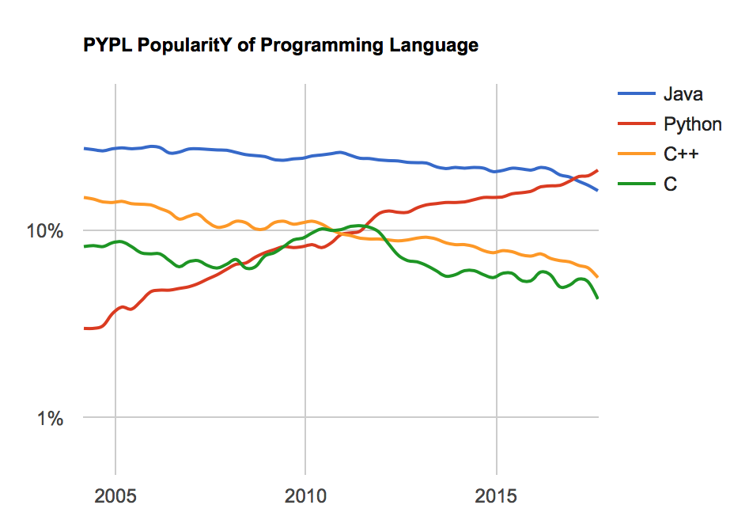
Language popularity over years
Measured by how often language tutorials are searched on Google.
This is the trend in USA.
You can get the trend of other languages from http://pypl.github.io/PYPL.html?country=US

Slide 63
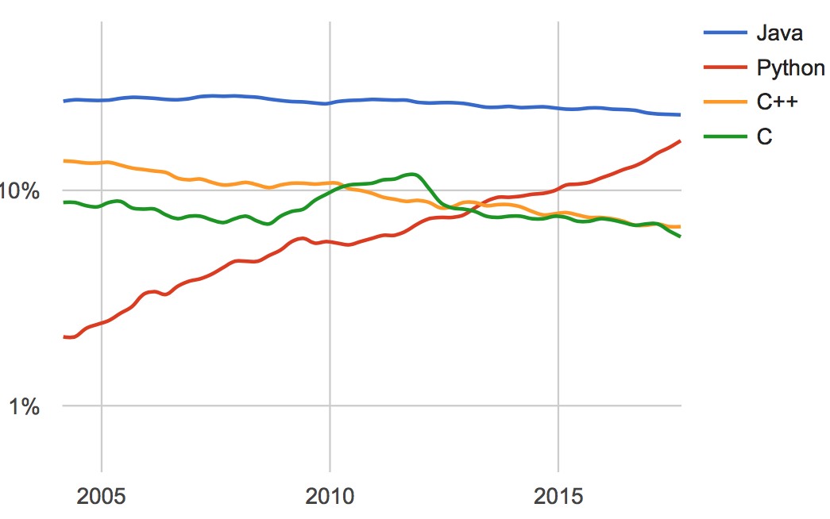
Popularity worldwide

Slide 64
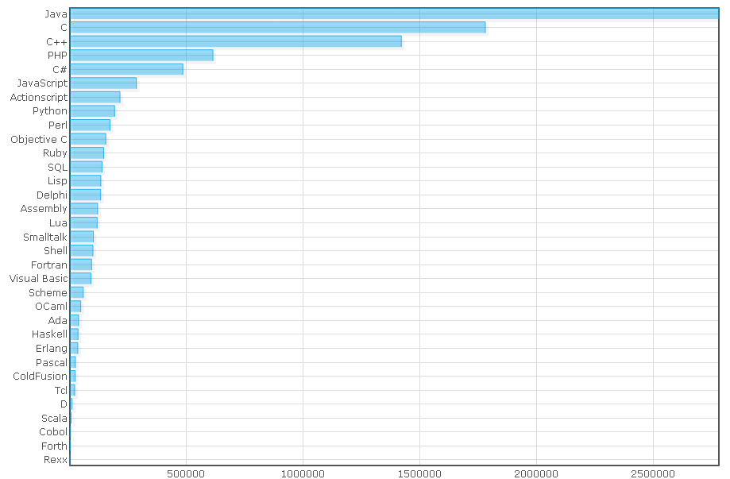
Popularity of programming languages

Slide 65
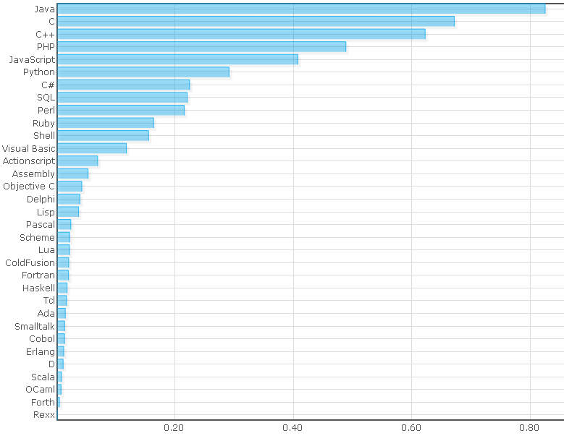
Popularity of programming languages
This is a chart showing combined results from all data sets

Slide 66
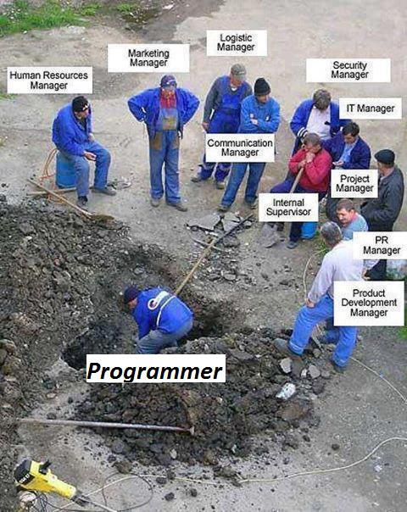
programmer

