Slide 1

Map-reduce programming paradigm
“In pioneer days they used oxen for heavy pulling, and when one ox couldn’t budge a log, they didn’t try to grow a larger ox.
We shouldn’t be trying for bigger computers, but for more systems of computers.”
—Grace Hopper
Some slides are from lecture of Matei Zaharia, and distributed computing seminar by Christophe Bisciglia, Aaron Kimball, & Sierra Michels-Slettvet.

Slide 2
What we have learnt
Lambda calculus
Syntax (variables, abstraction, application)
Reductions (alpha, beta, eta)
Functional programming
Higher order functions, map, reduce
Why are they relevant to programming in industry?
Here is one example

Slide 3
Data
The New York Stock Exchange generates about one terabyte of new trade data per day.
Facebook hosts approximately 10 billion photos, taking up one petabyte of storage.
Ancestry.com, the genealogy site, stores around 2.5 petabytes of data.
The Internet Archive stores around 2 petabytes of data, and is growing at a rate of 20 terabytes per month.
The Large Hadron Collider near Geneva, Switzerland, produces about 15 petabytes of data per year.
…
1 PB= 1000 terabytes, or 1,000,000 gigabytes

Slide 4
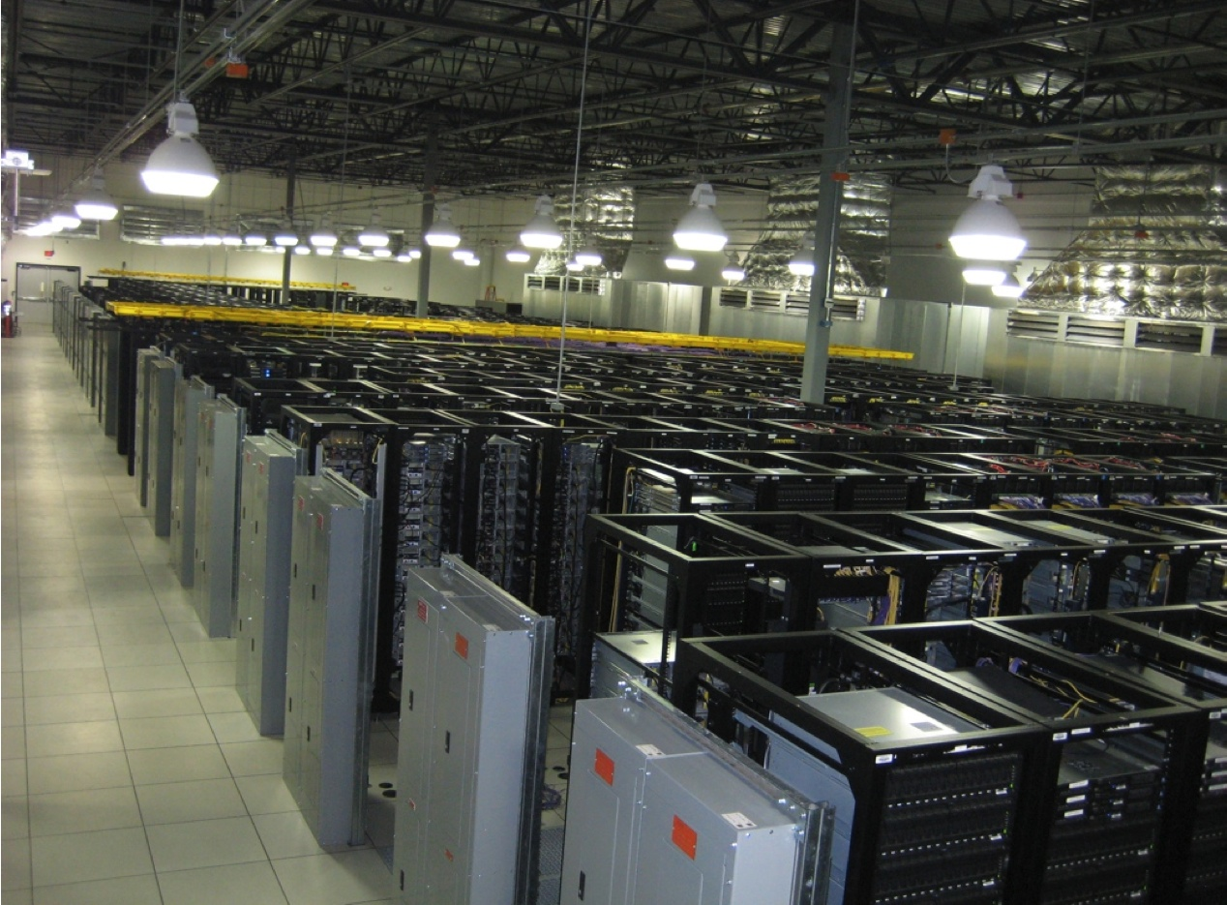
Map-reduce design goal
Scalability to large data volumes:
1000’s of machines, 10,000’s of disks
Cost-efficiency:
Commodity machines (cheap, but unreliable)
Commodity network
Automatic fault-tolerance (fewer administrators)
Easy to use (fewer programmers)
Google uses 900,000 servers as of August 2011.
“In pioneer days they used oxen for heavy pulling, and when one ox couldn’t budge a log, they didn’t try to grow a larger ox. We shouldn’t be trying for bigger computers, but for more systems of computers.”
—Grace Hopper

Slide 5
Challenges
Cheap nodes fail, especially if you have many
Mean time between failures for 1 node = 3 years
Mean time between failures for 1000 nodes = 1 day
Solution: Build fault-tolerance into system
Commodity network = low bandwidth
Solution: Push computation to the data
Programming distributed systems is hard
Communication and coordination
Failure recovery
Status report
Debugging
Optimization
….
Repeat the above work for every problem
Solution: abstraction
Clean and simple programming interface
Data-parallel programming model: users write “map” & “reduce” functions, system distributes work and handles faults

Slide 6
Map-reduce paradigm
A simple programming model that applies to many large-scale computing problems
Hide messy details in MapReduce runtime library:
automatic parallelization
load balancing
network and disk transfer optimization
handling of machine failures
robustness
improvements to core library benefit all users of library!

Slide 7
Typical problem solved by map-reduce
Read a lot of data
Map: extract something you care about from each record
Shuffle and Sort
Reduce: aggregate, summarize, filter, or transform
Write the results
(reduce + 0 (map (lambda (x) 1) ‘(a b c)))
Outline stays the same,
Map and Reduce change to fit the problem

Slide 8
Where mapreduce is used
At Google:
Index construction for Google Search
Article clustering for Google News
Statistical machine translation
At Yahoo!:
“Web map” powering Yahoo! Search
Spam detection for Yahoo! Mail
At Facebook:
Data mining
Ad optimization
Spam detection
Numerous startup companies and research institutes

Slide 9
Example 1: Distributed searching
Split data
grep
matches
Split data
grep
matches
Very
big
data
All
matches
Split data
grep
matches
cat
Split data
grep
matches
grep: a unix command to search text
grep semantic test.txt //find all the lines containing semantic
cat: a unix command to concatenate and display

Slide 10
Example 2: Distributed word counting
Split data
count
count
Split data
count
count
Very
big
data
merged
count
Split data
count
count
merge
Split data
count
count
Potential application:
click counting, which url are more frequently visited
Link counting, which page has more in-links or out-links

Slide 11
Map-reduce
R
E
D
U
C
E
Very
big
data
M
A
P
Result
Map:
Accepts input (key1, value1) pair
Emits intermediate a list of (key2, value2) or (key2, value2+) pairs
Reduce :
Accepts intermediate list of (key2, value2+) pairs
Emits a list of (key2, value3) pairs

Slide 12
Map and reduce
map f lst: (α → β) → (α list) → (β list)
Creates a new list by applying f to each element of the input list;
returns output in order.
Length example:
(reduce + 0 (map (lambda (x) 1) ‘(a b c)))
:α
f
f
f
f
f
f
:β

Slide 13
Reduce
reduce f x₀ lst: (β×α→β) × β × (α list)→ β
Moves across a list, applying f to each element plus an accumulator. f returns the next accumulator value, which is combined with the next element of the list
(reduce + 0 (map (lambda (x) 1) ‘(a b c)))
:α
f
f
f
f
f
returned
initial
:β

Slide 14
Word count example
Input: a large file of words
A sequence of words
Output: the number of times each distinct word appears in the file
A set of (word, count) pairs
Algorithm
For each word w, emit (w, 1) as a key-value pair
Group pairs with the same key. E.g., (w, (1,1,1))
Reduce the values for within the same key
Performance
Step 1 can be done in parallel
Reshuffle of the data
In parallel for different keys
Sample application: analyze web server logs to find popular URLs

Slide 15
The execution process
Input
Map
partition
Reduce
Output
the, 1
quick, 1
brown, 1
fox, 1
brown, (1, 1)
Fox, (1, 1)
how, (1)
now, (1)
the, (1, 1, 1)
the quick
brown fox
Map
brown, 2
fox, 2
how, 1
now, 1
the, 3
Reduce
the, 1
fox, 1
ate, 1
the, 1
mouse, 1
the fox ate
the mouse
Map
ate, (1)
cow, (1)
mouse, (1)
quick, (1)
ate, 1
cow, 1
mouse, 1
quick, 1
how, 1
now, 1
brown,1
cow,1
Reduce
how now
brown cow
Map

Slide 16
What a programmer need to write
map(key, value):
// key: document name; value: text of document
for each word w in value:
emit(w, 1)
reduce(key, values):
// key: a word; value: an iterator over counts
result = 0
for each count v in values:
result += v
emit(result)

Slide 17
Map‐Reduce environment takes care of:
Partitioning the input data
Scheduling the program’s execution across a set of machines
Handling machine failures
Managing required inter‐machine communication
Allows programmers without any experience with parallel and distributed systems to easily utilize the resources of a large distributed cluster

Slide 18
Combiner
Often a map task will produce many pairs of the form (k,v1), (k,v2), … for the same key k
E.g., popular words in Word Count
Can save network time by pre-aggregating at mapper
combine(k1, list(v1)) → v2
Usually same as reduce function
Works only if reduce function is commutative and associative

Slide 19
Combiner example
Input
Map
Shuffle & Sort
Reduce
Output
the, 1
quick, 1
brown, 1
fox, 1
brown, (1, 1)
Fox, (1, 1)
how, (1)
now, (1)
the, (2, 1)
the quick
brown fox
Map
brown, 2
fox, 2
how, 1
now, 1
the, 3
Reduce
the, 2
fox, 1
ate, 1
mouse, 1
the fox ate
the mouse
Map
ate, (1)
cow, (1)
mouse, (1)
quick, (1)
ate, 1
cow, 1
mouse, 1
quick, 1
how, 1
now, 1
brown,1
cow,1
Reduce
how now
brown cow
Map

Slide 20
Mapper in word count (using hadoop)
public class MapClass extends MapReduceBase
implements Mapper<LongWritable, Text, Text, IntWritable> {
private final static IntWritable ONE = new IntWritable(1);
public void map(LongWritable key, Text value,
OutputCollector<Text, IntWritable> out,
Reporter reporter) throws IOException {
String line = value.toString();
StringTokenizer itr = new StringTokenizer(line);
while (itr.hasMoreTokens()) {
out.collect(new text(itr.nextToken()), ONE);
}
}
}
“The brown fox”→ <“the”, 1>, <“brown”,1>, <“fox”, 1>

Slide 21
Reducer
public class ReduceClass extends MapReduceBase
implements Reducer<Text, IntWritable, Text, IntWritable> {
public void reduce(Text key, Iterator<IntWritable> values,
OutputCollector<Text, IntWritable> out,
Reporter reporter) throws IOException {
int sum = 0;
while (values.hasNext()) {
sum += values.next().get();
}
out.collect(key, new IntWritable(sum));
}
}
(“the”, <1, 1, 1>) → <“the”, 3>
if there is no combiner

Slide 22
Main program
public static void main(String[] args) throws Exception {
JobConf conf = new JobConf(WordCount.class);
conf.setJobName("wordcount");
conf.setMapperClass(MapClass.class);
conf.setCombinerClass(ReduceClass.class);
conf.setReducerClass(ReduceClass.class);
conf.setNumMapTasks(new Integer(3));
conf.setNumReduceTasks(new Integer(2));
FileInputFormat.setInputPaths(conf, args[0]);
FileOutputFormat.setOutputPath(conf, new Path(args[1]));
conf.setOutputKeyClass(Text.class); // out keys are words (strings)
conf.setOutputValueClass(IntWritable.class); // values are counts
JobClient.runJob(conf);
}

Slide 23
Under the hood
User
Program
fork
fork
fork
Master
assign
map
assign
reduce
Input Data
Worker
write
Output
File 0
local
write
Worker
Split 0
read
Split 1
Worker
Split 2
Output
File 1
Worker
Worker
remote
read,
sort

Slide 24
Execution Overview
Split data
MapReduce library splits input files into M pieces
starts up copies of the program on a cluster (1 master + workers)
Master assigns M map tasks and R reduce tasks to workers
Map worker reads contents of input split
parses key/value pairs out of input data and passes them to map
intermediate key/value pairs produced by map: buffer in memory
Mapper results written to local disk;
partition into R regions;
pass locations of buffered pairs to master for reducers
Reduce worker uses RPC to read intermediate data from remote disks; sorts pairs by key
Iterates over sorted intermediate data; calls reduce; appends output to final output file for this reduce partition
When all is complete, user program is notified

Slide 25
Step 1 data partition
The user program indicates how many partitions should be created
conf.setNumMapTasks(new Integer(3));
That number of partitions should be the same as the number of mappers
MapReduce library splits input files into M pieces
User program
the quick
brown fox
the fox ate
the mouse
how now
brown cow
the quick
Brown
fox
the fox ate
the mouse
how now
brown cow
Map reduce
lib

Slide 26
Step 2: assign mappers and reducers
Master assigns M map tasks and R reduce tasks to workers
conf.setNumMapTasks(new Integer(3));
conf.setNumReduceTasks(new Integer(2));
User
Program
fork
fork
fork
Master
assign
map
assign
reduce
Worker
Worker
local
write
Worker
Worker
Worker

Slide 27
Step 3: mappers work in parallel
Each map worker reads assigned input and output intermediate <key, value> pairs
public void map(LongWritable key, Text value,
OutputCollector<Text, IntWritable> out,
Reporter reporter) throws IOException {
String line = value.toString();
StringTokenizer itr = new StringTokenizer(line);
while (itr.hasMoreTokens()) {
out.collect(new text(itr.nextToken()), ONE);
}
}
Output buffered in RAM
the quick
brown fox
The, 1
quick, 1
…
Map

Slide 28
Step 4: results of mappers are partitioned
Each worker flushes intermediate values, partitioned into R regions, to disk and notifies the Master process.
Which region to go can be decided by hash function
master
the quick
brown fox
The, 1
quick, 1
Brown, 1
fox, 1
Mapper

Slide 29
Step 5: reducer
Master process gives disk locations to an available reduce-task worker who reads all associated intermediate data.
int sum = 0;
while (values.hasNext()) {
sum += values.next().get();
}
out.collect(key, new IntWritable(sum));
master
The, 1
quick, 1
Brown, 1
fox, 1
brown, (1, 1)
Fox, (1, 1)
how, (1)
now, (1)
the, (1,1, 1)
brown, 2
fox, 2
how, 1
now, 1
the, 3
the quick
brown fox
Mapper
Reducer
(quick,1) goes to other reducer

Slide 30
Parallelism
map() functions run in parallel, creating different intermediate values from different input data sets
reduce() functions also run in parallel, each working on a different output key
All values are processed independently
Bottleneck: reduce phase can’t start until map phase is completely finished.

Slide 31
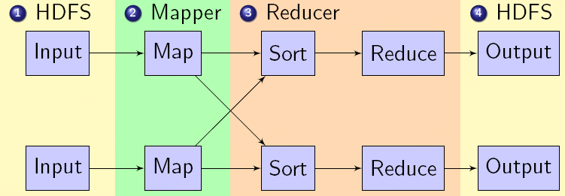
Data flow
Mappers read from HDFS (Hadoop Distributed File System)
Map output is partitioned by key and sent to Reducers
Reducers sort input by key
Reduce output is written to HDFS
Input, final output are stored on a distributed file system
Scheduler tries to schedule map tasks “close” to physical storage location of input data
Intermediate results are stored on local FS of map and reduce workers
Output is often input to another map/reduce task

Slide 32
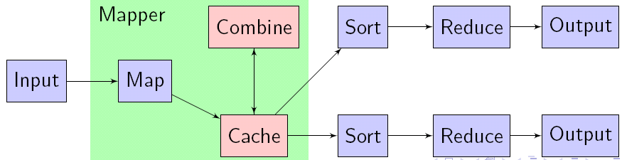
Combiner
Add counts at Mapper before sending to Reducer.
Word count is 6 minutes with combiners and 14 without.
Implementation
Mapper caches output and periodically calls Combiner
Input to Combine may be from Map or Combine
Combiner uses interface as Reducer
(“the”, <1, 1, 1>) ➔ <“the”, 3>

Slide 33
Coordination
Master data structures
Task status: (idle, in-progress, completed)
Idle tasks get scheduled as workers become available
When a map task completes, it sends the master the location and sizes of its R intermediate files, one for each reducer
Master pushes this info to reducers
Master pings workers periodically to detect failures
User
Program
fork
fork
fork
Master
assign
map
assign
reduce
Worker
Worker
local
write
Worker
Worker
Worker

Slide 34
How many Map and Reduce jobs?
M map tasks, R reduce tasks
Rule of thumb:
One DFS chunk per map is common
Improves dynamic load balancing and speeds recovery from worker failure
Usually R is smaller than M, because output is spread across R files

Slide 35
Hadoop
An open-source implementation of MapReduce in Java
Uses HDFS for stable storage
Yahoo!
Webmap application uses Hadoop to create a database of information on all known web pages
Facebook
Hive data center uses Hadoop to provide business statistics to application developers and advertisers
In research:
Astronomical image analysis (Washington)
Bioinformatics (Maryland)
Analyzing Wikipedia conflicts (PARC)
Natural language processing (CMU)
Particle physics (Nebraska)
Ocean climate simulation (Washington)
http://lucene.apache.org/hadoop/

Slide 36

Hadoop component
Distributed file system (HDFS)
Single namespace for entire cluster
Replicates data 3x for fault-tolerance
MapReduce framework
Executes user jobs specified as “map” and “reduce” functions
Manages work distribution & fault-tolerance
“In pioneer days they used oxen for heavy pulling, and when one ox couldn’t budge a log, they didn’t try to grow a larger ox. We shouldn’t be trying for bigger computers, but for more systems of computers.”
—Grace Hopper

Slide 37

HDFS
Two types nodes: name nodes and data nodes
Single name node stores metadata (file names, block locations, etc)
Files split into 128MB blocks
Blocks replicated across several data nodes (usually 3)
Optimized for large files, sequential reads
Files are append-only
Namenode
File1
1
2
3
4
1
2
1
3
2
1
4
2
4
3
3
4
Datanodes

Slide 38
Mapreduce in Amazon elastic computing
What if you do not have many machines….
You can practice on one machine
You can run on amazon EC2 and S3
Cloud computing: refers to services by those companies that let external customers rent computing cycles on their clusters
Amazon EC2: virtual machines at 10¢/hour, billed hourly
Amazon S3: storage at 15¢/GB/month
EC2 Provides a web-based interface and command-line tools for running Hadoop jobs
Data stored in Amazon S3
Monitors job and shuts down machines after use
Attractive features:
Scale: up to 100’s of nodes
Fine-grained billing: pay only for what you use
Ease of use: sign up with credit card, get root access

Slide 39
Takeaway messages
MapReduce programming model hides the complexity of work distribution and fault tolerance
Principal design philosophies:
Make it scalable, so you can throw hardware at problems
Make it cheap, lowering hardware, programming and admin costs
MapReduce is not suitable for all problems, but when it works, it may save you quite a bit of time
Cloud computing makes it straightforward to start using Hadoop (or other parallel software) at scale

Slide 40
Limitations of MapReduce
Not every algorithm can be written in MapReduce
MapReduce is good at one-pass computation,
inefficient for multi-pass algorithms
No efficient primitives for data sharing
State between steps goes to distributed file system
Slow due to replication and disk storage

Slide 41
Apache Spark
from operator import add f = sc.textFile("README.md") wc = f.flatMap(lambda x: x.split(' ')).map(lambda x: (x,1)).reduceByKey(add)
wc.saveAsTextFile("wc_out.txt")

Slide 42
Java 7:
JavaRDD<String> distFile = sc.textFile("README.md"); // Map each line to multiple words JavaRDD<String> words = distFile.flatMap(
new FlatMapFunction<String, String>() { public Iterable<String> call(String line) { return Arrays.asList(line.split(" ")); } });
Java 8:
JavaRDD<String> distFile = sc.textFile("README.md");
JavaRDD<String> words = distFile.flatMap(line -> Arrays.asList(line.split(" ")));

