Slide 1
<440: XSLT>
Jianguo Lu
University of Windsor

Slide 2
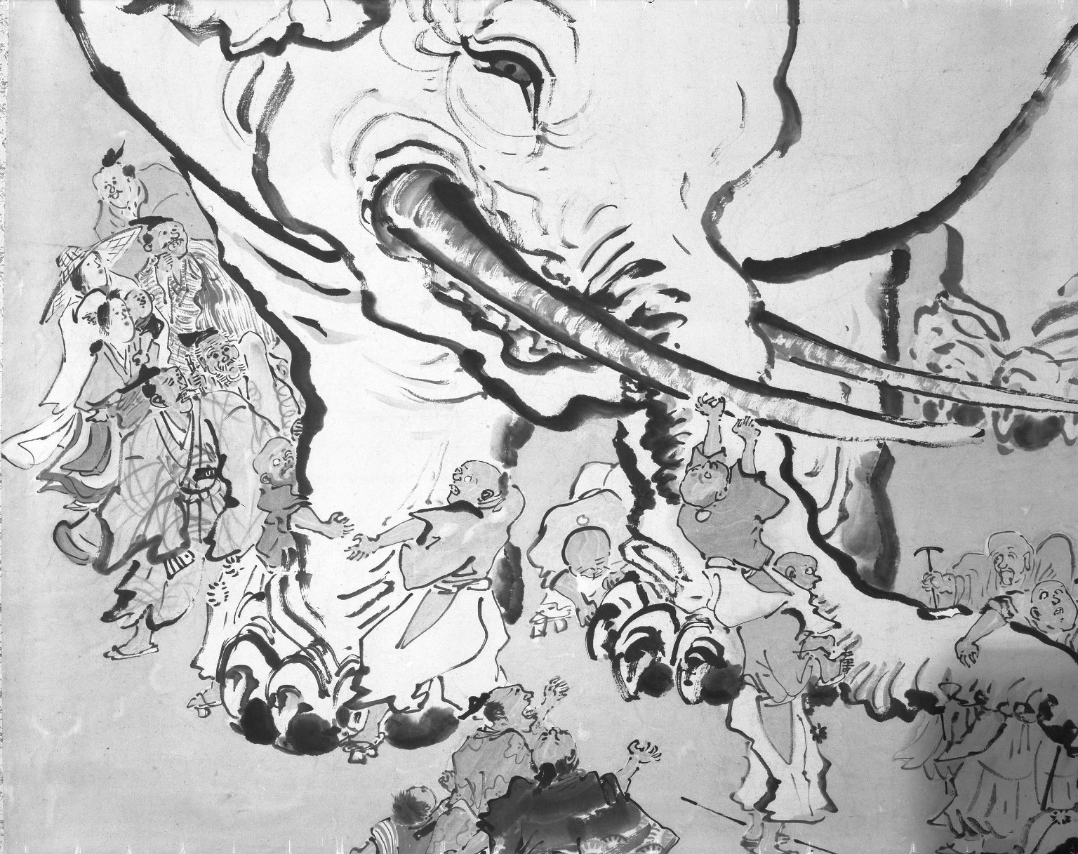
Blind Men Appraising an Elephant by Ohara Donshu, Edo Period (early 19th century), Brooklyn Museum

Slide 3
XML based programming
With the widespread adoption of XML standard, there are languages designed specifically for XML processing
XML query
XQuery
XML transformation
XSLT
relies on XPath and XML Schema
Web Service

Slide 4

Hello world example
<?xml version="1.0" encoding="iso-8859-1"?>
<?xml-stylesheet type="text/xsl" href="hello.xsl"?>
<greeting>Hello, world!</greeting>
<?xml version="1.0" encoding="iso-8859-1"?>
<xsl:stylesheet version="1.0"
xmlns:xsl=
"http://www.w3.org/1999/XSL/Transform">
<xsl:template match="/">
<html>
<head>
<title>Today's greeting</title>
</head>
<body>
<p><xsl:value-of select="greeting"/></p>
</body>
</html>
</xsl:template>
</xsl:stylesheet>
<html>
<head>
<META http-equiv="Content-Type" content="text/html; charset=UTF-8">
<title>Today's greeting</title>
</head>
<body>
<p>Hello, world!</p>
</body>
</html>

Slide 5

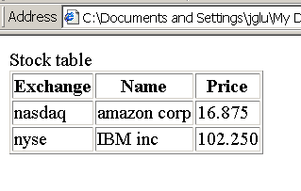


Running XSLT from the client side
Browser gets the XML+XSLT, and interprets them inside the browser.
How to specify the XSL associated with the XML file?
<?xml-stylesheet type="text/xsl" href="stock.xsl"?>
Advantages:
Easy to develop and deploy.
Disadvantages:
Not every browser supports XML+XSL;
Browsers do not support all XSLT features;
Not secure: you only want to show part of the XML data;
Not efficient.
Web server

Slide 6


Run XSLT from the server side
XSL processor transforms the XML and XSLT to HTML, and the web server send the HTML to the browser.
Popular tool: xalan
Download xalan.jar from
http://www.apache.org/dyn/closer.cgi/xml/xalan-j
Run Xalan to transform xml documents:
java -classpath xalan/bin/xalan.jar org.apache.xalan.xslt.Process -in stock.xml -xsl stock.xsl -out stock.html
Web server
XSL Processor
HTML
HTML

Slide 7
XSLT(XML Stylesheet Language Transformation)
XSLT Version 1.0 is a W3C Recommendation, 1999
http://www.w3.org/Style/XSL/
XSLT is used to transform XML to other formats.
XSLT 1
XML
XML
XSLT 2
HTML
XSLT 3
TEXT

Slide 8
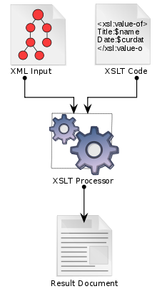
XSLT basics
XSLT is an XML document itself
It is a tree transformation language
XSLT
XSLT processor
XML
It is a rule-based declarative language
XSLT program consists of a sequence of rules.
It is a functional programming language.
It has no side-effects

Slide 9
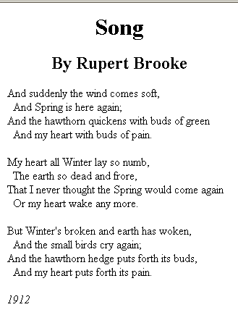
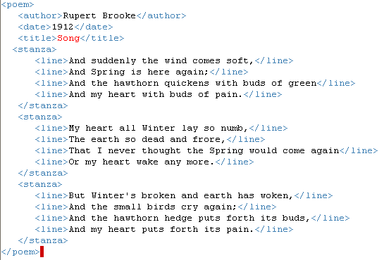
Poem example: xml and intended html output

Slide 10
Poem example: XSL
<xsl:stylesheet xmlns:xsl="http://www.w3.org/1999/XSL/Transform"
version="1.0">
<xsl:template match="poem">
<html>
<head>
<title><xsl:value-of select="title"/> </title>
</head>
<body>
<xsl:apply-templates select="title"/>
<xsl:apply-templates select="author"/>
<xsl:apply-templates select="stanza"/>
<xsl:apply-templates select="date"/>
</body>
</html>
</xsl:template>
<xsl:template match="title">
<div align="center">
<h1><xsl:value-of select="."/> </h1>
</div>
</xsl:template>
<xsl:template match="author">
<div align="center">
<h2>By <xsl:value-of select="."/> </h2>
</div>
</xsl:template>
<xsl:template match="date">
<p><i><xsl:value-of select="."/> </i></p>
</xsl:template>
<xsl:template match="stanza">
<p><xsl:apply-templates select="line"/> </p>
</xsl:template>
<xsl:template match="line">
<xsl:if test="position() mod 2 = 0"> &#160;&#160; </xsl:if>
<xsl:value-of select="."/> <br/>
</xsl:template>
</xsl:stylesheet>

Slide 11
Generate the online test questions
<test>
<Q a="E">
<question>
Which of the following is not an OO programming language?
</question>
<item> Java
</item><item> C++
</item><item> Smalltalk
</item><item> Simula 67
</item><item> None of the above.
</item></Q>
<Q a="A"><question>Which of the following language is not a declarative language?
</question><item>
Java
</item><item> Prolog
</item><item> SQL
</item><item> Scheme
</item><item> None of the above.
</item></Q>
Which of the following is not an OO programming language? A. Java B. C++ C. Smalltalk D. Simula 67 E. None of the above.
Which of the following language is not a declarative language? A. Java B. Prolog C. SQL D. Scheme E. None of the above.
Which of the following is a script language? A. Java B. C# C. PHP D. Prolog E. Scheme F. None of the above.

Slide 12
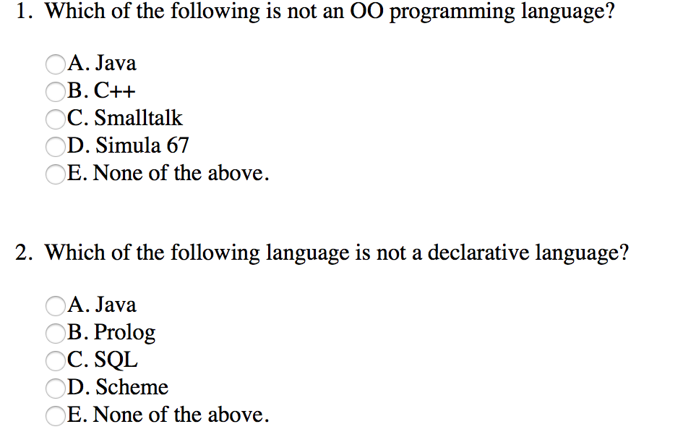

Slide 13
Rule-based
<xsl:template match="title">
<div align="center">
<h1><xsl:value-of select="."/> </h1>
</div>
</xsl:template>
<xsl:template match="author">
<div align="center">
<h2>By <xsl:value-of select="."/> </h2>
</div>
</xsl:template>
<xsl:template match="date">
<p><i><xsl:value-of select="."/> </i></p>
</xsl:template>
… …
XSLT consists of a sequence of template rules;
Each describes how a particular element type (or other constructs) can be processed;
Rules are not arranged in any particular order (theoretically)
They don’t have to match the order of input or output;
Programmers don’t know (and don’t care) the execution ordering of the rules;
That is why it is called a declarative language;
Programmers specify what output should produce when particular pattern occurs in input.

Slide 14
No side effect
If functions have side effects, it is important to call them the right number of times, in a correct order, and in a correct context.
Why XSLT does not want to have side effects:
Requirement from the rule-based language
Incremental development
Incremental rendering
Browser display partially downloaded xml file

Slide 15
XSLT process model
<source>
<employee>
<firstName>Joe</firstName>
<surName>Smith</surName>
</employee>
<employee>
<firstName>Andrew</firstName>
<surName>Wang</surName>
<supervisor>
<employee>
<firstName>Steve</firstName>
<surName>Miller</surName>
</employee>
</supervisor>
</employee>
</source>
<?xml version="1.0" encoding="utf-8"?>
<xsl:stylesheet xmlns:xsl=
"http://www.w3.org/1999/XSL/Transform"
version=“1.0">
<xsl:template match="employee">
Hello, Found you!
</xsl:template>
</xsl:stylesheet>
Output:
Hello, Found you!
Hello, Found you!
Questions:
Why only two matches?
What are the two matches?

Slide 16
Built-in template
Select the employee who is a supervisor (incorrect)
<xsl:template match="employee/supervisor/employee">
Hello, found you!
</xsl:template>
XSLT starts with the root of the document.
If there is no template rule defined, built-in template is invoked.
For element, the built-in template processes the children of the current element.
For text, the built-in template copy the text to the result tree.
Outout:
<?xml version="1.0" encoding="UTF-8"?>
Joe
Smith
Andrew
Wang
Hello, found you!

Slide 17
Text node XML Tree
Output
Joe
sur name is Smith
Andrew
sur name is Wang
Steve
sur name is Miller
<?xml version="1.0" encoding="utf-8"?>
<xsl:stylesheet xmlns:xsl="http://www.w3.org/1999/XSL/Transform" version="1.0">
<xsl:template match="surName">
sur name is <xsl:value-of select="." />
</xsl:template>
</xsl:stylesheet>
document
<source>
text
<employee>
text
<employee >
text
<firstName>
<surName>
<firstName>
<surName>
<supervisor>
Joe
Smith
Andrew
Wang
…

Slide 18
Override built-in template
Pick employees who are supervisors (still not correct)
<xsl:template match="employee">
</xsl:template>
<xsl:template match="employee/supervisor/employee">
Hello, found you!
</xsl:template>
</xsl:stylesheet>
Output:
nothing.

Slide 19
Override built-in template
Output:
Joe
Smith
Andrew
Wang
Hello, found you!
When find outer employees, apply rules
<xsl:template match="employee">
<xsl:apply-templates/>
</xsl:template>
<xsl:template match="employee/supervisor/employee">
Hello, found you!
</xsl:template>
</xsl:stylesheet>

Slide 20
More specific about what to do
<xsl:template match="employee">
<xsl:apply-templates select=“supervisor/>
</xsl:template>
<xsl:template match="employee/supervisor/employee">
Hello, found you!
</xsl:template>
</xsl:stylesheet>
Output:
Hello, found you!

Slide 21
XML process model: why built-in rules
<?xml version='1.0'?>
<xsl:stylesheet xmlns:xsl="http://www.w3.org/1999/XSL/Transform" version="1.0">
<xsl:template match="para">
<p><xsl:apply-templates/></p>
</xsl:template>
<xsl:template match="emphasis">
<i><xsl:apply-templates/></i>
</xsl:template>
</xsl:stylesheet>
Output copies most part of the input
It would be cumbersome to write each of those built-in rules explicitly
<?xml version='1.0'?> <para> This is a <emphasis> test </emphasis></para> .
Output
<p> This is a <i> test </i></p>.

Slide 22
The input
<source>
<employee>
<firstName>Joe</firstName>
<surName>Smith</surName>
</employee>
<employee>
<firstName>Andrew</firstName>
<surName>Wang</surName>
<supervisor>
<employee>
<firstName>Steve</firstName>
<surName>Miller</surName>
</employee>
</supervisor>
</employee>
</source>

Slide 23
The order of rules
<xsl:template match="employee">
<tr> <xsl:apply-templates /> </tr>
</xsl:template>
<xsl:template match="surName">
<td> <xsl:value-of select="."/> </td>
</xsl:template>
<xsl:template match="firstName">
<td> <xsl:value-of select="."/> </td>
</xsl:template>
Input data decides the rules to be applied.
It works well if the output has the same structure and sequence as the input;
All we did is performing simple editing of values as we go along.
What if we want sur name printed first?
Result:
<tr>
<td>Joe</td>
<td>Smith</td>
</tr>
<tr>
<td>Andrew</td>
<td>Wang</td>
<tr>
<td>Steve</td>
<td>Miller</td>
</tr>
</tr>

Slide 24
Controlling which rule to apply first
Be more precise about which node to process, rather than just saying process all children of the current node
Be more precise about how to process them, rather than just saying choose the best-fit template rule
<xsl:template match="employee">
<tr> <xsl:apply-templates select="surName" />
<xsl:apply-templates select="firstName" />
</tr>
</xsl:template>
<xsl:template match="surName | firstName">
<td> <xsl:value-of select="."/> </td>
</xsl:template>
Instead of selecting all child elements and finding the appropriate template rule for each one, this one explicitly selects <surName> and <firstName> elements
Other child elements are not processed.
<supervisor> is not processed.
Output
<tr><td>Smith</td><td>Joe</td></tr>
<tr><td>Wang</td><td>Andrew</td></tr>

Slide 25
Resolve conflict
<xsl:template match="employee">
doing this
</xsl:template>
<xsl:template match="source/employee">
doing that
</xsl:template>
In this case there are two rules matching with employee elements.
Which rule should be used?
Output
doing that
doing that
Priority rules
“source/employee” gets higher priority than “employee”;
“employee” gets higher priority than “*”;
* matches everything. We will see that later.

Slide 26

Another priority example
<xsl:template match="doc">
<html><head><title>A Document</title></head>
<body><xsl:apply-templates/></body></html>
</xsl:template>
<xsl:template match="para">
<p><xsl:apply-templates/></p>
</xsl:template>
<xsl:template match="emphasis">
<i><xsl:apply-templates/></i>
</xsl:template>
<xsl:template match="emphasis/emphasis">
<b><xsl:apply-templates/></b>
</xsl:template>
</xsl:stylesheet>
Why nested emphasis is not using the rule adding <i> ?
<doc>
<para>This is a <emphasis>test</emphasis>.
<emphasis>Nested <emphasis>emphasis</emphasis>
</emphasis>.
</para>
</doc>
<html>
<head>
<title>A Document</title>
</head>
<body>
<p>This is a <i>test</i>.
<i>Nested <b>emphasis</b></i>.</p>
</body>
</html>

Slide 27
Pattern matching vs. <for-each>
Pattern matching style of processing is the most characteristic feature of XSLT;
Good for
applications where each type of node in the document is handled independently;
processing an element that may contain children of different types in an unpredictable sequence.
documents that are likely to evolve over time.
As new child elements are added, template rules to process them can be added, without changing the logic for the parent element.
There are alternatives
<xsl:for-each> is closer to procedure programming
Perform explicit processing for each node

Slide 28
<for-each> and XPath
Select sequence of items using XPath expression, performs same processing for each item in the sequence.
<xsl:template match="source">
<xsl:for-each select="employee">
<tr> <xsl:apply-templates select="surName"/></tr>
</xsl:for-each>
</xsl:template>
<xsl:template match="surName">
<td> <xsl:value-of select="."/> </td>
</xsl:template>
“employee” is an XPath.
“source”, “surName”, “.” are also xpaths.
It selects nodes relative to the context node (the node currently being processed).
Output
<tr><td>Smith</td></tr><tr><td>Wang</td></tr>

Slide 29
XPath
XPath select nodes relative to its context
<xsl:template match="source">
<xsl:for-each select="employee/supervisor/employee">
<tr> <xsl:apply-templates select="surName"/></tr>
</xsl:for-each>
</xsl:template>
<xsl:template match="surName">
<td> <xsl:value-of select="."/> </td>
</xsl:template>
Output
<tr><td>Miller</td></tr>

Slide 30
Selecting more than one case
<xsl:template match="source">
<xsl:for-each select="employee/supervisor/employee | employee">
<tr> <xsl:apply-templates select="surName"/>
<xsl:apply-templates select="firstName"/>
</tr>
</xsl:for-each>
</xsl:template>
<xsl:template match="surName | firstName">
<td> <xsl:value-of select="."/> </td>
</xsl:template>
Output
<tr><td>Smith</td><td>Joe</td></tr>
<tr><td>Wang</td><td>Andrew</td></tr>
<tr><td>Miller</td><td>Steve</td></tr>
Can we have more concise notation than “employee/supervisor/employee | employee" ?
In general, simply writing the element names are not enough. What is the syntax (or the XPath language)?

Slide 31
XPath language
XPath is a sublanguage in XSLT.
For example, previous example can be simplified as follows, where “//employee” is an XPath expression, meaning any employee element, no matter where it occurs.
<xsl:template match="source">
<xsl:for-each select= “//employee">
<tr> <xsl:apply-templates select="surName"/>
<xsl:apply-templates select="firstName"/>
</tr>
</xsl:for-each>
</xsl:template>
<xsl:template match="surName | firstName">
<td> <xsl:value-of select="."/> </td>
</xsl:template>

Slide 32
XPath
One critical capability of a stylesheet language is to locate source elements to be styled.
XPath has a string-based syntax (it is no longer in XML format)
It describes "location paths" between parts of a document or documents
XPath defines a library of standard functions
Such as arithmetic expressions.
XPath is a major element in many xml based languages, such as XSLT and XML query languages
XPath is a W3C Standard
One inspiration for XPath was the common "path/file" file system syntax

Slide 33
What is XPath
Like traditional file paths
public_html/440/xslt.ppt
XPath uses path expressions to identify nodes in an XML document.
source/employee
Absolute path
/source/employee
Relative path
employee

Slide 34
XPath pattern syntax
A path consists of a series of steps, separated by slashes
E.g., “employee/supervisor” has two steps
A step can be an axis specifier, followed by a node test, and a predicate
“employee” in our previous example is a node test.
“employee[1]” is an node test followed by a predicate
“ancestor::employee” contains an axis followed by a node test
axis
Node test
predicate
ancestor :: employee [1]
/
supervisor
step
step

Slide 35
Predicate in XPath
<xsl:template match="source">
<xsl:for-each select="employee[1]">
<xsl:value-of select="firstName"/>
</xsl:for-each>
</xsl:template>
“[1]” is a predicate, matching the first element
Output
Joe
Predicate can involve xslt library functions
<xsl:for-each select="employee[position()=last()]">
Output
Andrew
<xsl:for-each select=“employee[position() mod 2 = 0]”>
match even nodes
Recall the poem example uses similar predicate

Slide 36
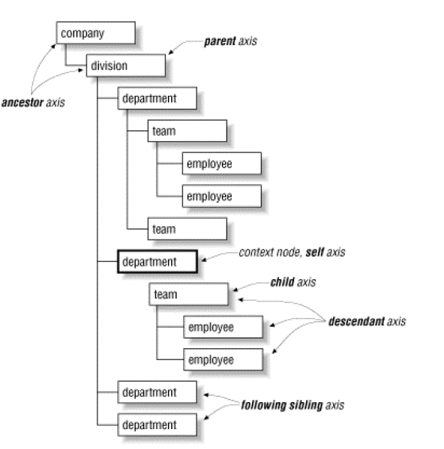
Axes
Ancestor
Parent
Child
Descendant
Sibling
Self

Slide 37
Axis in XPath
<xsl:template match="supervisor/employee">
ancestor node of <xsl:value-of select="firstName"/> is
<xsl:value-of select="ancestor::employee/firstName"/>
</xsl:template>
<xsl:template match="employee">
<xsl:apply-templates select="supervisor/employee"/>
</xsl:template>
ancestor:: is the axis specifier. It matches with ancestor employee elements
Output:
ancestor node of Steve is Andrew

Slide 38
XPath examples
“para”
Matches all <para> children in the current context
“para/emphasis”
Matches all <emphasis> elements that have a parent of <para>
“emphasis | strong”
Matches <emphasis> or <strong> elements
“/”
Matches the root of the document
“para//emphasis”
Matches all <emphasis> elements that have an ancestor of <para>
“section/para[1]”
Matches the first <para> child of all the <section> children in the current context
“//title”
Matches all <title> elements anywhere in the document
“.//title”
Matches all <title> elements that are descendants of the current context

Slide 39
Access attributes
/library
/library/author
//author
/library/@location
//book[@title=“Artificial Intelligence”]
<library location="Bremen">
<author name="Henry Wise">
<book title="Artificial Intelligence"/>
<book title="Modern Web Services"/>
<book title="Theory of Computation"/>
</author>
<author name="William Smart">
<book title="Artificial Intelligence"/>
</author>
<author name="Cynthia Singleton">
<book title="The Semantic Web"/>
<book title="Browser Technology Revised"/>
</author>
</library>

Slide 40
XPath examples
“section/*/note”
Matches <note> elements that have <section> grandparents.
“stockquote[@symbol]”
Matches <stockquote> elements that have a "symbol" attribute
“stockquote[@symbol=appl]”
Matches <stockquote> elements that have a "symbol" attribute with the value ”appl“
Exercise: Select all the stock with price greater than 2
stockquote[@price > 2] ?
Stockquote[@price &gt; 2]

Slide 41
Other language constructs
If statement
<xsl:template match="line">
<xsl:if test="position() mod 2 = 0"> &#160;&#160; </xsl:if>
<xsl:value-of select="."/><br/>
</xsl:template>
Template definition and call
Sample input:
<?xml version="1.0" ?>
<stocks>
<stock exchange="nasdaq">
<name>amazon corp </name>
<symbol>amzn</symbol>
<price>16</price>
</stock>
<stock exchange="nyse">
<name>IBM inc</name>
<price>102</price>
</stock>
</stocks>
stock.xml

Slide 42
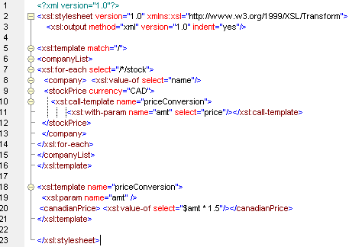
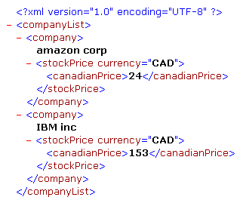
Template definition and call
<?xml version="1.0" ?>
<stocks>
<stock exchange="nasdaq">
<name>amazon corp </name>
<symbol>amzn</symbol>
<price>16</price>
</stock>
<stock exchange="nyse">
<name>IBM inc</name>
<price>102</price>
</stock>
</stocks>

Slide 43
XSLT rule: <xsl:template>
<xsl:template match="stock">
<company>
<value>
<xsl:value-of select="price*1.5"/> CAD
</value>
<name>
<xsl:value-of select="name"/>
</name>
<company>
</xsl:template>
xslt template for <stock>
<?xml version="1.0" ?>
<stocks>
<stock exchange="nasdaq">
<name>amazon corp </name>
<symbol>amzn</symbol>
<price>16</price>
</stock>
<stock exchange="nyse">
<name>IBM inc</name>
<price>102</price>
</stock>
</stocks>
<company>
<value>
get the value of <price>* 1.5, i.e. 24 CAD
</value>
<name>
get the value of <name>, i.e amazon
</name>
</company>
Part of the output
stock.xml

Slide 44
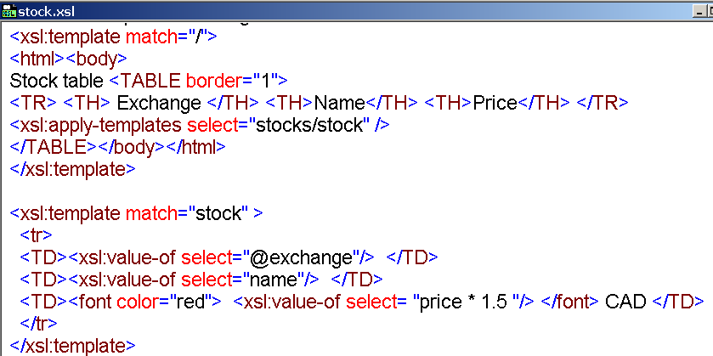
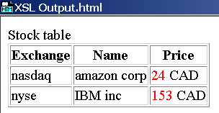
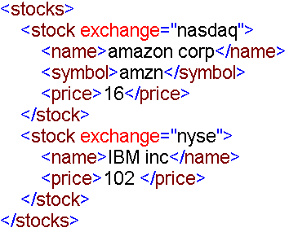
Transforming XML to HTML
toHTML.xsl

Slide 45
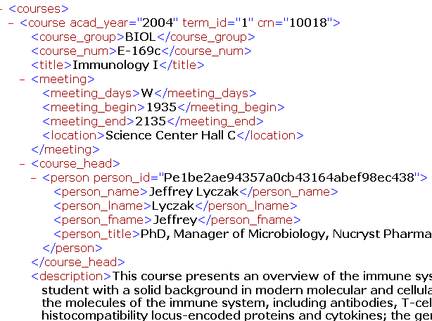
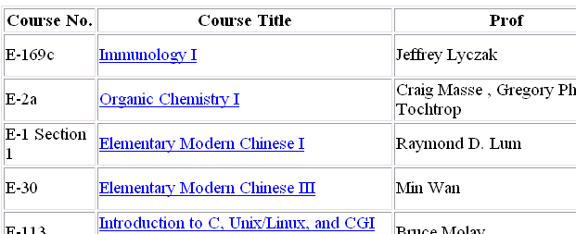
Assignment
<html>
<script>
function addDisplay (details) {
document.write(details);
}
</script>
<body>
<table border="1">
<th>Course No.</th><th>Course Title</th><th>Prof</th><th> Year </th><th> Days</th><th>Time</th><th>Location</th>
<tr>
<td>E-169c</td><td> <a href="JavaScript:addDisplay('This course presents an overview of the immune system and focuses on providing the student with a solid background in modern molecular and cellular immunology. The course covers the molecules of the immune system, including antibodies, T-cell receptors, and major histocompatibility locus-encoded proteins and cytokines; the genes encoding these molecules; the cells of the immune system and their interactions; and the biological functions of the immune system and its regulation. Prerequisite: background in biology, biochemistry, and genetics.');">Immunology I</a>

Slide 46
Xsl:attribute
Add an attribute name and its vaule
If you want
<a href=“something generated by xslt”> … </a>
You may want to write
<a href=“<xsl:value_of select=“description”>”> … </a>
But that is not a valid xml document
We need to give a value to an attribute
<xsl:attribute name=“href”>
<xsl:value_of select=“description”>
</xsl:attribute>

Slide 47
Add attribute to an element
Task: pass XSLT values as JavaScript parameter
When clicking on the hyper link such as Fundamentals of Grammar, the course description will popup
Popup a window
function addDisplay (details) {
document.write(details);
}
Pass values in XSLT to JavaScript
<a href=“JavaScript:addDisplay( ‘someTextExtractedUsingXSLT’)”> Fundamentals of Grammar </a>
➔
<a href=“JavaScript:addDisplay( <xsl:value_of select=“description”>> Fundamentals of Grammar </a>
➔
<a> <xsl:attribute name="href">
JavaScript:addDisplay(‘ <xsl:value-of select=“description”/> '); </xsl:attribute>
Fundamentals of Grammar </a>

Slide 48
Summary
XSLT is an XML transformation language
The input is an XML document, the output can be in any format
XSLT itself is in XML format
XSLT is very different from other programming languages
Rule based (templates, …)
Processing model (scan from the root of the input)
It also has the conventional programming language constructs
If, for-each, variable, procedure declaration and invocation …
It relies on XPath
XPath itself is not in XML format

Slide 49
Questions?
"If you give someone a program, you will frustrate them for a day; if you teach them how to program, you will frustrate them for a lifetime.”
Anonymous

