Slide 1
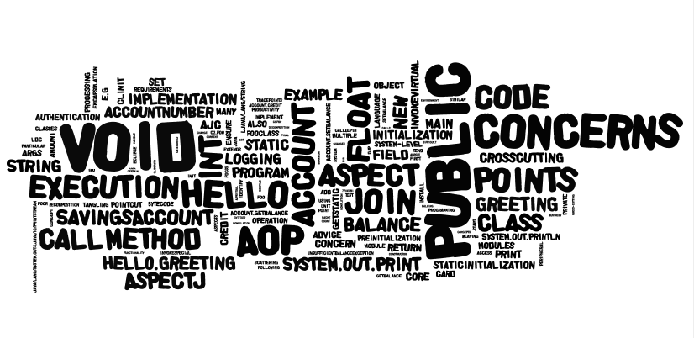
Aspect-Oriented Programming and AspectJ
Jianguo Lu
University of Windsor

Slide 2

Following “AspectJ in Action” Chapter 2, 3.

Slide 3
Motivating example
void transfer(Account fromAccount, Account toAccount, int amount) {
if (!getCurrentUser().canPerform(OP_TRANSFER)) {
throw new SecurityException();
}
if (fromAccount.getBalance() < amount) {
throw new InsufficientFundsException();
}
Transaction tx = database.newTransaction();
try {
fromAccount.withdraw(amount);
toAcount.deposit(amount);
tx.commit();
systemLog.logOperation(OP_TRANSFER, fromAccount, toAccount, amount);
}
catch(Exception e) {
tx.rollback();
}
}
The code has lost its elegance and simplicity
various new concerns tangled with the basic functionality (business logic concern).
The transactions, security, logging, etc. all exemplify cross-cutting concerns.
Implementation of crosscutting concerns are scattered across numerous methods.
Change of the implementation would require a major effort.
Solution: Separate different concerns.

Slide 4
AOP – encapsulation of concerns
Gregor Kiczales and his team at Xerox PARC originated this concept in 1997. This team also developed the first, and still most popular, AOP language: AspectJ.
AOP aids programmers in the separation of concerns:
Break down a program into distinct parts that overlap in functionality as little as possible.
In particular, AOP focuses on the modularization and encapsulation of cross-cutting concerns.
Older programming paradigms also focus on separation and encapsulation of concerns (or any area of interest of focus) into single entities.
Packages, classes, and methods encapsulate concerns into single entities.
Some concerns defy such easy encapsulation.
They are crosscutting concerns, because they exist in many parts of the program
e.g., Logging

Slide 5
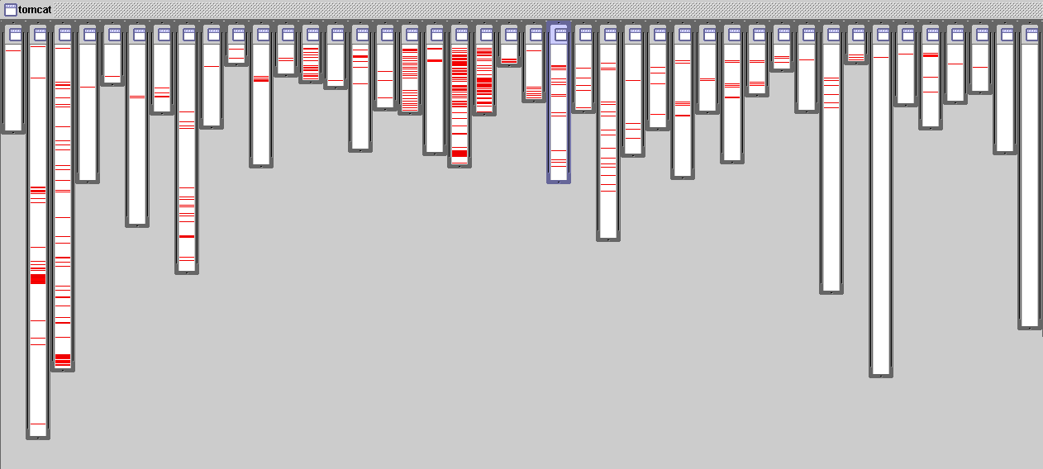
Example of crosscutting concerns
Logging in Tomcat:
Red shows the lines of code that handle logging
Logging code scattered across packages and classes

Slide 6
Cross-cutting concerns
Concern: a particular goal, concept, or area of interest.
Software system comprises several core and system-level concerns.
For example, a credit card processing system's
Core concern would process payments,
System-level concerns would handle logging, transaction integrity, authentication, security, performance, and so on.
Many system-level requirements tend to be orthogonal (mutually independent) to each other and to the module-level requirements.
System-level requirements also tend to crosscut many core modules.
Crosscutting concerns -- affect multiple implementation modules.
Using current programming methodologies, crosscutting concerns span over multiple modules, resulting in systems that are harder to design, understand, implement, and evolve.

Slide 7
Example of crosscutting concerns
public class SomeBusinessClass extends OtherBusinessClass { public void performSomeOperation(OperationInformation info) { // Ensure authentication // Ensure info satisfies contracts // Lock the object to ensure data-consistency in case other // threads access it // Ensure the cache is up to date // Log the start of operation // ==== Perform the core operation ==== // Log the completion of operation // Unlock the object } // More operations similar to above }
Implementation of performSomeOperation() does more than performing the core operation;
it handles the peripheral logging, authentication, multithread safety, contract validation, and cache management concerns.
In addition, many of these peripheral concerns would likewise apply to other classes.

Slide 8
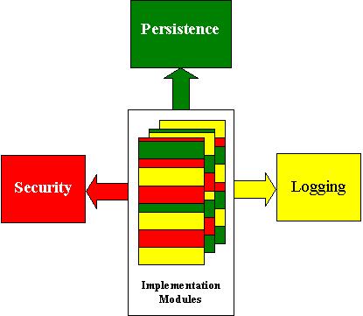
Implementation modules as a set of concerns

Slide 9


Symptoms of implementing crosscutting concerns using current methodology
We can broadly classify those symptoms into two categories:
Code tangling: two or more concerns are implemented in the same body of a component, making it more difficult to understand
e.g. in an account transfer method, there are the transfer business logic and the logging code
Code scattering: similar code is distributed throughout many program modules. Change to the implementation may require finding and editing all affected code
e.g. logging code is scattered across all kinds of modules
Scattering and tangling (S&T) tend to appear together; they describe different facets of the same problem

Slide 10
Implications of code tangling and scattering
Poor traceability:
poor mapping between a concern and its implementation
Lower productivity:
developer can not focus on one concern
Less code reuse:
difficult to reuse a module since it implements multiple concerns
Poor code quality:
Code tangling produces code with hidden problems.
More difficult evolution:
modifying one concern may cause ripples in many other modules

Slide 11
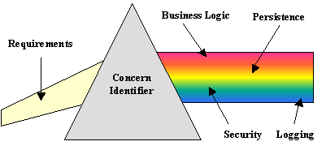
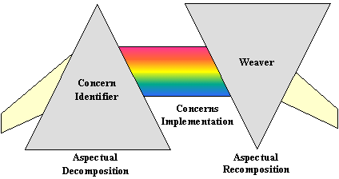
Concern decomposition and weaving: the prism analogy

Slide 12
Fundamentals of AOP
AOP lets you implement individual concerns in a loosely coupled fashion, and combine these implementations to form the final system.
Aspectual decomposition: Decompose the requirements to identify crosscutting and common concerns. Separate module-level concerns from crosscutting system-level concerns.
E.g, in credit card module example, you would identify three concerns: core credit card processing, logging, and authentication.
Concern implementation: Implement each concern separately.
E.g., implement the core credit card processing unit, logging unit, and authentication unit.
Aspectual re-composition: an aspect integrator specifies re-composition rules by creating modularization units -- aspects.
The re-composition process, also known as weaving or integrating, uses this information to compose the final system.
E.g., you'd specify, in a language provided by the AOP implementation, that each operation's start and completion be logged. You would also specify that each operation must clear authentication before it proceeds with the business logic.

Slide 13
Running AOP
base
program
Aspect
AOP compiler
woven program

Slide 14
AOP Hello world example: a class and an aspect
public class Hello {
void greeting(){
System.out.println("Hello!");
}
public static void main( String[] args ){
new Hello().greeting();
}
}
public aspect With {
before() : call( void Hello.greeting() ) {
System.out.print(“AOP>> ");
}
}

Slide 15
The first program: compile and run
>ajc Hello.java With.aj
>java Hello
AOP>> Hello!
ajc: Aspect weaver
Compiles Java and AspectJ
Produces efficient code
Incremental compilation
Accepts bytecode

Slide 16
Three ways to run aspectj
Preinstalled
Method 1: Use ajc installed on our ubuntu machines on campus
Install on your own machines
Method 2: Install command line ajc
Method 3: Install on AJDT on eclipse

Slide 17
Method 1: Use pre-installed aspectj on ubuntu
ssh into bravo.cs.uwindsor.ca
Compile and run
ajc SomeAspect.aj SomeJavaWithMain.java
java SomeJavaWithMain

Slide 18
Take care of the classpath
jlu@bravo:~/440/A2$ ajc Hello.java HelloA.aj
jlu@bravo:~/440/A2$ java Hello
Exception in thread "main" java.lang.NoClassDefFoundError: Hello
Caused by: java.lang.ClassNotFoundException: Hello
at java.net.URLClassLoader$1.run(URLClassLoader.java:202)
at java.security.AccessController.doPrivileged(Native Method)
at java.net.URLClassLoader.findClass(URLClassLoader.java:190)
at java.lang.ClassLoader.loadClass(ClassLoader.java:306)
at sun.misc.Launcher$AppClassLoader.loadClass(Launcher.java:301)
at java.lang.ClassLoader.loadClass(ClassLoader.java:247)
Could not find the main class: Hello. Program will exit.

Slide 19
Add the current directory to your classpath
jlu@bravo:~/440/A2$ java -classpath . Hello
Exception in thread "main" java.lang.NoClassDefFoundError: org/aspectj/lang/Signature
Caused by: java.lang.ClassNotFoundException: org.aspectj.lang.Signature
at java.net.URLClassLoader$1.run(URLClassLoader.java:202)
at java.security.AccessController.doPrivileged(Native Method)
at java.net.URLClassLoader.findClass(URLClassLoader.java:190)
at java.lang.ClassLoader.loadClass(ClassLoader.java:306)
at sun.misc.Launcher$AppClassLoader.loadClass(Launcher.java:301)
at java.lang.ClassLoader.loadClass(ClassLoader.java:247)
Could not find the main class: Hello. Program will exit.

Slide 20
Add aspectjrt
jlu@bravo:~/440/A2$ ajc Hello.java HelloA.aj
jlu@bravo:~/440/A2$ java -classpath .:/usr/share/java/aspectjrt-1.6.9.jar Hello
Before: staticinitialization(Hello.<clinit>)
After: staticinitialization(Hello.<clinit>)
Before: execution(void Hello.main(String[]))
Before: get(PrintStream java.lang.System.out)
After: get(PrintStream java.lang.System.out)
Before: call(void java.io.PrintStream.println(String))
Hello
After: call(void java.io.PrintStream.println(String))
After: execution(void Hello.main(String[]))
jlu@bravo:~/440/A2$

Slide 21
Find the jar file
jlu@bravo:~/440/A2$ find /usr -name 'aspectjrt*’
……
/usr/share/java/aspectjrt.jar
/usr/share/java/aspectjrt-1.6.9.jar

Slide 22
Method 2: Installing command line AspectJ
Download AspectJ from http://www.eclipse.org/aspectj/
Start the installation by running the following
java –jar aspectj.jar
The current version is aspectj1.7 in 2012
Setup path and classpath
Control Panel/System/Advanced/Environment Variables
add <aspectj install dir>/lib/aspectjrt.jar to your classpath environment variable;
add <aspectj install dir>/bin to your path environment variable.
Compile AspectJ programs by
ajc YourJavaClass.java YourAspect.aj
>ajc Hello.java With.aj

Slide 23
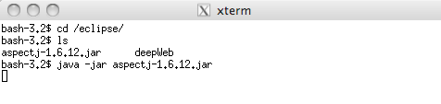

Same for Mac OS and Windows

Slide 24

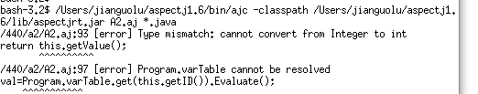
Possible errors
bash-3.2$ /Users/jianguolu/aspectj1.6/bin/ajc -1.6
-classpath /Users/jianguolu/aspectj1.6/lib/aspectjrt.jar:tiny.jar:.
A2.aj *.java
bash-3.2$ java -classpath /Users/jianguolu/aspectj1.6/lib/aspectjrt.jar:tiny.jar:. UseParser

Slide 25
Setting Java Classpath in Windows
specify value of environment variable CLASSPATH;
right click on my computer ➔ choosing properties ➔Advanced ➔ Environment variable
this will open Environment variable window in windows.
Add the path of aspectj jar file to CLASSPATH
You can check the value of Java classpath in windows type "echo %CLASSPATH%" in your DOS command prompt and it will show you the value of directory which are included in CLASSPATH.
Need to restart the command window to let classpath take effect
You can also set classpath in windows by using DOS command like :
set CLASSPATH=%CLASSPATH%;yourAspectJrt.jar;

Slide 26
classpath
The class path is the path that the Java runtime environment searches for classes and other resource files.
The class path can be set using
the -classpath option when calling an SDK tool (the preferred method)
java –classpath . Hello
by setting the CLASSPATH environment variable.
The -classpath option is preferred
you can set it individually for each application
Not affect other applications
Different OS has different ways to set the environment variable
Windows XP, vista, windows 7, windows 8
Mac OS
Unix, solaris, linux, ubuntu, wubuntu

Slide 27
Method 3: AJDT: AspectJ Development Tools
Eclipse based tool to support AspectJ
install AJDT
From Menu Help/install new software
Paste the following link
http://download.eclipse.org/tools/ajdt/37/dev/update
Make sure eclipse version is consistent with ajdt version
AJDT37 goes fine with Eclipse Indigo and Helios in 2011
More recent version in 2012:
Eclipse 4.2.*
http://download.eclipse.org/tools/ajdt/42/dev/update

Slide 28
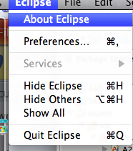
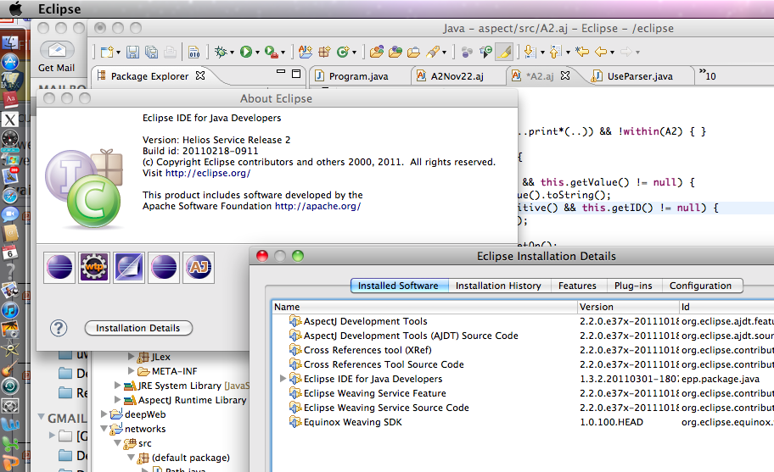
Eclipse version

Slide 29
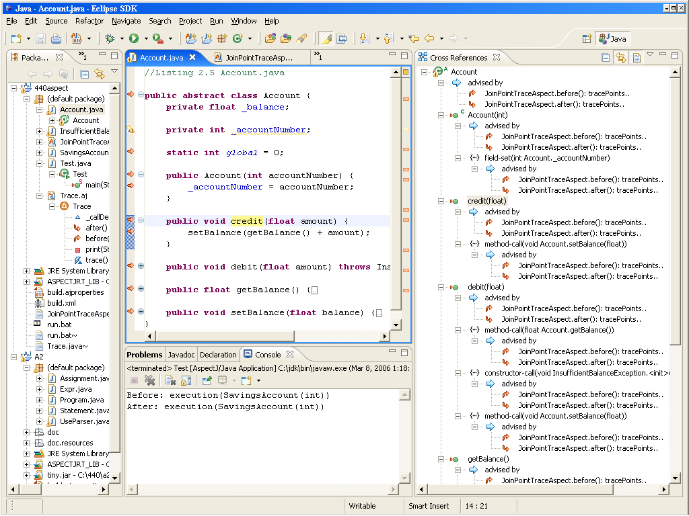
Eclipse AspectJ

Slide 30
The first program: after weaving (Simplified view!!!)
public class Hello {
void greeting(){ System.out.println("Hello!"); }
public static void main( String[] args ){
Hello dummy = new Hello();
System.out.print(“AOP>> ");
dummy.greeting();
}
}
public class Hello {
void greeting(){ System.out.println("Hello!"); }
public static void main( String[ ] args ){ new Hello().greeting(); }
}
public aspect With {
before() : call( void Hello.greeting() ) { System.out.print(“AOP>> "); }
}
What are the classes generated after compilation?
Look at the bytecode using “javap –c Hello”

Slide 31
Bytecode of With.class
… …
public With();
… …
public void ajc$before$With$1$7718efb1();
Code:
0: getstatic #33; //Field java/lang/System.out:Ljava/io/PrintStream;
3: ldc #35; //String AOP>>
5: invokevirtual #41; //Method java/io/PrintStream.print:(Ljava/lang/String;)V
8: return
public static With aspectOf();
Code:
0: getstatic #46; //Field ajc$perSingletonInstance:LWith;
3: ifnonnull 19
6: new #48; //class org/aspectj/lang/NoAspectBoundException
9: dup
10: ldc #49; //String With
12: getstatic #16; //Field ajc$initFailureCause:Ljava/lang/Throwable;
15: invokespecial #52; //Method org/aspectj/lang/NoAspectBoundException."<init>":(Ljava/lang/String;Ljava/lang/Throwable;)V
18: athrow
19: getstatic #46; //Field ajc$perSingletonInstance:LWith;
22: areturn
public static boolean hasAspect();
… …
}

Slide 32
Bytecode of Hello.class
public class Hello extends java.lang.Object{
public Hello();
… …
void greeting();
Code:
0: getstatic #21; //Field java/lang/System.out:Ljava/io/PrintStream;
3: ldc #23; //String Hello!
5: invokevirtual #29; //Method java/io/PrintStream.println:(Ljava/lang/String;)V
8: return
public static void main(java.lang.String[]);
Code:
0: new #2; //class Hello
3: dup
4: invokespecial #32; //Method "<init>":()V
7: invokestatic #44; //Method With.aspectOf:()LWith;
10: invokevirtual #47; //Method With.ajc$before$With$1$7718efb1:()V
13: invokevirtual #34; //Method greeting:()V
16: return
}
public aspect With {
before() : call( void Hello.greeting() ) { System.out.print("AOP>> "); }
}

Slide 33
Change the aspect
public aspect With {
before() : call( void Hello.greeting() ) {
System.out.print("AOP>> "); }
}
Print “AOP>>” after calling greeting() method
public aspect With {
after() : call( void Hello.greeting() ) { System.out.print("AOP>> "); }
}
Print “AOP>>” after calling all methods in Hello class
public aspect With {
after() : call( void Hello.*(..) ) { System.out.print("AOP>> "); }
}
Print “AOP>>” before executing greeting method
public aspect With {
before() : execution( void Hello.greeting() ) {
System.out.print("AOP>> "); }
}

Slide 34
When pointcut is changed from call to execution
public aspect With {
before() : execution (void Hello.greeting() ) {
System.out.print("AOP>> ");
}
}
… …
void greeting();
Code:
0: invokestatic #44; //Method With.aspectOf:()LWith;
3: invokevirtual #47; //Method With.ajc$before$With$1$ae8e2db7:()V
6: getstatic #21; //Field java/lang/System.out:Ljava/io/PrintStream;
9: ldc #23; //String Hello!
11: invokevirtual #29; //Method java/io/PrintStream.println:(Ljava/lang/String;)V
14: return
public static void main(java.lang.String[]);
Code:
0: new #2; //class Hello
3: dup
4: invokespecial #32; //Method "<init>":()V
7: invokevirtual #34; //Method greeting:()V
10: return
}

Slide 35
Join point, pointcut, advice, and aspect
Join point
Well-defined points in the program flow
a place where the aspect can join execution
public class Hello {
void greeting(){ System.out.println("Hello!"); }
public static void main( String[] args ){ new Hello().greeting(); }
}
Pointcut
A language construct to identify certain join points
e.g. call( void Hello.greeting() )
Advice:
Code to be executed at certain join points
e.g., before() : call( void Hello.greeting() ) {
System.out.print(“AOP>> "); }
Aspect
A module contains pointcuts, advice, etc. e.g.,
public aspect With {
before() : call( void Hello.greeting() ) {
System.out.print(“AOP>> "); }
}

Slide 36
The AspectJ language
One concept
Join points
Four constructs
Pointcuts
Advice
Aspects
Inter-type declarations

Slide 37
Example: count calls to foo method
public FooClass {
void foo() {}
void bar() {}
public static void main(String[] args) {
FooClass c1 = new FooClass();
FooClass c2 = new FooClass();
c1.foo(); c1.foo(); c1.bar();
c2.foo(); c2.foo(); c2.foo(); c2.bar();
System.out.println(“Done”);
}
}

Slide 38
Example: count calls to “foo”
aspect CountCalls {
int count = 0;
before() : call(* foo(..)) {
count++;
}
after() : execution(public static * main(..)) {
System.out.println(“count = “+count);
}
}
when foo is called
execute extra code
before the call to foo
after the main method executes, print
the count on standard output

Slide 39
Building with or without aspect
> ajc FooClass.java
> java FooClass
Done
a simple way
to add debugging
or tracing code
> ajc FooClass.java CountCalls.aj
> java FooClass
Done
count = 5
taking away the “probe” just requires leaving it out of the compilation

Slide 40
AspectJ language concepts
aspect CountCalls {
int count = 0;
before() : call(* foo(..)) {
count++;
}
after() : execution(public static * main(..)) {
System.out.println(“count = “+count);
}
}
pointcut
advice body
when
where
what
advice

Slide 41
AOP concepts
AOP encapsulates crosscutting concerns through aspect.
Aspect can alter the behavior of the base code (the non-aspect part of a program) by applying advice (additional behavior) over a quantification of join points (points in the structure or execution of a program),
Pointcut describes a set of join points
Examples of joint points:
method execution;
field reference;
all references to a particular set of fields.

Slide 42
Join points
Identifiable point in the execution of a program
Categories of join points
Method join points
call( void Hello.greeting() )
execution( void Hello.greeting() )
Constructor join points
call( void Hello.new() )
execution( void Hello.new() )
Field access join points
return “Account “+_accountNumber;
_accountNumber=12345;
Class initialization join points
staticinitialization(Account)
Object initialization join points
initializaion(public Account.new(..));
Object preinitialization
Advice execution

Slide 43
What are the join points in the following program
public class Test {
public static void main(String[] args)
throws InsufficientBalanceException {
SavingsAccount account = new SavingsAccount(12456);
account.credit(100);
account.debit(50);
}
}
public class SavingsAccount extends Account {
public SavingsAccount(int accountNumber) {
super(accountNumber);
}
}
public abstract class Account {
private float _balance;
private int _accountNumber;
public Account(int accountNumber) {
_accountNumber = accountNumber;
}
public void credit(float amount) {
setBalance(getBalance() + amount);
}
public void debit(float amount)
throws InsufficientBalanceException {
float balance = getBalance();
if (balance < amount) {
throw new InsufficientBalanceException(
"Total balance not sufficient");
} else { setBalance(balance - amount); }
}
public float getBalance() { return _balance; }
public void setBalance(float balance) { _balance = balance; }
}

Slide 44
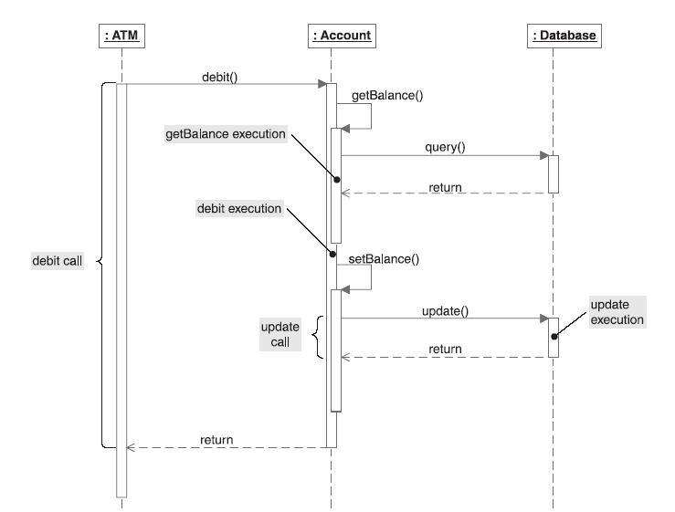
Some join points

Slide 45
The aspect to print out all the join points
public aspect JoinPointTraceAspect {
private int _callDepth = -1;
pointcut tracePoints() : !within(JoinPointTraceAspect);
before() : tracePoints() { _callDepth++; print("Before", thisJoinPoint); }
after() : tracePoints() { print("After", thisJoinPoint); _callDepth--; }
private void print(String prefix, Object message) {
for(int i = 0, spaces = _callDepth * 2; i < spaces; i++) {
System.out.print(" ");
}
System.out.println(prefix + ": " + message);
}
}

Slide 46
The join points
Before: staticinitialization(Test.<clinit>)
After: staticinitialization(Test.<clinit>)
Before: execution(void Test.main(String[]))
Before: call(SavingsAccount(int))
Before: staticinitialization(Account.<clinit>)
After: staticinitialization(Account.<clinit>)
Before: staticinitialization(SavingsAccount.<clinit>)
After: staticinitialization(SavingsAccount.<clinit>)
Before: preinitialization(SavingsAccount(int))
After: preinitialization(SavingsAccount(int))
Before: preinitialization(Account(int))
After: preinitialization(Account(int))
Before: initialization(Account(int))
Before: execution(Account(int))
Before: set(int Account._accountNumber)
After: set(int Account._accountNumber)
After: execution(Account(int))
After: initialization(Account(int))
Before: initialization(SavingsAccount(int))
Before: execution(SavingsAccount(int))
After: execution(SavingsAccount(int))
After: initialization(SavingsAccount(int))
After: call(SavingsAccount(int))
Before: call(void SavingsAccount.credit(float))
Before: execution(void Account.credit(float))
Before: call(float Account.getBalance())
Before: execution(float Account.getBalance())
Before: get(float Account._balance)
After: get(float Account._balance)
After: execution(float Account.getBalance())
After: call(float Account.getBalance())
Before: call(void Account.setBalance(float))
Before: execution(void Account.setBalance(float))
Before: set(float Account._balance)
After: set(float Account._balance)
After: execution(void Account.setBalance(float))
After: call(void Account.setBalance(float))
After: execution(void Account.credit(float))
… …
Method join points
Constructor join points
Field access join points
Class initialization join points
Object initialization join points

Slide 47
Aspect-Oriented Programming and AspectJ (part 2)
Jianguo Lu
University of Windsor

Slide 48
Languages features
One concept
Four constructs
Pointcuts
Advice
Inter-class definition
Aspect
Context passing
Reflective API

Slide 49
Pointcut
A language construct to pick out certain join points
call ( public float Account.getBalance() )
⇑ ⇑
Pointcut type Signature
Pointcut types:
call, execution, set, get, initialization, etc
Pointcut signatures
method signature, constructor signature, type signature, field signature
Named pointcut
public pointcut getBalanceOp(): call ( public float Account.getBalance());
pointcut tracePoints() : !within(JoinPointTraceAspect)

Slide 50
Use wildcards and operators to describe multiple join points
Wildcard examples
call ( public float Account.getBalance() )
//any get methods with no arguments
call(public float Account.get*())
//any methods with no arguments
call(public float Account.*())
//any methods with any arguments
call(public float Account.*(..))
// any methods not necessarily returning float
call(public * Account.*(..))
//any methods, can be private etc.
call(* Account.*(..))
//any methods, can be in a subclass of Account, such as SavingAccount
call(* Account+.*(..))
//any method in any class
call(* *.*(..))
Wildcards
* any number of characters except the period
.. any number of characters including periods
+ any subclass

Slide 51
Operators to compose poincuts
Unary operator ! (negation)
!within(JoinPointTraceAspect)
exclude all join points occurring inside JoinPointTraceAspect
within(Account)
Binary operators || and &&
call(* foo(..)) || call (* bar(..))
call(* foo(..)) && within(CountCalls)
getBalanceOp() || call(* foo(..))
getBalanceOp() is a named pointcut defined in previous slide

Slide 52
Signatures
Method signature
Constructor signature
Type signature
Field Signature
call ( public float Account.getBalance() )
⇑ ⇑
Pointcut type Signature

Slide 53
Constructor signature
Method signature
Constructor signature
Type signature
Field Signature
There is no return value;
new is used for method name.
Usage:
call ( public SavingsAccount.new(int) )
Constructor signature examples:
public SavingsAccount.new(int)
public SavingsAccount.new(..)
//All constructors in SavingsAccount
public A*.new(..)
//All constructors of classes starts with A
public A*+.new(..)
//All constructors of classes starts with A or their subclasses
public *.new(..)
// All constructors of all classes in current package

Slide 54
Type signature
Method signature
Constructor signature
Type signature
Field Signature
Usage:
staticinitialization(Account)
the join point that initializes Account class
In Account Trace:
pointcut tracePoints() :
!within(SimpleTrace)
&& staticinitialization(Account);
Before: staticinitialization(Account.<clinit>)
After: staticinitialization(Account.<clinit>)
Example of type signature
Account
*Account
Account+
java.*.Date
java..*

Slide 55
Field signature
Method signature
Constructor signature
Type signature
Field Signature
Usage:
get (private float Account._balance)
set (private float Account._balance)
Examples:
* Account.* //all fields in the account class
!public static * banking..*.*
//all non-public static fields of banking and its sub-packages

Slide 56
Kinded pointcuts
Method execution and call
execution(MethodSignature)
call(MethodSignature)
Constructor execution and call
execution(ConstructorSignature)
call(ConstructorSignature)
Field access
get(FieldSignature)
set(FieldSignature)
Class and object initialization
staticinitialization(TypeSignature)
initialization(ConstructorSignature)
preinitialization(ConstructorSignature)
Advice execution
adviceexecution()

Slide 57
Call vs. execution
: Editor
: Point
setX()
before(): call(…)
before(): execution(…)
around(): call(…)
around(): execution(…)
after(): call(…)
return
after(): execution(…)
This is UML sequence diagram

Slide 58
There are other types of pointcuts
Kinded pointcuts
Control-based pointcuts
Lexical-structure based pointcuts
Execution object pointcuts and argument pointcuts
Used to capture context
Conditional check pointcuts

Slide 59
Control-flow based pointcuts
Capture join points based on the control flow of join points captured by another pointcut
cflow(call(* Account.debit(..)))
All the joinpoints in the control flow of debit(..) method in Account that is called, including the call to debit(..) itself
Running result if tracePoints() is changed into:
pointcut tracePoints() :
!within(JoinPointTraceAspect)
&& cflow(call(* Account.debit(..)) )
Before: call(void SavingsAccount.debit(float))
Before: execution(void Account.debit(float))
Before: call(float Account.getBalance())
Before: execution(float Account.getBalance())
Before: get(float Account._balance)
After: get(float Account._balance)
After: execution(float Account.getBalance())
After: call(float Account.getBalance())
Before: call(void Account.setBalance(float))
Before: execution(void Account.setBalance(float))
Before: set(float Account._balance)
After: set(float Account._balance)
After: execution(void Account.setBalance(float))
After: call(void Account.setBalance(float))
After: execution(void Account.debit(float))
After: call(void SavingsAccount.debit(float))
Trace produced by cflow(call(* Account.debit(..)))

Slide 60
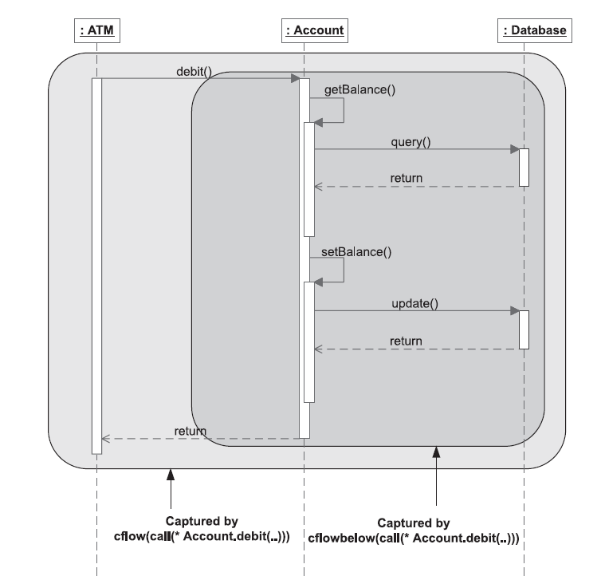
Cflow and cflowbelow

Slide 61
Control-flow based pointcuts
cflowbelow(call(* Account.debit(..))
Same as cflow(..), except excluding the call to debit(..) itself
cflow(staticinitialization(Account))
All the join points in the control flow occurring during initializing Account class
if tracePoints() is redefined as follows and if
“static int minBalance=1000;” is added in Account class
pointcut tracePoints() :
!within(JoinPointTraceAspect)
&& cflow(staticinitialization(Account));
Before: staticinitialization(Account.<clinit>)
Before: set(int Account.minBalancel)
After: set(int Account.minBalance)
After: staticinitialization(Account.<clinit>)

Slide 62
Lexical-structure based pointcuts
It refers to the scope of code as it is written
Capture join points occurring inside specified classes, aspects, or methods
Inside classes/aspects:
within(TypePattern)
Inside methods
withincode(MethodSignature)
Examples:
within(Account)
!within(TraceAspect)
withincode(* Account.debit(..))
Exercise: Capture all the calls to print methods except those occurs in TraceAspect
In Assignment, we need to capture the calls to System.out.println(pm.toString())
call(System.out.println(..)) ?
call(System.out.print*(..)) ?
call(* java.io.PrintStream.print*(..))
&& !within(TraceAspect)

Slide 63
System and PrintStream
call(System.out.print*(..))
Vs.
call(* java.io.PrintStream.print*(..))
Field Summary
static PrintStream err
The "standard" error output stream.
static InputStream in
The "standard" input stream.
static PrintStream out
The "standard" output stream.
java.io Class PrintStream
java.lang.Object
java.io.OutputStream
java.io.FilterOutputStream
java.io.PrintStream

Slide 64
Access the arguments and objects
After each deposit, we want to have a receipt, telling the amount deposited, and the balance on the account
account.credit(amount)
account.getBalance()
First try to solve the problem
after(): call(* *.credit(float)) {
System.out.println("deposit:"+amount+“ after deposit:" +account.getBalance());
}
But, what are amount and account? They should be defined.
Solution
after(Account account, float amount):
call(* *.credit(float))
&& args(amount)
&& target(account) {
System.out.println("deposit:"+amount+“ after deposit:" +account.getBalance());
}

Slide 65
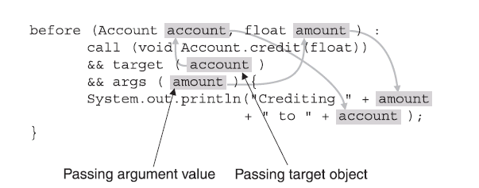
Anatomy of argument passing
The part before the colon:
Specifies types and names of objects that need to be collected.
Similar to method arguments.
The anonymous pointcut after colon:
Define how the arguments to be captured
Advice body:
Use the captured arguments
Similar to a method body

Slide 66
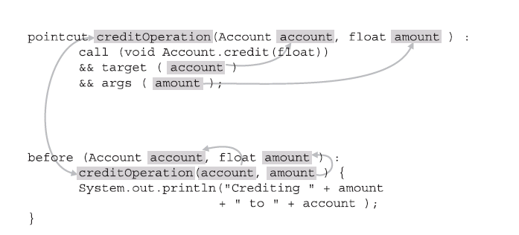
Named pointcut and context passing
pointcut creditOperation(Account account, float amount):
call ( void Account.credit(float))
&& target(account)
&& args(amount);
before (Account account, float amount) :
creditOperation(account, amount) {
System.out.println(“ crediting “+amount + “ to “ + account);
}

Slide 67
Advice
A method like language construct
Define code to be executed at certain join points
Three kinds of advices
before advice: executes prior to the join points;
after advice: executes following the join points;
around advice: surrounds the join point’s execution. Used to bypass execution, or cause execution with altered context.
Example
before() : call( void Hello.greeting() ) {
System.out.print("> ");
}

Slide 68
after advice
Two kinds of returns:
after returning normally;
after returning by throwing an exception.
Example
after() : call(* Account.debit(..)){ … …}
This advice will be executed regardless how it returns, normally or by throwing an exception
after() returning : call(* Account.debit(..)){ … …}
will be executed after successful completion of the call.
after() throwing : call(* Account.debit(..)){ … …}

Slide 69
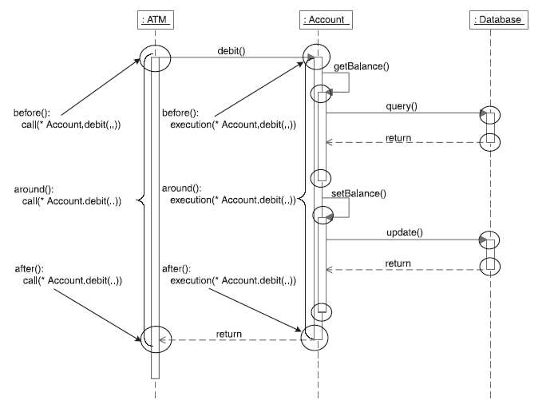
Before, after, and around

Slide 70
Before and after
dispatch
after
before

Slide 71
around
dispatch
around

Slide 72
around advice
Commonly used to:
Bypass execution of join points, e.g.,
void around(): call(* *.debit(..)){ }
Execute the join point multiple times, e.g.,
void around(): call(* *.credit(..))
{ proceed(); proceed();}
Execute join point with changed context, e.g.,
void around(float amount):
call(* *.credit(float))&& args(amount) {
proceed(amount+1000);
}
proceed(..) returns the same value as the captured join points.
proceed(..) has the same arguments as declared in around.

Slide 73
Pass context from join point to advice
Use args(), target( ) and this() pointcuts to expose context
Example
void around(float amount): call(* *.credit(float))&& args(amount) {
proceed(amount+1000); }
void around(Account account, float amount):
call(* *.credit(float))&& args(amount) && target(account)
{ proceed(account, amount+1000);
System.out.println(account.getBalance());
}
Question
What is the result when calling credit(100)?
The balance is 1100!
the arguments of proceed() should be the same as those of around()
the returning type of around should be the same as that of credit method

Slide 74
Exercise
Given the code segment in main method:
account.credit(30);
account.debit(20);
Without aspects, the balance is 10.
What will be the account balance for the following advice?
void around(): call(* *.credit(..)){ proceed(); proceed();}
What will be the balance for the following two advices?
void around(float amount): call(* *.credit(float)) && args(amount) {
proceed(amount+1000);
}
void around(): call(* *.debit(..)){ }

Slide 75
Pass context in named pointcut: Hello example
public class MessageCommunicator {
public static void deliver(String person, String message) {
System.out.print(person + ", " + message);
}
}
public class Test {
public static void main(String[] args) {
MessageCommunicator.deliver("Harry", "having fun?");
}
}
Harry, having fun?
In India: Harry-ji, having fun?
In Japan, Harry-san, having fun?
First try:
call(void MessageCommunicator.deliver(String, String)
Solution:
public aspect HindiSalutationAspect {
pointcut sayToPerson(String person) :
call(void MessageCommunicator.deliver(String, String)) && args(person, String);
void around(String person) : sayToPerson(person) {
proceed(person + " -ji");
}
}

Slide 76
Factorial example
Your task: caching previous computing results
public class TestFactorial {
public static void main(String[] args) {
System.out.println("Result: " + factorial(5) + "\n");
System.out.println("Result: " + factorial(10) + "\n");
System.out.println("Result: " + factorial(15) + "\n");
System.out.println("Result: " + factorial(20) + "\n");
}
public static long factorial(int n) {
if (n == 0) { return 1;
} else { return n * factorial(n-1);
}
}
}
Expected output:
C:\440\aspectJ\ch03\section3.2.9>call java TestFactorial
Seeking factorial for 5
Result: 120
Seeking factorial for 10
Found cached value for 5: 120
Result: 3628800
Seeking factorial for 15
Found cached value for 10: 3628800
Result: 1307674368000
Seeking factorial for 20
Found cached value for 15: 1307674368000
Result: 2432902008176640000

Slide 77
Factorial caching aspect
public aspect OptimizeFactorialAspect {
pointcut factorialOperation(int n) : call(long *.factorial(int)) && args(n);
pointcut topLevelFactorialOperation(int n) :
factorialOperation(n)
&& !cflowbelow(factorialOperation(int));
private Map _factorialCache = new HashMap();
before(int n) : topLevelFactorialOperation(n) {
System.out.println("Seeking factorial for " + n); }
long around(int n) : factorialOperation(n) {
Object cachedValue = _factorialCache.get(new Integer(n));
if (cachedValue != null) {
System.out.println("Found cached value for " + n+ ": " + cachedValue);
return ((Long)cachedValue).longValue();
}
return proceed(n);
}
after(int n) returning(long result) : topLevelFactorialOperation(n) {
_factorialCache.put(new Integer(n), new Long(result));
}
}

Slide 78
Static crosscutting
Modify the static structure of a program
introduce new members
change relationship between classes
compile time error
warning declaration

Slide 79
Member introduction
public aspect MinimumBalanceRuleAspect {
private float Account._minimumBalance;
public float Account.getAvailableBalance() {
return getBalance() - _minimumBalance;
}
after(Account account) : execution(SavingsAccount.new(..)) && this(account) {
account._minimumBalance = 25;
}
before(Account account, float amount) throws InsufficientBalanceException :
execution(* Account.debit(..)) && target(account) && args(amount) {
if (account.getAvailableBalance() < amount) {
throw new InsufficientBalanceException("Insufficient available balance");
}
}
}
account.credit(100);
account.debit(80);

Slide 80
Infinite loop
Infinite loop example
aspect A {
before(): call(* *(..)) {
System.out.println("before");
}
}
Remove the loop
aspect A {
before(): call(* *(..)) && !within(A){
System.out.println("before");
}
}

Slide 81
Reflective API
access to static and dynamic information associated with join points
you can also use this(), args(), target() pointcuts to capture dynamic context
In each advice body you can access three special objects:
thisJoinPoint, contains dynamic info of the advised join point
thisJoinPointStaticPart, contains static info, such as source location, signature, kind.
thisEnclosingJoinPointStaticPart, contains the static info about enclosing join point.

Slide 82
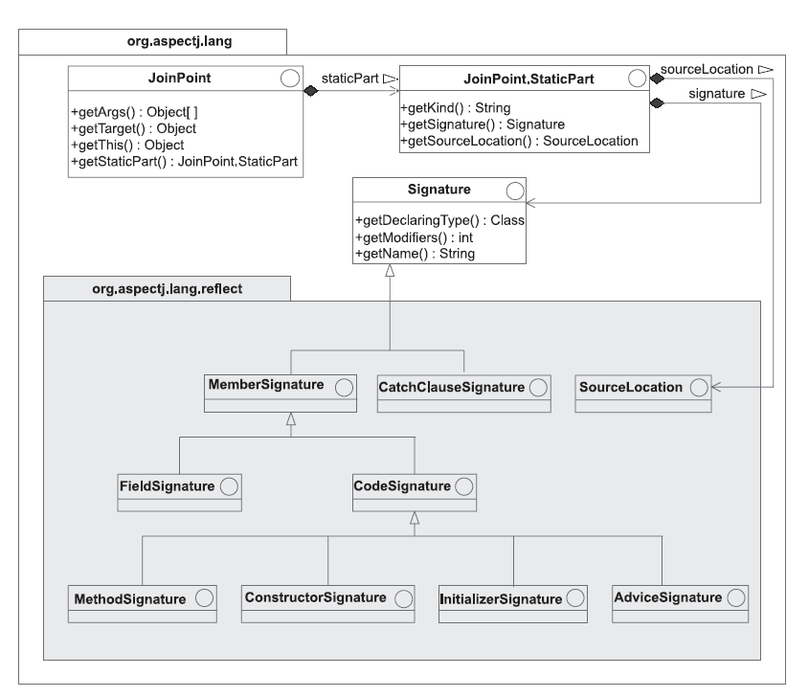
Reflective API

Slide 83
The reflective API in org.aspectj.lang package
JoinPoint
Object [ ] getArgs()
Object getTarget(): get target object for a called join point
Object getThis(): get current executing object. return null for join points in static methods.
JoinPoint.StaticPart getStaticPart()
JoinPoint.StaticPart
String getKind(): return kind of the join point, such as “method-call”, “field-set”
Signature getSignature(), Signature object
SourceLocation getSourceLocation(), SouceLocation interface contains method to access file name, line number etc.

Slide 84
Print out static and dynamic info about join points
import org.aspectj.lang.*;
import org.aspectj.lang.reflect.*;
public aspect JoinPointTraceAspect {
private int _indent = -1;
pointcut tracePoints() :
!within(JoinPointTraceAspect)
&& cflow(call (* *.credit(..)));
before() : tracePoints() {
_indent++;
println("========= " + thisJoinPoint + " ===========");
printDynamicJoinPointInfo(thisJoinPoint);
printStaticJoinPointInfo(thisJoinPointStaticPart);
}
after() : tracePoints() {
_indent--;
}
private void printDynamicJoinPointInfo(JoinPoint joinPoint) {
println("This: " + joinPoint.getThis() +
" Target: " + joinPoint.getTarget());
StringBuffer argStr = new StringBuffer("Args: ");
Object[] args = joinPoint.getArgs();
for (int length = args.length, i = 0; i < length; ++i) {
argStr.append(" [" + i + "] = " + args[i]);
}
println(argStr);
}
private void printStaticJoinPointInfo(
JoinPoint.StaticPart joinPointStaticPart) {
println("Signature: " + joinPointStaticPart.getSignature()
+ " Kind: " + joinPointStaticPart.getKind());
SourceLocation sl = joinPointStaticPart.getSourceLocation();
println("Source location: " +
sl.getFileName() + ":" + sl.getLine());
}
private void println(Object message) {
for (int i = 0, spaces = _indent * 2; i < spaces; ++i) {
System.out.print(" ");
}
System.out.println(message);
}}

Slide 85
Running result
========= call(void SavingsAccount.credit(float)) ===========
This: null Target: SavingsAccount@cd2c3c
Args: [0] = 100.0
Signature: void SavingsAccount.credit(float) Kind: method-call
Source location: Test.java:6
========= execution(void Account.credit(float)) ===========
This: SavingsAccount@cd2c3c Target: SavingsAccount@cd2c3c
Args: [0] = 100.0
Signature: void Account.credit(float) Kind: method-execution
Source location: Account.java:11
========= call(float Account.getBalance()) ===========
This: SavingsAccount@cd2c3c Target: SavingsAccount@cd2c3c
Args:
Signature: float Account.getBalance() Kind: method-call
Source location: Account.java:12
========= execution(float Account.getBalance()) ===========
This: SavingsAccount@cd2c3c Target: SavingsAccount@cd2c3c
Args:
Signature: float Account.getBalance() Kind: method-execution
Source location: Account.java:26
========= get(float Account._balance) ===========
This: SavingsAccount@cd2c3c Target: SavingsAccount@cd2c3c
Args:
Signature: float Account._balance Kind: field-get
Source location: Account.java:27
========= call(void Account.setBalance(float)) ===========
This: SavingsAccount@cd2c3c Target: SavingsAccount@cd2c3c
Args: [0] = 100.0
Signature: void Account.setBalance(float) Kind: method-call
Source location: Account.java:12
========= execution(void Account.setBalance(float)) ===========
This: SavingsAccount@cd2c3c Target: SavingsAccount@cd2c3c
Args: [0] = 100.0
Signature: void Account.setBalance(float) Kind: method-execution
Source location: Account.java:30
========= set(float Account._balance) ===========
This: SavingsAccount@cd2c3c Target: SavingsAccount@cd2c3c
Args: [0] = 100.0
Signature: float Account._balance Kind: field-set
Source location: Account.java:31

Slide 86
Ordering aspects
public class Home {
public void enter() { System.out.println("Entering"); }
public void exit() { System.out.println("Exiting"); }
}
public class TestHome {
public static void main(String[] args) {
Home home = new Home();
home.exit();
System.out.println();
home.enter();
}
}
C:\440\aspectJ\ch04\section4.2>call java TestHome
Switching off lights
Engaging
Exiting
Entering
Disengaging
Switching on lights
What if we want the following sequence:
Engaging-> switching off light -> exiting
Switching on lights -> disengaging -> entering
public aspect HomeSecurityAspect {
before() : call(void Home.exit()) {
System.out.println("Engaging");
}
after() : call(void Home.enter()) {
System.out.println("Disengaging");
}
}
public aspect SaveEnergyAspect {
before() : call(void Home.exit()) {
System.out.println("Switching off lights");
}
after() : call(void Home.enter()) {
System.out.println("Switching on lights");
}
}

Slide 87
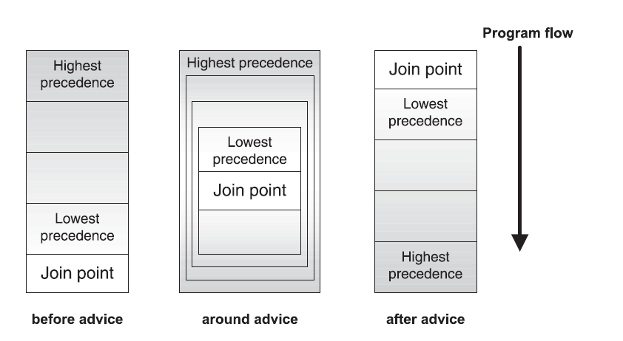
Ordering of advices

Slide 88
Define precedence between aspects
public aspect HomeSystemCoordinationAspect {
declare precedence: HomeSecurityAspect, SaveEnergyAspect;
}
C:\440\aspectJ\ch04\section4.2.2>call java TestHome
Engaging
Switching off lights
Exiting
Entering
Switching on lights
Disengaging

Slide 89
AOP Review: Motivation
void transfer(Account fromAccount, Account toAccount, int amount) {
if (!getCurrentUser().canPerform(OP_TRANSFER)) {
throw new SecurityException();
}
if (fromAccount.getBalance() < amount) {
throw new InsufficientFundsException();
}
Transaction tx = database.newTransaction();
try {
fromAccount.withdraw(amount);
toAcount.deposit(amount);
tx.commit();
systemLog.logOperation(OP_TRANSFER, fromAccount, toAccount, amount);
}
catch(Exception e) {
tx.rollback();
}
}

Slide 90
Code tangling
Module handling multiple concerns simultaneously
Logging
Business logic
Other concern

Slide 91
Code scattering
Single issue implemented in multiple modules
Logging
Internet
banking
Accounting
Customer
Teller

Slide 92
Implementation modules as a set of concerns

Slide 93
Concern decomposition and weaving: the prism analogy

Slide 94
Base program and aspects
base
Program
Aspect
generates events for:
method call / execution
field set / get
constructors
...
observes events of base program,
looking for certain patterns:
in case of match, execute extra code

Slide 95
References
AspectJ Home Page
http://www.eclipse.org/aspectj
http://www.eclipse.org/aspectj/doc/released/progguide/index.html
AspectJ Development Tools Eclipse Plugin
– http://www.eclipse.org/ajdt/
Gregor Kiczales speaks at Google about AOP and AspectJ
http://video.google.com/videoplay?docid=8566923311315412414&q=engEDU
I want my AOP! Separate software concerns with aspect-oriented programming
http://www.javaworld.com/javaworld/jw-01-2002/jw-0118-aspect_p.html
Test flexibility with AspectJ and mock objects
http://www-128.ibm.com/developerworks/java/library/j-aspectj2/?open&l=007,t=gr
Hands on Programming with AspectJ
http://www.eclipse.org/ajdt/EclipseCon2006/

Slide 96
AOP and observer pattern

Slide 97
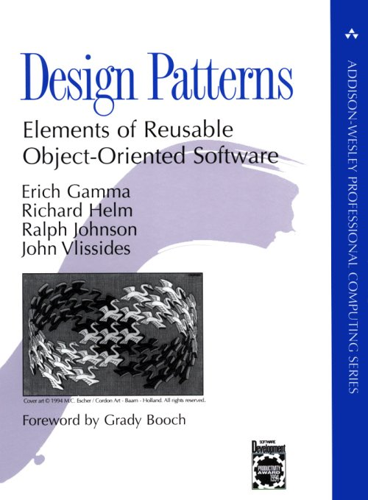
Design pattern
General reusable solution to a commonly occurring problem in software design
Not a finished design that can be transformed directly into source code
It is a template for solving a problem
Gamma, Erich; Richard Helm, Ralph Johnson, and John Vlissides (1995). Design Patterns: Elements of Reusable Object-Oriented Software. Addison-Wesley. ISBN 0-201-63361-2.

Slide 98
Observer design pattern
In many programs, when an object changes state, other objects may have to be notified
Example: when an car in a game is moved
The graphics engine needs to know so it can re-render the item
The traffic computation routines need to re-compute the traffic pattern
The objects the car contains need to know they are moving as well
Another example: data in a spreadsheet
The display must be updated
Possibly multiple graphs that use that data need to re-draw themselves
This pattern answers the question: How best to notify those objects when the subject changes?
And what if the list of those objects changes during run-time?

Slide 99
The key participants in observer pattern
The Subject, which provides an (virtual) interface for attaching and detaching observers
The Observer, which defines the (virtual) updating interface
The ConcreteSubject, which is the class that inherits/extends/implements the Subject
The ConcreteObserver, which is the class that inherits/extends/implements the Observer
This pattern is also known as dependents or publish-subscribe

Slide 100
GUI example
Intuitive way of thinking ---
Points, Lines, Shapes,
encapsulation, class hierarchy
Code is the natural reflection of the intuitive way of thinking
Display
*
Shape
moveBy(int, int)
Point
2
Line
getX() getY() setX(int) setY(int) moveBy(int, int)
getP1() getP2() setP1(Point) setP2(Point) moveBy(int, int)

Slide 101
Poor code modularity
Display needs to be updated every time a shape is moved
class Point extends Shape {
private int x = 0, y = 0;
int getX() { return x; }
int getY() { return y; }
void setX(int x) {
this.x = x;
display.update(this);
}
void setY(int y) {
this.y = y;
display.update(this);
}
}
Display
1
*
Shape
moveBy(int, int)
Point
2
Line
getX() getY() setX(int) setY(int) moveBy(int, int)
getP1() getP2() setP1(Point) setP2(Point) moveBy(int, int)
From Kiczales’s slides

Slide 102
AOP makes code look like design
It is impossible to write a class to encapsulate the ObserverPattern
aspect ObserverPattern {
private Display Shape.display;
pointcut change(): call(void figures.Point.setX(int))
|| call(void Point.setY(int)) || call(void Line.setP1(Point)) || call(void Line.setP2(Point))
|| call(void Shape.moveBy(int, int));
after(Shape s) returning: change() && target(s) {
s.display.update();
} }
Display
1
*
Shape
moveBy(int, int)
ObserverPattern
Point
2
Line
getX() getY() setX(int) setY(int) moveBy(int, int)
getP1() getP2() setP1(Point) setP2(Point) moveBy(int, int)

Slide 103
The ObserverPattern can be simplified
aspect ObserverPattern {
private Display Shape.display;
pointcut change(): call(void Shape.moveBy(int, int))
|| call(void Shape+.set*(..));
after(Shape s) returning: change() && target(s) {
s.display.update();
} }
Display
1
*
Shape
moveBy(int, int)
ObserverPattern
Point
2
Line
getX() getY() setX(int) setY(int) moveBy(int, int)
getP1() getP2() setP1(Point) setP2(Point) moveBy(int, int)

Slide 104
What OOP developers can see
Display
*
Shape
makePoint(..) makeLine(..)
moveBy(int, int)
Point
2
Line
getX() getY() setX(int) setY(int) moveBy(int, int)
getP1() getP2() setP1(Point) setP2(Point) moveBy(int, int)

Slide 105
Without AspectJ
class Line extends Shape{
private Point p1, p2;
Point getP1() { return p1; }
Point getP2() { return p2; }
void setP1(Point p1) {
this.p1 = p1;
Display.update(this);
}
void setP2(Point p2) {
this.p2 = p2;
Display.update(this);
}
}
class Point extends Shape{
private int x = 0, y = 0;
int getX() { return x; }
int getY() { return y; }
void setX(int x) {
this.x = x;
Display.update(this);
}
void setY(int y) {
this.y = y;
Display.update(this);
}
}
“display updating” is not modular
evolution is cumbersome
changes are scattered
have to track & change all callers
it is harder to think about

Slide 106
With AspectJ
class Line extends Shape {
private Point p1, p2;
Point getP1() { return p1; }
Point getP2() { return p2; }
void setP1(Point p1) {
this.p1 = p1;
}
void setP2(Point p2) {
this.p2 = p2;
}
}
class Point extends Shape {
private int x = 0, y = 0;
int getX() { return x; }
int getY() { return y; }
void setX(int x) {
this.x = x;
}
void setY(int y) {
this.y = y;
}
}
aspect ObserverPattern {
pointcut change():
execution(void Line.setP1(Point)) ||
execution(void Line.setP2(Point));
after() returning: change() {
Display.update();
}
}

Slide 107
Top level changes
aspect ObserverPattern {
pointcut change(Shape shape):
this(shape) &&
(execution(void Shape.moveBy(int, int)) ||
execution(void Line.setP1(Point)) ||
execution(void Line.setP2(Point)) ||
execution(void Point.setX(int)) ||
execution(void Point.setY(int)));
pointcut topLevelchange(Shape s): change(s) && !cflowbelow(change(Shape));
after(Shape shape) returning: topLevelchange(shape) {
Display.update(shape);
}
}

Slide 108
What AOP developers see
Display
*
Shape
makePoint(..) makeLine(..)
moveBy(int, int)
ObserverPattern
Point
2
Line
BoundsChecking
getX() getY() setX(int) setY(int) moveBy(int, int)
getP1() getP2() setP1(Point) setP2(Point) moveBy(int, int)
FactoryEnforcement

Slide 109
Boundary check
aspect BoundsPreConditionChecking {
before(int newX):
execution(void Point.setX(int)) && args(newX) {
check(newX >= MIN_X);
check(newX <= MAX_X);
}
before(int newY):
execution(void Point.setY(int)) && args(newY) {
check(newY >= MIN_Y);
check(newY <= MAX_Y);
}
private void check(boolean v) {
if ( !v )
throw new RuntimeException();
}
}

