Slide 1
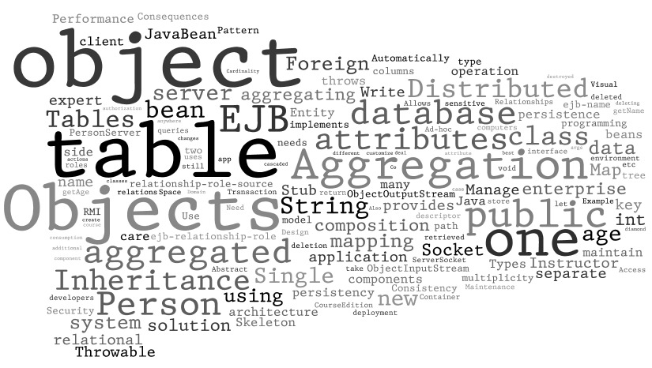
Distributed Objects and object persistence

Slide 2
Distributed objects
Distributed computing: part of the system located on separate computers
Distributed objects: allow objects running on one machine to be used by client applications on different computers
Distributed object technologies:
Java RMI
CORBA
DCOM

Slide 3

Implementing distributed objects
client
Distributed object
Remote interface
Remote interface
stub
Skeleton
network
Skeleton: server side proxy object
Stub: client side proxy object
Stub and skeleton implements the same remote interface

Slide 4
Write your own distributed object
Client only knows the interface
public interface Person {
public int getAge() throws Throwable;
public String getName() throws Throwable;
}
Client uses the object just as if it were local
public class PersonClient {
public static void main(String[] args) {
try {
Person person = new Person_Stub();
int age = person.getAge();
String name = person.getName();
System.out.println(name + age);
} catch (Throwable t) {
}
}
}
Networking is taken care of by Person_Stub

Slide 5
From the client side
public class Person_Stub implements Person{
Socket socket;
public Person_Stub() throws Throwable{
socket=new Socket(“ip address here", 8765);
}
public int getAge()throws Throwable{
ObjectOutputStream outStream =
new ObjectOutputStream(socket.getOutputStream());
outStream.writeObject("age");
outStream.flush();
ObjectInputStream inStream=
new ObjectInputStream(socket.getInputStream());
return inStream.readInt();
}
public String getName()throws Throwable{ … }
}

Slide 6
From the server side
public class Person_Skeleton extends Thread { …
public Person_Skeleton(Person person) { this.myPerson = person;}
public void run() { …
ServerSocket serverSocket = new ServerSocket(8765);
Socket socket = serverSocket.accept();
while (socket != null) {
ObjectInputStream inStream = new ObjectInputStream(socket.getInputStream());
String method = (String) inStream.readObject();
if (method.equals("age")) {
int age = myPerson.getAge();
ObjectOutputStream outStream =
new ObjectOutputStream(socket.getOutputStream());
outStream.writeInt(age);
outStream.flush();
} else if (method.equals("name")) { … }
} …
}
public static void main(String[] args){
PersonServer person = new PersonServer("mike", 24);
Person_Skeleton skel=new Person_Skeleton(person);
skel.start();
}}

Slide 7
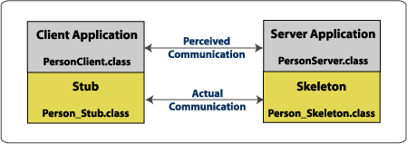
public class PersonServer implements Person {
int age;
String name;
public PersonServer(String n, int a) { name=n; age=a;}
public int getAge() {return age; }
public String getName() {return name; }
}

Slide 8
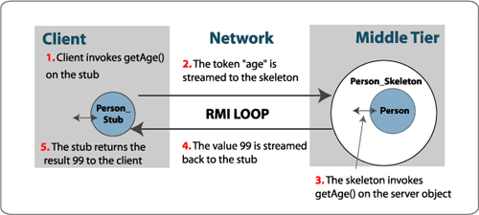
From hand-craft to RMI
RMI technology
Automatically generate appropriate stubs and skeletons
Error and exception handling
Parameter passing
RMI is not good enough in
Object persistence;
Transaction handling;
Security;
… …

Slide 9
Explicit Middleware
Transaction API
Transaction service
client
Distributed object
security API
Remote interface
Remote interface
Security service
stub
Skeleton
Database driver
DB API
network
Explicit middleware
Transfer(Account a1, Account a2, long amount) {
Call middleware API to check security;
call middleware API to start a transaction;
if (a1.balance>amount)
subtract the balance of a1 and add the amount to a2;
call DB API to store the data;
call middleware API to end the transaction;
}
Difficult to write, maintain, and support

Slide 10
Implicit middleware
Distributed object
Transaction API
Transaction service
client
Request interceptor
security API
Remote interface
Remote interface
Security service
stub
Skeleton
Database driver
DB API
implicit middleware
network
Transfer(Account a1, Account a2, long amount){
if (a1.balance>amount)
subtract the balance of a1 and add the amount to a2;
}
Declare the middle services needed in a text file.
Generate a Request Interceptor from this declaration
Easy to write, maintain, and support

Slide 11
EJB (enterprise java bean)
EJB 2.0 wants to provide basic services and environment to make enterprise systems easier to develop, by providing
automatically-managed persistence logic
transaction plumbing for components
an enforced-authorization framework
"best of breed" capabilities by providing all this in a vendor-neutral fashion
This is the ambitious goal set by EJB version 2

Slide 12
three versions of EJB
EJB 1 (1998) advocated by IBM and Sun, quickly adopted in industry
EJB 2 (2001) excessively complicated, widely criticized
EJB 3 (2006) reinventing EJB, simplified, adopted tech from Hibernate etc.
“One day, when God was looking over his creatures, he noticed a boy named Sadhu whose humor and cleverness pleased him. God felt generous that day and granted Sadhu three wishes. Sadhu asked for three reincarnations—one as a ladybug, one as an elephant, and the last as a cow. Surprised by these wishes, God asked Sadhu to explain himself. The boy replied, "I want to be a ladybug so that everyone in the world will admire me for my beauty and forgive the fact that I do no work. Being an elephant will be fun because I can gobble down enormous amounts of food without being ridiculed. I will like being a cow the best because I will be loved by all and useful to mankind." God was charmed by these answers and allowed Sadhu to live through the three incarnations. He then made Sadhu a morning star for his service to humankind as a cow.
EJB too has lived through three incarnations.”
—from “EJB3 in action”

Slide 13
Multi-tier Enterprise Architecture
Browser 1
Database 1
Application server 1
Web server
Legacy application
Browser 2
Application server 2
Browser 3
Database 2
Tier 1
Tier 2
Tier 3
Tier 4

Slide 14
Types of beans
EJB
Message Bean
Session Bean
EmployeeBean
Entity Bean
name
sal
findByName()
SELECT *
FROM EMP
WHERE NAME=?
Entity bean supports object persistence
Access to relational data is done through SQL
Most Java programmers aren't great database engineers
Therefore let the application server worry about how to obtain the data
Emp
NAME
SAL

Slide 15
Part 2: Object Persistence

Slide 16
Persistence
Persistency: characteristic of data that outlives the execution of the program that created it.
Almost all applications require persistence data
Data are typically saved in relational database
In Java, we can write SQL statement using JDBC API
Send a SQL query string in Java
Obtains rows of returned query results
Process the rows one by one

Slide 17
JDBC example
Statement stmt = conn.createStatement();
ResultSet rs = stmt.executeQuery( "SELECT * FROM MyTable" );
while ( rs.next() ) {
int numColumns = rs.getMetaData().getColumnCount();
for ( int i = 1 ; i <= numColumns ; i++ ) {
System.out.println("COLUMN" + i + " = "+ rs.getObject(i));
}
}
Disadvantages
The process is low level and tedious
Programmers love Objects

Slide 18
Object Persistence
Object persistence: Allow an object to outlive the process that creates it
State of an object can be stored in a permanent storage;
An object with the same state can be recreated later;
Most often the storage and retrieval involves a whole network of objects
Not every object need to be persistent.
A typical application is a mix of persistent objects and transient objects
Objects can't be directly saved to and retrieved from relational databases.
Approaches to object persistence
Object serialization
Convert object into a byte stream and store it as a whole in database/ file system.
XML file based persistence, such as JAXB (Java Architecture for XML Binding)
Object database
Objects are the 1st class citizen in the database
Object relational mapping (ORM)
Supported by Hibernate, EJB, etc.

Slide 19
Object-based persistence: java.io.Serializable
Converts an object (and all internal objects) into a stream of bytes that can be later deserialized into a copy of the original object (and all internal objects).
Pros:
Fast, simple, compact representation of an object graph.
May be great choice for *temporary* storage of data.
Cons:
Creates long-term maintenance issues
Harder to evolve objects and maintain backward compatibility with serialized representation.
public class Address extends Serializable {
// Class Definition
}
// Serialise an object
FileOutputStream f = new FileOutputStream("tmp");
ObjectOutput out = new ObjectOutputStream(f);
out.writeObject(new Address());
out.flush();
out.close();
// Deserialise an object
FileInputStream f = new FileInputStream("tmp");
ObjectInput in = new ObjectInputStream(f);
Address address = (Address) in.readObject();
in.close();

Slide 20
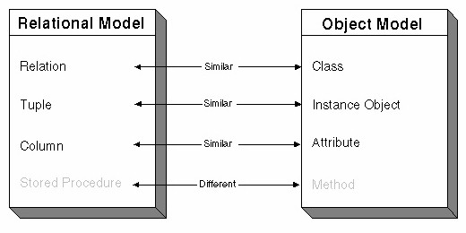
Objects and relations
O/R mismatch
Relation | Object
goal of relational modeling is to normalize data (i.e., eliminate redundant data from tables) | goal of object-oriented design is to model a business process by creating real-world objects with data and behavior
RDBMS stores data only | objects have identity, state, and behavior
no inheritance | organized into inheritance hierarchy
tables are related via values in foreign and primary keys | objects are traversed using direct references

Slide 21

Paradigm mismatch
public class User {
private String username;
private String name;
private String address;
private Set billingDetails;
// Accessor methods (getter/setter), business methods, etc.
...
}
public class BillingDetails {
private String accountNumber;
private String accountName;
private String accountType;
private User user;
// Accessor methods (getter/setter), business methods, etc.
...
}
create table USERS (
USERNAME varchar(15) not null primary key,
NAME varchar(50) not null,
ADDRESS varchar(100)
)
create table BILLING_DETAILS (
ACCOUNT_NUMBER varchar(10) not null primary key,
ACCOUNT_NAME varchar(50) not null,
ACCOUNT_TYPE varchar(2) not null,
USERNAME varchar(15) foreign key references user
)
O/R mismatch
ACCOUNT_NUMBER | ACCOUNT_NAME | ACCOUNT_TYPE | USERNAME
111 | aaa | 01 | david
222 | bbb | 02 | david
…
Example from “Java Persistence with Hibernate”

Slide 22
Association problem
public class User {
private Set billingDetails;
...
}
public class BillingDetails {
private User user;
...
}
In OO, relationships are expressed as references.
Object references are directional. They are pointers. If you need to navigate in both directions, you must define the relationship twice.
Navigation example:
user.getBillingDetails().getAddress
billing.getUser().get…
In RDBMS, relationships expressed as foreign keys.
FK associates are not directional. You can create arbitrary relationships with joins.
O/R mismatch

Slide 23
Many-to-many association
OO association can have many-to-many multiplicity
Table association is always one-to-one or one-to-many
To represent many-to-many association, a link table must be introduced
public class User {
private Set billingDetails;
...
}
public class BillingDetails {
private Set users;
...
}
O/R mismatch
create table USER_BILLING_DETAILS (
USER_ID bigint foreign key references USERS,
BILLING_DETAILS_ID bigint foreign key references BILLING_DETAILS,
PRIMARY KEY (USER_ID, BILLING_DETAILS_ID)
)

Slide 24
The granularity problem
Address is broken down to street, city, etc.
In OO, It is natural to have an Address class
Classes have multi levels of granularity
User: coarse-grained
Address: finer-grained
Zipcode(String): simple type
RDBMS just has two levels of granularity visible
tables such as USERS
columns such as ADDRESS_ZIPCODE.
create table USERS (
USERID varchar(15) not null primary key,
NAME varchar(50) not null,
ADDRESS_STREET varchar(50),
ADDRESS_CITY varchar(15),
ADDRESS_STATE varchar(15),
ADDRESS_ZIPCODE varchar(5),
ADDRESS_COUNTRY varchar(15)
)
O/R mismatch

Slide 25
Object identity
Object ‘sameness’
object identity: Objects are identical if they occupy the same memory location in the JVM. This can be checked by using the == operator.
Object equality: Objects are equal if they have the same value, as defined by the equals (Object o) method. Classes that don't explicitly override this method inherit the implementation defined by java.lang.Object, which compares object identity.
Database identity:
Objects stored in a relational database are identical if they represent the same row, or
equivalently, if they share the same table and primary key value.
O/R mismatch

Slide 26
Object identity
Primary keys are often system-generated
E.g. The USER_ID and BILLING_DETAILS_ID columns contain system-generated values.
These columns were introduced purely for the benefit of the data model
how should they be represented in the domain model?
create table USERS (
USER_ID bigint not null primary key,
USERNAME varchar(15) not null unique,
NAME varchar(50) not null,
...
)
create table BILLING_DETAILS (
BILLING_DETAILS_ID bigint not null primary key,
ACCOUNT_NUMBER VARCHAR(10) not null unique,
ACCOUNT_NAME VARCHAR(50) not null,
ACCOUNT_TYPE VARCHAR(2) not null,
USER_ID bigint foreign key references USER
)
O/R mismatch

Slide 27
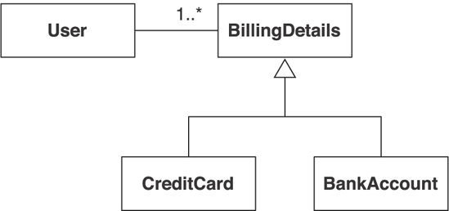
Subtype problem
Inheritance problem:
RDBMS products don’t support “table inheritance”
There is no standard way to map the class hierarchy to tables
Polymorphism problem
User class associates to BillingDetails, which has two subclasses
It is a polymorphic association
The corresponding query may be also polymorphic, which has no obvious solution in DB.
O/R mismatch

Slide 28
Object navigation problem
In an object graph usually there’s roots, where navigation starts.
Root

Slide 29
Object navigation problem
O/R mismatch
Event
Venue
name
name
date
Address
Participant
street
name
city
event.getVenue().getAddress().getStreet();
SELECT street FROM Addresses WHERE AddressId= (SELECT VenueAddress FROM Venues WHERE VenueId= (SELECT EventVenue FROM Events WHERE EventId=1));

Slide 30
The cost of mismatch
the main purpose of up to 30 percent of the Java application code written is to handle the tedious SQL/JDBC and manual bridging of the object/relational paradigm mismatch.
There should be a systematic way
O/R mismatch

Slide 31
What is ORM (object/relational mapping )
automated (and transparent) persistence of objects in an application to the tables in a relational database, using metadata that describes the mapping between the objects and the database.
works by (reversibly) transforming data from one representation to another. This implies certain performance penalties
An ORM solution consists of the following four pieces:
An API for performing basic CRUD (create, read, update, delete) operations on objects of persistent classes;
A language or API for specifying queries that refer to classes and properties of classes;
A facility for specifying mapping metadata
A technique for the ORM implementation to interact with transactional objects to perform dirty checking, lazy association fetching, and other optimization functions
Has a long history, but widely adopted only since 2001.

Slide 32
Current ORM Impetus: the web app
A web app, with its multi-threaded object layer, particularly needs help with the correct handling of persistent data
Concurrent web requests from users
Web layer
App server(s)
Multi-threaded Object layer
Other apps
ORM
Database server
Database
32

Slide 33
Mapping objects to Tables
Simple case
Map entities to tables
Map attributes (with primitive data types) in an entity bean to columns in the table
Synchronizing the object with the table in EJB 2:
EmployeeBean
ID
name
sal
ejbLoad:
SELECT name, sal FROM employee WHERE id=?
ejbStore:
UPDATE employee SET name=?, sal=? WHERE id=?
ejbPostCreate:
INSERT INTO employee VALUES(?,?,?)
ejbRemove:
DELETE FROM employee WHERE id=?
findByName(n)
SELECT *
FROM EMP
WHERE NAME=n
NAME
SAL
ID
Employee Table

Slide 34
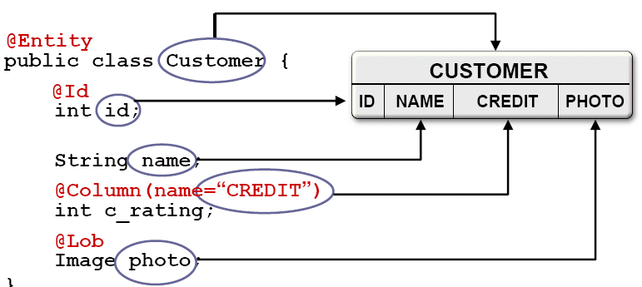
Object attributes and table columns
Not all attributes are mapped to table columns
Describe the mapping using deployment descriptor using XML (or using annotation in EJB3.0)
<enterprise-beans>
<entity>
<ejb-name>Employee</ejb-name>
<cmp-field> name </cmp-field>
<cmp-field> sal </cmp-field>
… …
</entity>
…
</enterprise-beans>
What if the attribute in an entity bean is an entity bean itself?
E.g., Employee bean may have Address attribute
It is a relations between objects

Slide 35
Relationships between objects
Aggregation
Mapping strategies
Single table aggregation
Foreign key aggregation
Manage cardinalities
Manage many-to many relations
Manage composition
Inheritance
One table for one inheritance tree
One table for one class
One table for one inheritance path
O/R mapping

Slide 36
Single Table Aggregation Pattern(1/4)
O/R mapping: aggregation
Abstract: map aggregation to a relational data model by integrating all aggregated objects’ attributes into a single table.
Example: CourseEdition has Instructor attribute
Design pattern: a general repeatable solution to a commonly-occurring problem in software design
CourseEdition
EndDate : String
StartDate : String
Code : String
instructor : Instructor
course :Course
Instructor
Type : Integer
SSN : Integer
surName : String
Age : Integer
townOfBirth : String
name : String

Slide 37

Single Table Aggregation(2/4)
Solution: Put the aggregated object's attributes into the same table as the aggregating object’s.
O/R mapping: aggregation
AggregatingTable
aggregatingObject
Attributes from aggregating table
aggregatedObject
Attributes from aggregated object table

Slide 38
Single Table Aggregation(3/4)
O/R mapping: aggregation
CourseEdition
EndDate : String
CourseEditionTable
StartDate : String
Code : String
instructor : Instructor
EndDate : VARCHAR(0)
course :Course
StartDate : VARCHAR(0)
Code : VARCHAR(0)
course : VARCHAR(0)
Type : SMALLINT
Instructor
SSN : SMALLINT
surName : SMALLINT
Type : Integer
Age : SMALLINT
SSN : Integer
townOfBirth : SMALLINT
surName : String
Age : Integer
townOfBirth : String
name : String

Slide 39
Single Table Aggregation(4/4) Consequences
Performance:
Pro: only one table needs to be accessed. No join operation is needed.
Con: the table may be too big with many duplicate cells.
Maintenance and flexibility:
If an aggregated type occurs in multiple classes/tables, a change in the aggregated class needs to be handled for all the tables.
E.g., Both Course and HumanResource tables contain Instructor class.
A change in Instructor class ripples to all the aggregating classes
Consistency of the database:
Aggregated objects are automatically deleted on deletion of the aggregating objects.
e.g. The deletion of Course table/rows causes the deletion of Instructor info
Ad-hoc queries:
E.g., If you want to form a query that scans all Instructor objects in the database, this is very hard to formulate.
O/R mapping: aggregation

Slide 40
Foreign Key Aggregation (1/3)
Abstract: The pattern shows how to map aggregation to a relational data model using foreign keys.
Solution: Use a separate table for the aggregated type.
Insert an synthetic object identity into the table
use this object identity in the table of the aggregating object to make a foreign key link to the aggregated object.
O/R mapping: aggregation
AggregatingTable
aggregatedObjectID
aggregatingObject
attribute1
… …
Foreign key
AggregatedObjectTable
aggregatedObject
ObjectID
attribute1
… …

Slide 41
Foreign Key Aggregation (2/3)
O/R mapping: aggregation
Example: Instructor and CourseEdition are mapped to two tables
CourseEdition
(from OM_Training)
CourseEditionTable
EndDate : String
StartDate : String
Code : String
instructor : Instructor
EndDate : VARCHAR(8)
course :Course
StartDate : VARCHAR(8)
Code : VARCHAR(8)
course : VARCHAR(8)
instructorID: VARCHAR(8)
Instructor
InstructorTable
(from OM_Training)
Foreign key
Type : Integer
Type : SMALLINT
SSN : Integer
SSN : SMALLINT
surName : String
surName :VARCHAR(8)
Age : Integer
Age : SMALLINT
townOfBirth : String
townOfBirth :VARCHAR(8)
name : String
instructorID: VARCHAR(8)

Slide 42
Foreign Key Aggregation: Consequences
Performance:
needs a join operation. at least two database accesses
Single Table Aggregation needs a single database operation.
If accessing aggregated objects is a statistical rare case this is acceptable.
If the aggregated objects are always retrieved together with the aggregating object, you have to have a second look at performance here.
Maintenance:
Factoring out objects like Instructor into tables of their own makes them easier to maintain and hence makes the mapping more flexible.
Consistency of the database:
Aggregated objects are not automatically deleted on deletion of the aggregating objects.
Ad-hoc queries: Factoring out aggregated objects into separate tables allows easy querying these tables with ad-hoc queries.
O/R mapping: aggregation

Slide 43
Specify relations using deployment descriptor
<enterprise-beans>
<entity>
<ejb-name>CourseEdition</ejb-name>
…
</entity>
<entity>
<ejb-name>Instructor</ejb-name>
…
</entity>
…
</enterprise-beans>
CourseEdition
O/R mapping: aggregation
EndDate : String
StartDate : String
Code : String
instructor : Instructor
course :Course
1
1
Instructor
<ejb-relation>
<ejb-relation-name>Instructor-CourseEdition</ejb-relation-name>
<ejb-relationship-role>
<ejb-relationship-role-name> Instructor-For </ejb-relationship-role-name>
<multiplicity>One</multiplicity> … …
<relationship-role-source> <ejb-name> Instructor </ejb-name> </relationship-role-source>
</ejb-relationship-role>
<ejb-relationship-role>
<ejb-relationship-role-name> Courses </ejb-relationship-role-name>
<multiplicity> One </multiplicity>
<relationship-role-source><ejb-name> CourseEdition </ejb-name></relationship-role-source>
</ejb-relationship-role>
</ejb-relation>
Type : Integer
SSN : Integer
surName : String
Age : Integer
townOfBirth : String
name : String

Slide 44
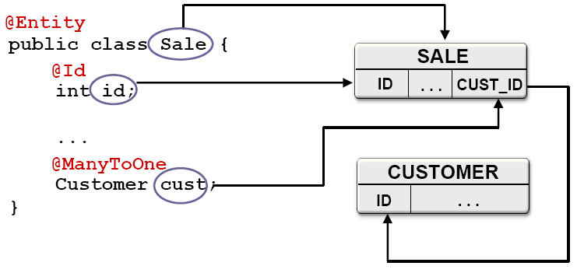
Manage Cardinality: 1 to many relationships
<ejb-relation>
<ejb-relation-name>Instructor-CourseEdition</ejb-relation-name>
<ejb-relationship-role>
<ejb-relationship-role-name> Instructor-For </ejb-relationship-role-name>
<multiplicity> Many </multiplicity>
<relationship-role-source> <ejb-name> Instructor </ejb-name> </relationship-role-source>
</ejb-relationship-role>
<ejb-relationship-role>
<ejb-relationship-role-name> Courses </ejb-relationship-role-name>
<multiplicity> One </multiplicity> … …
<relationship-role-source> <ejb-name> CourseEdition </ejb-name>
</relationship-role-source>
<cmr-field> <cmr-field-name> courses </cmr-field-name>
<cmr-field-type> java.util.Collection </cmr-field-type>
</cmr-field>
</ejb-relationship-role>
</ejb-relation>
CourseEdition
O/R mapping: aggregation
EndDate : String
StartDate : String
Code : String
instructor : Instructor
course :Course
n
1
Instructor
Type : Integer
SSN : Integer
surName : String
Age : Integer
townOfBirth : String
name : String

Slide 45
Manage cardinality: many to many relationships
Example: A Trainee may register several CourseEditions, and one CourseEdition has a number of Trainees.
Solution: Create a separate table containing the object identifiers (or Foreign Keys) of the two object types participating in the association. Map the rest of the two object types to tables using any other suitable mapping pattern.
O/R mapping: aggregation
<ejb-relation>
<ejb-relation-name> Trainee-CourseEdition</ejb-relation-name>
<ejb-relationship-role>
<ejb-relationship-role-name> Trainee-EnrollIn-Courses </ejb-relationship-role-name>
<multiplicity> Many </multiplicity>
<relationship-role-source> <ejb-name> Instructor </ejb-name> </relationship-role-source>
<cmr-field> <cmr-field-name> courses </cmr-field-name>
<cmr-field-type> java.util.Collection </cmr-field-type>
</cmr-field>
</ejb-relationship-role>
<ejb-relationship-role>
<ejb-relationship-role-name> Courses-HaveEnrolled-Trainees </ejb-relationship-role-name>
<multiplicity> Many </multiplicity>
<relationship-role-source> <ejb-name> CourseEdition </ejb-name> </relationship-role-source>
<cmr-field> <cmr-field-name> trainees </cmr-field-name>
<cmr-field-type> java.util.Collection </cmr-field-type>
</cmr-field>
</ejb-relationship-role>
</ejb-relation>

Slide 46
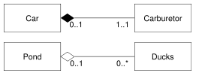

Object aggregation and composition
Aggregation and composition
Composition is a stronger form of aggregation.
In composition, when deleting the owning objects, the contained object will also be deleted.
In UML, composition relation is drawn as filled diamond, while aggregation as unfilled diamond.
Examples:
When a car is destroyed, so is its carburetor. When a pond is destroyed, the ducks are still alive.
When a university closes, the departments will be closed as well. However, data about professors should still be there.
O/R mapping: aggregation

Slide 47
Manage composition in EJB 2.0
Use cascaded delete in deployment descriptor, to indicate that deletion operation on Instructor is cascaded down to associated Telephone objects.
<ejb-relation>
<ejb-relation-name>Instructor-Telephone</ejb-relation-name>
<ejb-relationship-role>
<multiplicity>One</multiplicity> … …
<relationship-role-source> <ejb-name> Instructor </ejb-name> </relationship-role-source>
</ejb-relationship-role>
<ejb-relationship-role>
<multiplicity>Many</multiplicity> <cascade-delete/> … …
<relationship-role-source> <ejb-name> Telephone </ejb-name> </relationship-role-source>
</ejb-relationship-role>
</ejb-relation>
O/R mapping: aggregation

Slide 48
Mapping inheritance
Strategies of mapping inheritance to tables:
One table for the inheritance tree
One table for each class
One table for each inheritance path
O/R mapping: Inheritance
E
m
p
l
o
y
e
e
N
a
m
e
S
I
N
B
i
t
h
t
h
D
a
t
e
S
a
l
a
r
i
e
d
E
m
p
l
o
y
e
e
F
r
e
e
l
a
n
c
e
E
m
p
l
o
y
e
e
M
o
n
t
h
l
y
S
a
l
a
r
y
H
o
u
r
l
y
S
a
l
a
r
y

Slide 49
One table for the inheritance tree
Solution: use the union of all attributes of all objects in the inheritance hierarchy as the columns of a single database table.
O/R mapping: Inheritance
BaseClass Attributes | DescendantA Attributes | DescendantB Attributes
Attribute Values from Base | Null Values | Null Values
Attribute Values from Base | Attribute Values from A | Null Values
Attribute Values from Base | Null values | Attribute Values from B
Base class instance
DescendantA instance
DescendantB instance

Slide 50
One table for the inheritance tree
Consequences
Write/update performance: Reading/writing any objects in the hierarchy with one database operation
Space consumption: Requires more space to store the objects
O/R mapping: Inheritance

Slide 51
One table for each class
Solution
Map the attributes of each class to a separate table
O/R mapping: Inheritance
BaseClassTable
BaseClassAtrributes
DescendentA Table
DescendentB Table
DescendentB Attributes
DescendentA Attributes

Slide 52
One table for each class
O/R mapping: Inheritance
Consequences
Write and update performance: More database operations involved
Space consumption: has near optimal consumption
Maintenance cost: As the mapping is straightforward and easy to understand, schema evolution is straightforward and easy.

Slide 53
One table for each inheritance path
Solution:
Map attributes of each class to a separate table. add all inherited attributes.
If BaseClass is abstract, BaseClassTable is not generated.
Consequences
Write and update performance: One database operation to read or write an object
Maintenance: Adding or deleting attributes of a superclass results in changes to the tables of all derived classes.
O/R mapping: Inheritance
BaseClassTable
BaseClassAtrributes
LeftPathTable
BaseClassAttributes DescendentA Attributes
RightPathTable
BaseClassAttributes DescendentB Attributes

Slide 54
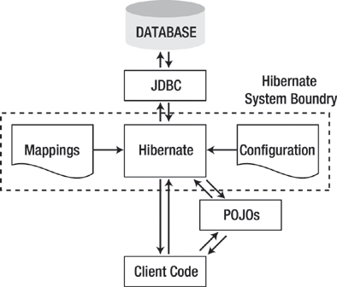
ORM tools
Map object-oriented domain model to relational database
Free developer of persistence-related programming task
Hibernate
maps Java types to SQL types
transparent persistence for classes meeting certain requirements
generates SQL for more than 25 dialects behind the scenes
provides data query and retrieval using either HQL or SQL
can be used stand-alone with Java SE or in Java EE applications
Java Persistence API (JPA)
Enterprise Java Beans Standard 3.0
introduced annotations to define mapping
javax.persistence package

Slide 55
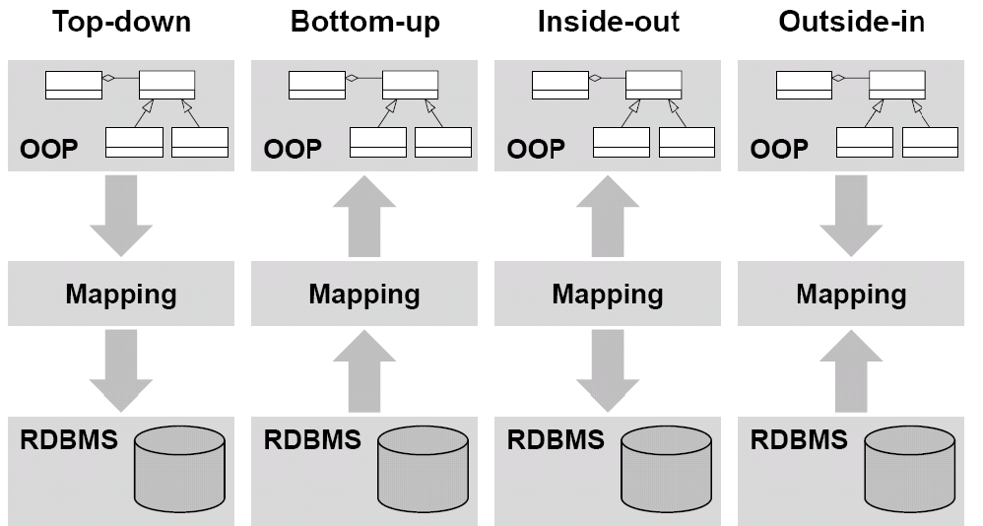
Mapping strategies

