Slide 1
TIMSORT
Michael Chen, Mason Baldwin, Alex Haas

Slide 2
01
Introduction

Slide 3
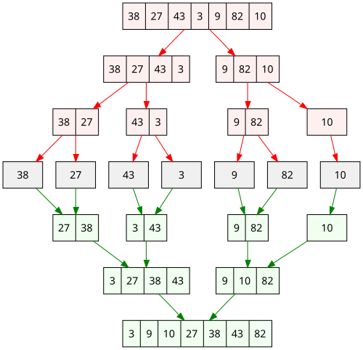
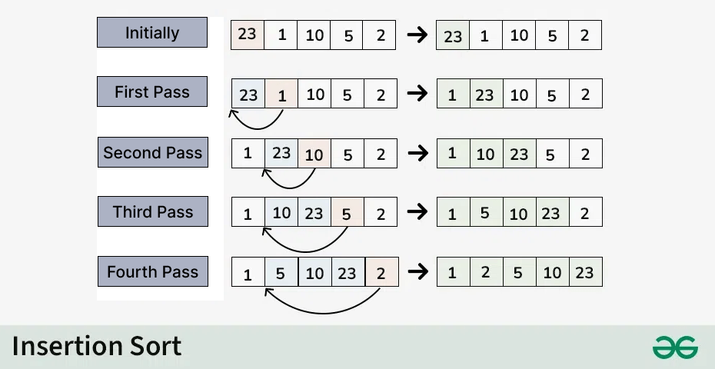
Popular Sorting Algorithms
Merge Sort
Insertion Sort
Strengths? Weaknesses?
Notes:
Mason

Slide 4
Popular Sorting Algorithms Runtime
Algorithm | Best Case | Average Case | Worst Case | Notes
Insertion Sort | 𝛀(n) | Θ(n^2) | O(n^2) | Best for small datasets, most elements are already in order.
Merge Sort | 𝛀(nlogn) | Θ(nlogn) | O(nlogn) | Best for large datasets, stable runtime.
What if we can combine Insertion Sort’s 𝛀(n) best case runtime with Merge Sort’s Θ(nlogn) average and worst case runtime?
Notes:
Mason

Slide 5
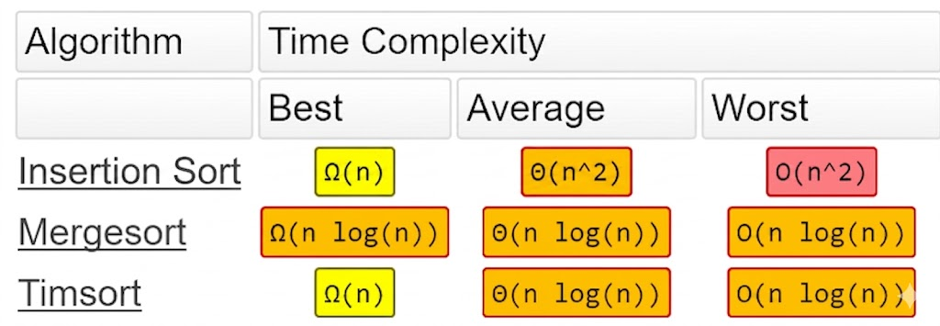
Timsort
Definition: A high-performance, adaptive algorithm that combines the low overhead of Insertion Sort with the scaling power of Merge Sort.
Time Complexity:
Best Case: 𝛀(n)Big-Ω (Big-Omega) notation (article)
Average Case: Θ(nlogn)
Worst Case: O(nlogn).
Space Complexity:
O(n), additional space is required for merging runs.
Applications:
Python: The default sort for list.sort() and sorted().
Java: Used in java.util.Arrays.sort() for objects and Collections.sort().
Notes:
Mason

Slide 6
02
General Approach

Slide 7
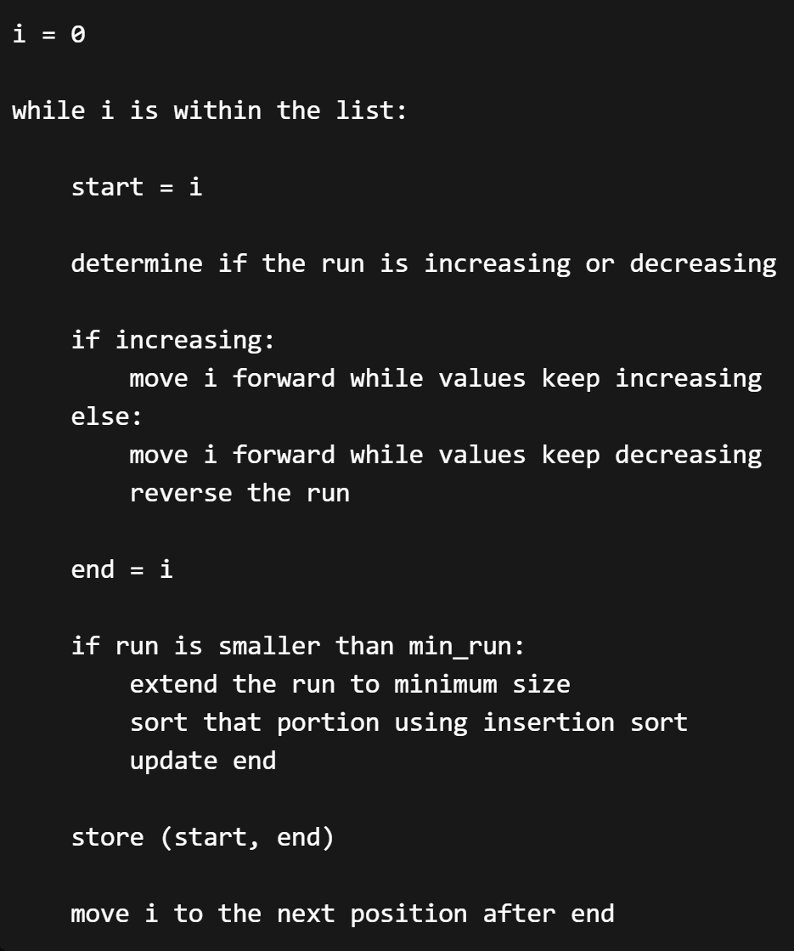
Runs
Key Idea: exploit contiguous sorted subsequences already present in a dataset
Example: Multiple servers log data in chronological order. When all server logs are uploaded to the main system, this order is still maintained:
Server A: [1, 3, 5]
Server B: [2, 4, 6]
Combined: [1, 3, 5, 2, 4, 6]
Importance of Minimum Run Size
Prevents too many small runs
Makes merging more efficient
Leverages insertion sort where its strongest
Notes:
Alex

Slide 8
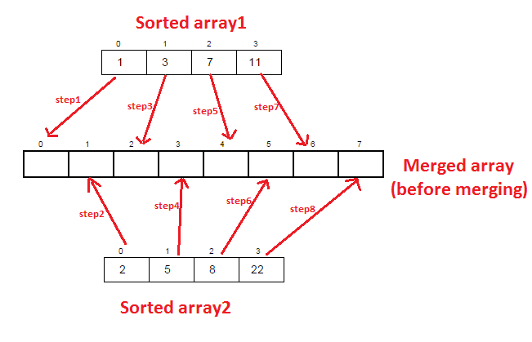
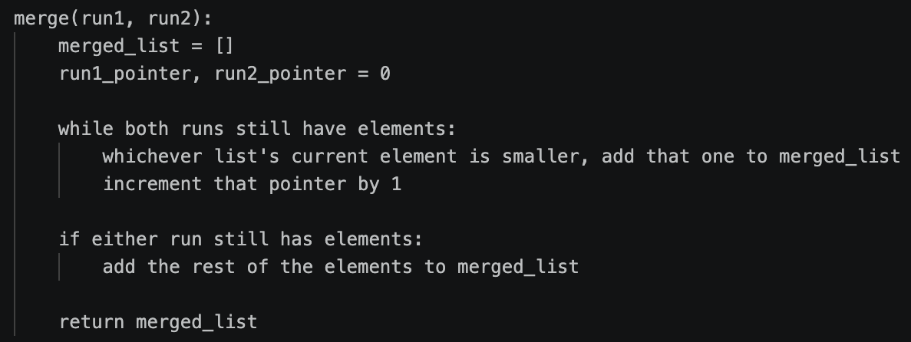

Merging
Each run = smaller sorted list
Iterative instead of recursive
Merge order matters! (O(n²) possible)
…
Notes:
Michael

Slide 9
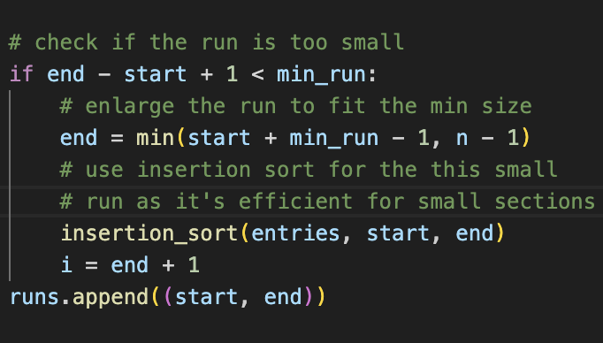
Min_run
Definition: The minimum length required for a run before it can be added to the merge stack.
If Run Size < min_run:
Use Insertion Sort to "boost" the run.
Pulls the next elements into the current sequence until the threshold is met.
If Run Size ≥ min_run:
Keep the run as-is and move to the next chunk.
Prepares these standardized chunks for the Merge Sort phase.
Notes:
Mason

Slide 10
03
Optimizations

Slide 11
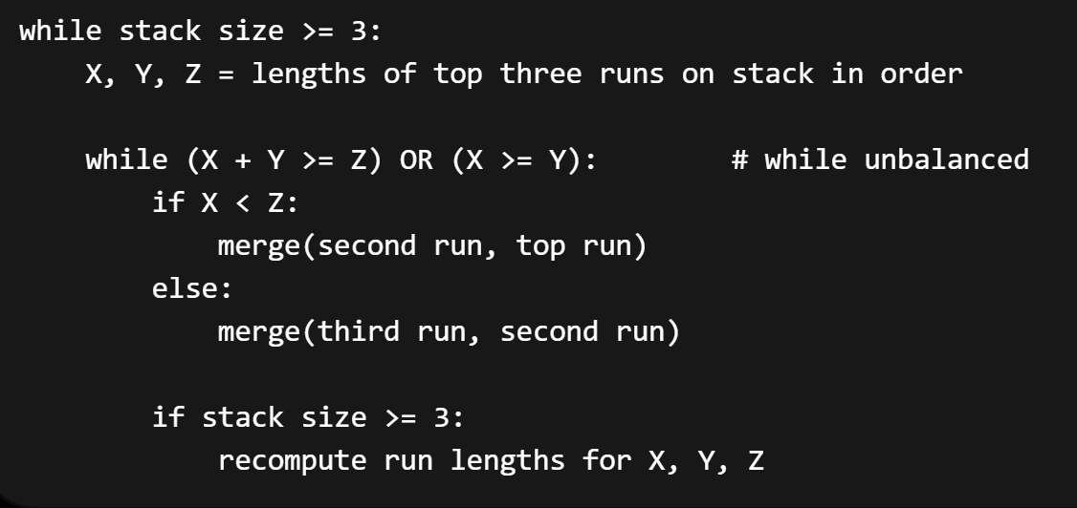
Merging Rules
Key Idea: Keep runs balanced by merging unbalanced runs as you add to stack
Badly sized runs lead to later inefficient merges
Newer runs should be smaller than older runs
Solution: merge now!
After stack is balanced, merge remaining runs.
Balancing Conditions
Analyze top 3 runs (of length X, Y, Z) on stack according to the balancing conditions:
1. X + Y ≥ Z
2. X ≥ Y
Notes:
Alex

Slide 12

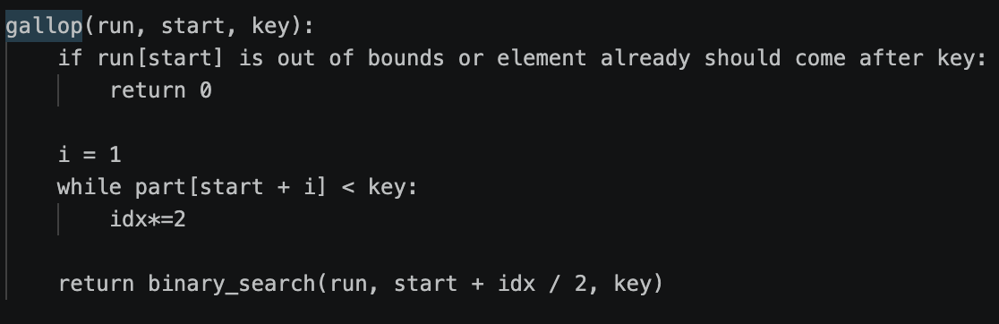
Galloping
Consider these two lists:
[1,2,3,4,5,6,7,8,9,11] [10,12,13,14,15,16,17,18,19,67]
Key idea: If one run ‘wins’ enough times in a row (min_gallp), it’ll probably keep winning for awhile
Notes:
Michael

Slide 13
04
Questions?

