Slide 1
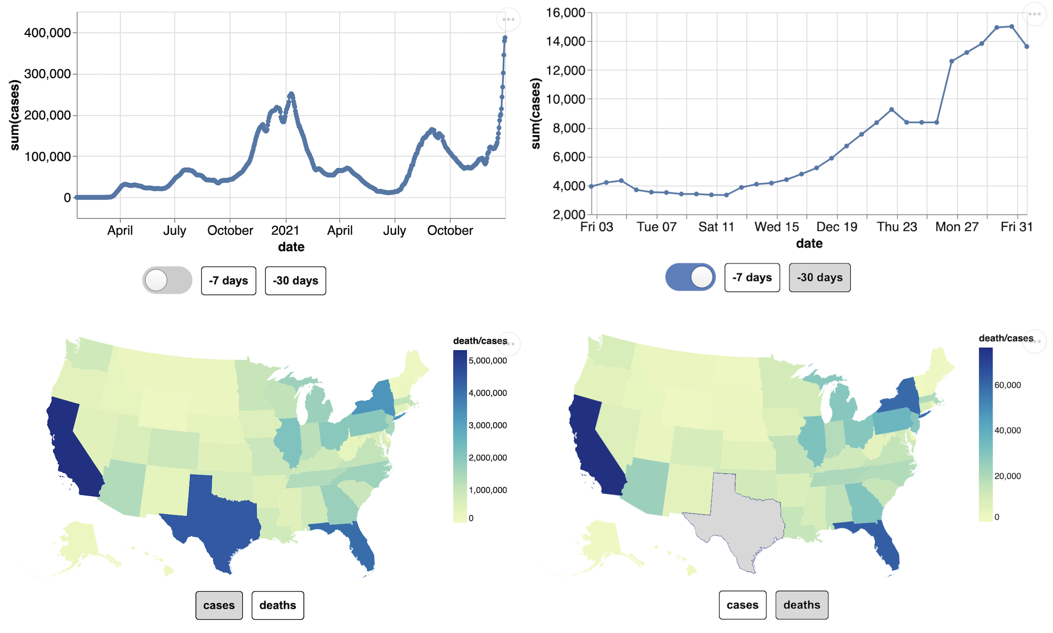
Task 1
The covid total cases or deaths across all the states in US.
Task 2
US‘s covid case trends and different states’ covid cases trend all the time. And the recent trends in 7 or 30 days.

Slide 2

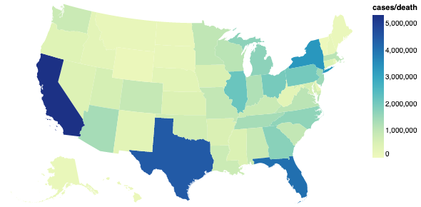

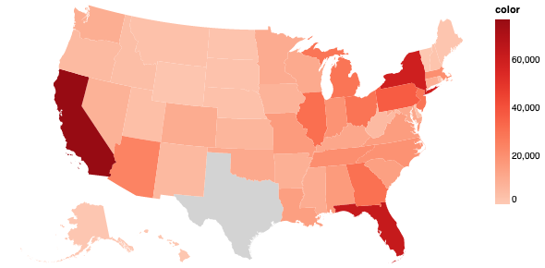



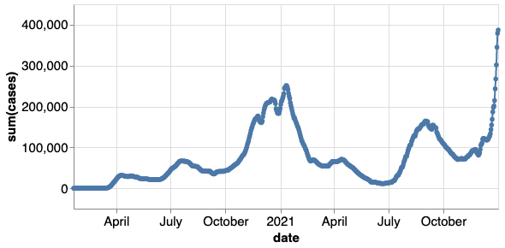
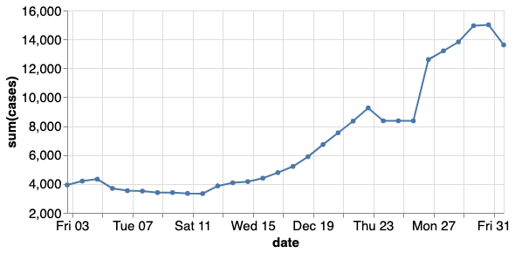


Task 1
How is covid total cases or deaths across all the states in US?
Task 2
How is US‘s covid case trends and different states’ covid cases trend all the time? And how about the recent trends in 7 or 30 days ?

Slide 3
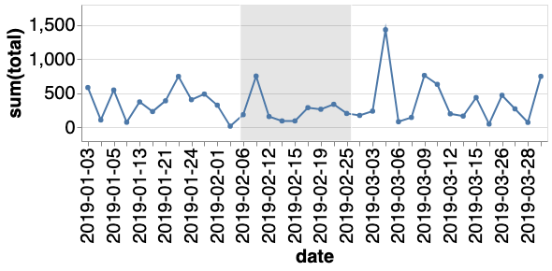


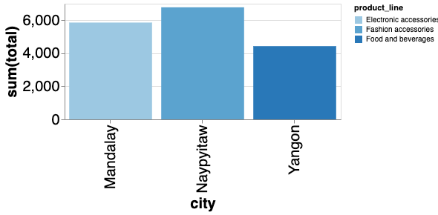
Task 1
How is covid total cases or deaths across all the states in US?
Task 2
How is US‘s covid case trends and different states’ covid cases trend all the time? And how about the recent trends in 7 or 30 days ?
Task 1
How is total sales of different product lines and branches along the time?
Task 2
How is the total sales for different cities‘ highest product line in different time periods?
(a)
(b)
(c)
(d)
(e)

Slide 4
Task 1
How is total sales of different product lines and branches along the time?
Task 2
How is the total sales for different cities‘ highest product line in different time periods?

