Slide 1

反方：课程学习价值不大。
Opposition: We don’t really need curriculum learning that much
辩手：一辩：蒋希
二辩：蒋沁言
三辩：林秋实
四辩：刘柱
2021.1.18

Slide 2
一辩：蒋希

Slide 3
Curriculum learning is of little value.
Curriculum learning:
The definition of curriculum learning has been given by Bengio^{[1]}.
In short, curriculum learning means “training from easier data to harder data”.
Recent survey^{[2]} also gave that curriculum learning should contain a Difficulty Measurer and a Training Scheduler.
Value:
Value is reflected in the following three aspects: application, theory and effect. Those should focus on current research, but not future.

Slide 4
Curriculum learning is of little value.
1. Limitations of application environment
2. Lack of theoretical support leads to some inexplicable contradictions
3. Effect and Cost

Slide 5
Curriculum learning is of little value.
1. Limitations of application environment
The limitation of fixed datasets in “WHEN DO CURRICULA WORK?”^{[3]}:
Furthermore, the form of curriculum discussed here only involves ordering examples from a fixed training dataset, rather than more drastic modifications of the training procedure, such as gradually increasing image resolution (Vogelsang et al., 2018) or the classes (Weinshall et al., 2018).

Slide 6
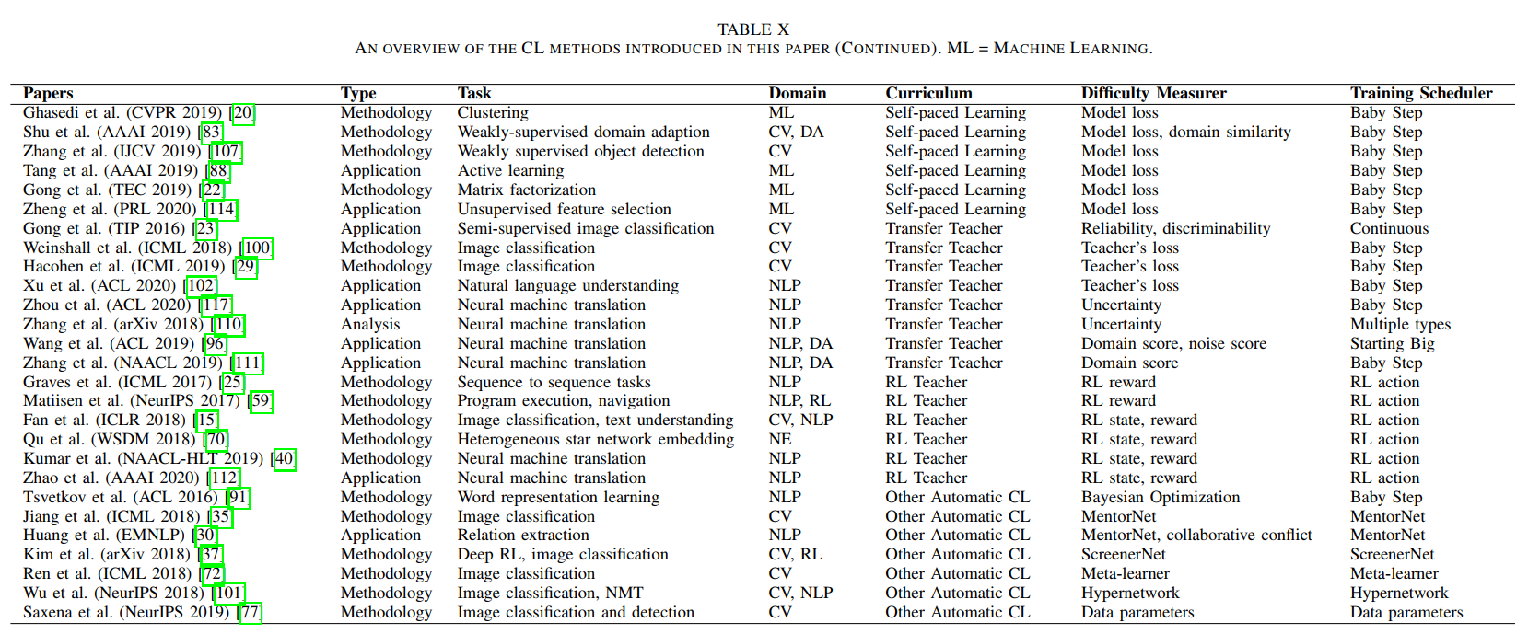
Curriculum learning is of little value.
1. Limitations of application environment
[2]
Different measurers and scheduler should be used in different task.

Slide 7
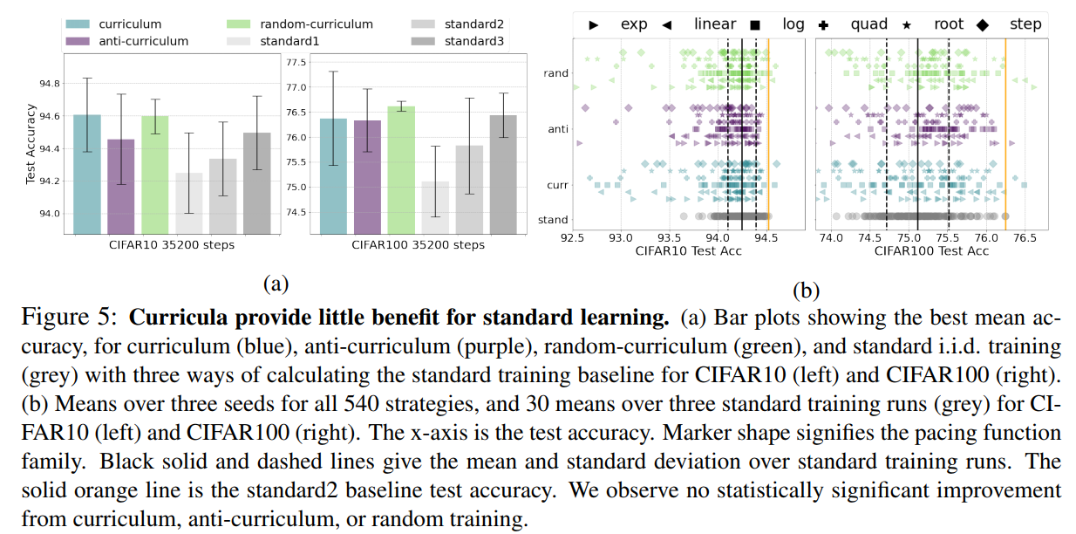
Curriculum learning is of little value.
1. Limitations of application environment
“WHEN DO CURRICULA WORK?”^{[3]}:
In the previous section, we found little evidence for statistically significant benefits from curricula or pacing. This observation is consistent with the fact that curricula have not become a standard part of supervised image classification.

Slide 8
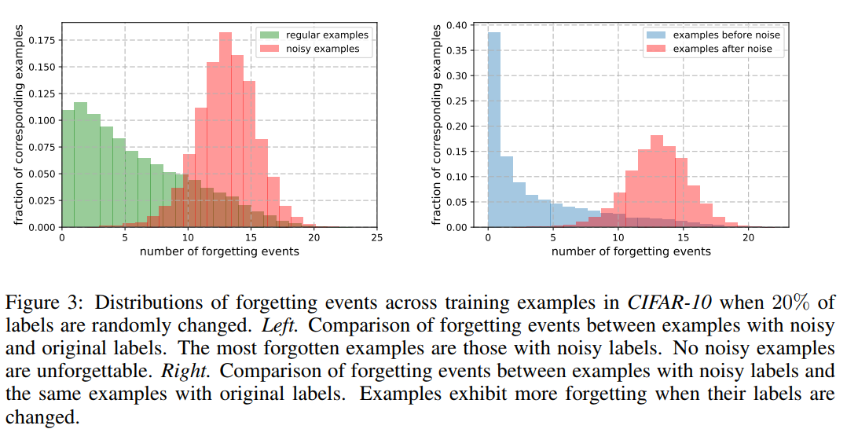
Curriculum learning is of little value.
2. Lack of theoretical support leads to some inexplicable contradictions
Difficult samples may be more valuable and require more time to learn.
However, owing to the fact that there are much more easy examples than those meaningful hard examples in dataset, the training tends to stagnate quickly and the model may suffer from over-fitting. Therefore, the hard sample mining method is fateful to optimize the model and improve the learning efficiency. [4]
[5]

Slide 9
Curriculum learning is of little value.
2. Lack of theoretical support leads to some inexplicable contradictions
Full dataset training might be better.
Unlike Elman, however, we found that learning was most effective when the network was exposed to the full complexity of the language throughout training, and that the advantage of this approach over ‘starting small’ increased as the language was made more Englishlike by introducing semantic constraints.[6]

Slide 10
Curriculum learning is of little value.
2. Lack of theoretical support leads to some inexplicable contradictions
It is difficult to exclude the role of Training Scheduler.

Slide 11
Curriculum learning is of little value.
3. Effect and Cost
Increasing the cost and procedures:
It is difficult to find the most suitable combination of Difficulty Measurer and Training Scheduler for a specific task and its dataset. There are no existing methodologies for selecting Difficulty Measurer and Training Scheduler other than exhaustive trials.
Note that while SPL and Transfer Teacher methods are semi-automatic with automatic Difficulty Measurer and predefined Training Scheduler, the RL Teacher and Other Automatic CL methods are fully automatic and adopt the extended definition of CL as a sequence of data selection, example reweighting, or training criteria. [2]

Slide 12
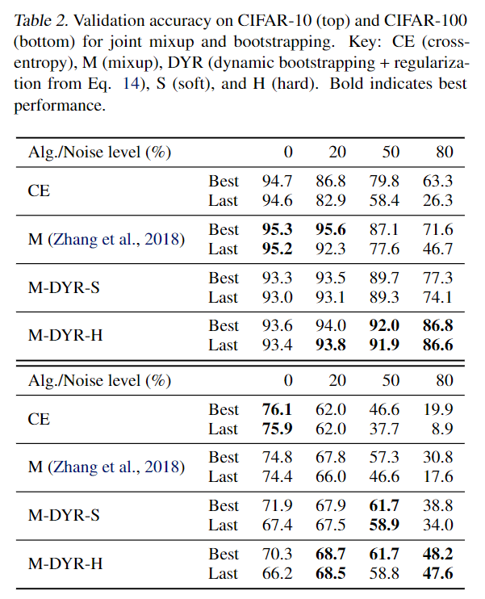
Curriculum learning is of little value.
3. Effect and Cost
Other methods may be more efficient:
When there are a mix-ture of correct and mislabelled targets, networkstend to fit the former before the latter. This suggests using a suitable two-component mix-ture model as an unsupervised generative modelof sample loss values during training to allowonline estimation of the probability that a sam-ple is mislabelled. [8]

Slide 13
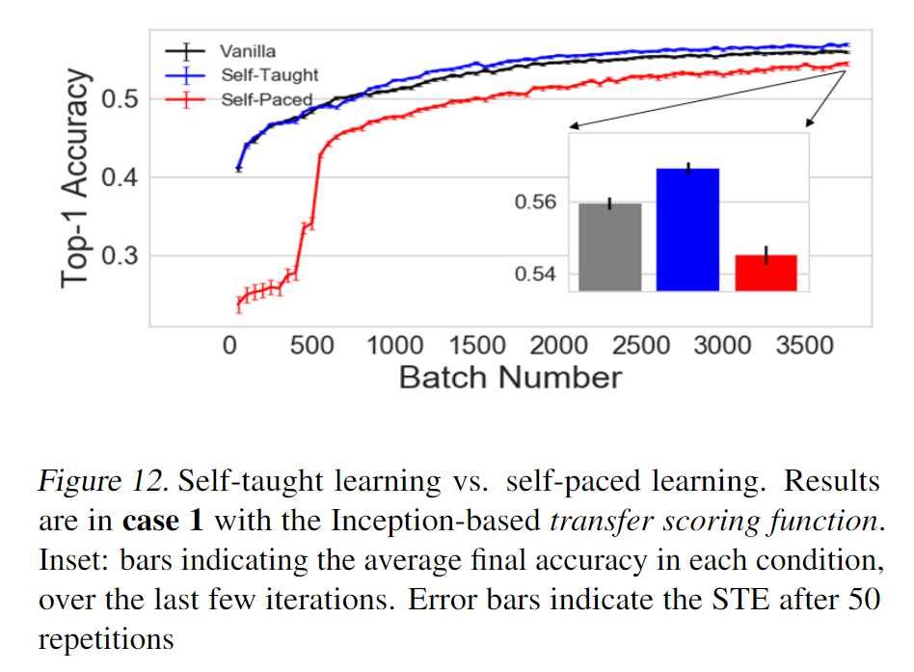
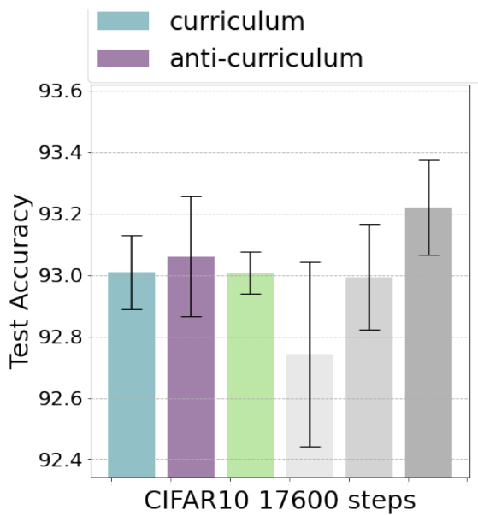
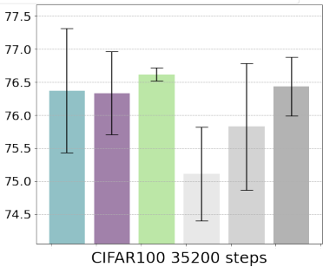
Curriculum learning is of little value.
3. Effect and Cost
Unstable performance:
[3]
[9]

Slide 14
Reference
[1]Bengio, Yoshua, et al. "Curriculum learning." Proceedings of the 26th annual international conference on machine learning. 2009.
[2]Wang X, Chen Y, Zhu W. A Comprehensive Survey on Curriculum Learning[J]. arXiv preprint arXiv:2010.13166, 2020.
[3]Wu X, Dyer E, Neyshabur B. When Do Curricula Work?[J]. arXiv preprint arXiv:2012.03107, 2020.
[4]Chen K, Chen Y, Han C, et al. Improving Person Re-Identification by Adaptive Hard Sample Mining[C]//2018 25th IEEE International Conference on Image Processing (ICIP). IEEE, 2018: 1638-1642.
[5]Toneva M, Sordoni A, Combes R T, et al. An empirical study of example forgetting during deep neural network learning[J]. arXiv preprint arXiv:1812.05159, 2018.

Slide 15
Reference
[6]Rohde D L T, Plaut D C. Language acquisition in the absence of explicit negative evidence: How important is starting small?[J]. Cognition, 1999, 72(1): 67-109.
[7]Narvekar S, Peng B, Leonetti M, et al. Curriculum Learning for Reinforcement Learning Domains: A Framework and Survey[J]. arXiv preprint arXiv:2003.04960, 2020.
[8]Arazo E, Ortego D, Albert P, et al. Unsupervised label noise modeling and loss correction[J]. arXiv preprint arXiv:1904.11238, 2019.
[9]Hacohen G, Weinshall D. On the power of curriculum learning in training deep networks[J]. arXiv preprint arXiv:1904.03626, 2019.

Slide 16
四辩：刘柱

Slide 17
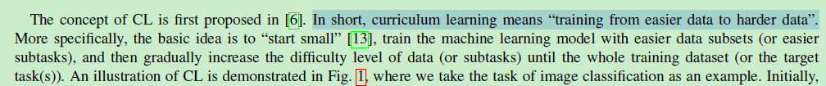
Definition of CL
狭义与广义？
A Comprehensive Survey on Curriculum Learning

Slide 18
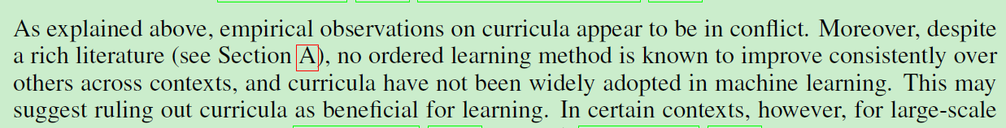
Limited Applications
Wu, Xiaoxia, Ethan Dyer, and Behnam Neyshabur. "When Do Curricula Work?." arXiv preprint arXiv:2012.03107 (2020).

Slide 19
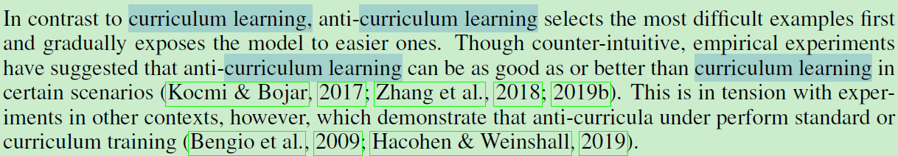
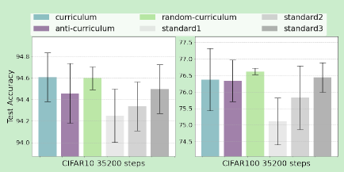
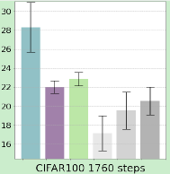
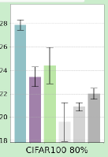
counter-intuitive or not?
Curriculum > Standard/Random > Anti-Curriculum , as human beings.
Standard
Limit time
Noisy data
Wu, Xiaoxia, Ethan Dyer, and Behnam Neyshabur. "When Do Curricula Work?." arXiv preprint arXiv:2012.03107 (2020).
从左到右：Fig 5 a; Fig 6 下排左二； Fig 7左右四

Slide 20
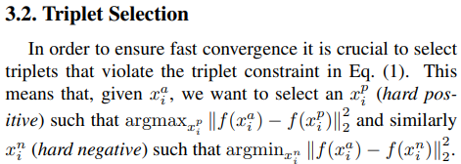
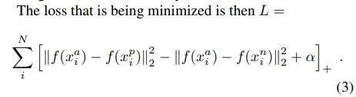
Hard sampling in Metric Learning
Does it contradict CL?
Schroff, Florian, Dmitry Kalenichenko, and James Philbin. "Facenet: A unified embedding for face recognition and clustering." Proceedings of the IEEE conference on computer vision and pattern recognition. 2015.

Slide 21
Interpretation
Wu, Xiaoxia, Ethan Dyer, and Behnam Neyshabur. "When Do Curricula Work?." arXiv preprint arXiv:2012.03107 (2020).

Slide 22
二辩：蒋沁言

Slide 23
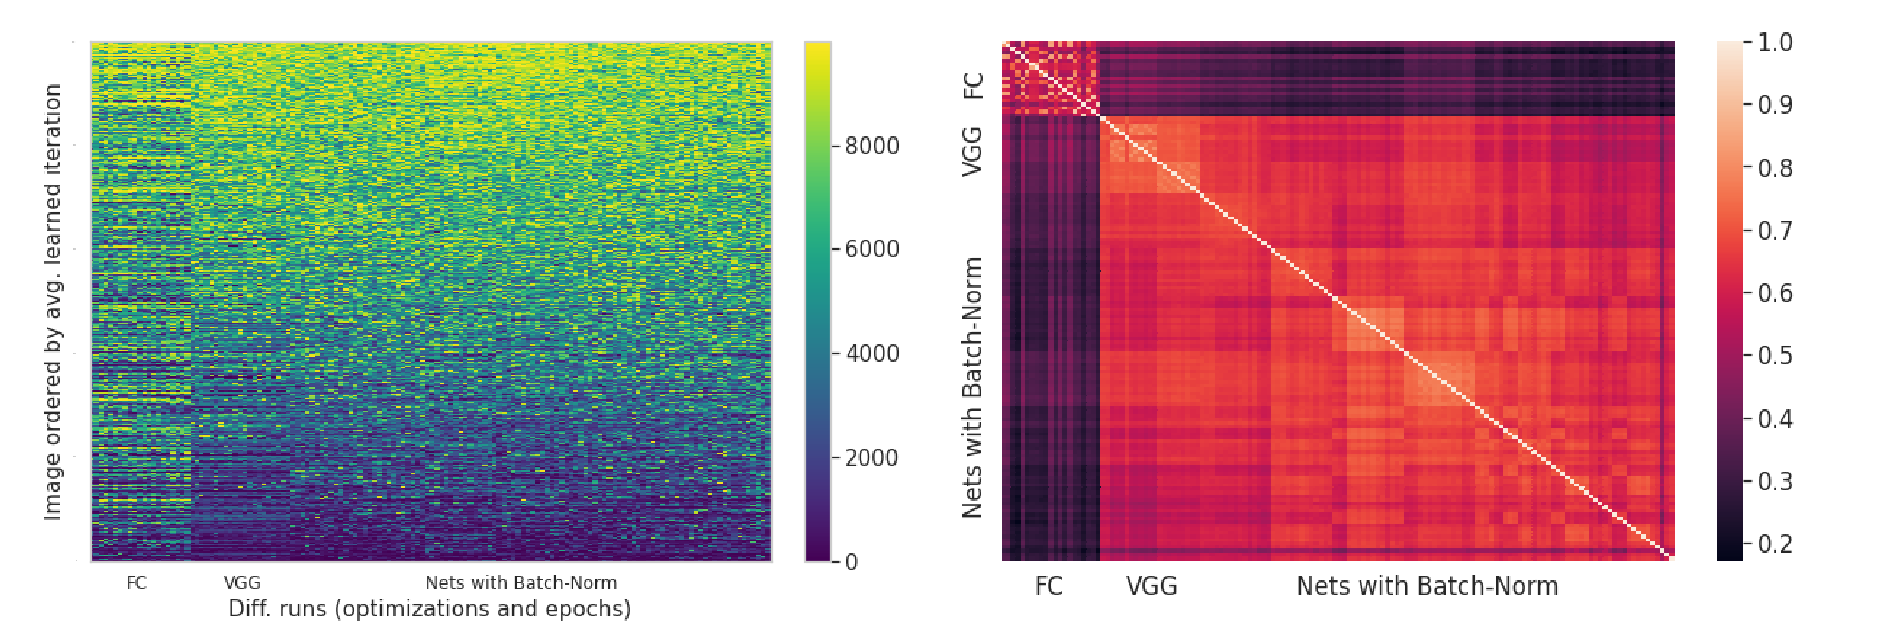
Notes:
Transformer

Slide 24
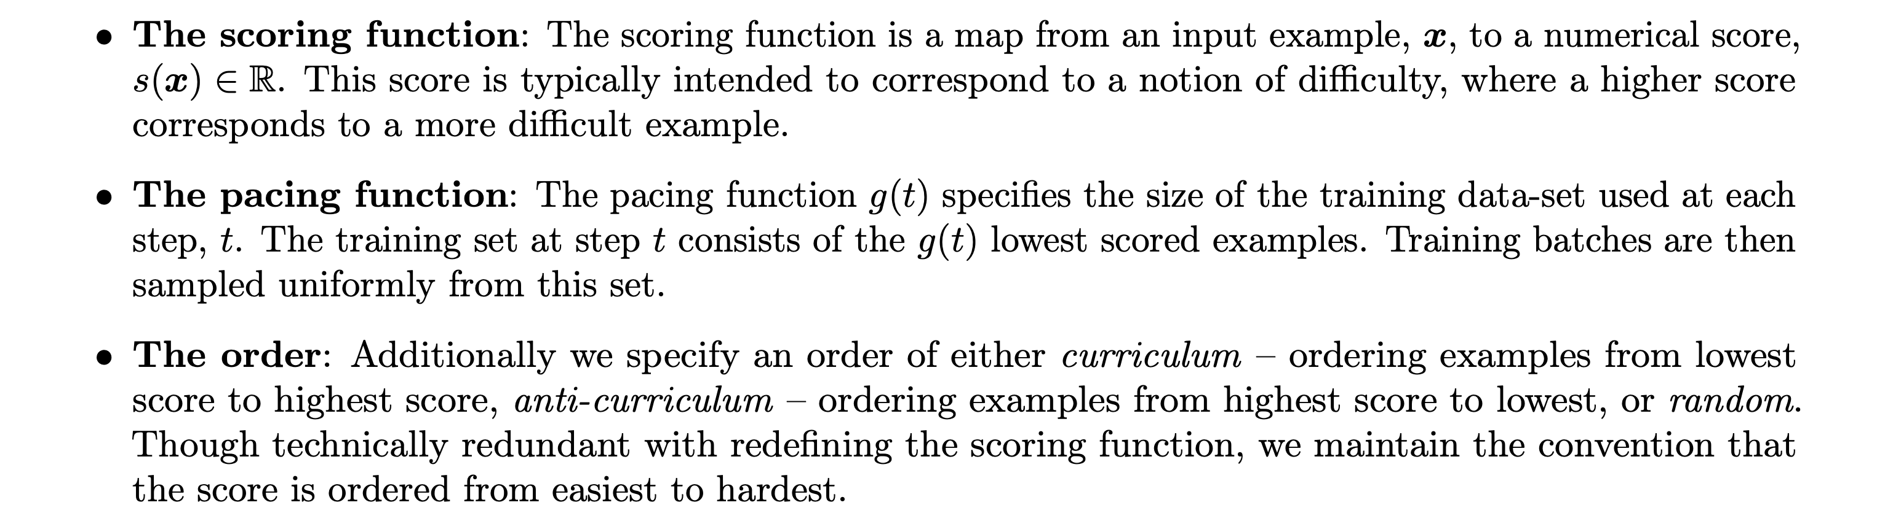

Slide 25
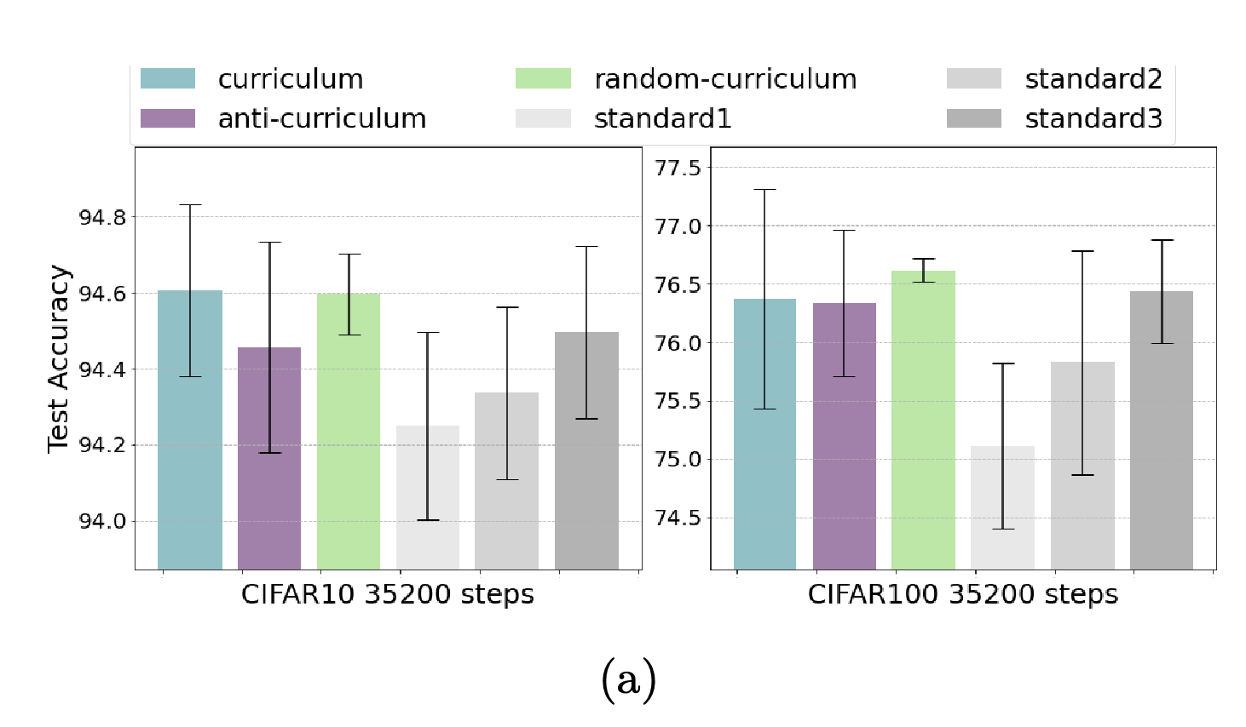

Slide 26
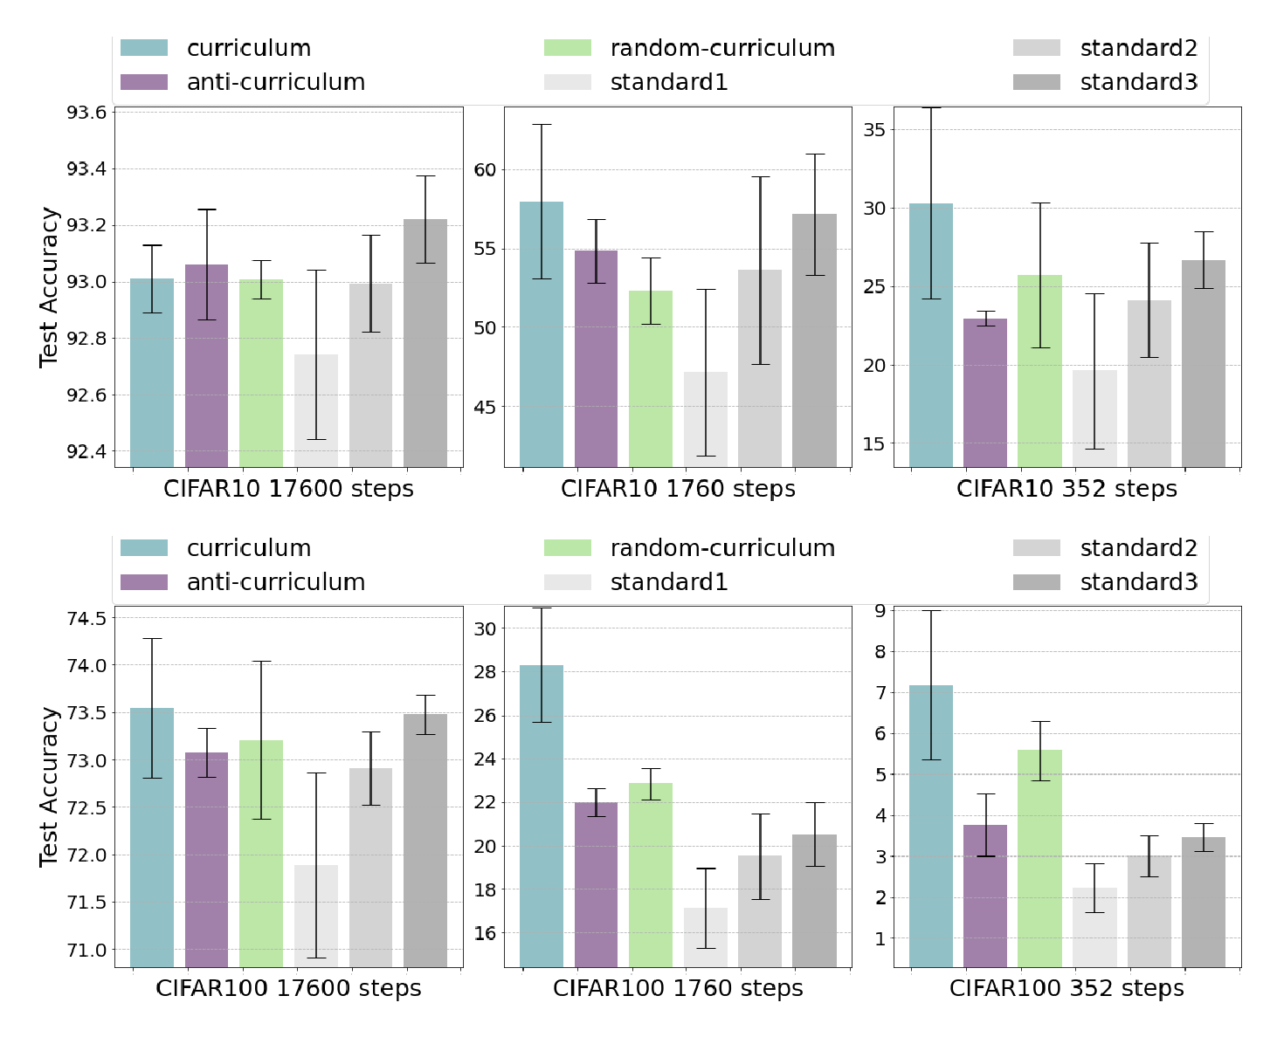

Slide 27
