Slide 1
正方：课程学习价值很大。
Opposition: We really need curriculum learning.
辩手：一辩：陆东
二辩：王志强
三辩：耿甜甜
四辩：陈明辉
2021.1.18

Slide 2
When Do Curricula Work?
简要介绍
陈明辉

Slide 3
这篇文章讲了个什么故事？
谈恋爱讲究势均力敌。
谈恋爱的时候，段位是否客观存在？(Implicit Curricula: Examples are learned in a consistent order.)
对一般人来说，谈恋爱不必如同升级打怪。(Curricula achieve (almost) no improvement in the standard setting.)
当然，如果你的🐟鱼塘比较大，又比较赶时间，还是有点帮助。(Curriculum learning improves over standard training when training time is limited.)
特别是在你不能准确评估对方段位的情况下。(Curricula improves over standard training in noisy regime.)

Slide 4
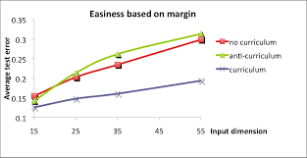
什么是课程学习（Curriculum Learning）？
课程学习（Curriculum Learning）由Montreal大学的Bengio教授团队在2009年的ICML上提出，主要思想是模仿人类学习的特点，由简单到困难来学习课程（在机器学习里就是容易学习的样本和不容易学习的样本），这样容易使模型找到更好的局部最优，同时加快训练的速度。

Slide 5
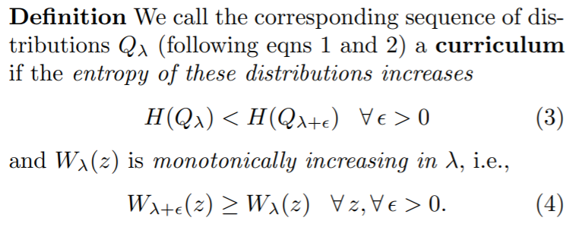
为什么要用课程学习？
The experiments presented here suggest that pretraining with a curriculum strategy might act similarly to unsupervised pre-training, acting both as a way to find better local minima and as a regularizer.
一个简答的例子就是训练的时候先训练一些简单的样本，之后不断的调整那些相对特殊的样本的权重，使得样本总体的数量和多样性（熵）都不断地扩大，直到最后就是一个完整的我们想要的训练集。

Slide 6
具体怎么用课程学习？
Early iteration determine. An example is learned and remains learned after that. (Ref: An Empirical Study of Example Forgetting during Deep Neural Network Learning)
Consistency score. Based on the consistency of a model in correctly predicting a particular example’s label trained under i.i.d. (Ref: Characterizing Structural Regularities of Labeled Data in Overparameterized Models)
Pacing function. (a) Fixed exponential pacing; (b) Varied exponential pacing; (c) Single-step pacing.(Ref: On The Power of Curriculum Learning in Training Deep Networks)

Slide 7
哪些工作运用了课程学习？
Vision: Imbalanced data classification[1], CurricularFace[2], VQA[3].
Language: GPT-3[4], T5[5], Neural Machine Translation[6].
[1] Dynamic Curriculum Learning for Imbalanced Data Classification. ICCV 2019.
[2] CurricularFace: Adaptive Curriculum Learning Loss for Deep Face Recognition. CVPR 2020.
[3] A Competence-aware Curriculum for Visual Concepts Learning via Question Answering. ECCV 2020.
[4] Language Models are Few-Shot Learners. NeurIPS 2020.
[5] Exploring the Limits of Transfer Learning with a Unified Text-to-Text Transformer. JMLR
[6] Competence-based Curriculum Learning for Neural Machine Translation. NAACL 2019.

Slide 8
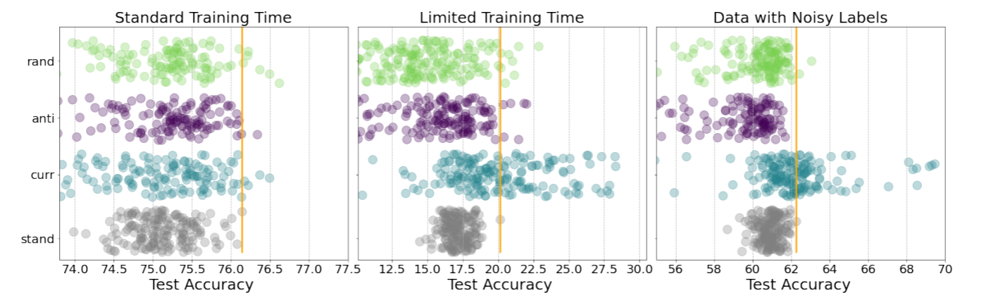
这篇文章实验上有什么花样？
This paper has extremely comprehensive evaluations, examining the influence of curriculum learning (curriculum/anti-curriculum/random-curriculum) in diverse settings (standard/limited training time budget/noisy data).

Slide 9
可以Battle的点
1. 实验是否足够清晰地说明Implicit Curricula定义的鲁棒？
2. 在Time-limited和noisy label情形下works，缺乏insights。
3. Text相关实验的缺乏，根据之前的文献实验显示课程学习在一些Text任务上是标准范式，为什么没在此做实验上的深挖？

Slide 10
Battle这篇对我有什么帮助？
Yoshua Bengio大佬背书，学不了吃亏，学不了上当。
Open Review的审稿人一致赞绝👍的写作和验证实验设计。
对样本这一机器学习范式的基本元素会有更宏观的认识。
Transformer我看不行（要讲武德）

Slide 11
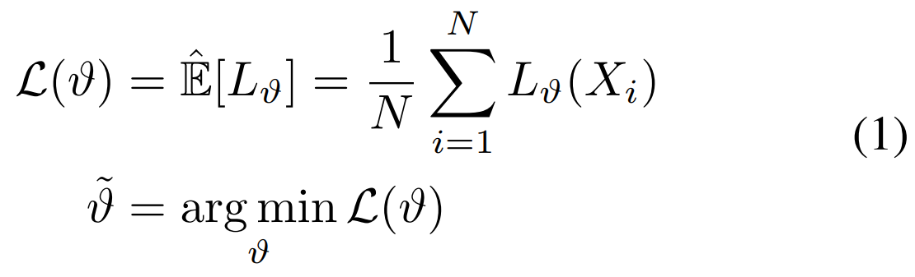
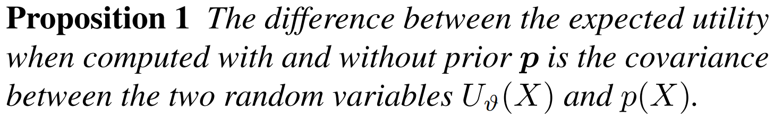
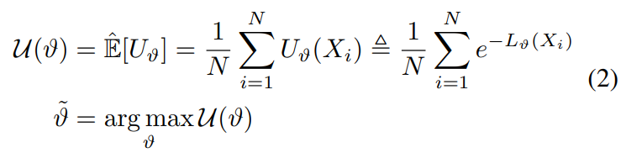
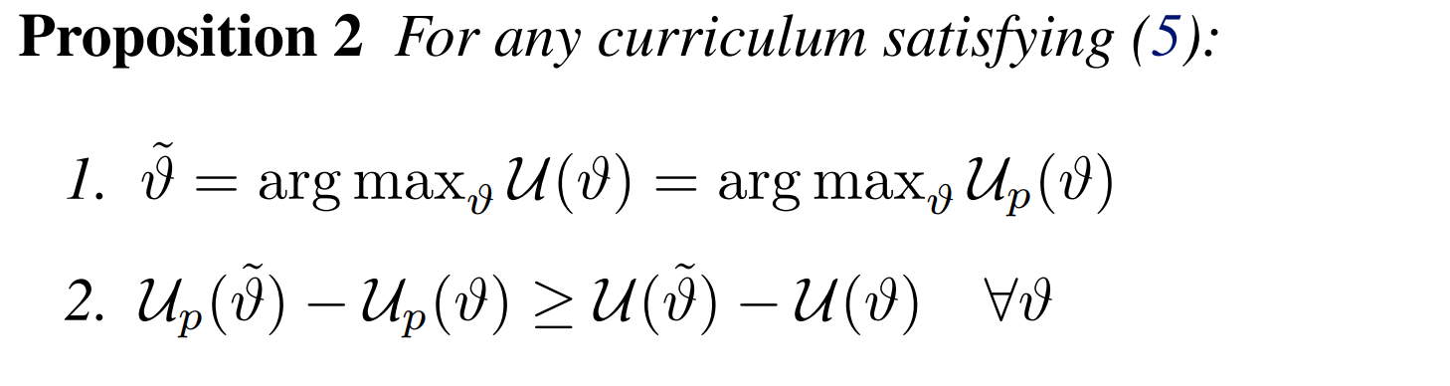
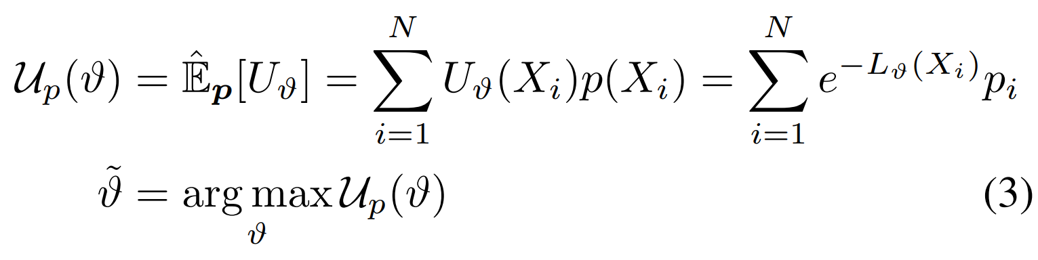
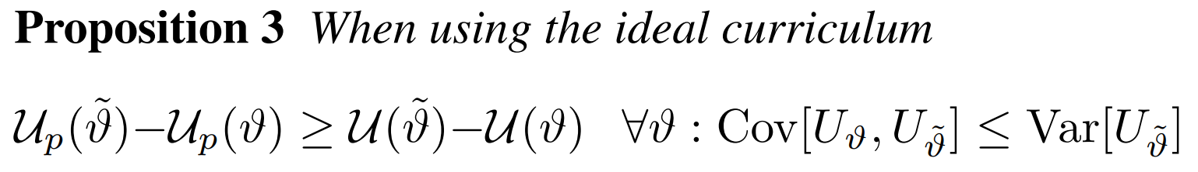
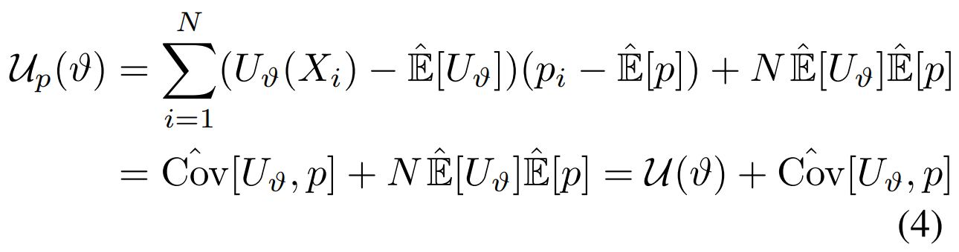
Ideal Curriculum

Slide 12
CL and HEM are not irreconcilable
CurricularFace: Adaptive Curriculum Learning Loss for Deep Face Recognition (CVPR 2020)
An Adaptive Curricular Learning Loss.
人脸识别中常用损失函数主要包括两类，基于间隔和难样本挖掘，这两种方法损失函数的训练策略都存在缺陷。前一种方法是对所有样本都采用一个固定的间隔值，没有充分利用每个样本自身的难易信息，这可能导致在使用大边际时出现收敛问题；后一种方法则在整个网络训练周期都强调难样本，可能出现网络无法收敛问题。
在CurricularFace中，做法是由每个Batch随机抽取样本，通过在线挖掘难样本自适应地建立课程

Slide 13
历年Curriculum Learning研究 （标题或摘要包含Curriculum的论文）
Year | CVPR | ICCV or ECCV
2013 | 0 | 0
2014 | 0 | -
2015 | 1 | 0
2016 | 1 | -
2017 | 2 | 3
2018 | 1 | 3
2019 | 0 | 4
2020 | 3 | 6
Year | ICML | NeurIPS | ICLR
2013 | 0 | 0 | -
2014 | 0 | 0 | -
2015 | 0 | 2 | -
2016 | 1 | 0 | -
2017 | 2 | 0 | -
2018 | 4 | 1 | 2
2019 | 2 | 4 | 1
2020 | 3 | 8 | 5

Slide 14
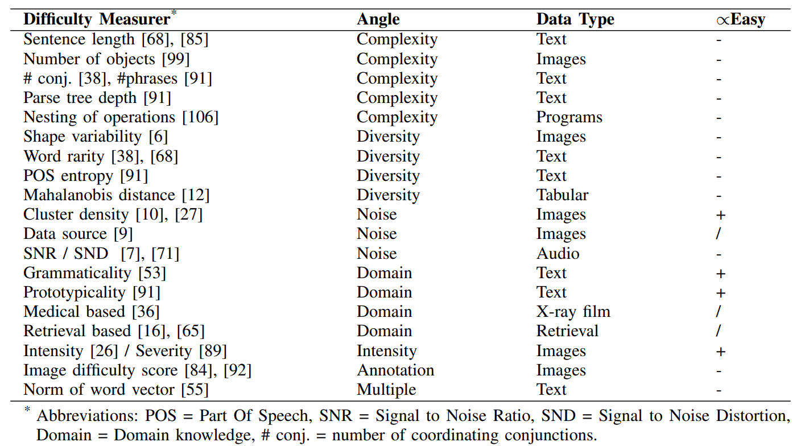
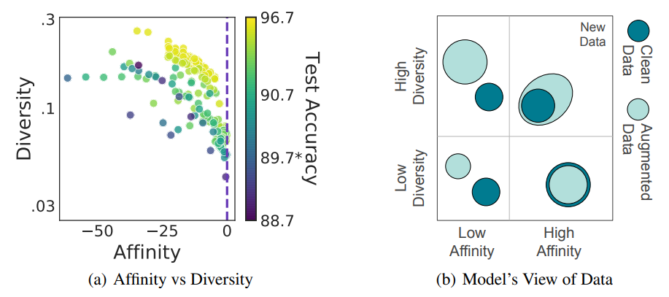
CL and Data Augmentation
Complexity and Diversity.
Ref: Affinity and Diversity: Quantifying Mechanisms of Data Augmentation
Closely Related with Semi-/Weak-/Self-Supervised!

Slide 15
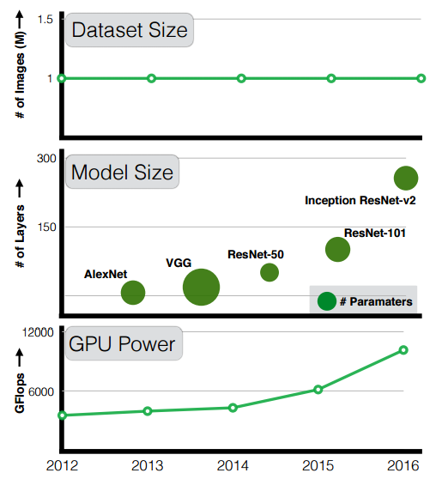
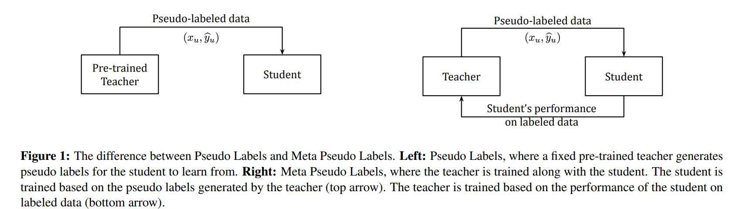
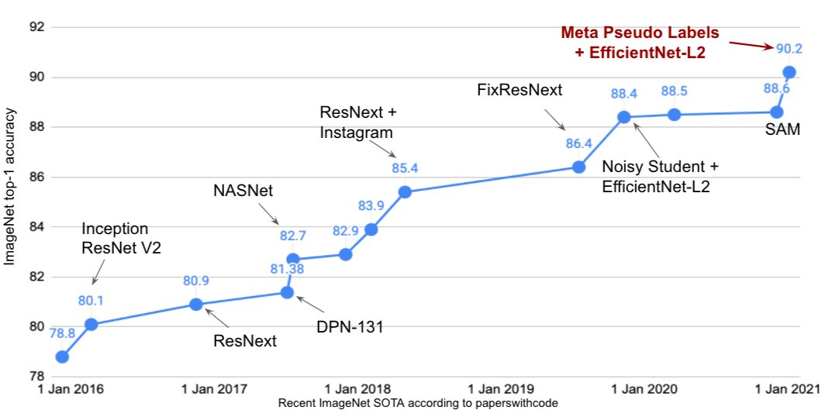
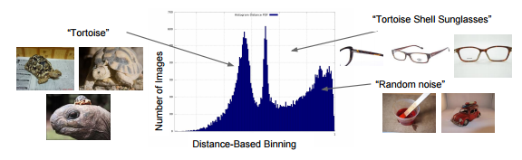
CL and JFT-300M dataset
Ref: Meta Pseudo Labels

Slide 16
Do we really need Curriculum Learning?
Sure we do！
多个朋友多条路，多个方法也不亏☺
We need, but
How Really？

Slide 17
课程学习：
是什么？
training strategy：一种模型学习的策略
简而言之，从易到难：从1+1到99乘法表，从hello world到import torch
从哪来？
从人类的智慧中来：imitates the meaningful learning order in human curricula → 义务教育：所有适龄儿童、少年必须接受的教育
科研来自于生活，So we really need it!
有啥用？
improving the generalization capacity and convergence rate of various models in a wide range of scenarios[1]
哪里用？
CV, NLP, RL, NAS, healthcare prediction, network embedding, etc.[1]
[1] A Comprehensive Survey on Curriculum Learning. Xin Wang, Member, IEEE, Yudong Chen, and Wenwu Zhu

Slide 18
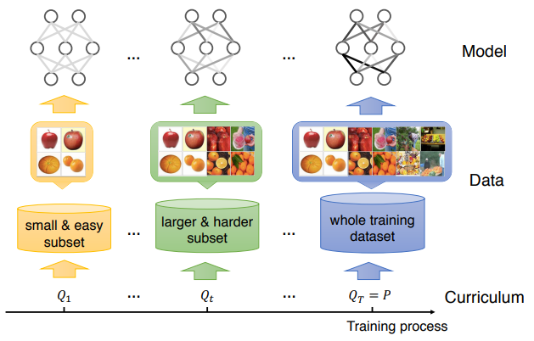
Definition：
什么是课程？什么又是课程学习？
简单理解：就是利用课程改变训练样本中的分布，一开始简单的样本数量很多，出现的概率大，随着λ【第几个epoch】增大，使得样本总体的数量和多样性（熵）都不断地扩大，最终和原始数据一致。
Notes:
Speciﬁcally, CL initially trains the model on a small and easy subset. With the progress of the training, CL gradually introduces more harder examples into the subset, and ﬁnally trains the model on the whole training dataset
对于样本等几率分布而言，样本数越大，熵值越大（可能的事件越多，不确定性越高）

Slide 19
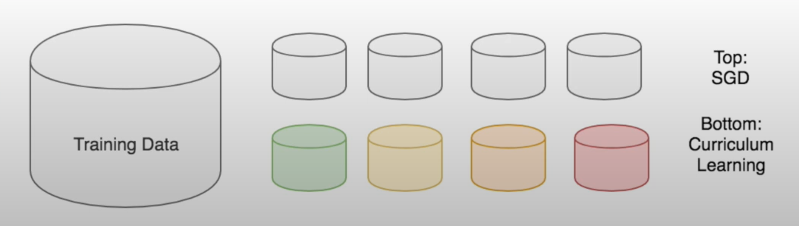
Curriculum Learning vs. SGD
Data ordered from easy to hard: similar to human learning

Slide 20
Curriculum Learning: Scoring & Pacing Functions

Slide 21
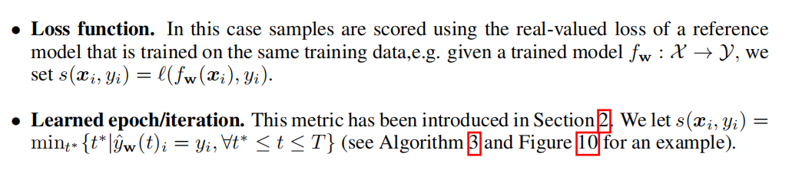
Scoring Functions → Difficulty Ranking

Slide 22
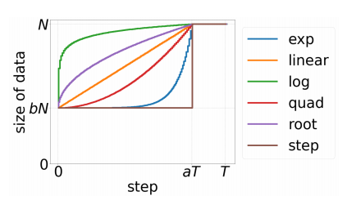
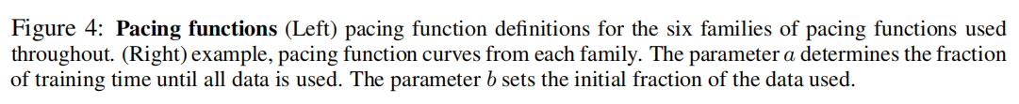
Pacing Functions → Increment of Hard Examples

Slide 23

Putting them together: Curriculum Learning
Notes:
M:

Slide 24
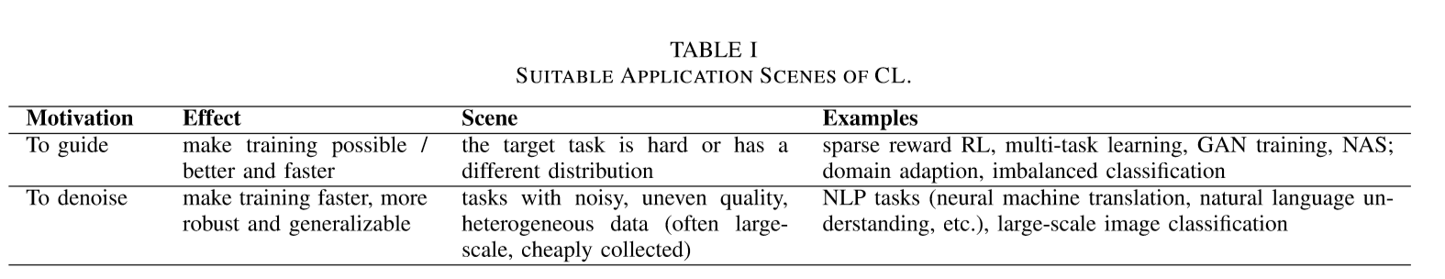
Effectiveness and Application scenes：
Optimization perspective: TO GUIDE
variance in the gradient directions derived from easier examples is significantly smaller, which contributes to a higher convergence rate
Data distribution perspective: TO DENOISE
深度学习需要大量的数据，这些数据多为人类、网络收集和标记，因此这些数据会包含noise，这些噪声数据就可以被当做harder examples，那些clean data就可以被当做easier examples
因为课程学习由易到难的学习，那么模型就可以先学简单的clean data，也就可以在噪声数据上训练时间的浪费 → 表明了课程学习的denoise的优势，尤其是在big/noisy data上
→ convergence speedup
improve the performance either with limited training time budget or in existence of noisy data[2]
[2] WHEN DO CURRICULA WORK? Xiaoxia Wu, Ethan Dyer, Behnam Neyshabur, ICLR 2021

Slide 25
Do we really need Curriculum Learning?
模型要的就是performance好，convergence rate快，还能handle noisy data，还能在限制时间的情况下有良好表现，大量应用场景都能用到
Curriculum Learning都能满足
这样的好东西，我们除了说We really need还能有别的答案吗？

Slide 26
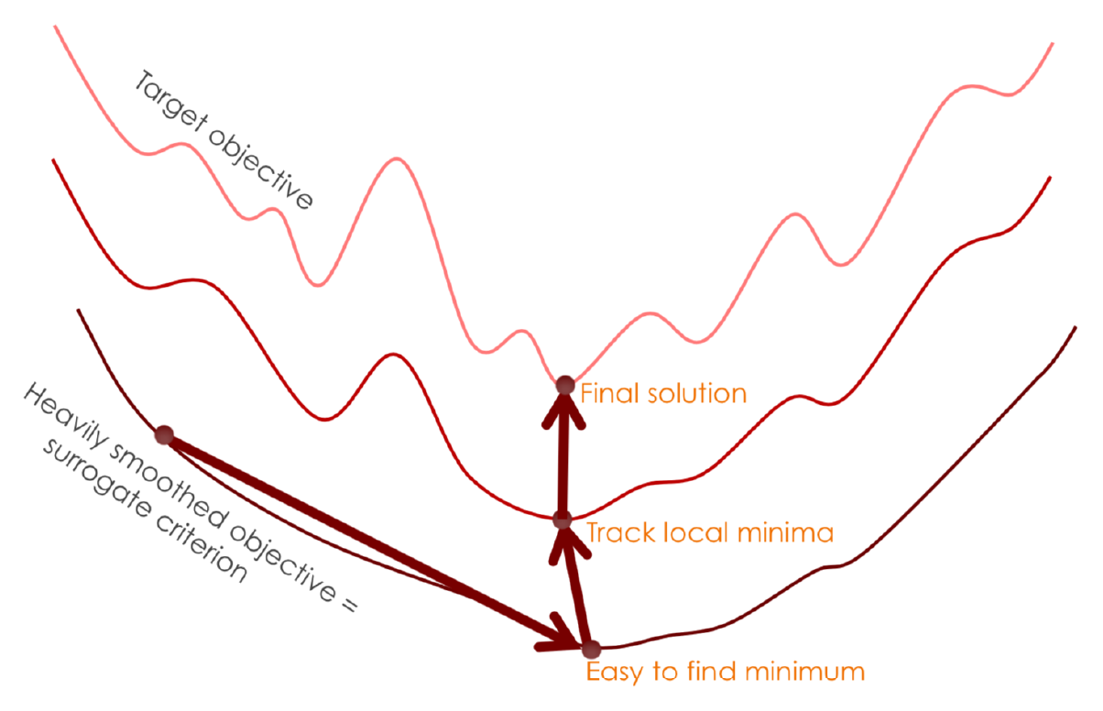
From the perspective of optimization problem, bengio et al. initially point out that CL can be seen as a particular continuation method.

Slide 27
Model
Data
Optimizer
The score function in curriculum learning tends to dig the implicit information of a specific dataset.

Slide 28
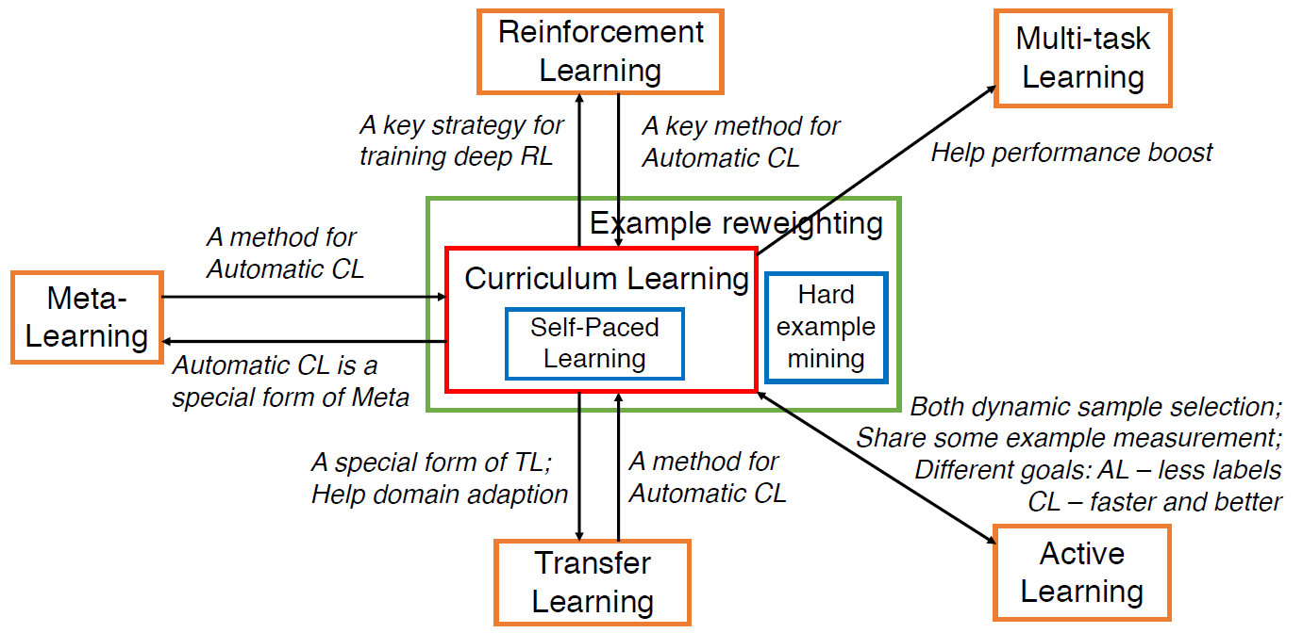

Slide 29
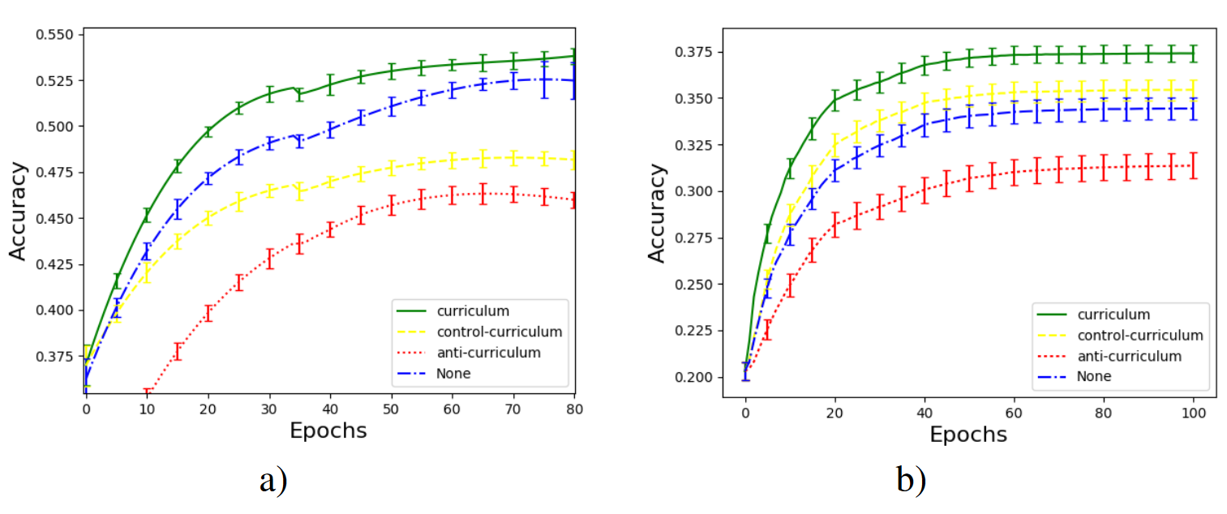
Weinshall et al. prove a theorem based on the linear regression problem with SGD training, which states that the expected rate of convergence of gradient descent is monotonically decreasing with the ideal difficulty score of examples.
An intuitive observation is that the variance in the gradient directions derived from easier examples is significantly smaller, which contributes to a higher convergence rate.
Daphna Weinshall et al. Curriculum learning by transfer learning: Theory and experiments with deep networks.

Slide 30
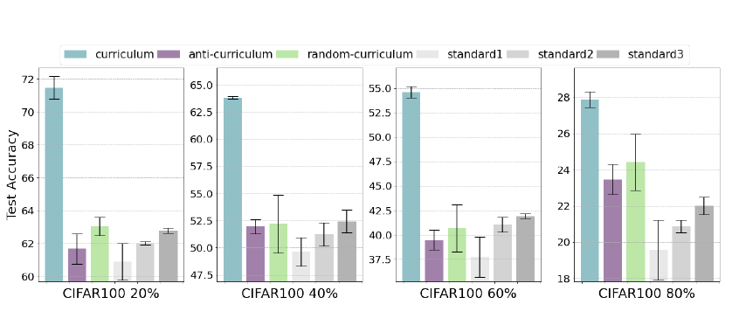
Curriculum learning dose help when training with noisy lables. Performance on CIFAR 100 with the addition of 20%, 40%, 60%, and 80%, label noise shows robust benefits when using curricula.

Slide 31
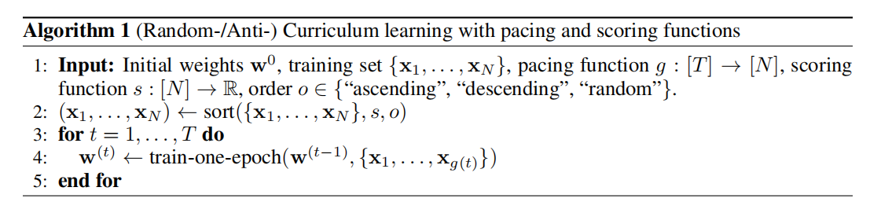

Slide 32
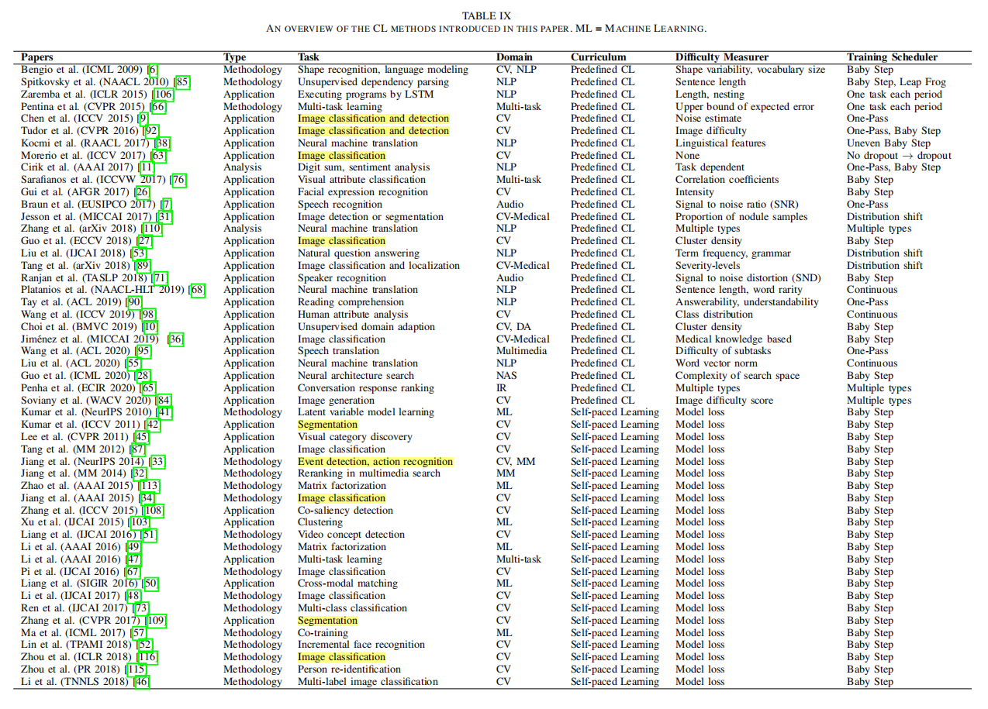

Slide 33
