Slide 1
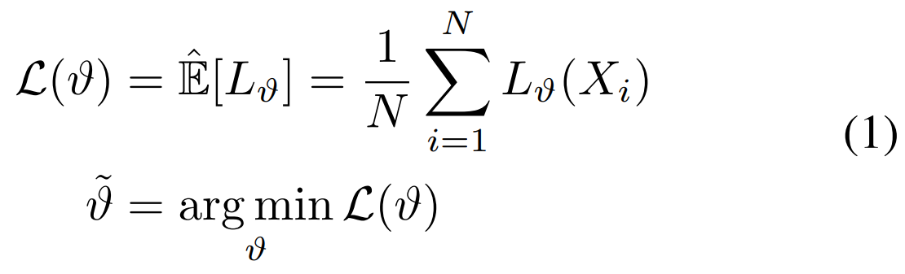
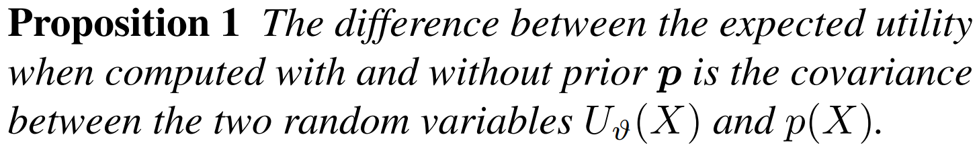
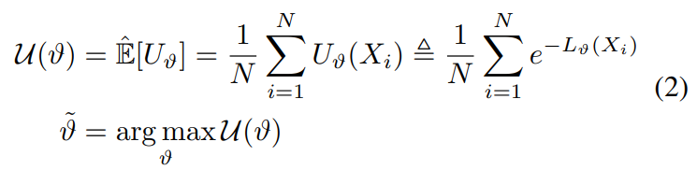
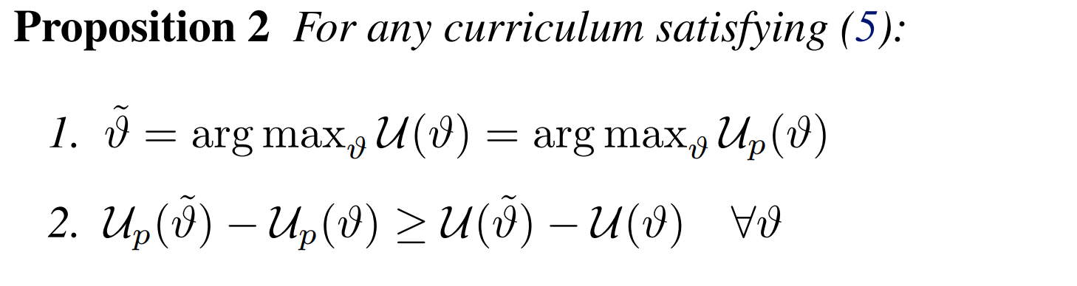
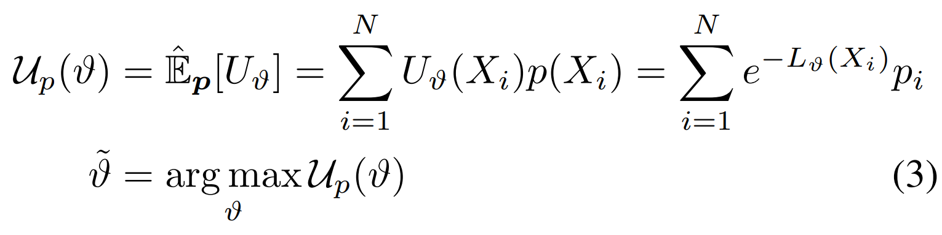
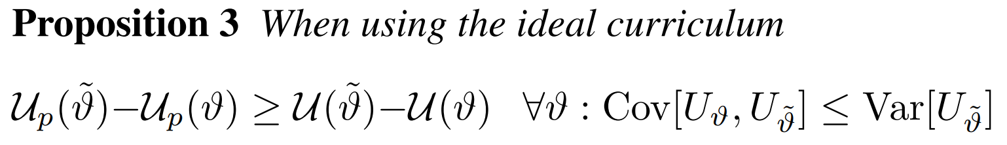
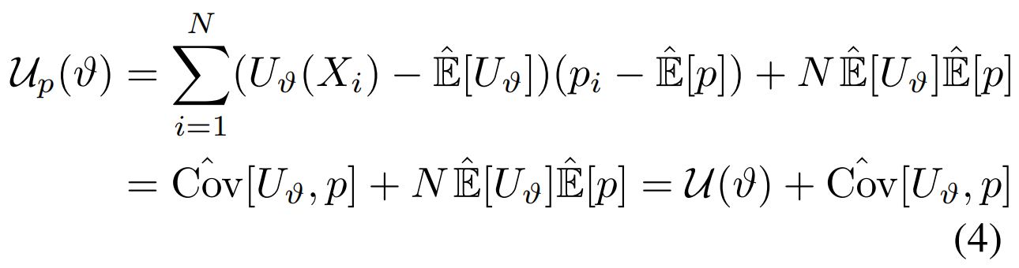
Ideal Curriculum

Slide 2
CL and HEM are not irreconcilable
CurricularFace: Adaptive Curriculum Learning Loss for Deep Face Recognition (CVPR 2020)
An Adaptive Curricular Learning Loss.
人脸识别中常用损失函数主要包括两类，基于间隔和难样本挖掘，这两种方法损失函数的训练策略都存在缺陷。前一种方法是对所有样本都采用一个固定的间隔值，没有充分利用每个样本自身的难易信息，这可能导致在使用大边际时出现收敛问题；后一种方法则在整个网络训练周期都强调难样本，可能出现网络无法收敛问题。
在CurricularFace中，做法是由每个Batch随机抽取样本，通过在线挖掘难样本自适应地建立课程

Slide 3
历年Curriculum Learning研究 （标题或摘要包含Curriculum的论文）
Year | CVPR | ICCV or ECCV
2013 | 0 | 0
2014 | 0 | -
2015 | 1 | 0
2016 | 1 | -
2017 | 2 | 3
2018 | 1 | 3
2019 | 0 | 4
2020 | 3 | 6
Year | ICML | NeurIPS | ICLR
2013 | 0 | 0 | -
2014 | 0 | 0 | -
2015 | 0 | 2 | -
2016 | 1 | 0 | -
2017 | 2 | 0 | -
2018 | 4 | 1 | 2
2019 | 2 | 4 | 1
2020 | 3 | 8 | 5

Slide 4
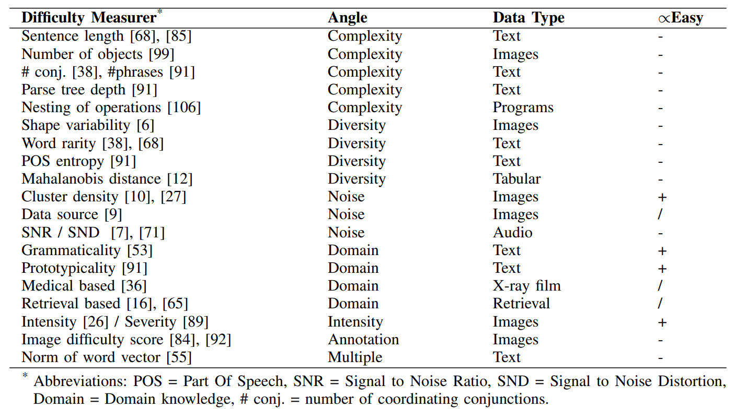
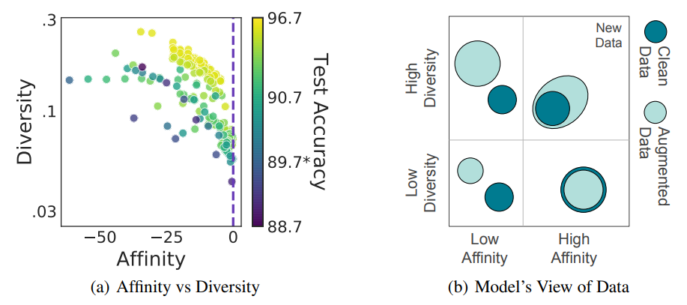
CL and Data Augmentation
Complexity and Diversity.
Ref: Affinity and Diversity: Quantifying Mechanisms of Data Augmentation
Closely Related with Semi-/Weak-/Self-Supervised!

Slide 5
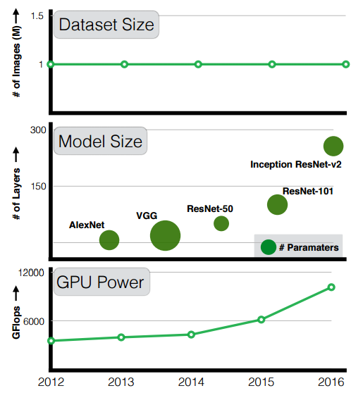
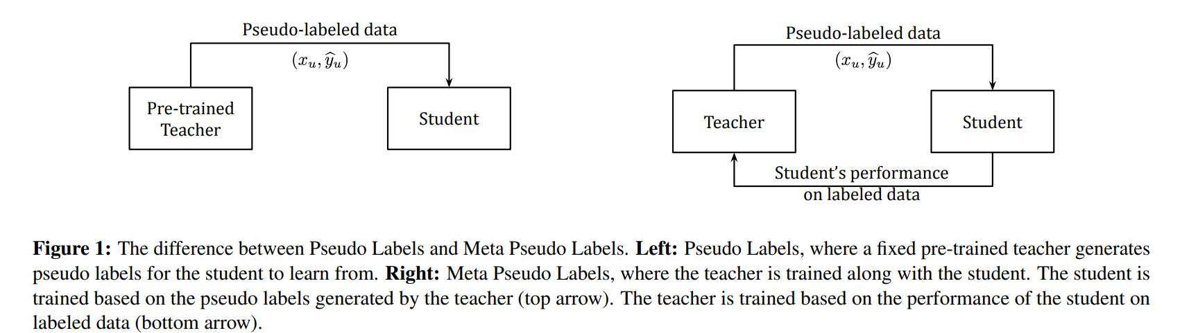
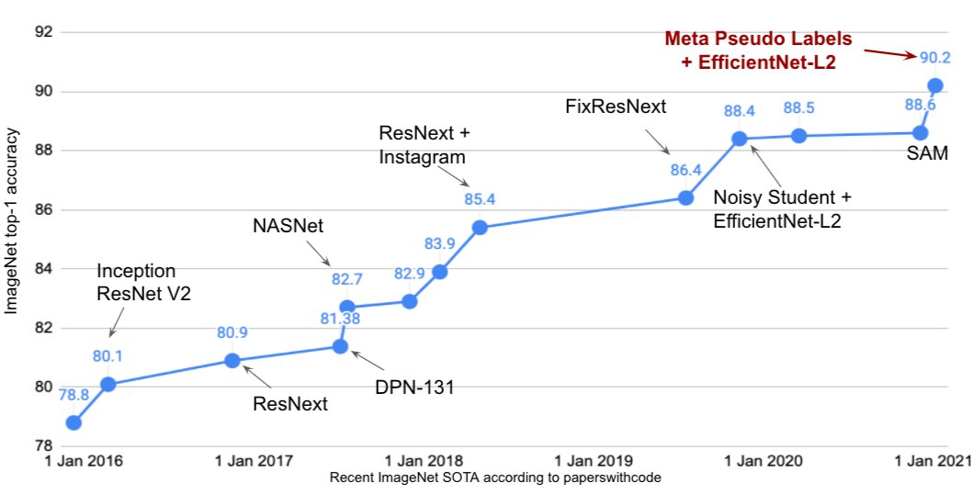
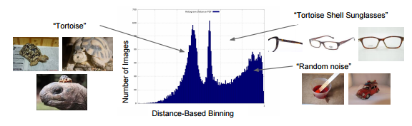
CL and JFT-300M dataset
Ref: Meta Pseudo Labels

