Slide 1
LinkHyper
Ryan Hsiao & Sathya McKinzie
Notes:
Introduce the app and explain the purpose
Share articles and data from any site (ex: wikipedia articles, books, movies, songs, etc..)
Explain what makes it different/talk about the “uniqueness” of the app
Can view which pieces of media are frequently similar to help discover similar topics (ex: books/movies which cover similar concepts)
User defined links to help discover what is similar
Serves as a “database of databases” in a way, where it combines information from plenty of other databases into one easily accessible area
Can catalogue and favorite the pieces of media, and view other people’s catalogues to find new and interesting articles which you likely would not have found otherwise
Users can also control the type of articles they see, whether by primarily looking at articles that are linked to ones they are already interested in, or by limiting/blocking sites they do not want to see (ex: news sites)
Explain who will use the app
General audience, not business/industry targeted. Different types of users:
1: Sharer who wants more people to see certain interesting items
2: Browser who wants to find interesting items
3: Journaler recording personal history of items read/watched/listened to
Explain how the relationship schema will work
Mostly standard entity sets for a forum-based site like Users, Topics (ForumThreads), Messages
Unique features include ExternalRecords, which gives structured classification of external items
Another unique feature in user-defined InternalLinks to show relationships between different items
Doesn’t have to have direct links (ex sequels of media) just if they might have similar vibes
Can be viewed as pooling databases together and letting the user find new media to enjoy

Slide 2
Introduction
LinkHyper is a web app that enables users to catalog, share, and discuss media of arbitrary format.
Each media item can be referred to in a structured way, collated from any desired external database, and users can define links between items in order to document the complex relationships between them.

Slide 3
Purpose of the app 1
What makes this app different from existing options?
Can view which pieces of media are frequently similar to help discover similar topics (ex: books/movies which cover similar concepts)
  User defined links to help discover what is similar
Serves as a “database of databases” in a way, where it combines information from plenty of other databases into one easily accessible area
Can catalogue and favorite the pieces of media, and view other people’s catalogues to find new and interesting articles which you likely would not have found otherwise
Users can also control the type of articles they see, whether by primarily looking at articles that are linked to ones they are already interested in, or by limiting/blocking sites they do not want to see (ex: news sites)

Slide 4
Purpose of the app 2
Planned pages in UI
Page to view favorited articles either by you, or by other people
Pages for each article to show commonly linked other articles
Page to view most popular type of articles over specific time period

Slide 5
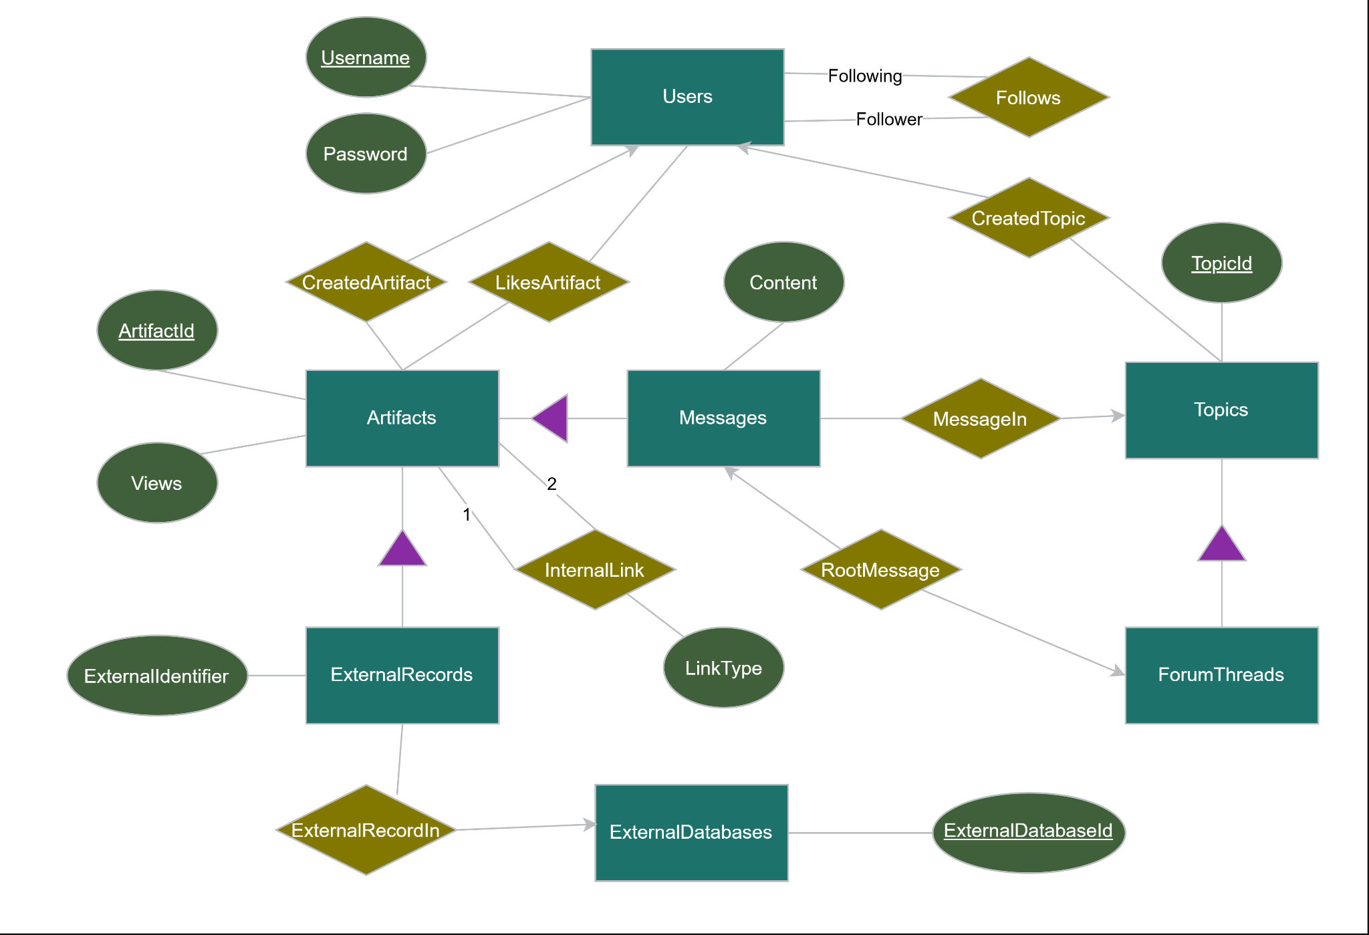
E/R Diagram 1
Features of Users, Messages, ForumThreads, etc. are typical in social media type apps.
Features of ExternalRecords, InternalLink reflect the more unique aspects of LinkHyper.

Slide 6
E/R Diagram 2
There are 3 many-to-many relationships, those being Follows, LikesArtifact, and InternalLink.
They are circled in red to the right.

Slide 7
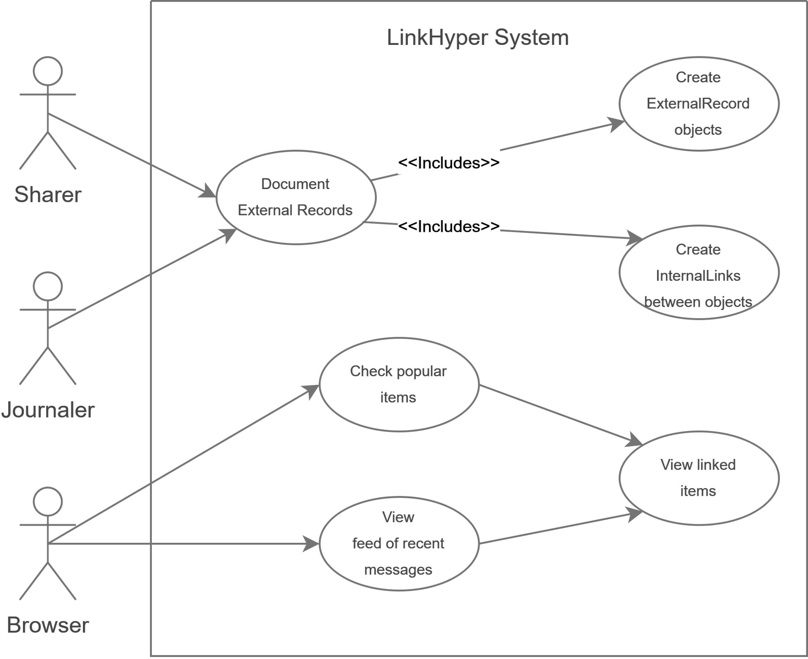
UML Usage diagram 1
The different types of actors all represent end-users with different modes of engaging with the app.
These are the three types of users we expect to use this app, and the roles are not mutually exclusive

Slide 8
UML Usage diagram 2
The sharer wants to show other users certain interesting items
The journaler is focused mostly on recording a personal catalogue of items in a structured format
The browser wants to see what interesting items other people have shared

Slide 9
SQL relations 1
User
CREATE TABLE user (
username char(20) not null,
password char(20) not null,
PRIMARY KEY (username)
);
Artifact
Artifact is the chosen technical term used for items that can be linked in this project. Since subclasses are not mutually exclusive in ER diagrams, note that it is possible for an artifact to be both a message and an external record, though for most cases an artifact will be one or another.
CREATE TABLE artifact (
artifact_id decimal(9, 0) not null,
views integer not null,
username char(20) not null, -- CreatedArtifact
PRIMARY KEY (artifact_id)
);
Message
This is the relation containing what would normally be called posts or comments in other social media apps.
CREATE TABLE message (
artifact_id decimal(9, 0) not null,
topic_id decimal(9, 0) not null, -- MessageIn
-- char and varchar have very limited length
content text not null
);
External Record
This represents an item that is stored and uniquely identified in an external database. The most general case is for the external identifier to consist of a URL. A more specific example of an external identifier is an ISBN for a book.
CREATE TABLE externalrecord (
artifact_id decimal(9, 0) not null,
external_database_id decimal(9, 0) not null,
external_identifier varchar(200) not null
);

Slide 10
SQL relations 2
Topic
A general collection of items, with the current only subclass being a thread of messages as would be seen in a forum.
CREATE TABLE topic (
topic_id decimal(9, 0) not null,
username char(20) not null, -- CreatedTopic
PRIMARY KEY (topic_id)
);
Forum Thread
CREATE TABLE forumthread (
topic_id decimal(9, 0) not null,
artifact_id decimal(9, 0) not null -- RootMessage
);
External Database
CREATE TABLE externaldatabase (
external_database_id decimal(9, 0) not null,
PRIMARY KEY(external_database_id)
);

Slide 11
SQL relations 3
Follows
This relation and the two relations afterward are all used to represent many-to-many relationships from the ER diagram.
CREATE TABLE follows (
follower char(20) not null,
following char(20) not null
);
Likes Artifact
CREATE TABLE likesartifact (
username char(20) not null,
artifact_id decimal(9, 0) not null
);
Internal Link
Links can be created between different artifacts. Some link types are predefined and have a standard meaning, such as marking that artifact 1 is an adaptation of artifact 2. Users are also able to define their own link types, which do not have a predefined meaning and can represent any sort of relationship between the two artifacts.
CREATE TABLE internallink (
artifact_1 decimal(9, 0) not null,
artifact_2 decimal(9, 0) not null,
link_type char(20) not null
);

