Slide 1
The Non-affine Fiber Network Plugin for Finite Element Analysis
Ryan R Mahutga, Victor H Barocas, & Patrick W Alford
Department of Biomedical Engineering
University of Minnesota, MN, USA
May 17, 2023

Slide 2
Getting Started
What You’ll Need:
FEBio Studio 2 + the FEBio SDK
Text Editor (Notepad++)
MATLAB (any newish version should work, I used 2021b)

Slide 3
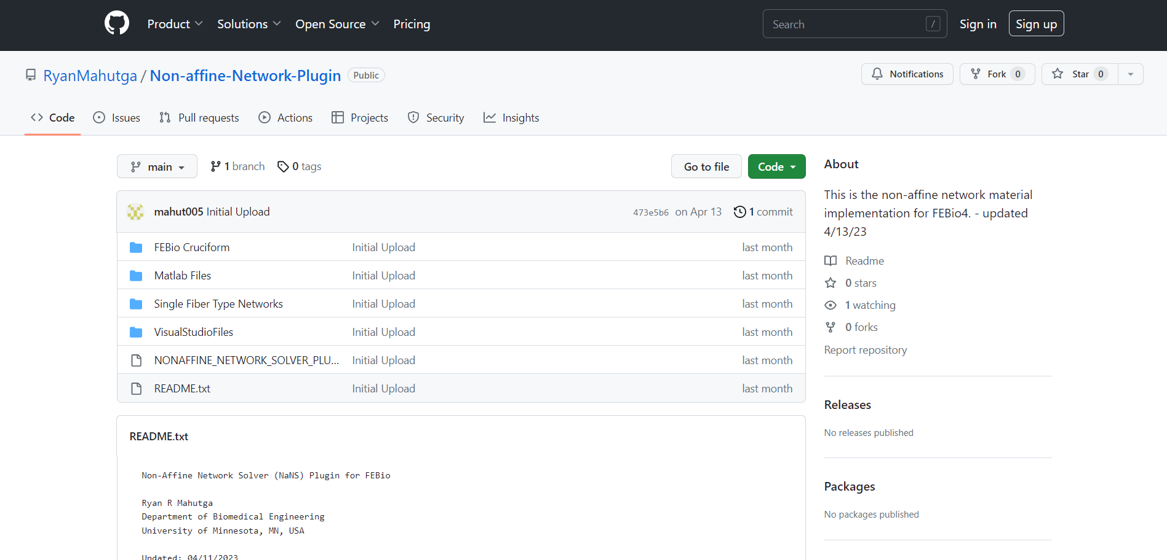
Download the Plugin

Slide 4
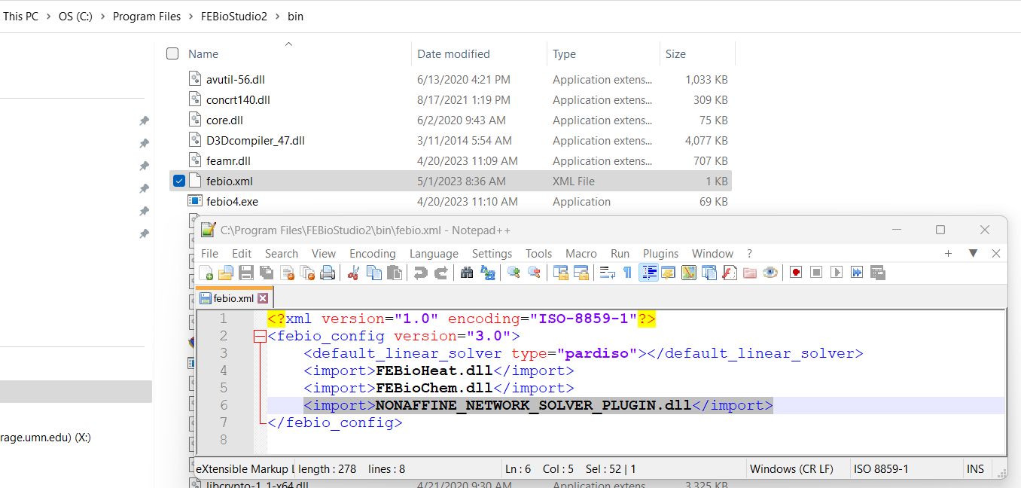
Modify the febio.xml File

Slide 5
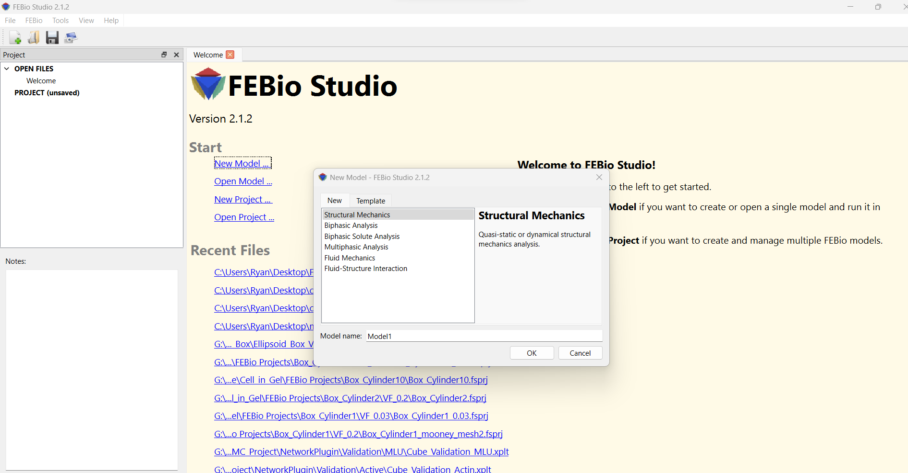
Create a Model

Slide 6
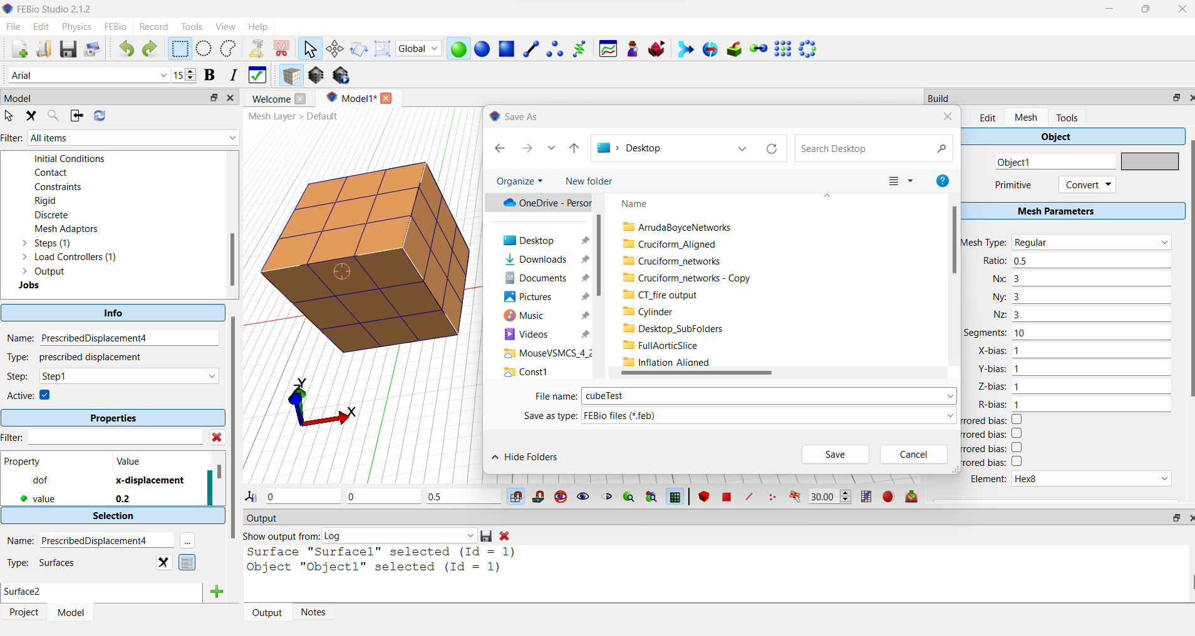
Export the Model .feb File

Slide 7
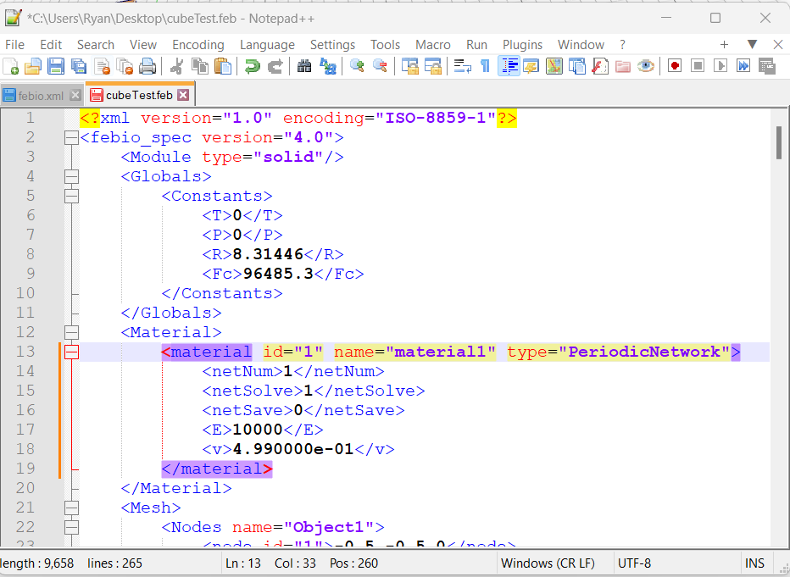
Edit the .feb File
NetNum refers to the number appended to ‘PeriodicNetworkN.txt’ which defines which network to use for which material.
NetSolve when true (1) solves the full network equilibrium when false (not=1) uses the affine approximation.
Affine approximation is faster and can be used when solving intermediate states you don’t really care about (i.e., one can use a load curve on this parameter so the full solution is only solved on the final iteration)
NetSave when true (1) saves many text files of network data (fiber stresses, stretches, etc.). The NetSave feature overwrites data and only saves one file per element so beware of its use.
E is the neoHookean modulus parameter and v is the Poisson’s Ratio of the material.

Slide 8
Edit the .feb (ADVANCED)
Included in the Matlab Files folder on Github is a folder called FE Simulation Modification
Open main2.m – this code will allow you to take a base .feb file with a specified number of elements and break it into a different material for each element, and create a new network for each material.
The file writeFEBio2.m will need to be modified for specific simulations (including pressure, using different mesh types, including material axes, etc.

Slide 9
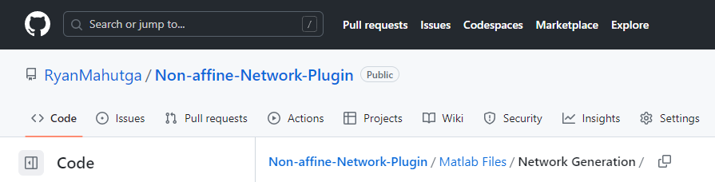
Create a Network
Navigate to MatlabFiles/Network Generation on GitHub
There are two files for creating networks
collagen_networks.m which creates single fiber type networks
createMLU.m which creates medial lamellar unit networks

Slide 10
Create a Network
Inside the main network creation files, one will find several important sub-functions
periodicDelaunay.m – performs periodic Delaunay tessellation on a set of nodes and extracts fibers
periodicDelaunay2D.m – performsa 2D periodic Delaunay tessellation on a set of nodes and extracts fibers
removeDupes.m – checks for duplicate fibers and remove them
NetworkPare.m – pares the network connectivity to the specified value
MinDegreeReorder.m – reorders the nodes to improve computational efficiency
networkFeatures.m – calculates fiber lengths and applies fiber radii
WriteNet3.m – writes the network to a text file
solve_periodic_BCs2.m is used to calculate fiber boundary crossing locations for plotting netoworks
plot_net_single_fib_type.m plots a single network with fiber types color coded
plot_net_tile_fib_type.m plots a 3x3 grid of networks with defined normal direction (1,2,3)

Slide 11
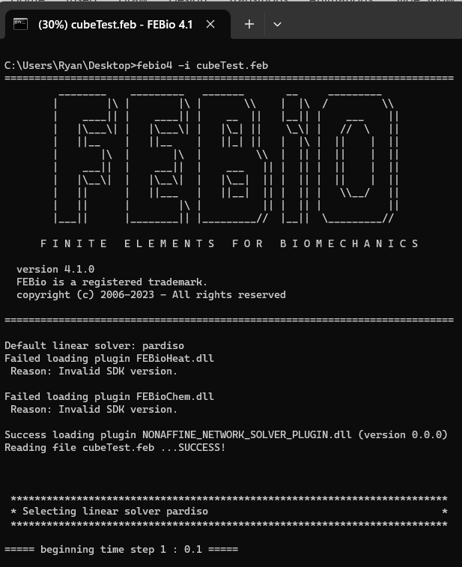
Run the Simulation
** If febio4 is unrecognized as a command go to System Properties >> Advanced >> Environment Variables >> Path >> Edit >> New >> [location of FEBio Studio]

Slide 12
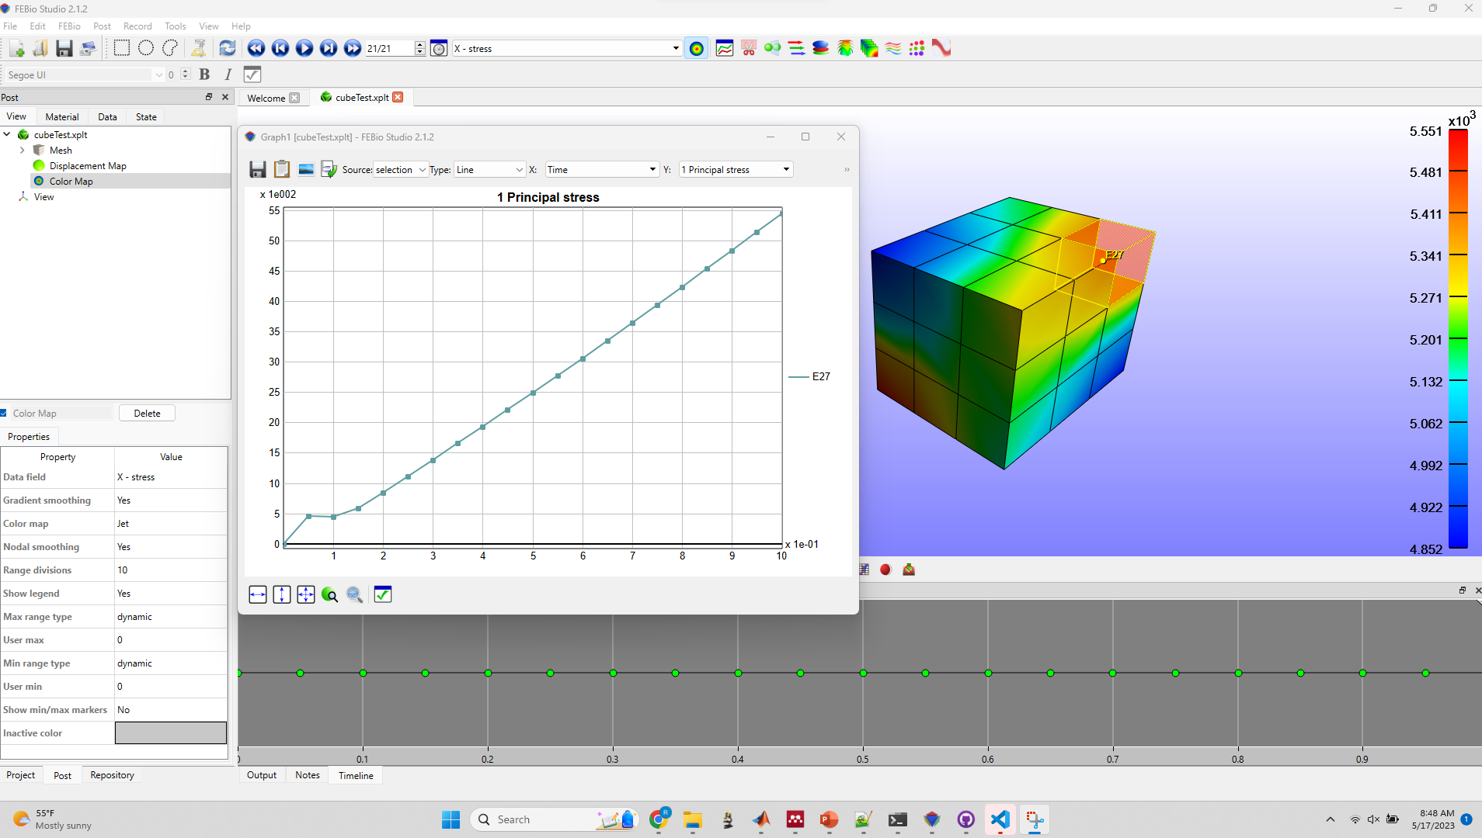
Visualize the Results
Open the [filename].xplt file to view the results.

