Slide 1
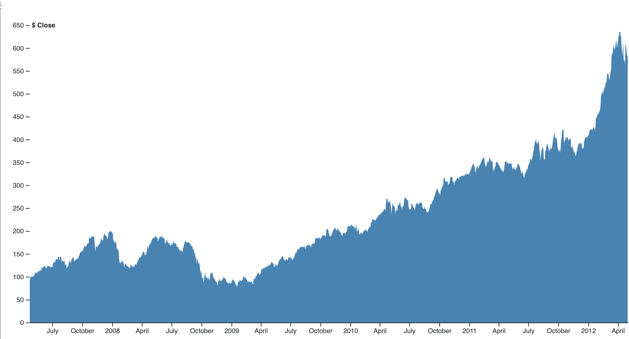
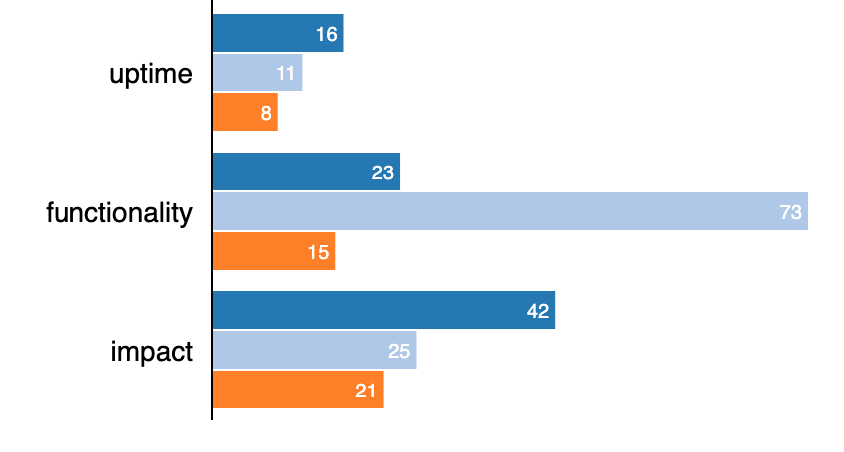
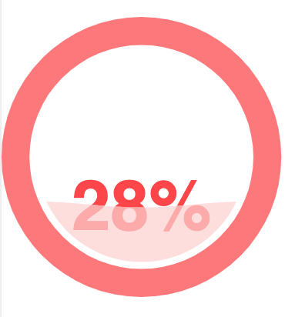
Proj 1
Proj 1
Proj 1
Notes:
Top Layer: Critical Project Health
Column One; Deadline Date: Takes Data from basecamp api
Column Two: Task: Takes Data from basecamp api
Column Three: Takes Vanilla JS, Platform manager will determine health based off observed progress.
Middle Layer: Financial Data
Graph represents Financial Data.
Bottom Layer: Overall Health Grade
Health bars concerning each project.
Overall health gauge; data comes from average between all health projects total.

