Slide 1

Ryan’s Casino Game
Ryan Murray

Slide 2

Ryan’s Casino Game contains three games in one! It gives the user to ability to interchange between high low, beat the dealer and big six.
I needed a panel manager which contained a control panel (home screen) , a loser panel, a big six panel, a beat the dealer panel and a high low panel.

Slide 3

The Home Screen
The home screen contains buttons that pop up directions and buttons to play the game that takes the user to the panel for that game. There is also a reset button that sets the users current money back to $100.

Slide 4

Beat the Dealer
In the beat the dealer panel there is a text box for the user to place a bet. There is a dealer roll button and a user roll button. I had to make sure the dealer rolled before the user and the dealer or user could not roll two times in a row. For example if the dealer rolled a 2, I could not let the user keep just user rolling and beating that 2.

Slide 5
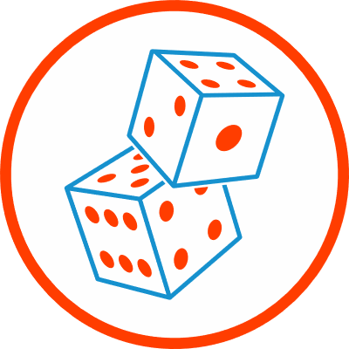
High Low
In high low I have a place for the user to type a bet and 3 connected radio buttons so only one can be pressed at a time. When one is pressed it gets the roll and compares it to if the high low or 7 button was pressed then changes the users current money accordingly.

Slide 6
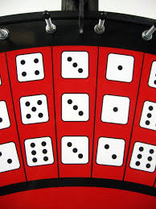
Big Six
In big six I have six text fields where the user can type in a bet (one for each number they could bet on). Originally I wanted the user to be able to bet on as many numbers as they want but that was too challenging so the users first non zero bet is the only bet that is counted. However many times the number the user bet on occurs is how much the user is paid. Ex. If the user bets $10 on 6 and 6,6,6, is rolled, the user wins $30.

Slide 7
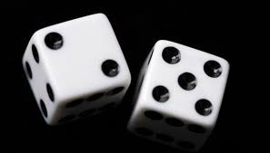
Common in all three games
In all three games I had to make sure the user typed in a numeric value for their bet.
I did this with a simple try catch, where I tried to convert the user input into a string. If that failed it would pop up the message for the user to type a numeric value.
I also had to check if the bet was greater then how much money the user currently has. I did this by an if statement comparing the bet to the current money and if the bet was bigger just output the message that the user does not have that much money.
Every time the user won money I checked if the current money was greater then the current high score. If so, I set the high score to the current money.
Every time the user lost money, I had to make sure there current money did not equal zero. If it did I would go to the loser screen which tells the loser they lost and gives them the option to play again.

