Slide 1

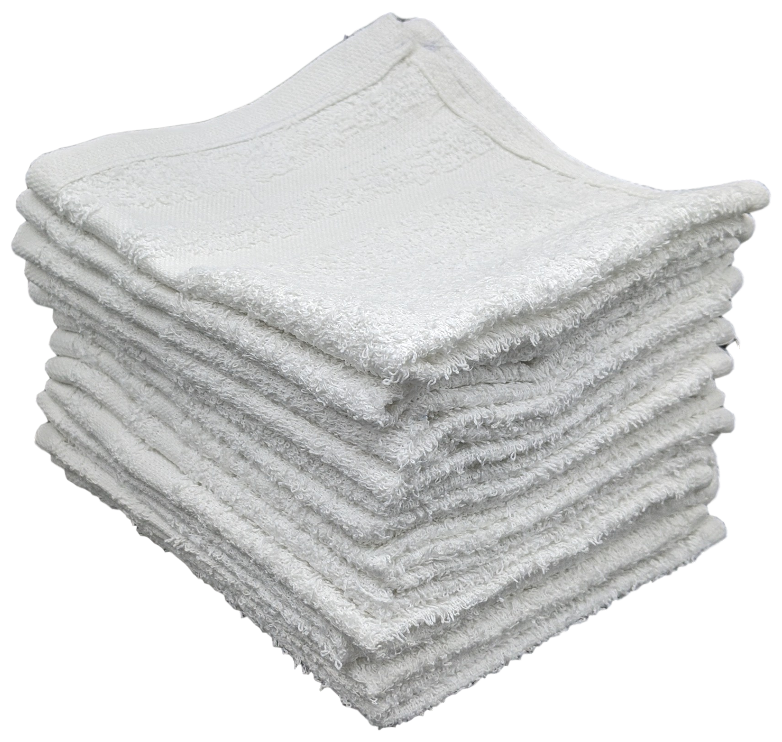
RAGS
Research Assistant for Graduate Students
Shaobo Cui, Ryan Sullivan, Kamala Varma

Slide 2
Outline
Paper data collection and storage
Recommendation algorithm and data used
User interface
Demo
Limitations and future work

Slide 3
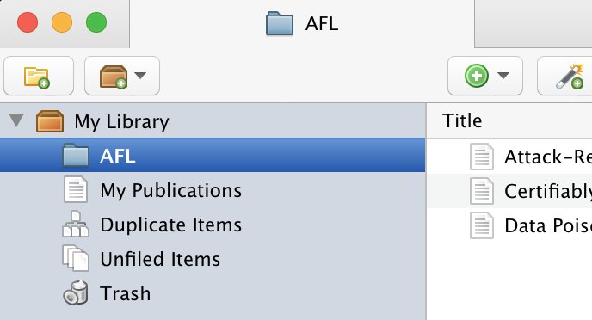
Data Collection - Building a Corpus of Papers

Slide 4
Data Collection - Building a Corpus of Papers
cited by
related to
Notes:
Google Scholar uses a sophisticated algorithm to identify articles related to the selected article. Clicking on the "Related Articles" link below the article record will display these articles.

Slide 5
Data Collection - Building a Corpus of Papers

Slide 6
Data Collection - Building a Corpus of Papers
Corpus of papers to pull recommendations from
Notes:
Narrow context, but also, not necessarily too narrow, and you could easily branch again

Slide 7
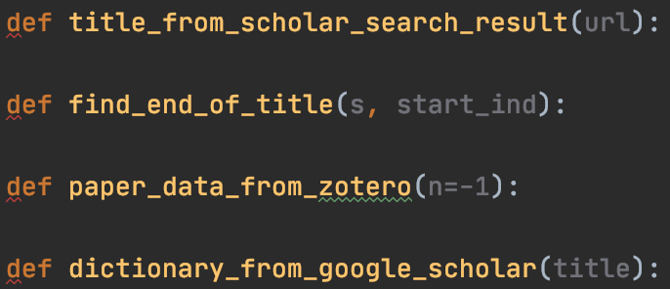
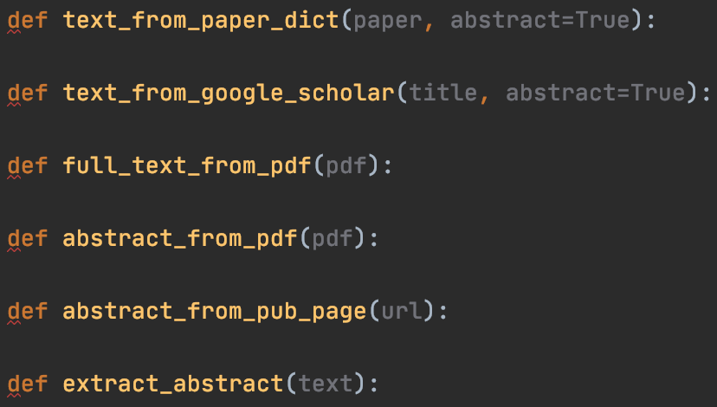
Overview of Paper Data Access-Related Functionality
Get full paper text or extract paper abstract
Get paper info from Zotero library given user ID or from Google Scholar given paper title or url of search result

Slide 8
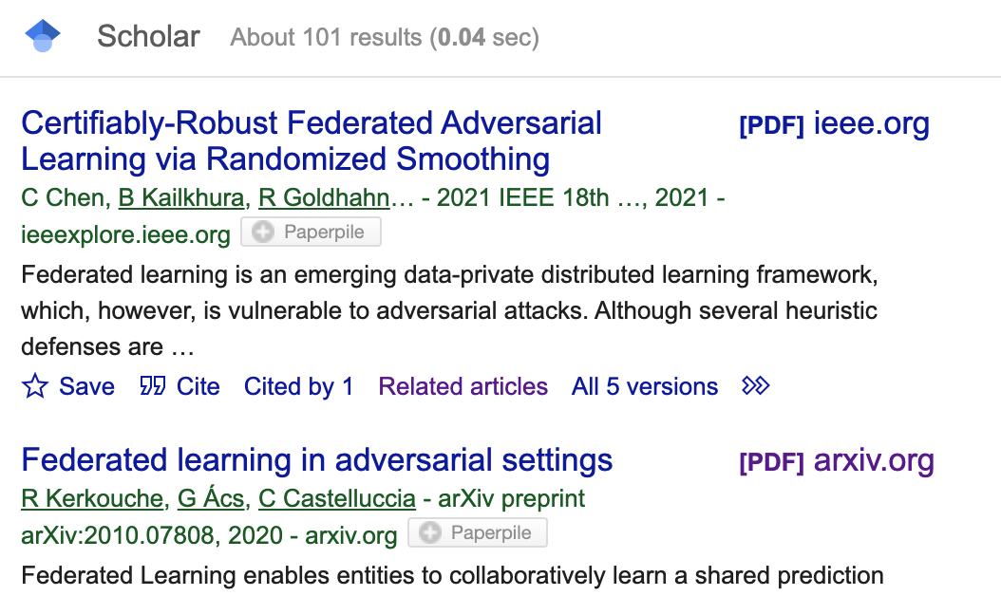
Overview of Paper Data Access-Related Functionality
problematic
Strict assumptions about what defines the start and end of an abstract

Slide 9
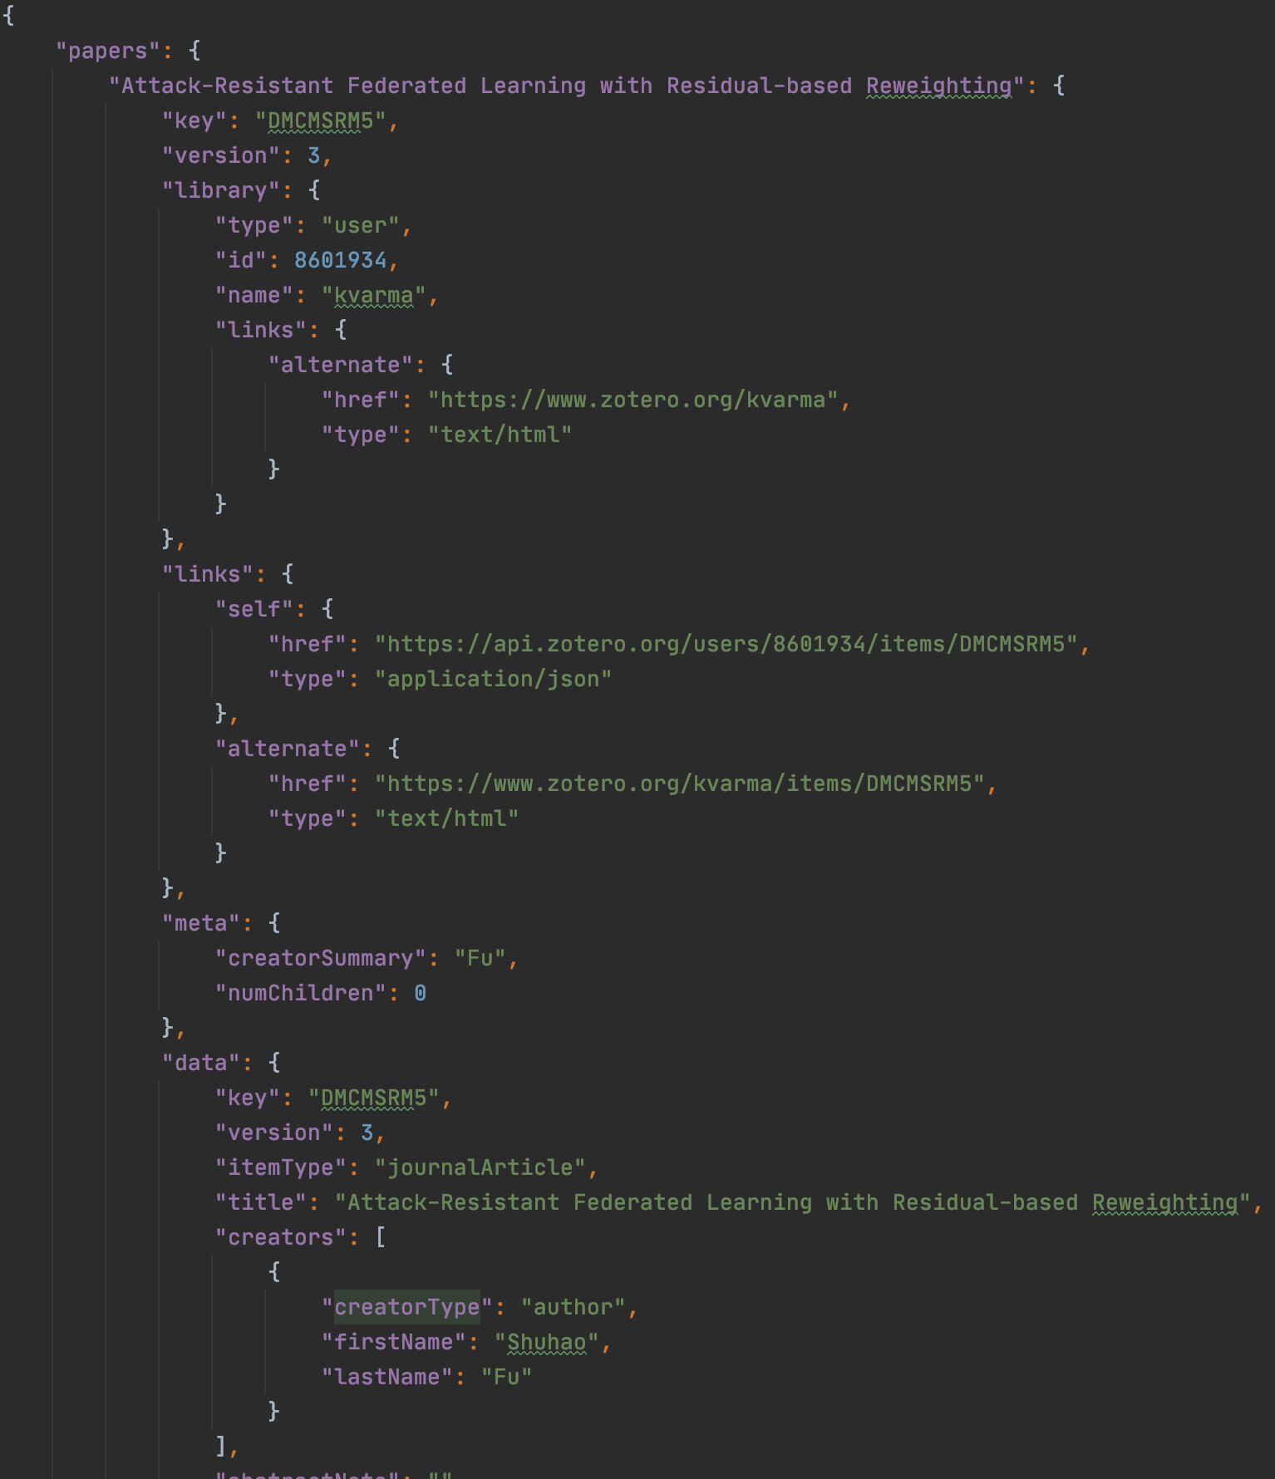
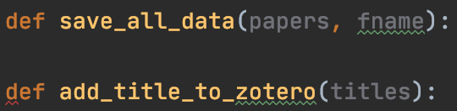
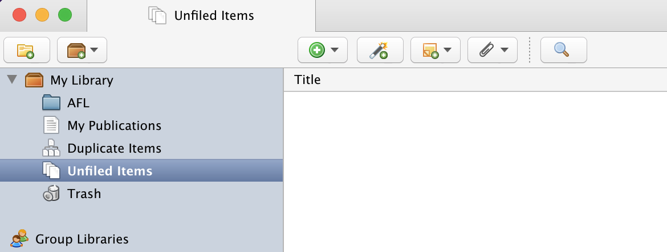
Paper Data Storage-Related Functionality

Slide 10
Recommendation algorithm
Content-based filtering:
Paper vectorized with SciBERT, sentence by sentence
Average of per-sentence paper vectors represent the paper
BERT summarization performed on text to reduce memory cost
Alternatively: use abstract instead of text
User profile formation:
For each paper added, add a new vector to the profile
Recommendation:
For each paper in corpus, compute cosine similarity with each paper in profile
Aggregate cosine similarities, with optional weight
Recommend papers with top similarity

Slide 11
Data used in recommendation
Paper identifier
Using title as identifier
Vectorized text/abstract representation
Corpus inclusion information
Using keywords here

Slide 12
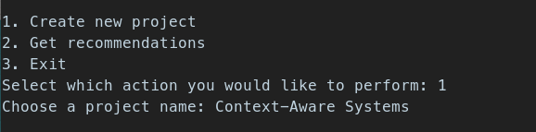
User Interface
Simple text-based interface for setting up projects and requesting recommendations
Users can create projects associated with their Zotero collections and get recommendations for those papers
Use Zotero to modify papers used for recommendations
Saves user settings and projects across uses

Slide 13
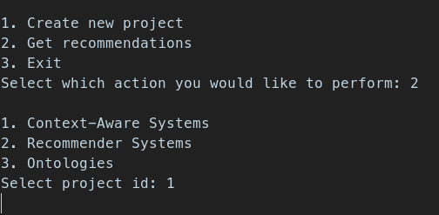
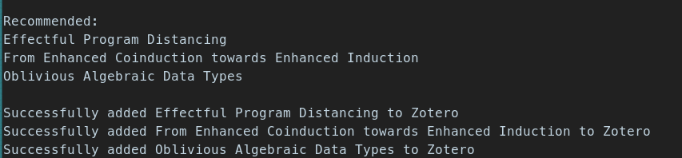
User Interface

Slide 14
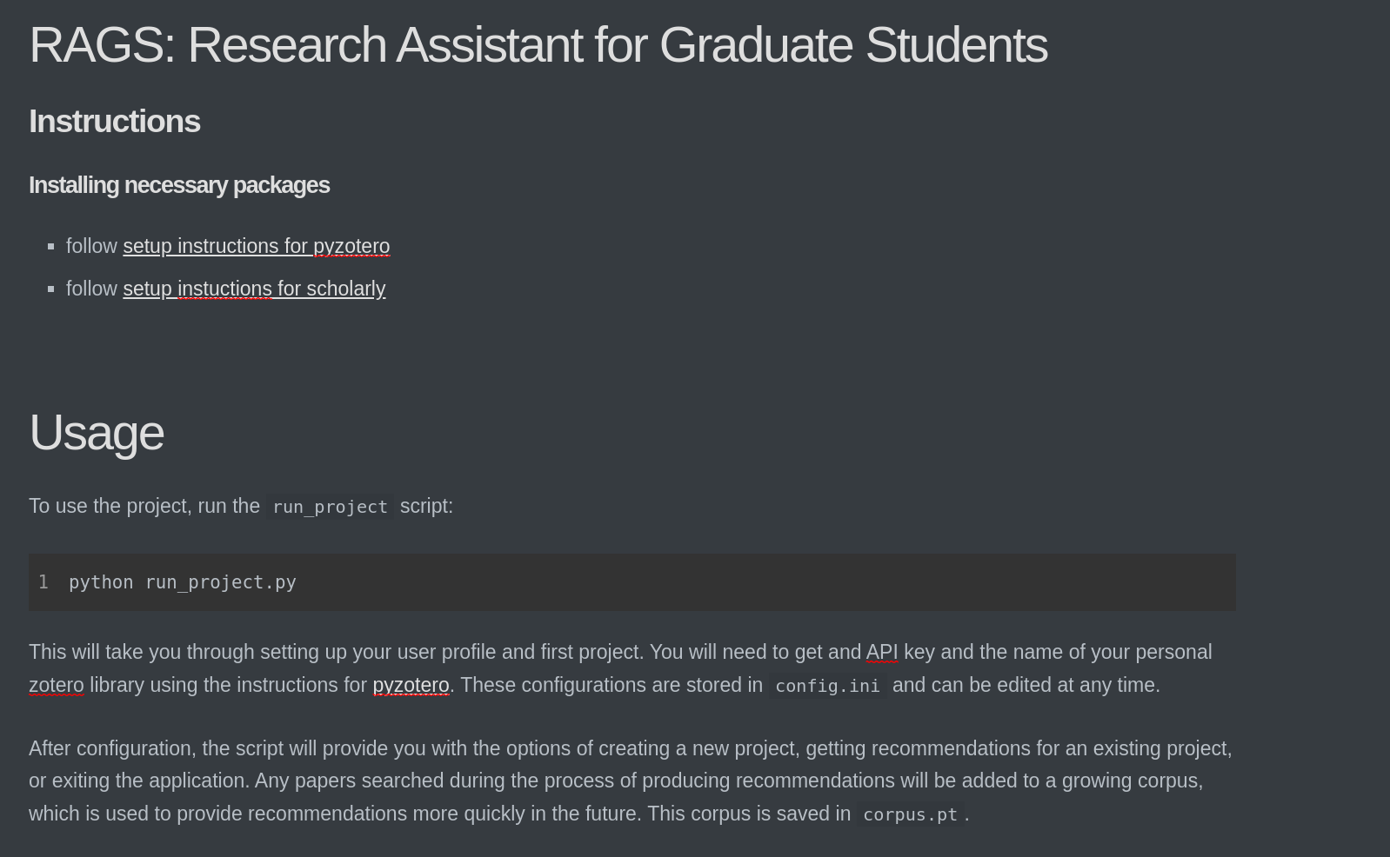
Documentation

Slide 15
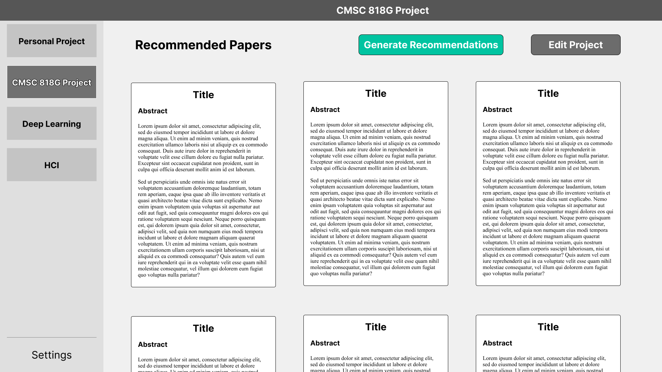
Graphical User Interface Design

Slide 16
Demo
Offline store of paper used as corpus as Scholarly is sometimes detected as bot and prevented from Google Scholar access

Slide 17
Limitations and Future Work
Better paper-related APIs
Current manual abstract extraction is unreliable
Scholarly (Google Scholar API) is new and unreliable
More paper-related APIs
Storage (eg. Mendeley, Paperpile)
Search/access - what if the paper is not available through Google Scholar?
More context in the recommendation system
Activities
Incorporate other assistance relevant to grad students
General planning/scheduling
Conference-related planning
Note taking/organization

