Slide 1

LibChat Transcript Analysis
Using machine learning in Python to analyze chat data
Ryan Negron

Slide 2
Field Experience
As an MLIS student, completing a Field Experience is a way to obtain real world, professional experience prior to graduating.
Achieving the ADDM Certificate (Data Science) has been my area of focus for the program.
I spent this summer semester working alongside the assessment team (Berenika, Jenn, Anne, and Diana), seeking to experiment with using machine learning to analyze chat transcripts pulled from LibChat interactions over the past 6 years.

Slide 3
Project Introduction
Our Goal | Timeline | Methods
Create a machine learning model that will: Help assess strong/weak points in our LibChat service Guide future trainings/decision-making Is repeatable for future applications. | 130-Hours over the course of 12 weeks. 1-hour weekly check-ins to denote progress and receive feedback | Model 1: Predictive Model using Linear Regression Model 2: Predictive Binary Classification Model using Sentiment Analysis Model 3: Feature Extraction Model 4: Split Chat and Topic Extraction

Slide 4
Data Dictionary
Variable Name | Description | Data Type
Chat ID | Unique ID # of chat | integer
Browser | Description of user’s search engine | object
Operating System | Machine of user | object
User Agent | Info about user’s machine | object
Referrer | URL of user at time of interaction | object
Widget | Widget used to initiate interaction | object
Department | Type of interaction | object
Timestamp | Time/date | object
Wait Time (s) | Time waited in seconds | integer
Duration (s) | Time elapsed during interaction in seconds | integer
Screensharing | If screen was shared | object
Rating (0-4) | User rating of chat | integer
Comment | Comment left by staff | object
Variable Name | Description | Data Type
Transfer History | If interaction was transferred mid-chat | object
Message Count | Number of messages in interaction | integer
Internal Note | Note made only viewable by staff | object
Tags | N/A | object
Ticket ID | Unique ID # of ticket created by staff | float
Deidentified_ Answerer | Anonymized LibChat staff member | object
Deidentified_ Email | Anonymized user | object
Deidentified_ Transcript | Anonymized chat interaction | object
Deidentified_ Initial_ Question | Anonymized first question asked | object

Slide 5
Exploratory Data Analysis
In any data project, the first step is to explore the data.
Count number of rows & columns (shape of the data)
Count number of unique values
Check the data types of each column in the data
Check for missing data
Visualize counts, distributions, and combinations

Slide 6

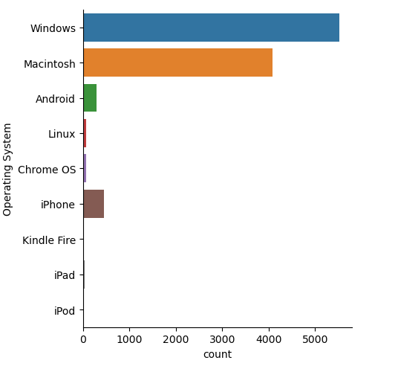
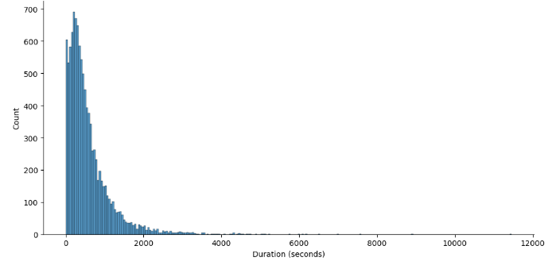
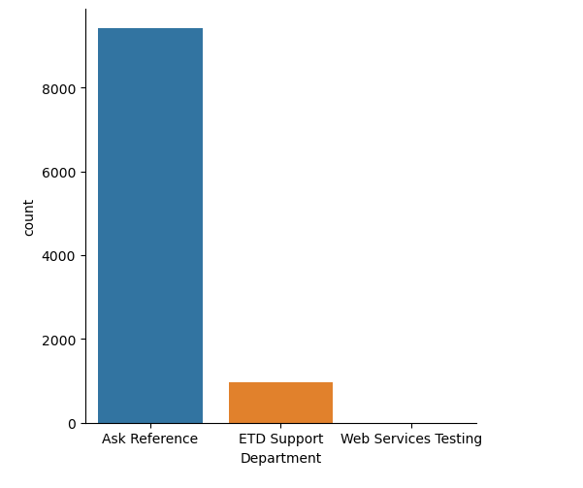
EDA Highlights
Let’s look at a few examples of what our Exploratory Data Analysis can show us.

Slide 7
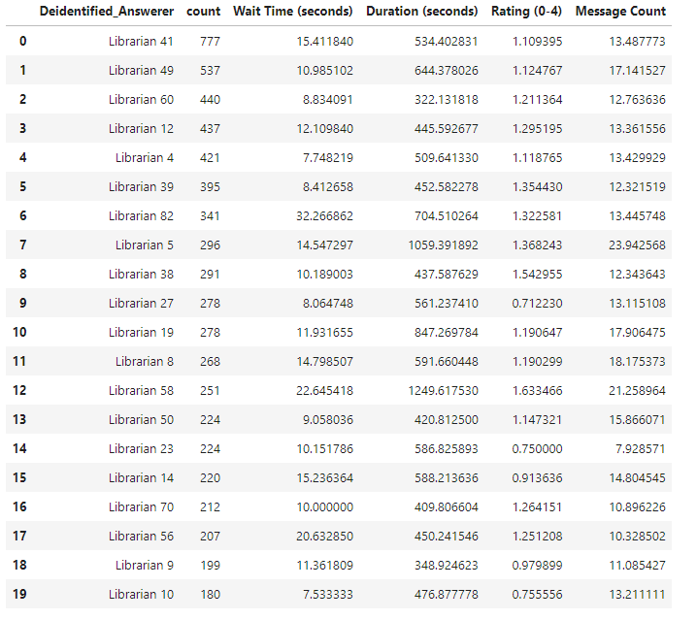
EDA Highlights
Stats by LibChat Staff
When we originally looked at the data and the averages for staff, these are the numbers that were produced.
I want to use this example to emphasize the importance of exploring your data before starting any research project.

Slide 8
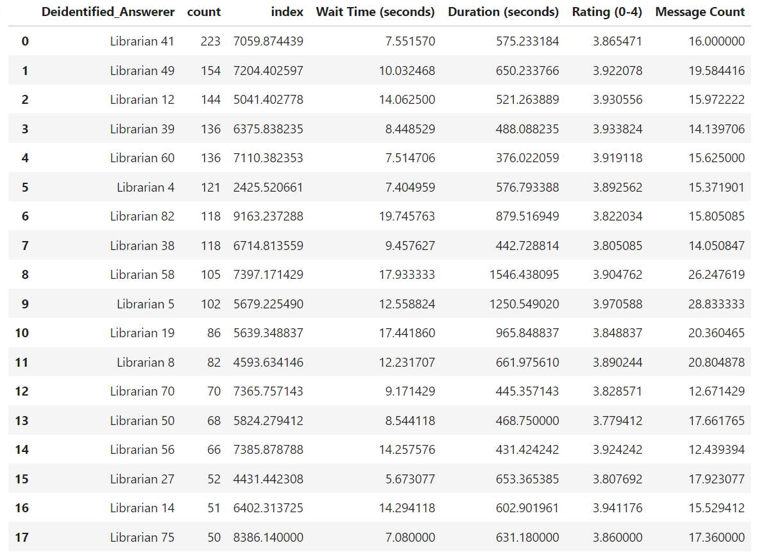
EDA Highlights
Stats by LibChat Staff
When we originally looked at the data and the averages for staff, these are the numbers that were produced.
I want to use this example to emphasize the importance of exploring your data before starting any research project.

Slide 9
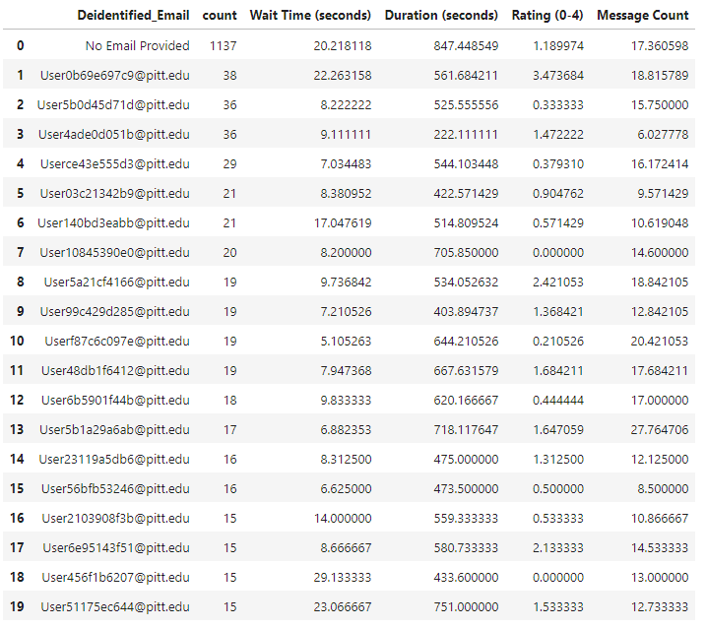
EDA Highlights
Stats by User
Here we can see the same effect on the user averages.
In addition, we now see just how many interactions have no data for the user email. This information can help us later or in other projects.

Slide 10
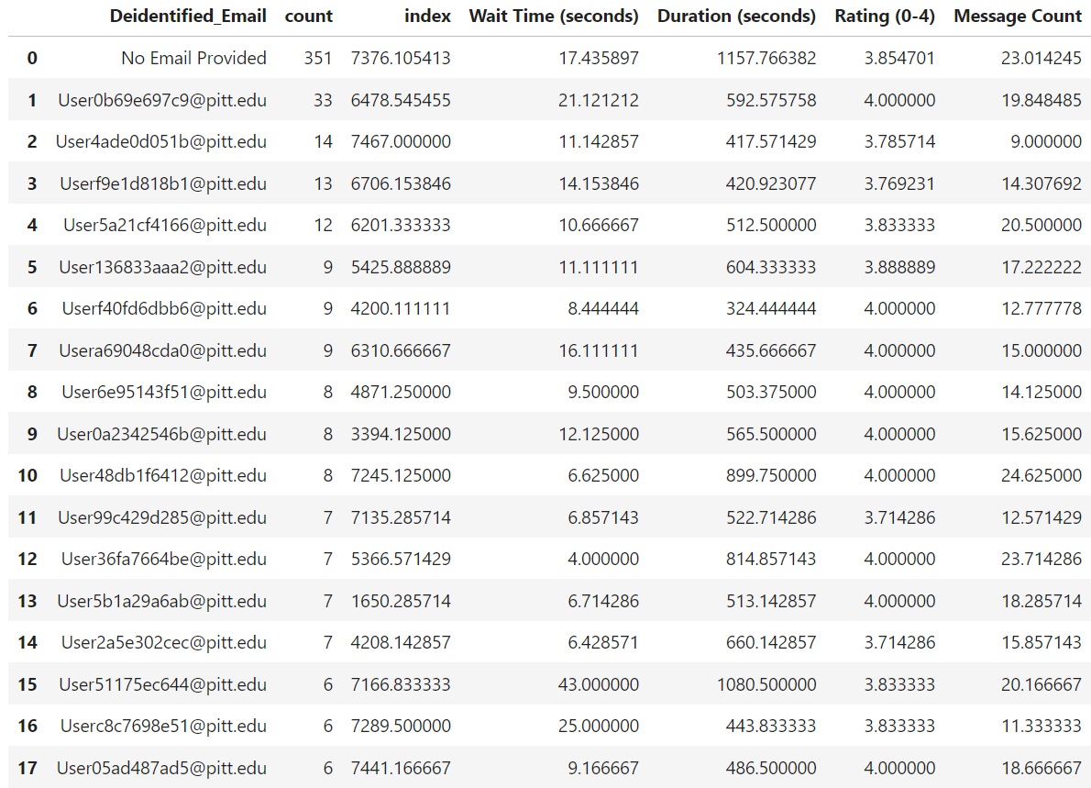
EDA Highlights
Stats by User
Here we can see the same effect on the user averages.
In addition, we now see just how many interactions have no data for the user email. This information can help us later or in other projects.

Slide 11
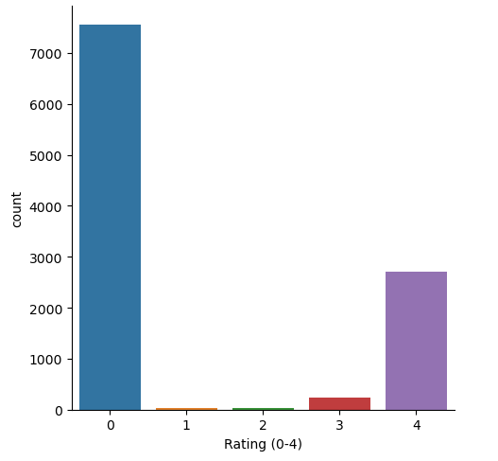
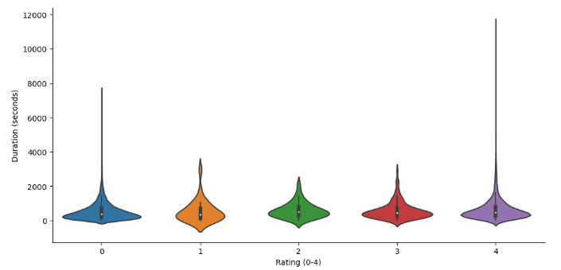
EDA Highlights
[Here we can see how many unrated chats overwhelm our dataset]
The Rating column is what we want to use as our output variable, so let’s explore that a bit more in depth.
Using the Duration variable as an example, we can check to see if the shape of the “0” or unrated chats appear like any of the shapes of the rated chats.

Slide 12
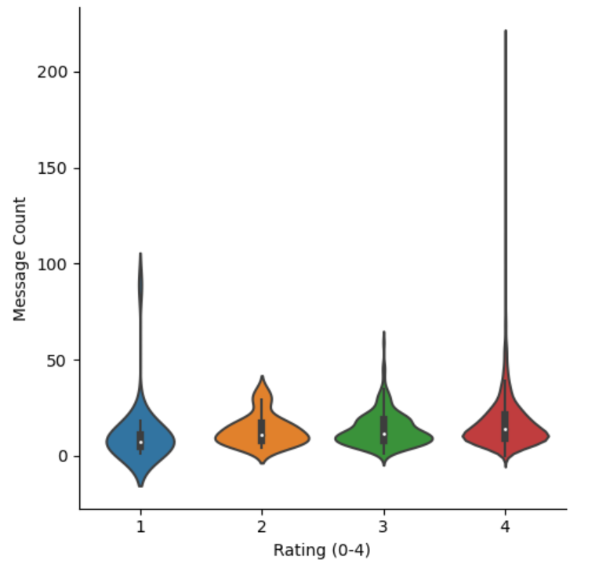
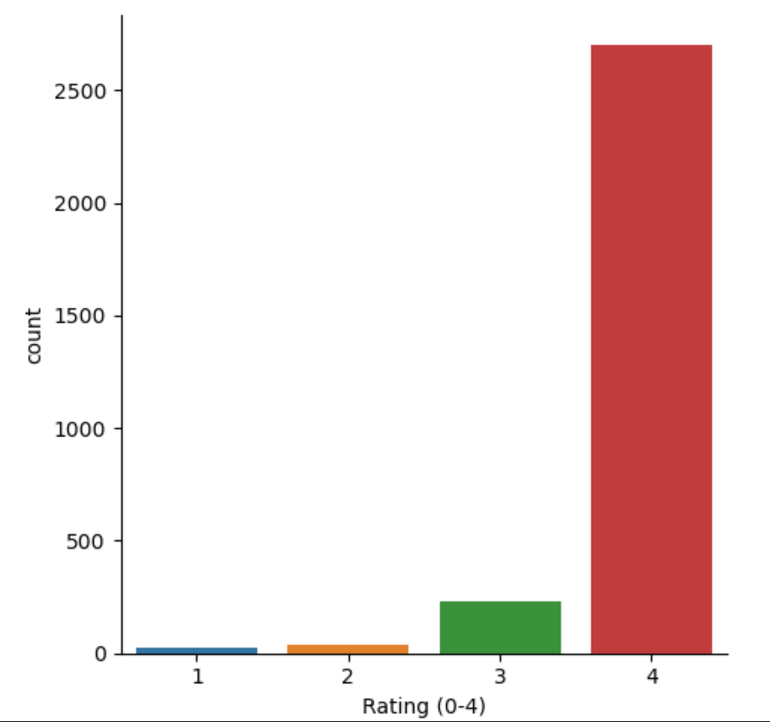
EDA Highlights
As stated in our original goals, we want to focus on how we can predict ratings of a given chat. For that, we must tidy our data and focus on chats only with ratings.
We will keep in mind that we are trimming A LOT of data points, but we must work with what we have for now.

Slide 13
Model 1: Predictive Model using Linear Regression
In our first approach, we attempted to predict patrons’ ratings using machine learning, with an output variable mimicking our previous 1-4 rating system.
Linear Regression is a statistical technique that uses a linear equation to predict the value of a variable (in our case Ratings) based on the value of another variable(s).
Using the data we extracted, I wrote several “models” implementing Python machine learning libraries such as statsmodels, scikit-learn, and RandomForest.

Slide 14
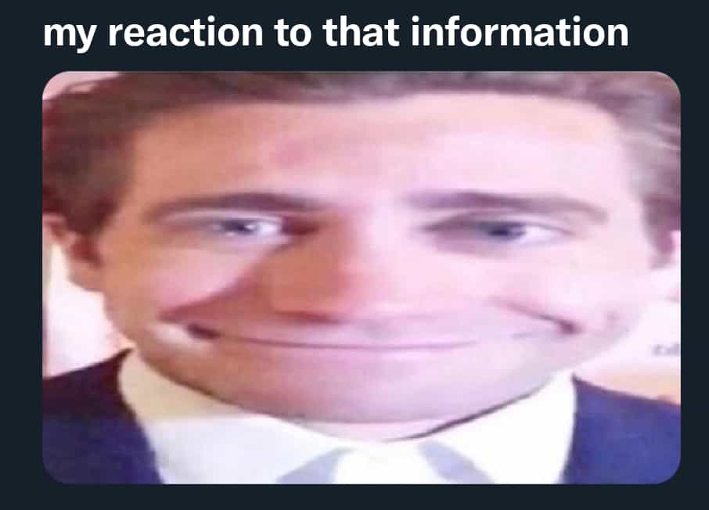
Model 1: Predictive Model using Linear Regression Results
This model proved ineffective due to the subjective nature of ratings, which only comprised about 18% of our data.
Using statistical scoring metrics, we were able to identify that this approach was no more effective at predicting chat ratings than using the average of each variable.

Slide 15
Model 2: Predictive Binary Classification Model using Sentiment Analysis
We revised our approach to predict satisfaction as a binary event (satisfied vs. unsatisfied).
Ratings of 1-3 were categorized as “Unsatisfied,” and a rating of 4 as “Satisfied.”
I then used similar modeling techniques to model 1, implementing the sentiment scores as additional input variables.

Slide 16

Model 2: Predictive Binary Classification Model using Sentiment Analysis Results
While this model yielded clearer results, it revealed that positive sentiment alone did not always correlate with higher ratings.
Neutral language often correlated with lower ratings, but the model still did not provide the desired predictive power.

Slide 17
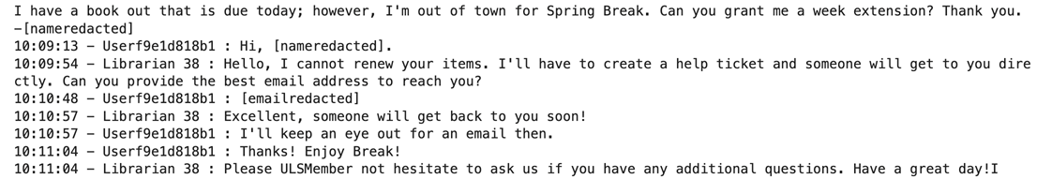

Model 2: Predictive Binary Classification Model using Sentiment Analysis Results
Example of a 1-Rated chat with a highly positive sentiment score:

Slide 18

Model 2: Predictive Binary Classification Model using Sentiment Analysis Results
Example of a 4-Rated chat with a highly negative sentiment score:

Slide 19
Model 3: Feature Extraction and Topic Modeling
We utilized natural language processing to extract key topics from chat transcripts. This model successfully identified language associated with higher and lower ratings.
Positive interactions often included phrases like “Thank you very much,” while negative ones included “don’t,” “cannot,” or “don’t know.”
However, this model was initially designed for review analysis, not raw transcript analysis. Applying it to review comments, as we plan to do with our NPS scoring system, could yield more significant results.

Slide 20
Model 4: Split Chat and Topic Extraction
This model, our most refined, used natural language processing, TFIDF vectorization, and regular expressions to split chats into “Librarian” and “User” segments. We aimed to:
1. Analyze “question” and “answer” topics.
2. Identify differences in language between users and librarians.
3. Assess strengths and weaknesses based on these topics.

Slide 21
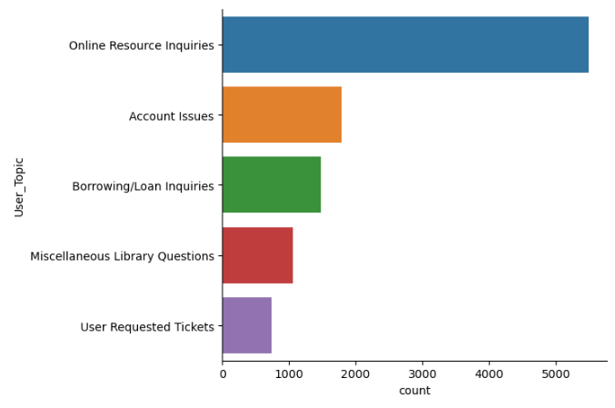
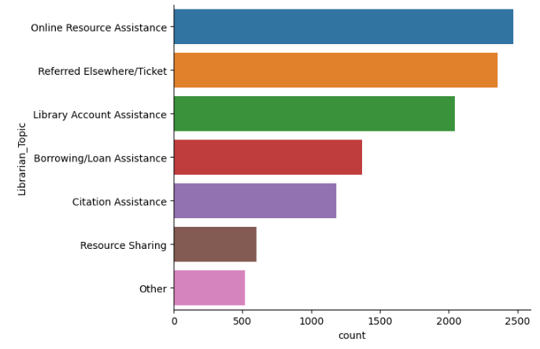
Key Findings: The Topics

Slide 22
Key Findings: Questions & Answers
The main takeaway of this goal was how we handled certain questions. This point led to my final conclusions and helped create a clear theme for our topics. What our patrons sought out help for on LibChat most was for assistance with online resources. This includes but is not limited to; inquiring about access to online databases/journals, seeing if the library had digital access to a print text, troubleshooting errors with online resources, etc.
The most common response to these inquiries was two-fold. Staff would do their best to assist in real time, providing helpful information that fell under the “Online Resource Assistance” topic. The other half of the time, these inquiries were “Referred Elsewhere”.

Slide 23
Key Findings: Library term differences
When speaking about general borrowing terms, the language of users and librarians varied. The biggest example was the term “reserve”. This term was used widely by users to refer to a variety of inquiries but mainly to seek how to place a hold on a particular item. The divide with this term is that librarian side of chat mainly used this term to refer to “course reserves”.

Slide 24
Key Findings: Our Strengths
Tying into the previous goal, we began to see a pattern when we look at the intersection of user questions and librarian answers. The overwhelming majority of patron inquiries were handled across several librarian topics, as we saw a lot of overlap in patron questions that required a diversity of answers.
According to the data, where we were the strongest was on examples of loan information and general borrowing inquiries. This includes but is not limited to; renewing items, placing holds on patron’s behalf’s, instructing patrons on how to request from other institutions (Resource Sharing) and explaining loan policies.

Slide 25
Key Findings: Our Weakness
Where the biggest room for improvement our research showed was in finding experts for more nuanced questions. In essence, the data will show that a major part of the inquiries that were sent to LibChat needed to be redirected in some capacity to the relevant expert.
Out of close to 11,000 interactions, less than 2,000 tickets were created, less than 19%.
With this being the case, the data points us to a significant gap in coverage for inquiries that cannot be easily answered in chat. An educated assumption based on some of the chat analysis is that in the past often a person’s email, phone number, or location was given to the patron instead of a ticket being created on their behalf. The patron then would have to reach out to the relevant expert on their own with little to know explanation of a timeline. This also makes the patron reiterate all their concerns they just spent the time doing on that given interaction.

Slide 26
Key Findings: The Context
Our “Unsatisfied” ratings (Ratings below a 4) are miniscule in number compared to our 4 rated chats even when they are all combined. Our rated chats in general only make up 23% of the data.
I believe leaning into our strong suits and emphasizing trainings on our weak points can lead to more satisfied interactions and in turn more ratings overall.

Slide 27
Key Findings: Justification for Change
As previously mentioned, the Assessment unit has moved on from this way of evaluating chats (on a simple 1-4 survey). Instead, they have begun utilizing, since the beginning of 2024, NPS Scoring which gives users a 1-10 scale and the option to leave verbose comments/reviews.
With this switch, we can implement some of the modeling used in this project to further predict and analyze performance, giving us the ability to compare the two rating systems to each other.

Slide 28
Wrap-up
In conclusion, our LibChat team has been doing phenomenal work for several years and the data speaks to exactly that.
In such a subjective topic as ratings, it is hard to pinpoint exactly what makes an individual satisfied vs unsatisfied with an interaction.
However, I hope through this project we can see the usefulness in machine learning as a tool for advancement and the wide variety of applications and use-cases it can have here at the ULS and in the library field.

